Slide 1
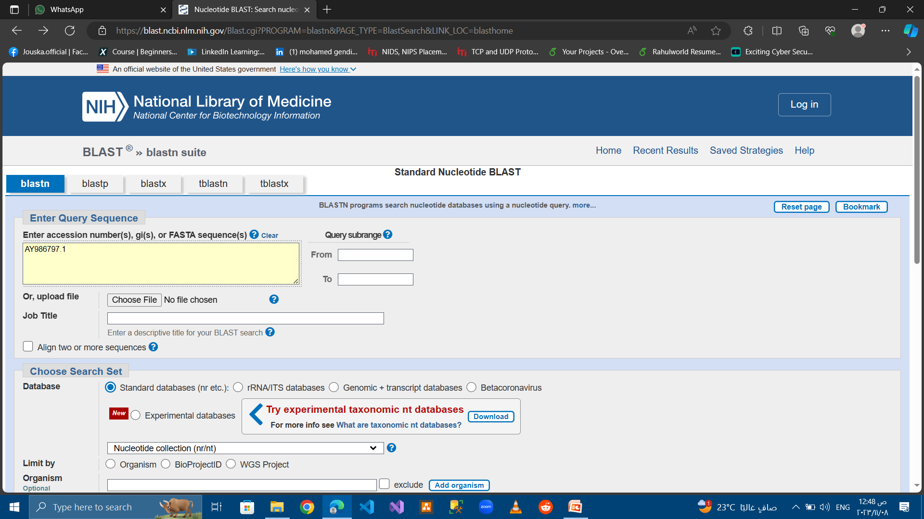
1- Run blastn for AY986797.1

Slide 2
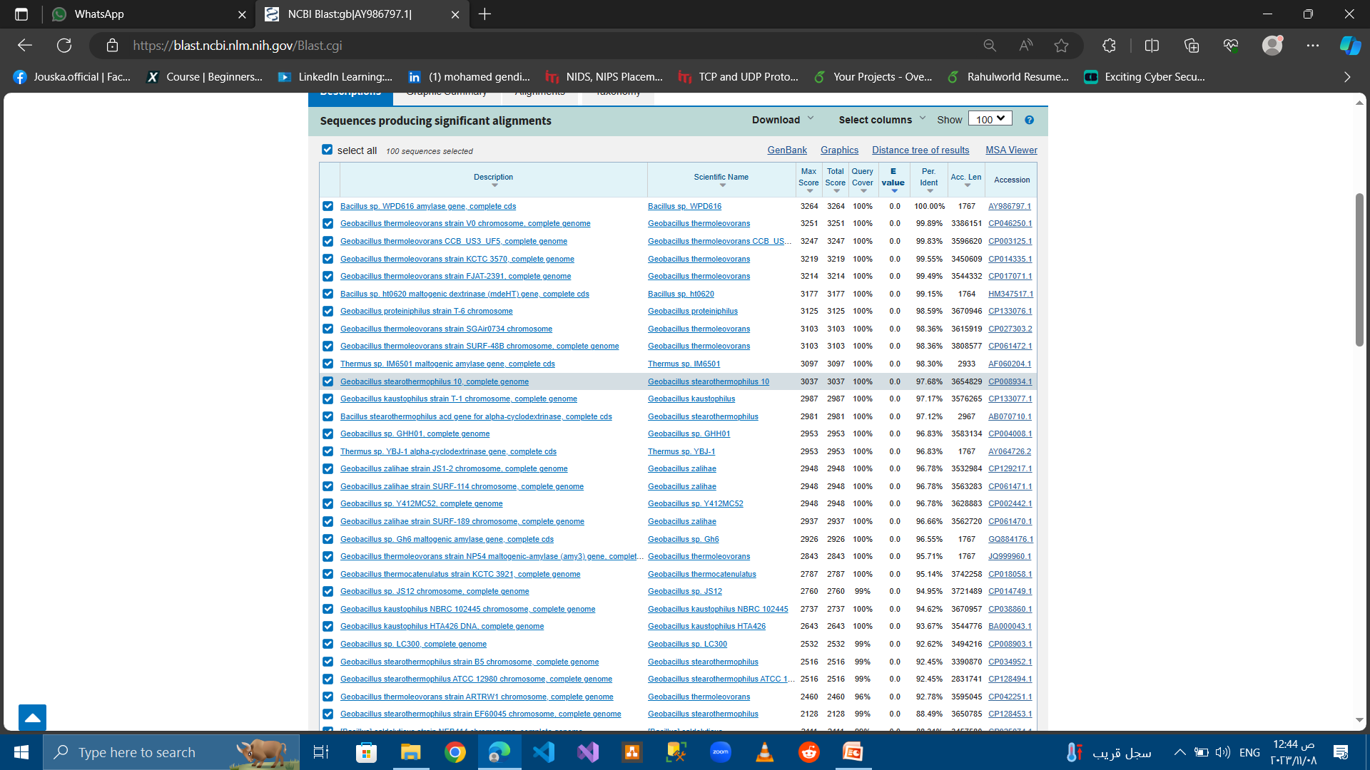

Slide 3
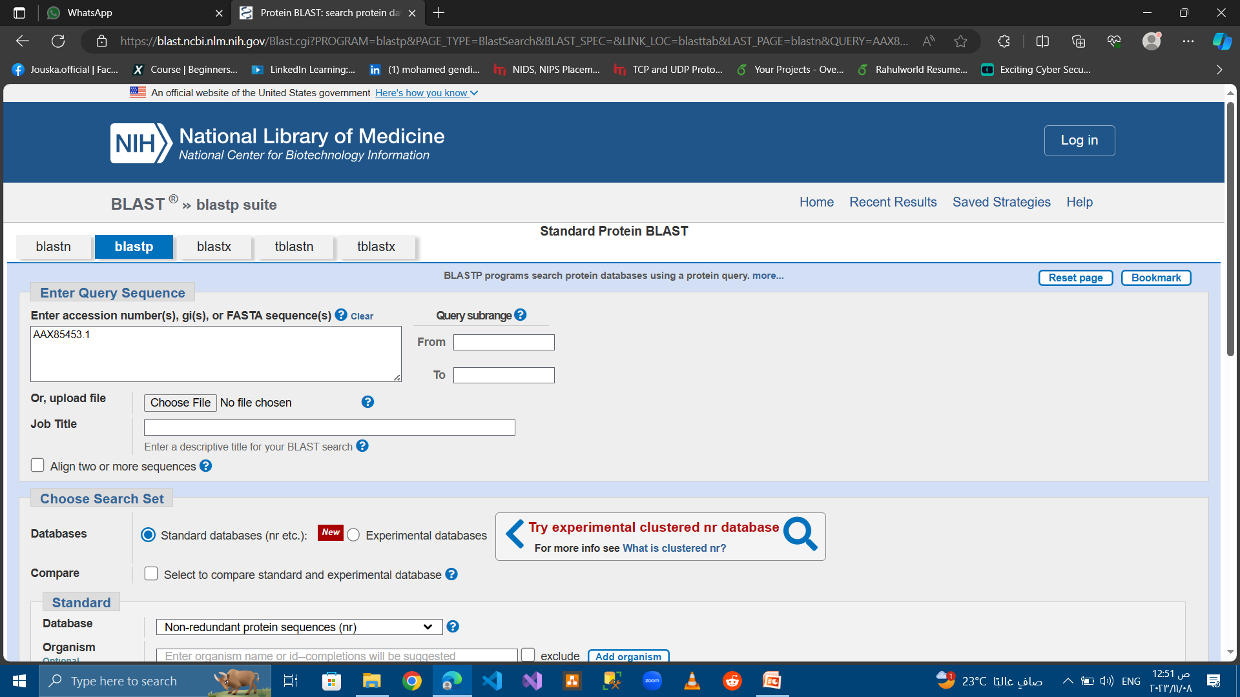
1- Run blastP for AAX85453.1

Slide 4
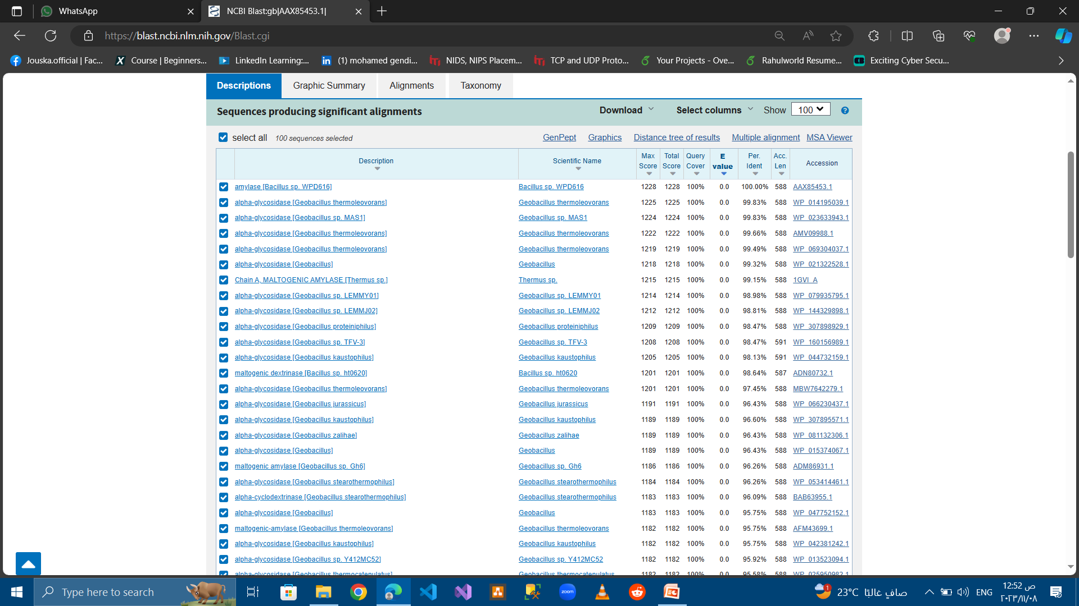

Slide 5
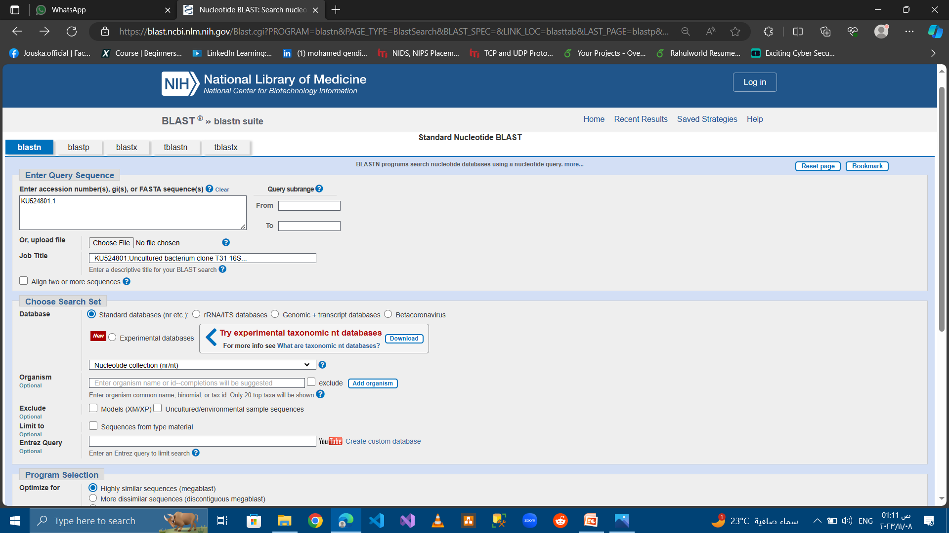
Run blastn for KU524801.1

Slide 6
