Slide 1
Task 2
Data Handling
Training model
Evaluating model

Slide 2
1- Data Handling
First, we make new features number of people and number of nights and remove the columns from the dataset

Slide 3
1- Data Handling
Second, we extract the month and the year from date of reservations and remove date of reservations column

Slide 4
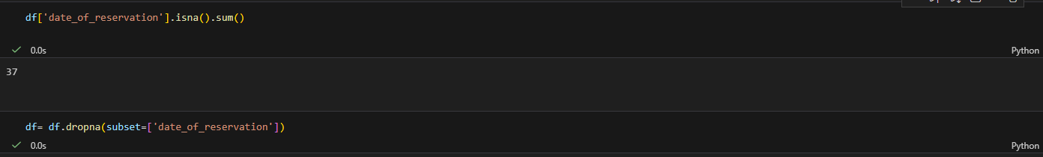
1- Data Handling
But we notice there is Nulls after we extract the year and month so we dropped them

Slide 5
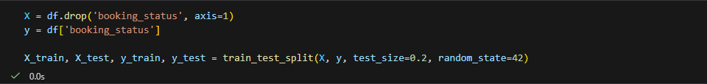
1- Data Handling
Then we replace booking status values with 0 and 1 and begin to split the data to work on it and handle outlier and encoding the categorical features

Slide 6
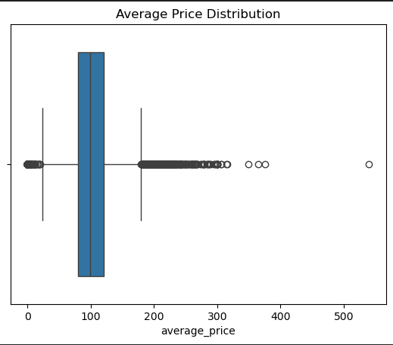
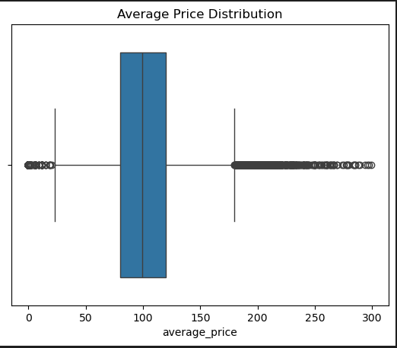
1- Data Handling
I chose not drop all of the outliers because there are values we need to know so I handled average price only.
We notice that the value after 300 won’t affect the model so we drop them

Slide 7
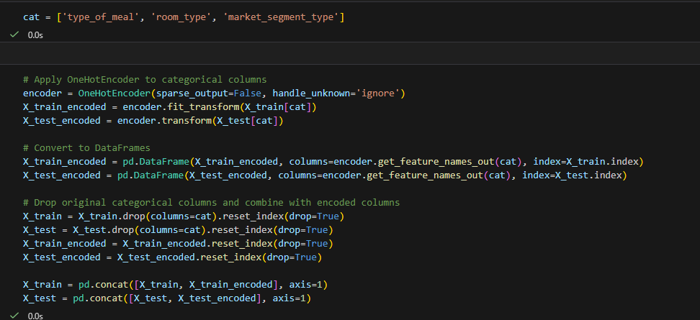
1- Data Handling
We now use one hot encoder to transform the object features to numerical.
We notice all the cat values are nominal values.

Slide 8
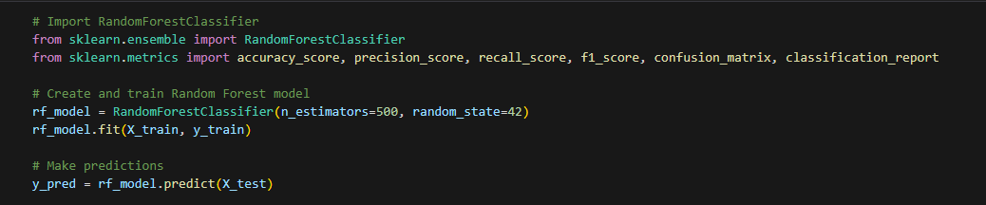
2- Training model
Now we begin to train the model, I used random forest because like I said before that there is outliers in our data and this type isn’t sensitive to it.

Slide 9
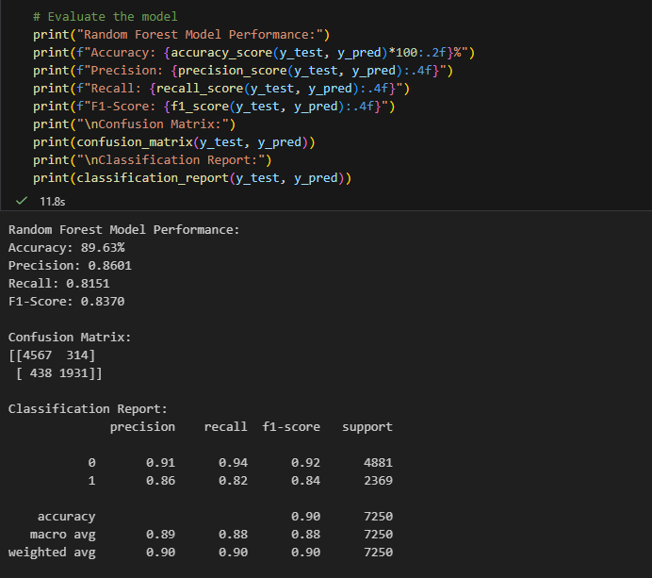
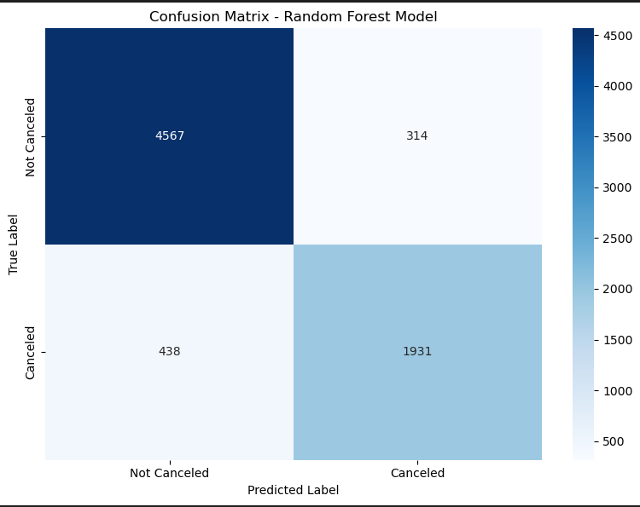
3- Evaluating the model

Slide 10
Thank You!

