Slide 1
EDA on Taxi data Machine Learning Regression Project
Mohamed Ayman
Aya Adel

Slide 2
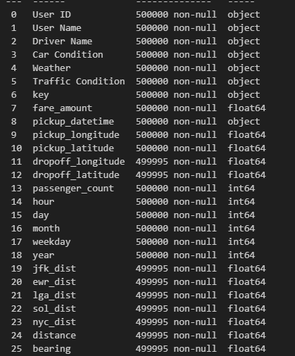
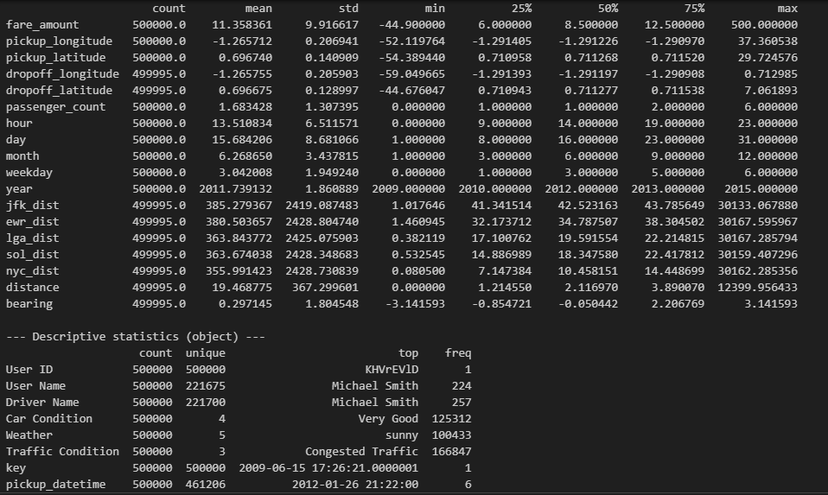
1. Data Overview
In our data we notice we have 500,000 entries and 26 features.
Contains :
- 8 Object features
- 18 Numerical features
We notice there are many outliers and
Non-reasonable values in some features.
And there are Null values
No Duplicated values

Slide 3
Data Distribution & features Relation

Slide 4
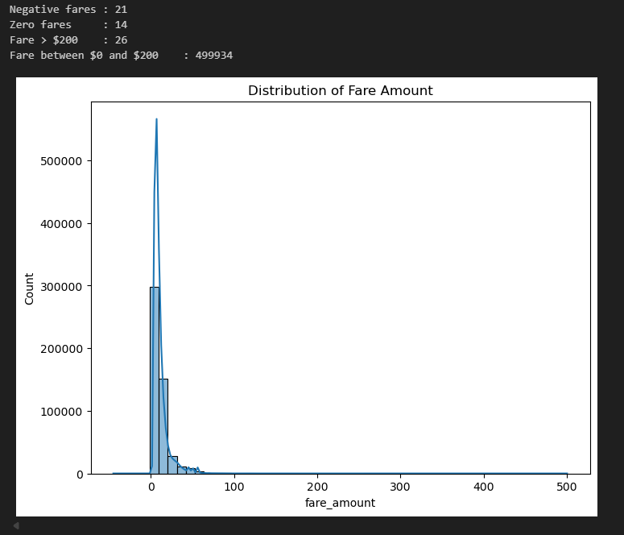
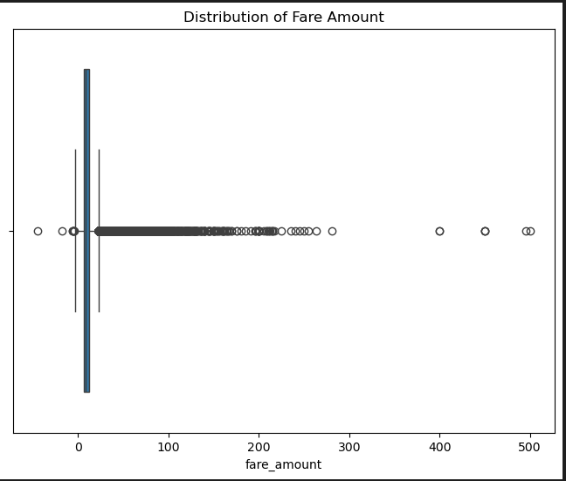
2. Data Distribution
Fare Amount:
- we notice there are Non-reasonable
values in the plot
- we see negative and zero values
- we notice there are:
- 21 Negative fares
- 14 Zero fares
- 26 records bigger than 200

Slide 5
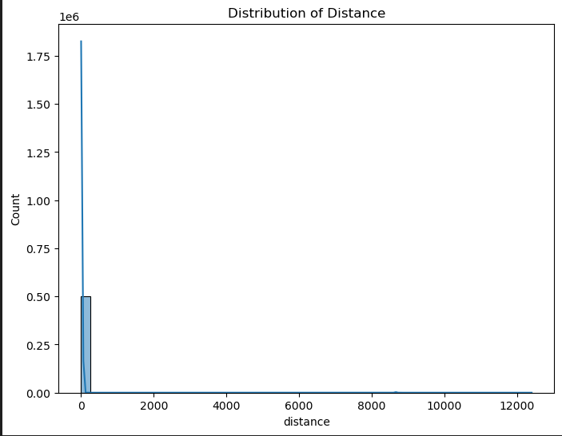
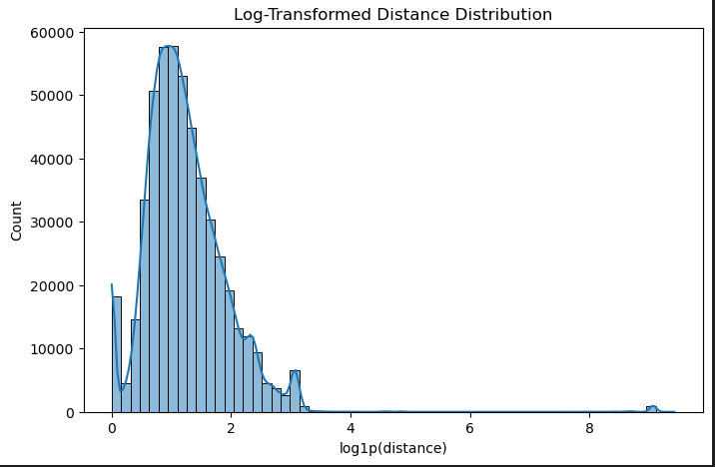
2. Data Distribution
Distance:
- we notice there are Non-reasonable
values
- we see zero values
- we can see that the most records in the
don’t travel in large distance and its
near the Pickup location

Slide 6
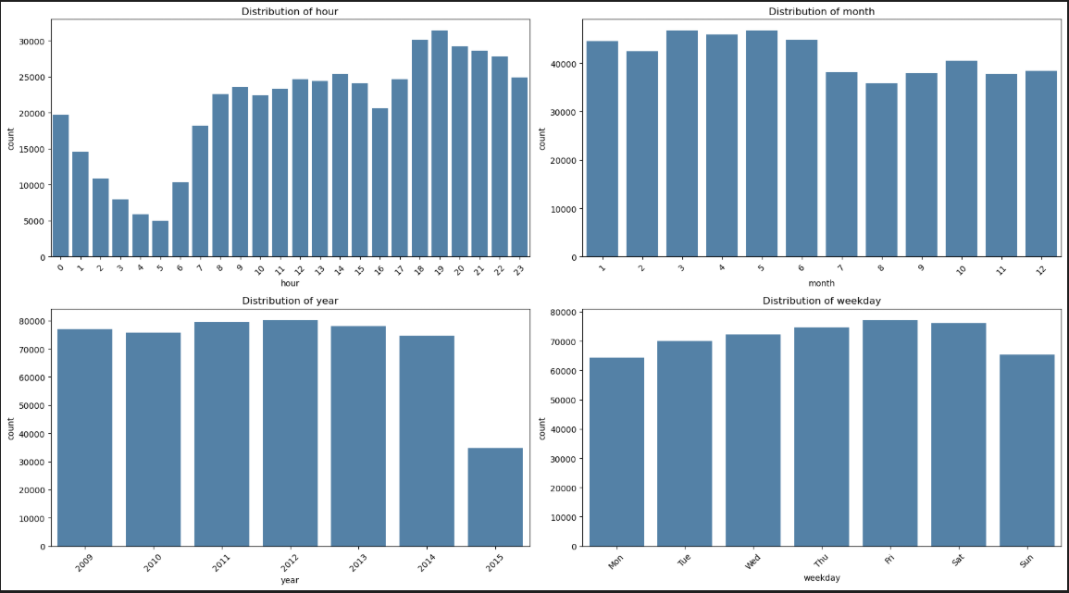
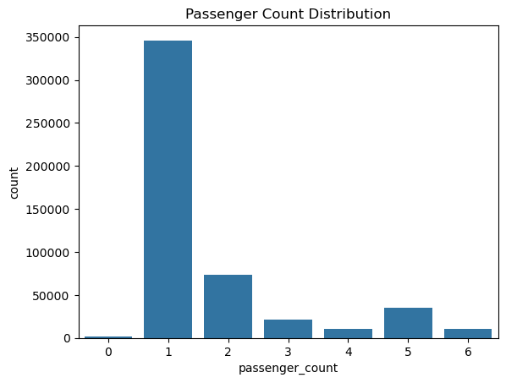
2. Data Distribution
Time:
Passenger Count:

Slide 7
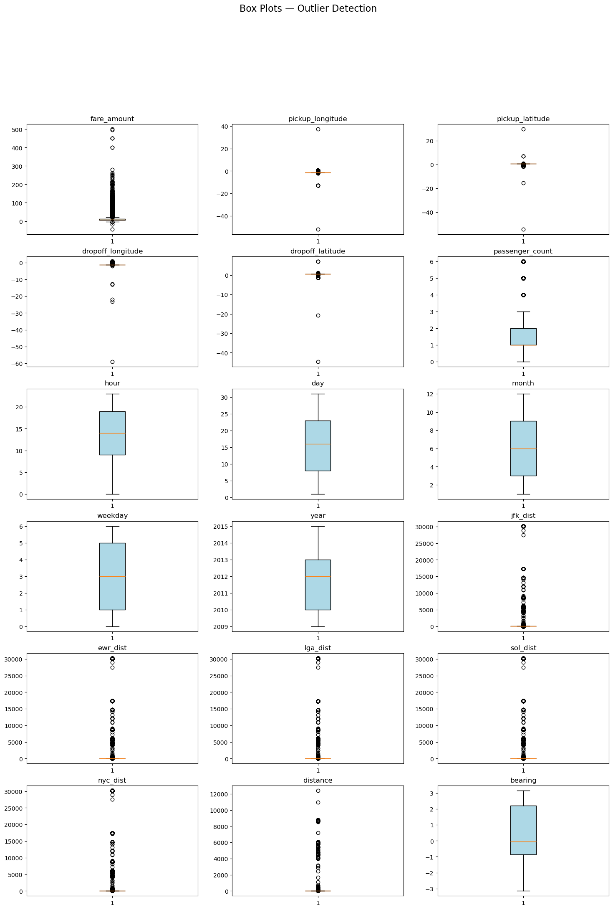
2. Data Distribution
Outliers Detection

Slide 8
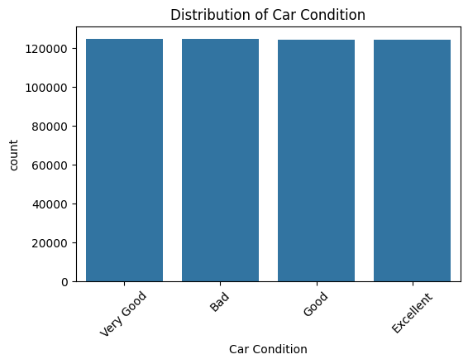
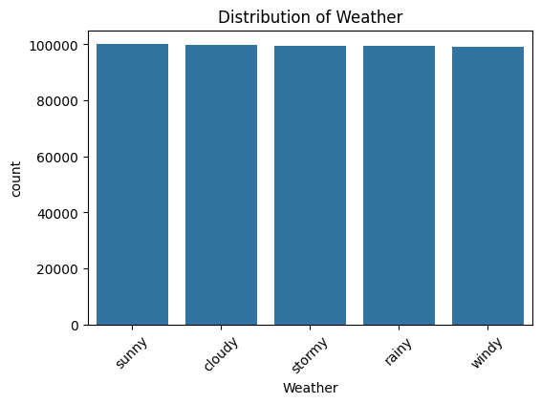
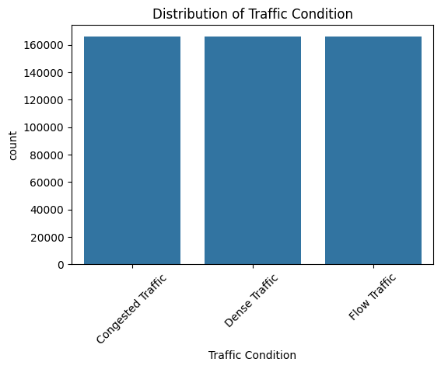
Car Condition:
Weather:
Traffic Condition:
After cleaning, each category has roughly the same number of observations, making it a balanced dataset.

Slide 9
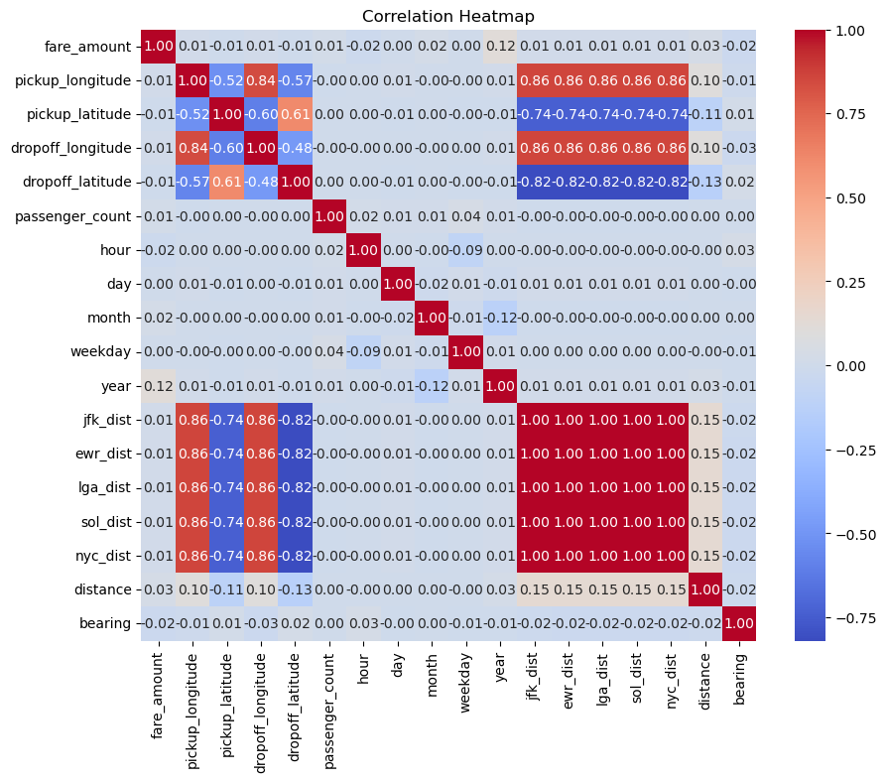
3. Correlation Heatmap
Before cleaning:

Slide 10
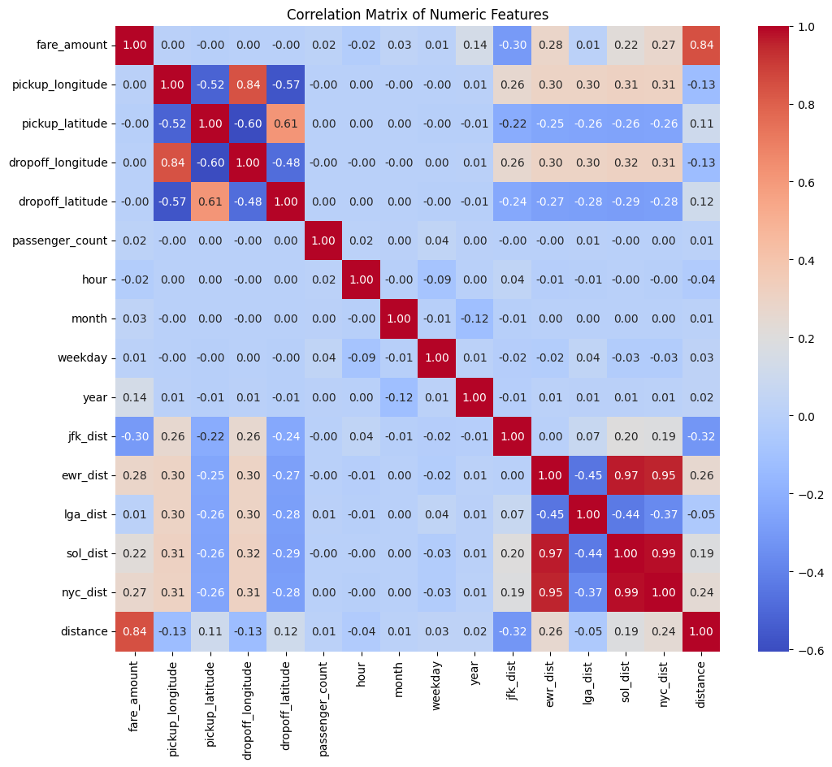
After cleaning:
Distance and Fare amount show a strong positive correlation (r = 0.84), confirming that fare increases with distance.

Slide 11
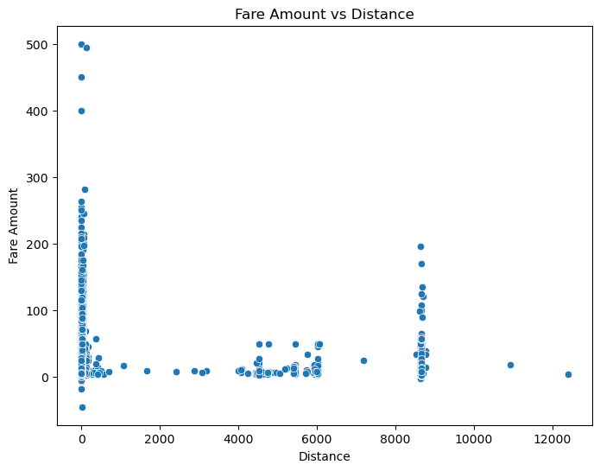
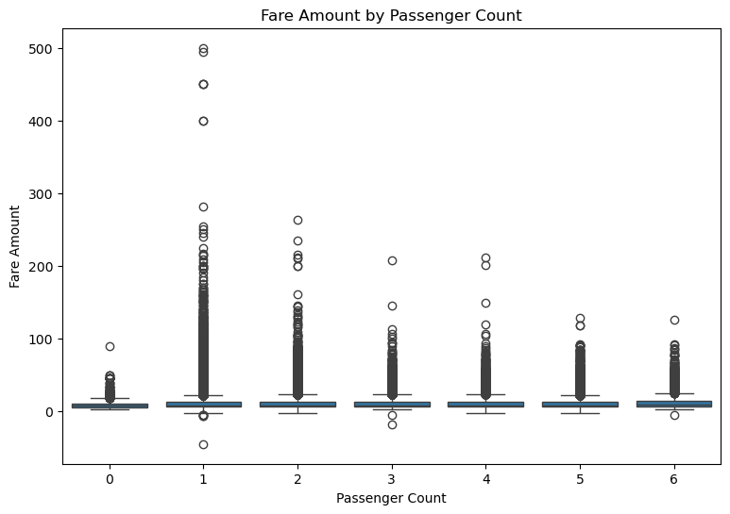
Passenger Count vs Fare amount before Cleaning:
Distance vs Fare amount before Cleaning:

Slide 12
Passenger Count vs Fare amount before Cleaning:
Distance vs Fare amount before Cleaning:

Slide 13
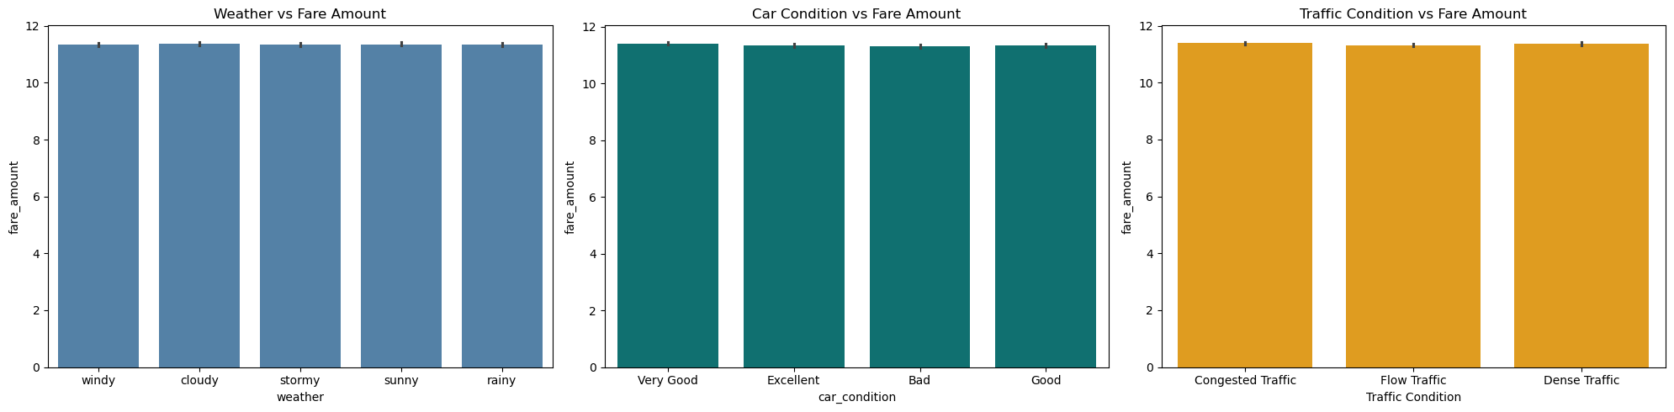
Categorical features vs fare amount:

Slide 14
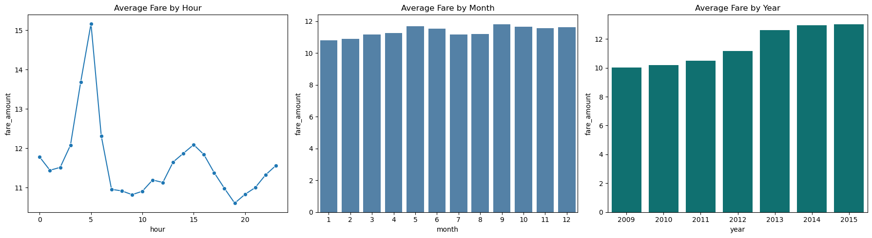
Time vs fare amount:
We notice big change in the hour 5 and 6

Slide 15
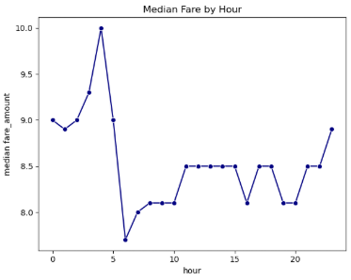
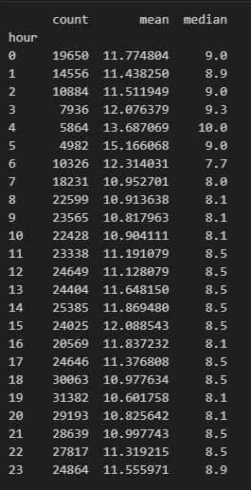
Time vs fare amount:
We used median because of the outlier in the fare amount

Slide 16
Thank You!

