Slide 1
Taxi Fares Prediction Machine Learning Regression Project
Mohamed Ayman
Aya Adel

Slide 2
1. Introduction
Why does booking cancelation is matter?
The Goal: predict fare amount of taxi data using machine learning algorithms.
Target: Fare amount
Regression
Handled the null values and No Missing Values or Duplicates.

Slide 3
2. Train-Test Split (Before Preprocessing)
80% Training Data
20% Testing Data
Split done before preprocessing
Prevents Data Leakage
We split the data before any processing to ensure that the test data remains unseen and is not affected by any cleaning or transformation operations.

Slide 4
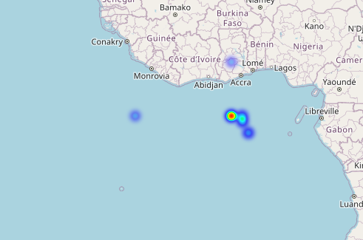
3. Data Preprocessing
Deleted pickup datetime because we have it’s extracted value
No missing values in dataset
Filtering the fare amount from any negative values
Dropped pickup, dropoff latitude and longitude because the coordinates was in the sea.

Slide 5
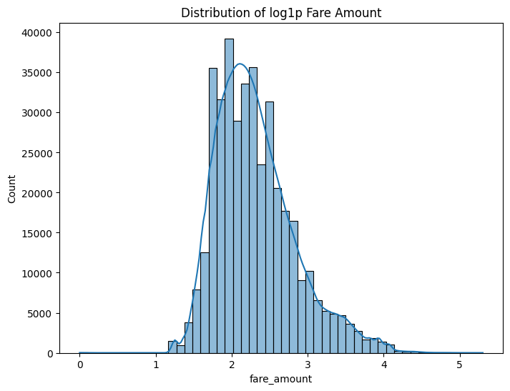
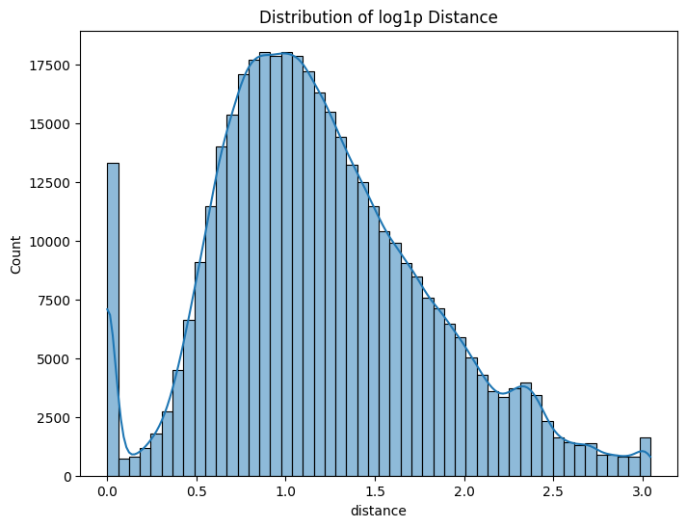
3. Data Preprocessing
We handled fare amount outlier with dropping all the values bigger than 200$
We handled distance outliers with dropping all the values bigger than 20Km

Slide 6
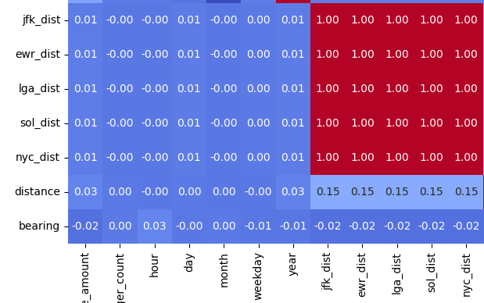
3. Data Preprocessing
Label Encoding or Ordinal Encoder for car condition
One-Hot Encoding for weather and traffic condition
We made Robust scaling to the numeric data and log on distance and fare amount to handle the skewing
and done PCA on dist columns because of multi collinearity

Slide 7
4. Feature Engineering
We created a new binary feature is_weekend to indicate whether a trip occurred on a weekend.
Purpose: Weekend trips often have different fare patterns due to traffic and demand.
We created a categorical feature time_of_day by binning the hour of the trip into four periods:
Morning: 5-11
Afternoon: 12-16
Evening: 17-20
Night: 21- 4

Slide 8
- We engineered two new time-based features: is_weekend to flag weekend trips, and time_of_day to categorize trips into morning, afternoon, evening, or night. These features help the model capture temporal variations in fare patterns.
- One-Hot Encoding
Converted time_of_day into numerical features for the model
Each column is 1 if the trip falls in that period, 0 otherwise.
Ensures the model can learn temporal effects on fares without assuming order.

Slide 9
Models Used
Decision Trees
Linear Regression
Random Forest
XGBoost
We used Four different algorithms to compare performance and choose the best one.

Slide 10
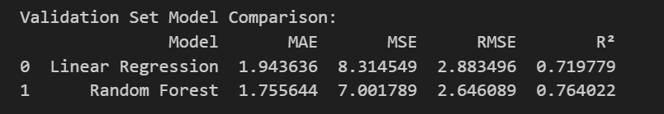
Model Comparison
Random Forest achieved the best evaluation.

Slide 11
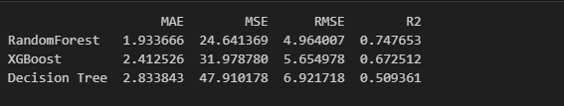
Model Comparison with categorical features
Random Forest achieved the best evaluation.
XGBoost performance is also usable but less than Random Forest.
Decision Trees is the worst one for this data.

Slide 12
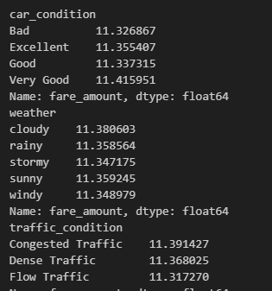
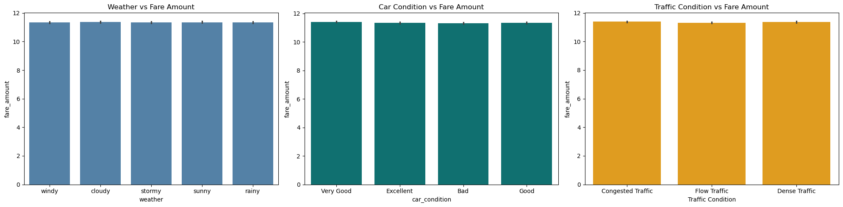
Model Comparison without categorical features
We can see that the relation between categorical features and fare amount are equals and that not reasonable

Slide 13
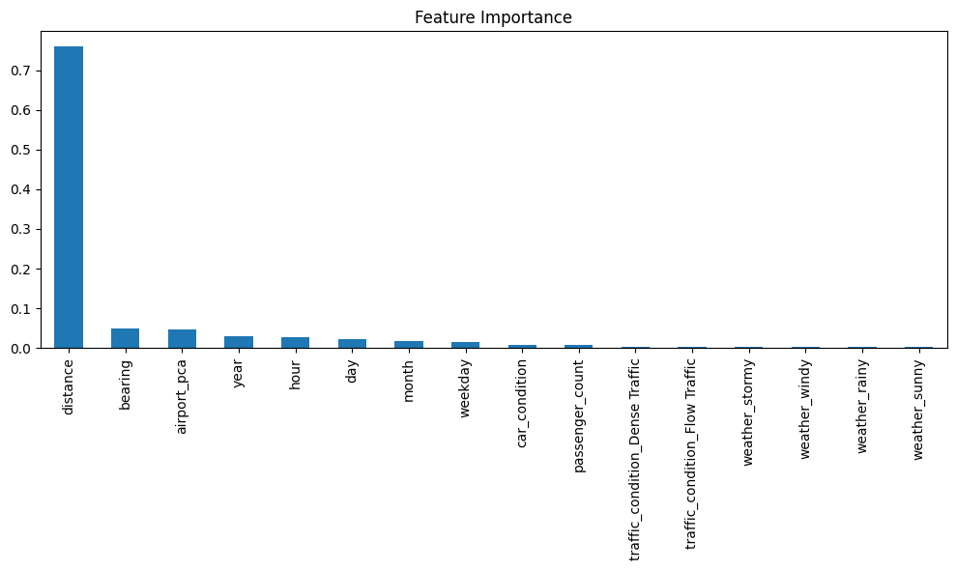
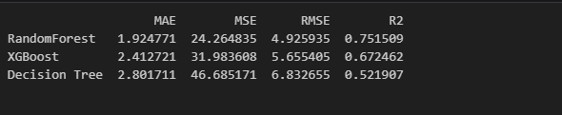
Model Comparison without categorical features
We can see that categorical features isn’t important in the model and we can drop it

Slide 14
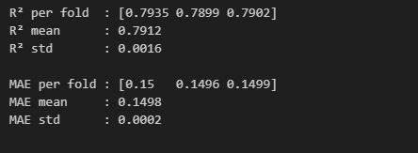
Random Forest Model with CV
We used Kfold with 3 splits

Slide 15
Thank You!

