Slide 1
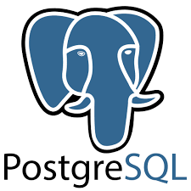
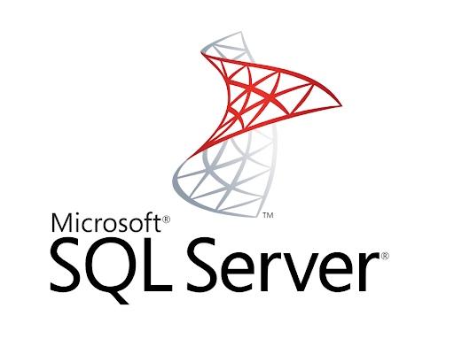
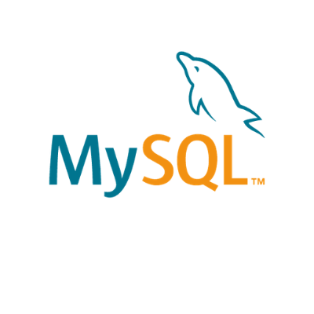
Relational DataBase Management Systems
RDMS

Slide 2
MySQL
MySQL is the most popular Relationship Database Management System (RDBMS) application in the world. Mastering MySQL is a must for programmers. Especially when associated with web programming that (almost) all use MySQL as a database.
In everyday use, an application will usually only have a database. In MySQL (and also in other relational database applications), a Database is a collection of interconnected tables. A database is a place where tables will be created.

Slide 3
SQL Server
The Microsoft relational database management system is a software product which primarily stores and retrieves data requested by other applications. These applications may run on the same or a different computer.
Going more in-depth, in order to understand what a SQL Server is, you must first understand what SQL is.
SQL is a special-purpose programming language designed to handle data in a relational database management system. A database server is a computer program that provides database services to other programs or computers, as defined by the client-server model. Therefore, a SQL Server is a database server that implements the Structured Query Language (SQL).
There are many different versions of Microsoft SQL Server, catering for different workloads and demands. A data centre version is tailored to higher levels of application support and scalability, while the Express version is a scaled down, free edition of the software.

Slide 4
PostGreSQL
PostgreSQL is a powerful, open source object-relational database system that uses and extends the SQL language combined with many features that safely store and scale the most complicated data workloads. The origins of PostgreSQL date back to 1986 as part of the POSTGRES project at the University of California at Berkeley and has more than 30 years of active development on the core platform.
PostgreSQL has earned a strong reputation for its proven architecture, reliability, data integrity, robust feature set, extensibility, and the dedication of the open source community behind the software to consistently deliver performant and innovative solutions. PostgreSQL runs on all major operating systems, has been ACID-compliant since 2001, and has powerful add-ons such as the popular PostGIS geospatial database extender. It is no surprise that PostgreSQL has become the open source relational database of choice for many people and organisations.
PostgreSQL comes with many features aimed to help developers build applications, administrators to protect data integrity and build fault-tolerant environments, and help you manage your data no matter how big or small the dataset.

Slide 5
comparison between MySQL, MySQL Server and PostGreMySQL
MySQL | MySQL Server | PostGre SQL
Open-Source | Open-Source | Licensed
Owned by Oracle | Owned by PostgreSQL Global Development Groupe | Owned by Microsoft
Scalable buffer pool to pull cache | Scalable buffer pool to pull cache | Isolate processes as separate OS processes
Limited functionality regarding tables to deal with complex processes | More functionality regarding temporary tables (divide tables into local and global), Better with complex processes | More functionality regarding temporary tables (divide tables into local and global), Better with complex processes
Organizes index into clusters and tables (not very flexible search) | Rich automated functionality for index management | Flexible search

