Slide 1
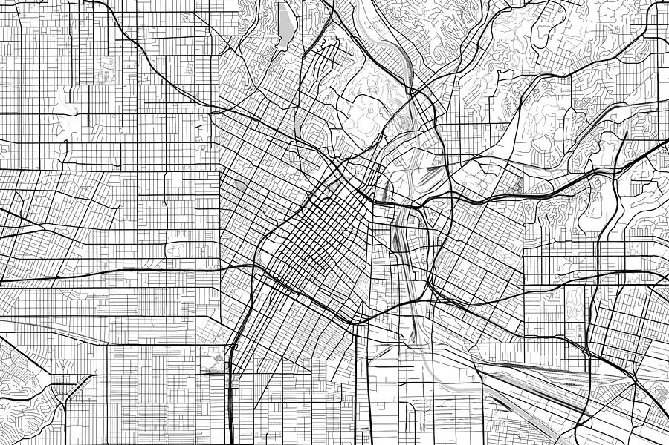

CRIME WATCH
A tool to keep you safe | Los Angeles County
Group 9 | DSE241 | 2018
Orysya Stus
Michael Galarnyk
Garrett Cheung

Slide 2
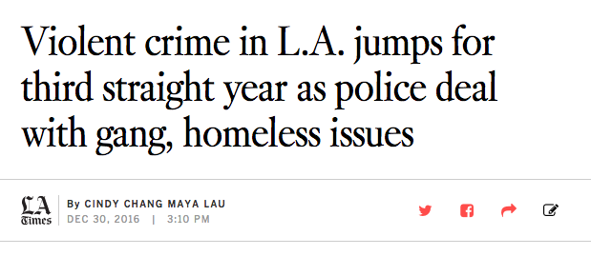
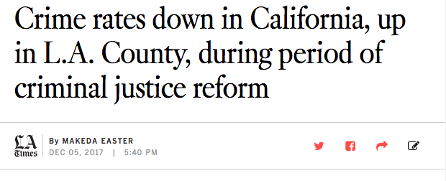
Crime in Los Angeles
Crime has been steadily increasing in LA County
According to the LAPD, violence is the second leading cause of death for young people in America
Juvenile violence and crime triple in the hour immediately after school
Notes:
http://www.lapdonline.org/search_results/content_basic_view/23514

Slide 3
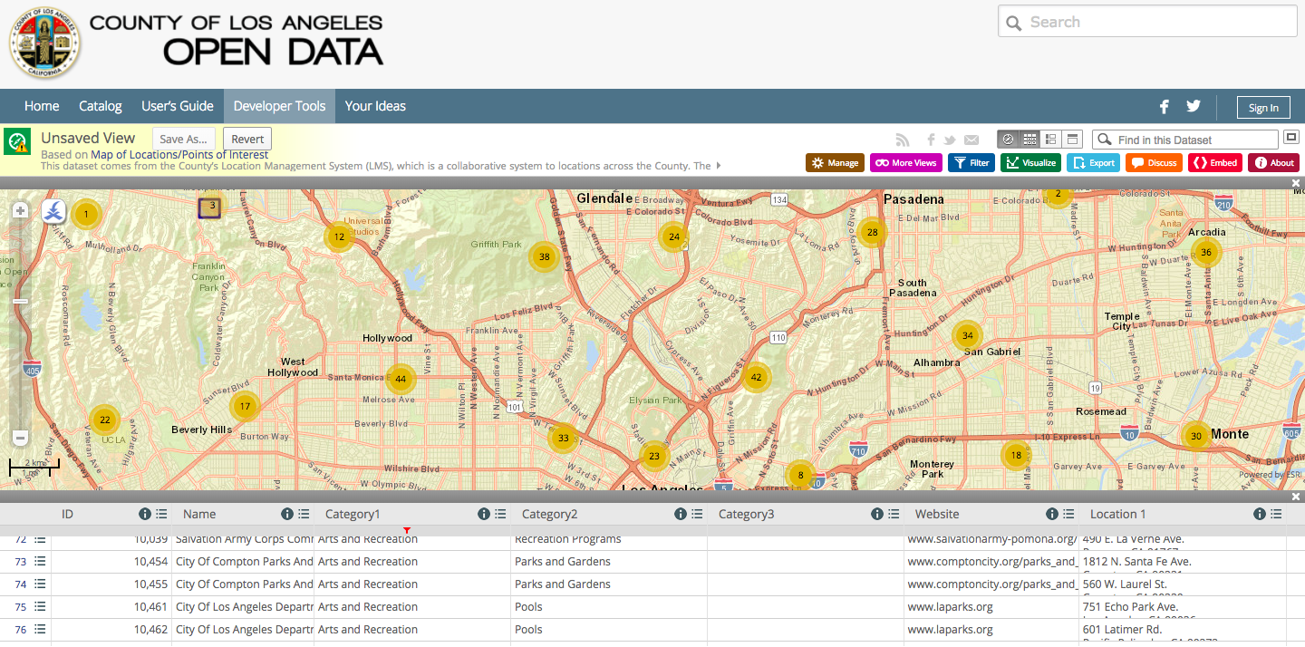
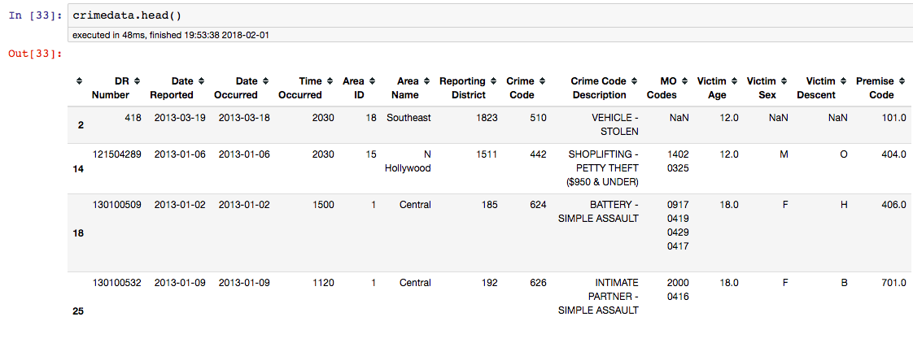
Datasets
Crime in Los Angeles Source: City of Los Angeles
Crime Data from 01/01/2010 to 09/09/2017
~237000 rows, 26 cols (53mb)
Victim age 18 and under
Includes type of crime, location, victim sex/age/ethnicity, crime status (continuing investigation/criminal arrested, etc.), modus operandi codes (stolen goods, vandalism,etc.)
Los Angeles district shapefiles
https://www.kaggle.com/cityofLA/crime-in-los-angeles/data
Map of Locations in Los Angeles Source: County of Los Angeles Open Data
Locations of points (latitudes, longitude) of interest in LA county
Parks, libraries, schools, other govt facilities, etc.
https://data.lacounty.gov/Administration/Map-of-Locations-Points-of-Interest/m2sb-tzx8

Slide 4
Tasks
Problem/Question | Solution
Not much is known about LA crimes involving youth victims (< 19 year olds). | Create Crime Watch, a tool to explore and present crimes geographically, by crime type, over time, and crime which is dynamic and interactive
Working with different data types, how will the data be integrated? | Process data, interpret shapefiles files properly, and join on district ids (thankfully data wrangling is minimal).
Which schools are in the most dangerous locations? | Develop a geographic visual to select a school location and specify the radius of interest, this will allow for understanding the incidences of crime within a certain radius from the school.
Which districts in the county should city government pay more attention to? | Overlay of districts on Crime Watch highlight problem areas where the city may want to devote resources to improving.
How have districts in the county changed over time in regards to incidences and rates of crime involving youth victims? | An animated heatmap of LA country over time will display how and where crime has evolved?

Slide 5


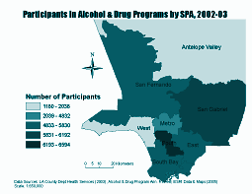
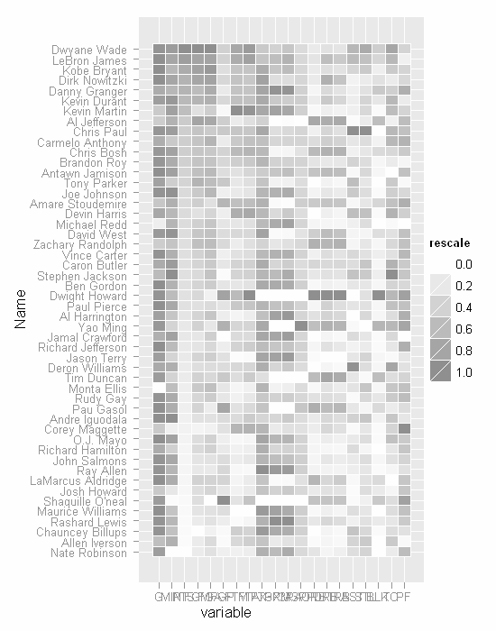

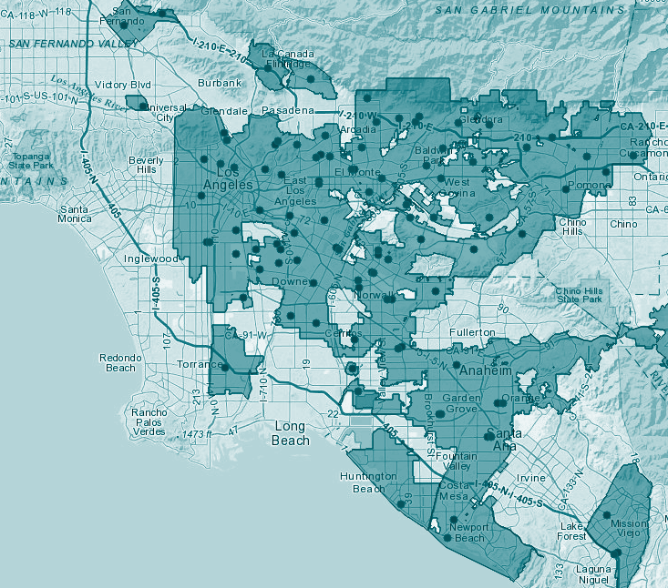
Implementation
Application Dominant
Filters bar:
Year
Crime
Crime Status
Victim (Age, Sex, Ethnicity)
District
etc.
General Layout
Callout Metrics/KPIs:
Top crimes by category
Most dangerous district
Number of deaths
Number of crime incidents by category
etc.
Key Visualization
By district
By radius from point
Overall death tolls
Rates over time
*Filter bar will be hidden using menu bar
Select locations (schools, parks, etc.)
*Distance mapping with radius filter
Dynamic cross filtering
Crime Watch by District
Crime Watch by Location
Heatmap of crimes by type
Notes:
Filter bar will be hidden using menu bar: http://kb.tableau.com/articles/howto/hide-a-worksheet-with-a-filter-action
Distance mapping with radius filter: https://community.tableau.com/thread/132845

Slide 6



Stakeholders
Parents and families
Law enforcement
Policy makers

Slide 7
ANY QUESTIONS?

