Slide 1
Evaluation of Artery Visualization for Heart Disease Diagnosis
Michael Galarnyk, Garrett Cheung, Orysya Stus

Slide 2
Motivation
Heart disease is the number one killer in the United States, and finding indicators of the disease at an early stage is critical for treatment and prevention.
Low endothelial shear stress (ESS) has been associated with rapid progression of disease.
An effective visualizations of a patient’s ESS data is vital for the quick and thorough non-invasive evaluation by a cardiologist

Slide 3
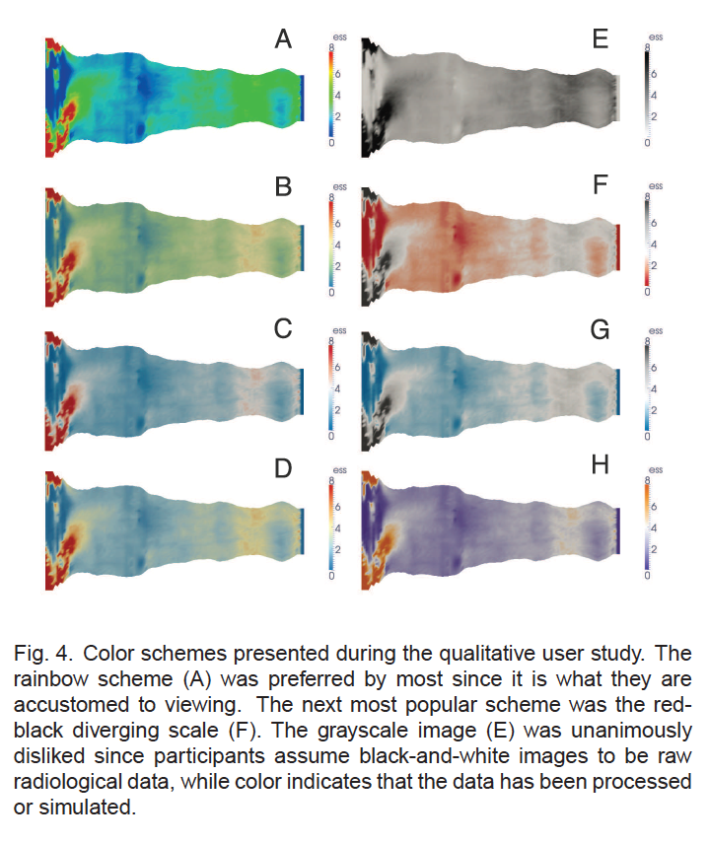
Problem Background
Rainbow is the standard color map used in the medical literature
Rainbow color maps are poorly suited since they are not perceptually ordered and isoluminant [5]. See sources [5, 23, 38, 37, 49 ] in original paper
Notes:
Rainbow colormap maybe popular due to
Excellent article going over why the colormap maybe harmful: http://ieeexplore.ieee.org/abstract/document/4118486/

Slide 4
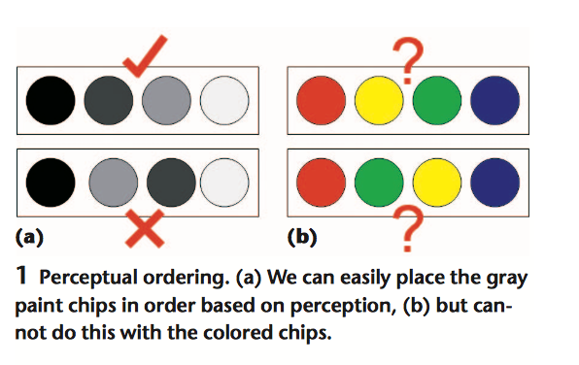
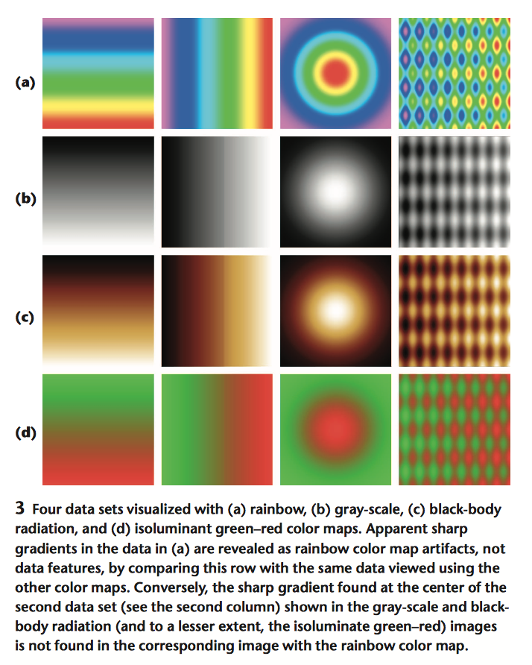
Related Work Overview
Rainbow color maps are poorly suited since they are not perceptually ordered and isoluminant [5].
The rainbow color map appears as if its separated into bands of almost constant hue, with sharp transitions between them.
Viewers perceive sharp transitions as sharp transitions in data, even when this is not the case .
D. Borland and R. T. II. Rainbow color map (still) considered harmful.
IEEE Computer Graphics and Applications, pages 14–17, 2007.
Notes:
Rainbow colormap maybe popular due to
Excellent article going over why the colormap maybe harmful: http://ieeexplore.ieee.org/abstract/document/4118486/
Pg 232-233 in textbook talks about why colormaps suck
Mention it in presentation

Slide 5
Proposed Method/Solution
Rainbow is the standard color map used in the medical literature
See if there were quantitatively measurable performance effects based on the color scheme utilized, specifically the rainbow and the diverging color maps
Test if a perceptually appropriate color (diverging) map leads to fewer diagnostic mistakes than a rainbow color map

Slide 6
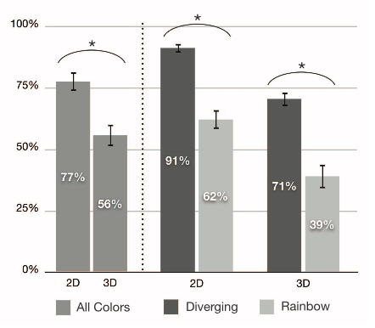
Results
Participants were more accurate in 2D and when using the diverging color map.
Perceptually appropriate color map leads to fewer diagnostic mistakes than a rainbow color map
Fig. 7. Average percent of low ESS regions identified broken down by 2D and 3D representation, and color. Error bars correspond to the standard error and the asterisks indicate results of statistical significance.
Notes:
Note that the paper also studied the effect of 2D versus 3D artery representations

Slide 7
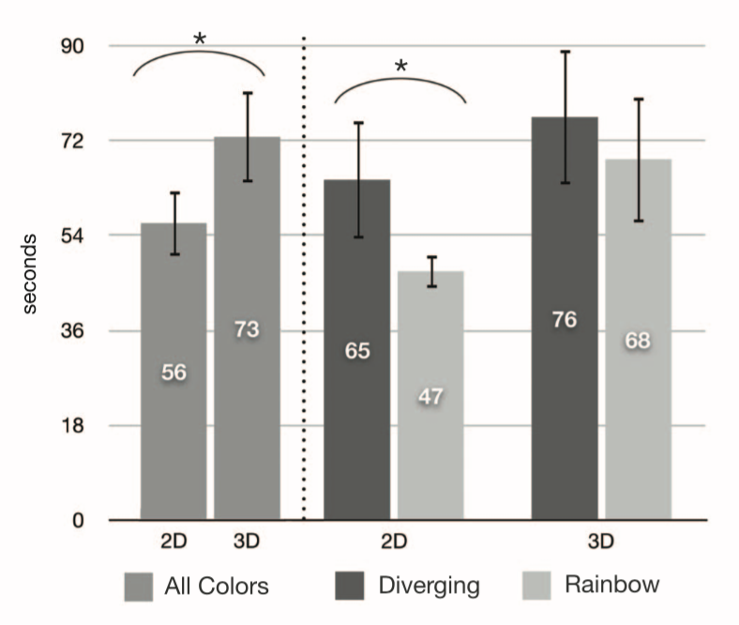
Results
Even though participants were far more likely (need a number) to identify using diverging (red-blue), it took a lot longer.
Subjects more used to rainbow color map.
Fig. 9. Average total time spent on each image
Notes:
Note that the paper also studied the effect of 2D versus 3D artery representations

Slide 8
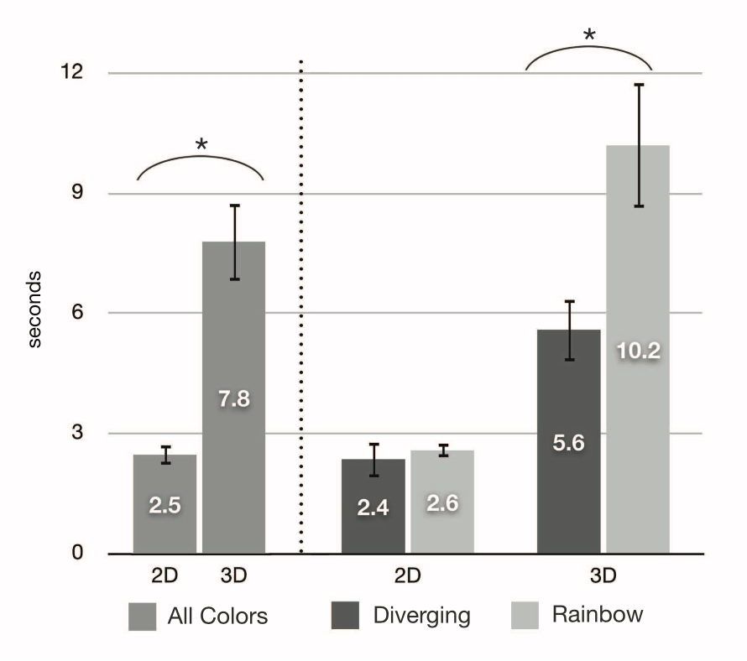
Results
If they account for number of regions identified, diverging and rainbow were equal.
A 3D experiment showed that diverging color maps are far more effective for the task.
Fig. 10. Average rates of seconds per region to identify
Notes:
Note that the paper also studied the effect of 2D versus 3D artery representations

Slide 9
Conclusion
Rainbow vs diverging.
Notes:
Note that the paper also studied the effect of 2D versus 3D artery representations

Slide 10
Extra Preference vs Reality
All participants preferred the rainbow color scheme when in reality they did not perform as well as the participants who used the diverging color map.
Notes:
Note that the paper also studied the effect of 2D versus 3D artery representations

Slide 11
Extra Misclassification
For the top performing combination (2D with non-rainbow), the low ESS regions that were not identified by participants were generally the smallest in area of all the regions in a given data set. These regions were also very close to the diverging point in the color map bordering between “low ESS” and “normal”. In the other conditions, there was no observed regularity in the low ESS regions missed. We observed a negligible number of false positives (only
Notes:
Note that the paper also studied the effect of 2D versus 3D artery representations

