Slide 1
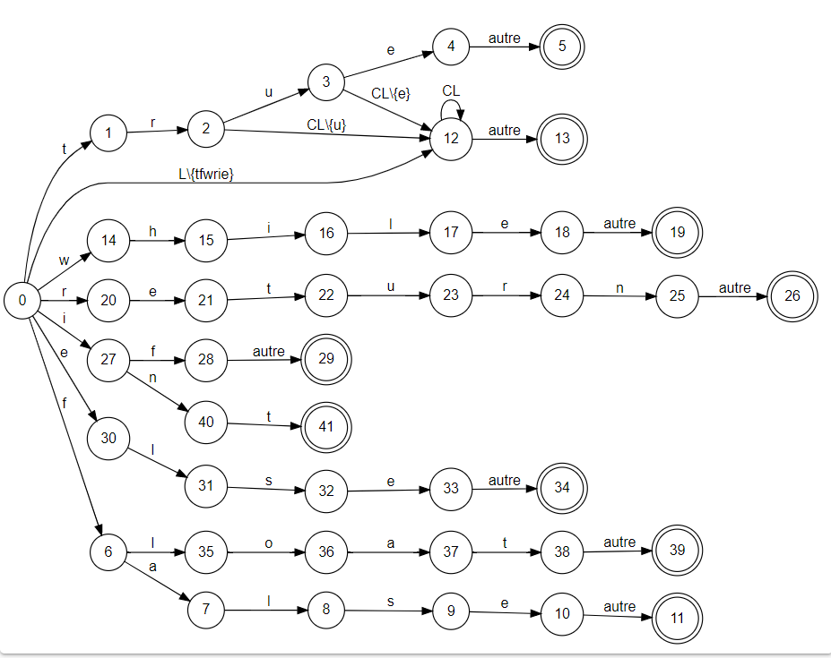
return(boolean_literal,true)*
return(ID,val)*
return(Mot_Cle,while)*
return(Mot_Cle,return)
return(Mot_Cle,if)
return(Type,Int)
return(Mot_Cle,else)
return(Type,Float)
return(boolean_literal,false)*

Slide 2
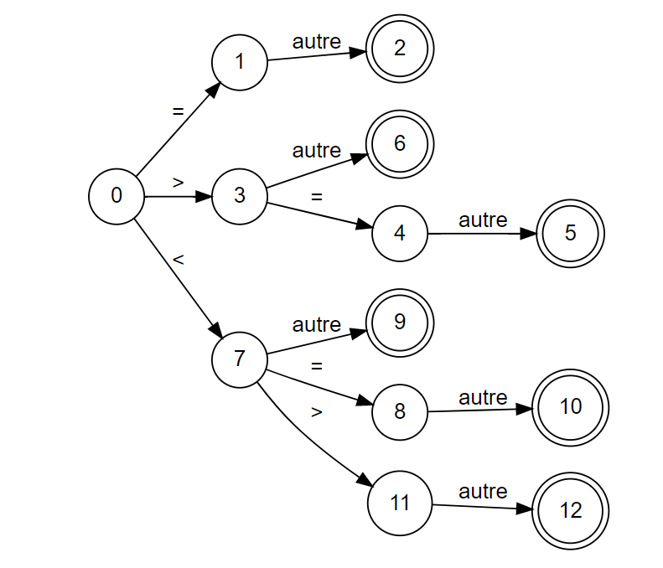
Return(oprel,=)*
Return(oprel,>)*
Return(oprel,>=)*
Return(oprel,<)*
Return(oprel,<=)*
Return(oprel,<>)*

Slide 3
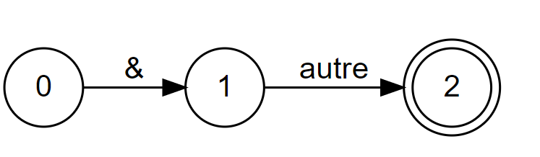
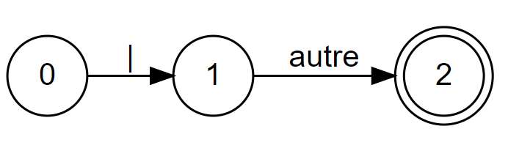
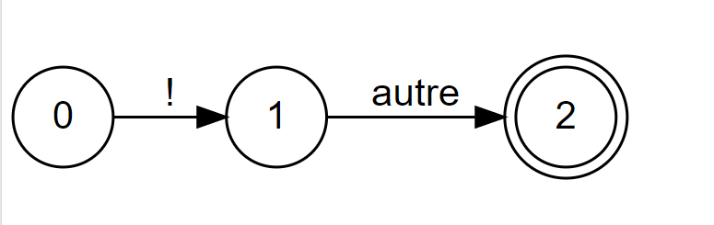
Return(opLog,&)*
Return(opLog,|)*
Return(opLog,!)*

Slide 4
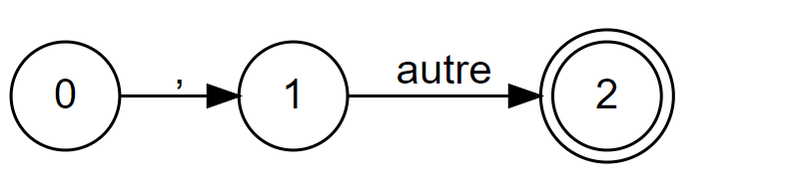
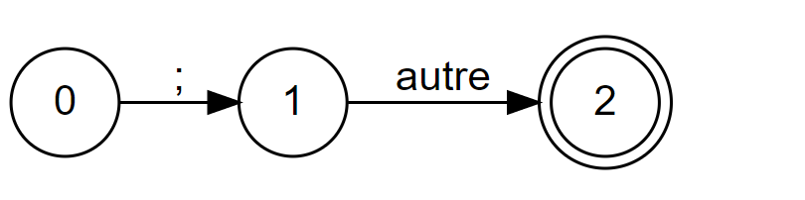
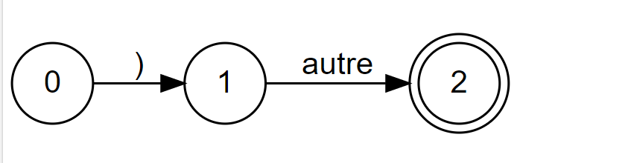
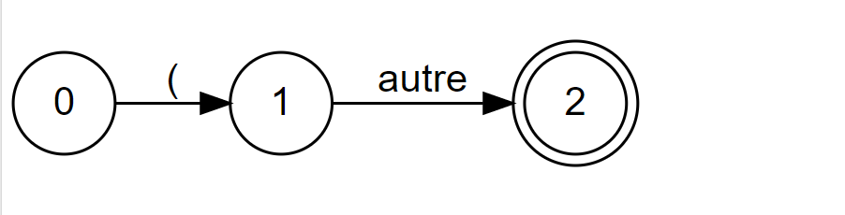
Return(v,,)*
Return(pv,;)*
Return(ParFer,()*
Return(ParOuv,()*

Slide 5
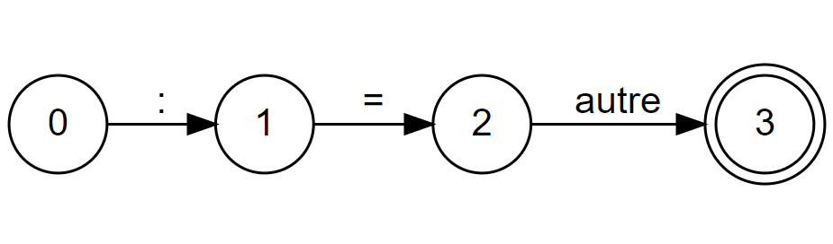
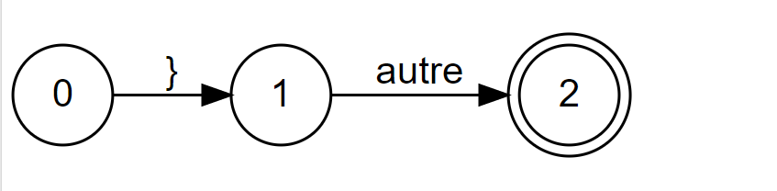
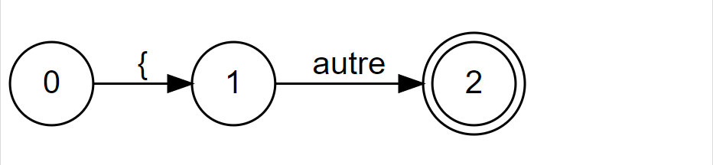
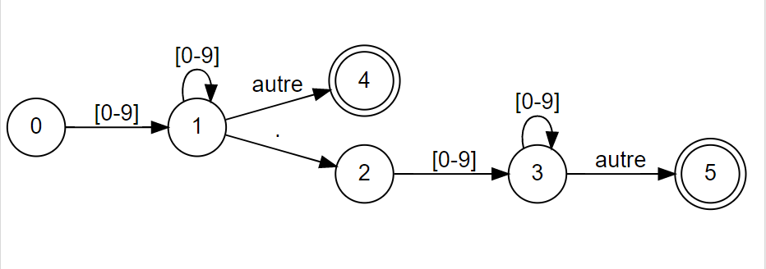
Return(OPPAFF,:=)*
Return(Fin,})*
Return(Debut,})*
Retun(integer_literal,val)
Retun(float_literal,val)

