Slide 1
Bakery Sales Dashboard Project
KPIs and Visual Analysis
Tools used: Power Query, Excel, Python (for PPT generation)

Slide 2
Project Overview
Objective: Build a dashboard to surface key bakery sales metrics and insights. Data Processing: Power Query used (dataset supplied). This presentation uses the cleaned data to compute KPIs and charts. Deliverables: KPIs, Revenue/Product chart, Peak Sales Hour chart, Monthly product sales chart.

Slide 3
Data Sources
- Sales dataset: BakerySales_RawData.csv (2654 rows, 27 cols)
- Price dataset: Bakeryprice_RawData.csv (22 rows, 2 cols)
- Extra workbook: ELABS_TASK-2.xlsx (sheets: DESIGN2, Dashboard, Bakery_analysis, Bakeryprice_RawData)

Slide 4
Key Performance Indicators (KPIs)
Total Sales (Revenue): 40,793,300
Total Number of Products Sold: 10,840
Most Sold Product: angbutter (3,229 units)
Day with Most Sales (by revenue): 2020-02-23 (492,900)

Slide 5
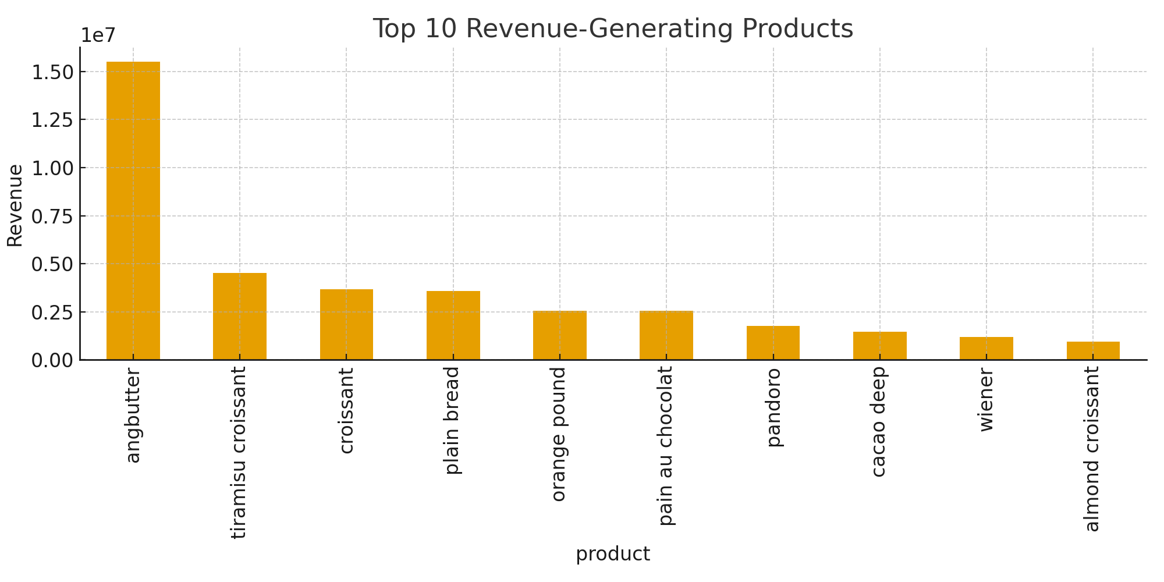
Top Revenue-Generating Products
Interpretation: Shows top products contributing to revenue.

Slide 6
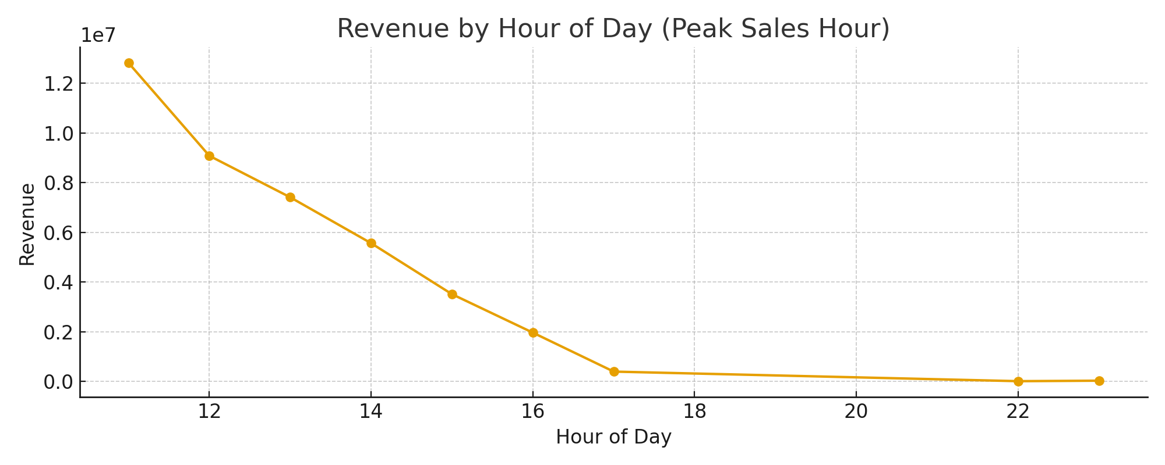
Peak Sales Hour (Revenue by Hour)
Interpretation: Identify hours with highest revenue to plan staffing & promotions.

Slide 7
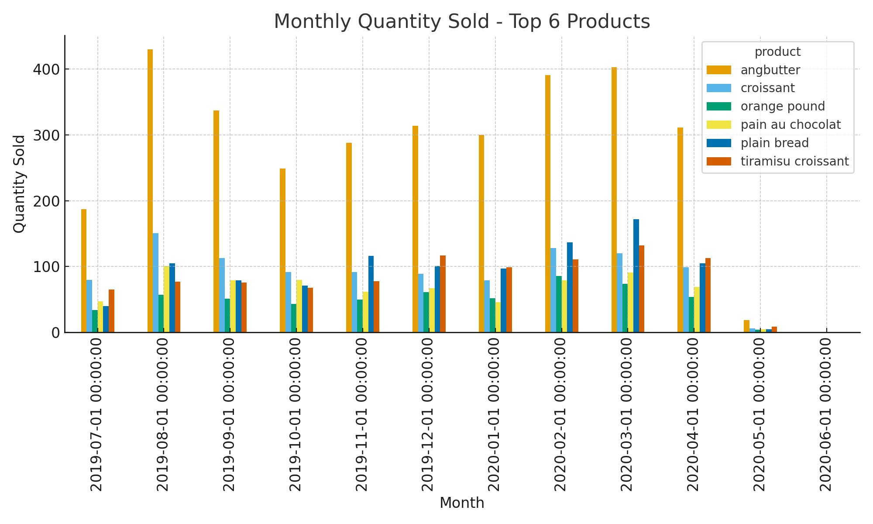
Monthly Quantity Sold (Top 6 Products)
Interpretation: Trend of top products over months.

Slide 8
Conclusion & Insights
- angbutter is the single largest-selling product by units and contributes significantly to revenue. - Peak sales hours and top-selling days can guide staffing and promotional strategies. - Monthly trends show which products are seasonal or growing in demand.

