Slide 1
SmartVisionAI
“The Future begins with us”

Slide 2
01
Problems

Slide 3
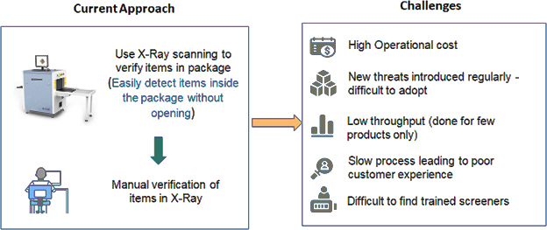
Notes:
Human precision at fraud detection in X-ray scans is not always effective
Human time to process image scan is about 2 minutes.
X-Ray Scan is not clear so the human eye can’t analyse it.
Detection of threats and contraband starts with high fidelity imaging and sensor data, but it doesn't end there. Data can quickly become overwhelming and human operators, no matter how skilled, can get fatigued and distracted.

Slide 4
8 out of 10 tests Banned items made it through US airport security
0.28% of times flight delay is caused by security delays (baggage scan) in 2017
According to Transportation Security Administration (USA)

Slide 5
02
Solution

Slide 6
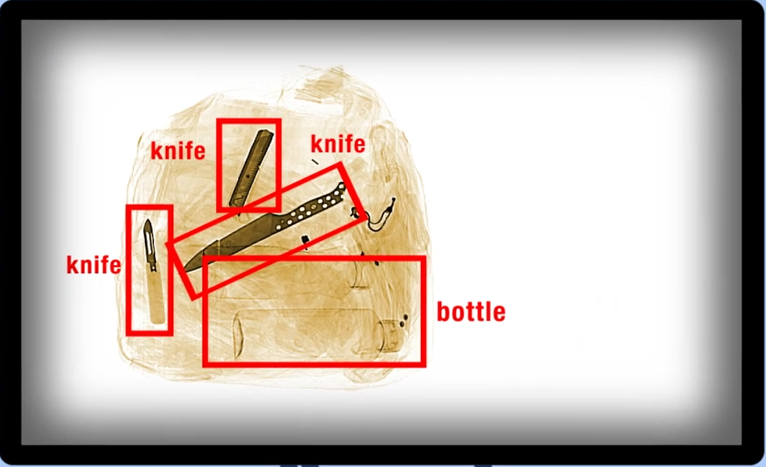
Our Solution
SmartVisionAI is an Artificial Intelligence-based solution which ensures accuracy and efficiency in threat-detection at security checkpoints. With robust & fast algorithms at its core, SmartVisionAI detects prohibited items in real-time from X-ray Baggage Scanner

Slide 7
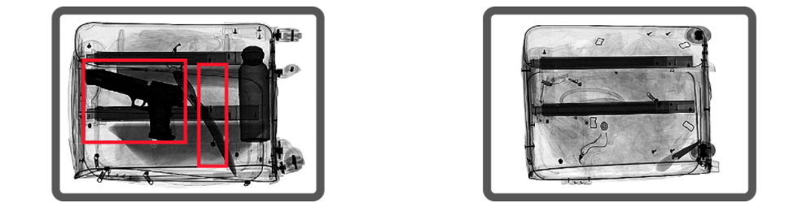
Our Product: BaggageVision

Slide 8
Where our solution can be applied ?
Airport
Stadium/Events
Prison
Malls
Schools
Administrations

Slide 9
Why us?
Time and Energy
Huge Range
Easy Integration
Most tasks will be done in less time and less energy with more precision
It can be trained to detect any contraband
Runs as a separate service and can be accessed via http endpoint.

Slide 10
03
Business Model

Slide 11
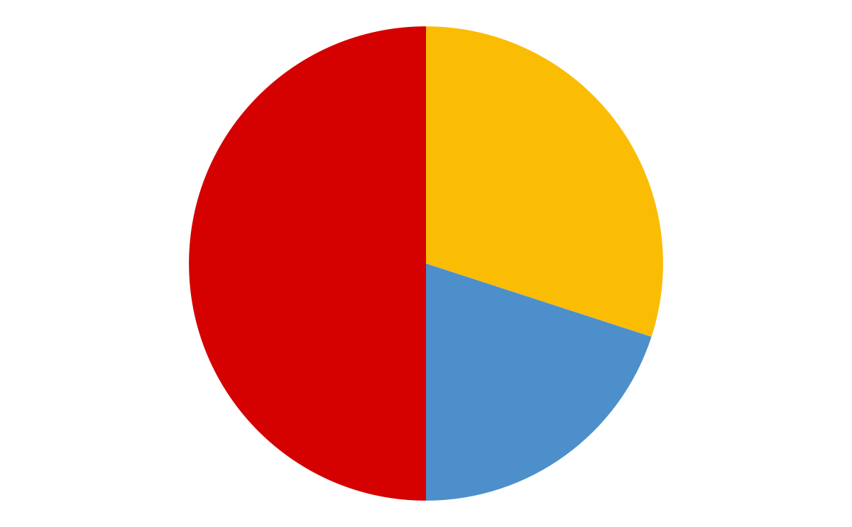
Business Model
Selling our services to private Security Companies
Personalized Services
30 %
Sell Personalize Object detection services for other customs
50 %
Selling our Services to Customs
20 %

Slide 12
150,000 TND
Estimated revenue in one year
Notes:
malyoun declaration

Slide 13
04
Competition

Slide 14



Competition
NextAV is Tunisian Based Startup that works on Computer Vision Solution
SeeThru is US based startup that have a product that detect threats from x ray car images
DataVision is Tunisian Based Startup that works on Computer Vision Solution

Slide 15
05
Our Solution Scalability

Slide 16
How are we growing ?
“
“
“
Expanding to Africa
X-ray Cargo Scanner
X-ray Car Scanner
Most of African country lacks the use of AI
Detecting threats in X-ray Cargo image Scanner
Detecting threats in X-ray Car image Scanner

Slide 17
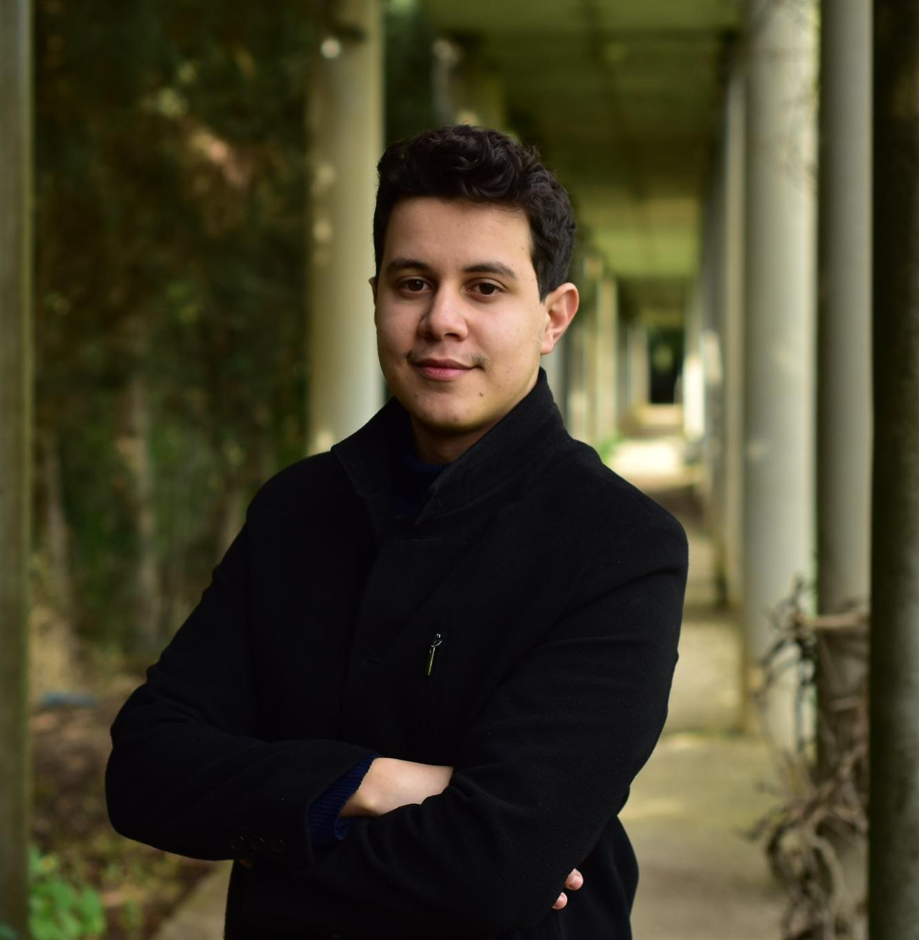
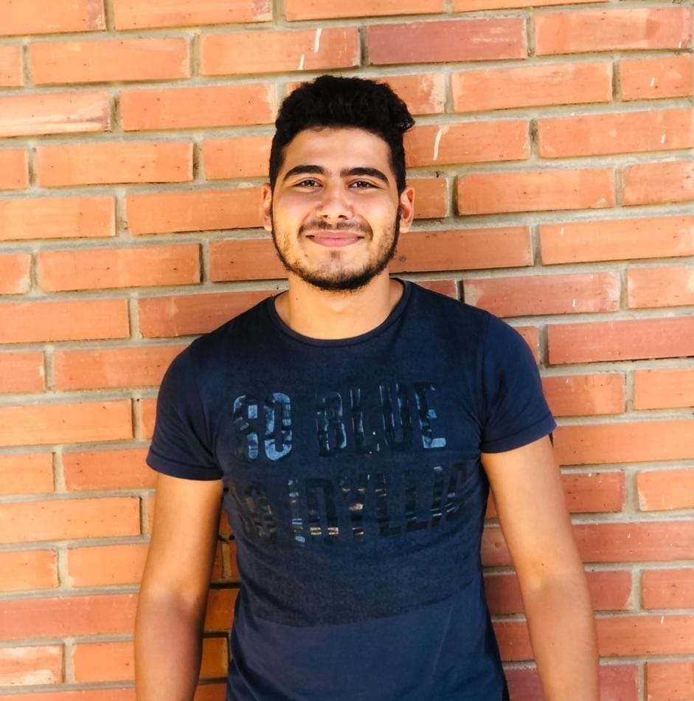
Our team
Wassim Henia
Mohamed Boutaieb
ML/DL Engineer
Software Engineer

Slide 18
Thank you for your attention
Please keep this slide for attribution

