Slide 1
Matrices calculator
Computer programming project
Mohamed Ashraf Gamal El Din Dawoud
13P1085
Section: 1

Slide 2
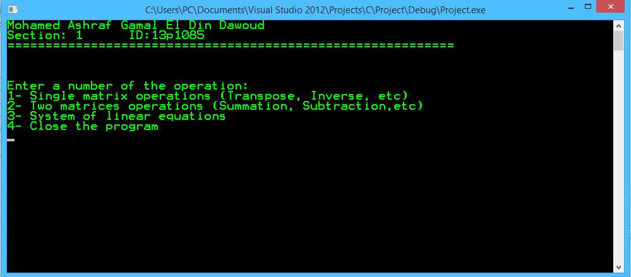
Main Menu

Slide 3
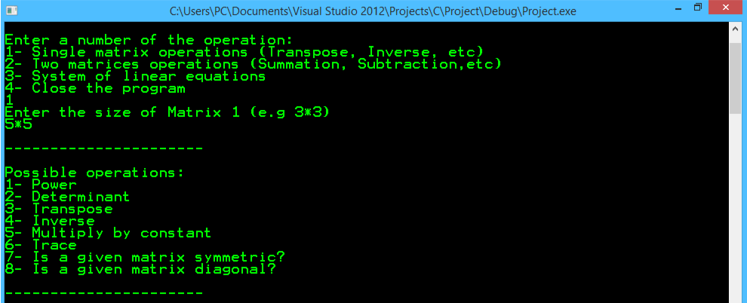
1.0 Single Matrix operation (square matrix) Possible operations depending on matrix size

Slide 4
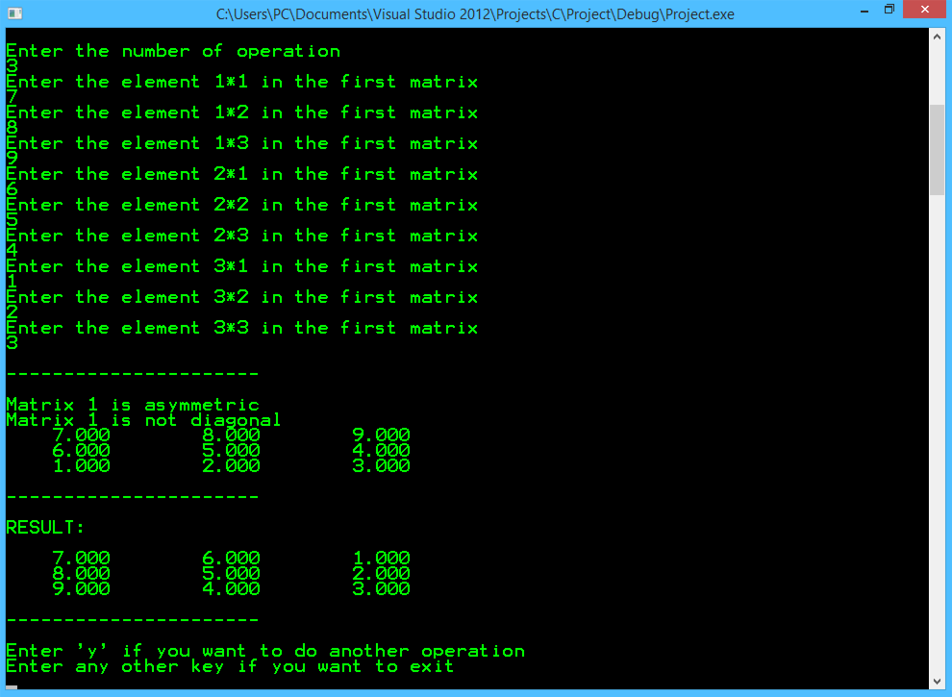
1.1 Single Matrix operation (square matrix) 1.1.1 Transpose:

Slide 5
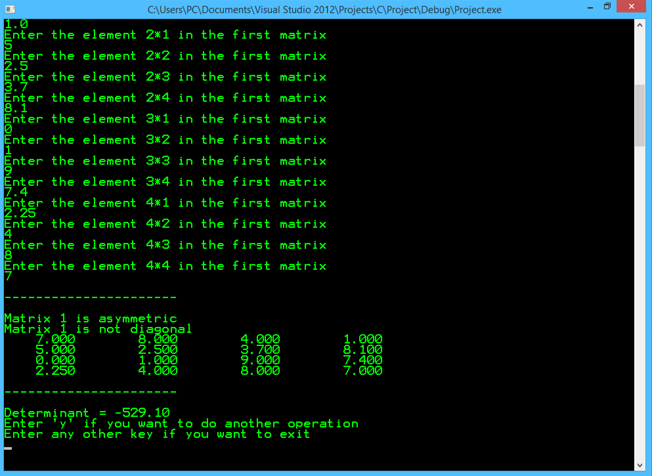
1.1 Single Matrix operation (square matrix) 1.1.2 Determinant:

Slide 6
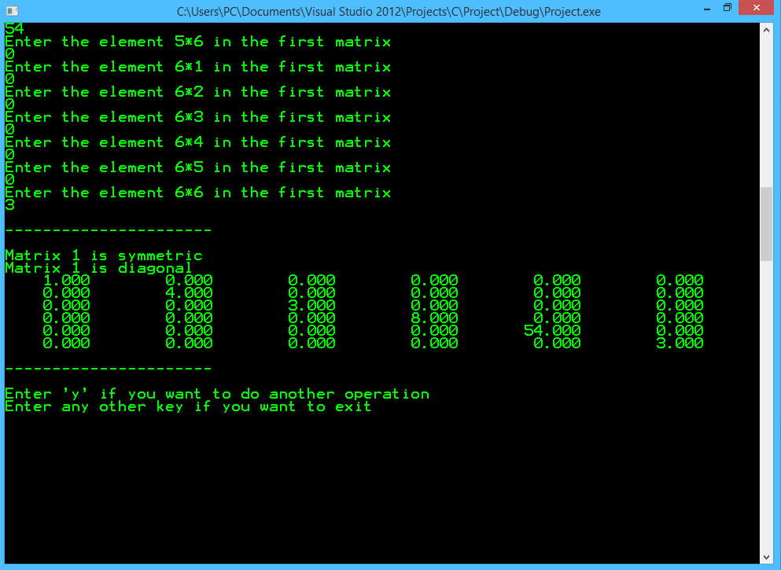
1.1 Single Matrix operation (square matrix) 1.1.3 Diagonal matrix:

Slide 7
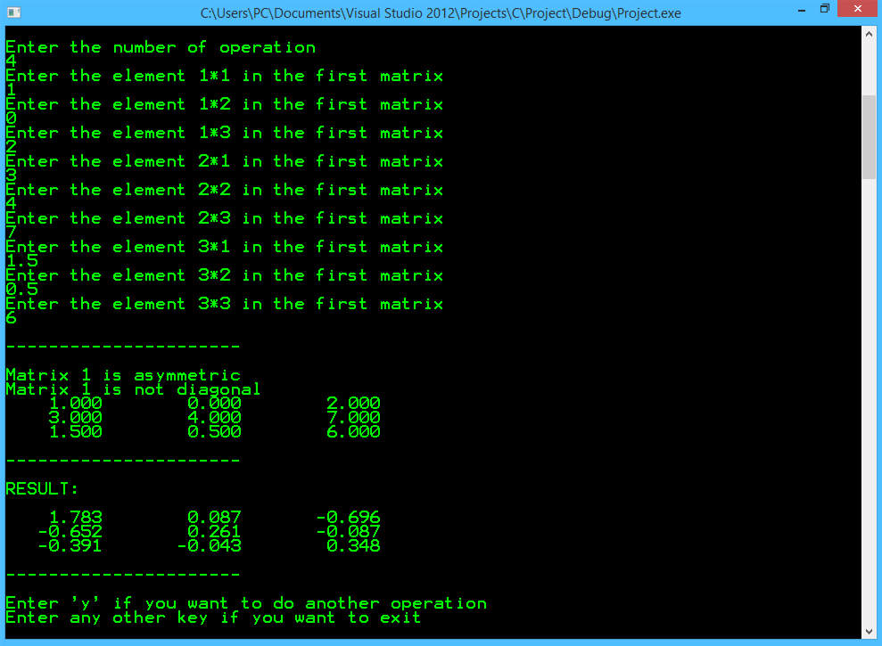
1.1 Single Matrix operation (square matrix) 1.1.4 Inverse matrix:

Slide 8
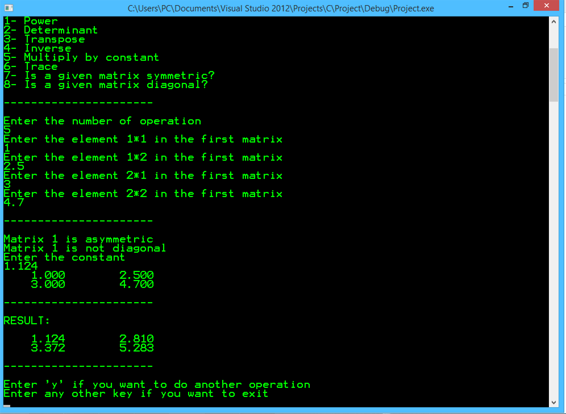
1.1 Single Matrix operation (square matrix) 1.1.5 Multiply by constant:

Slide 9
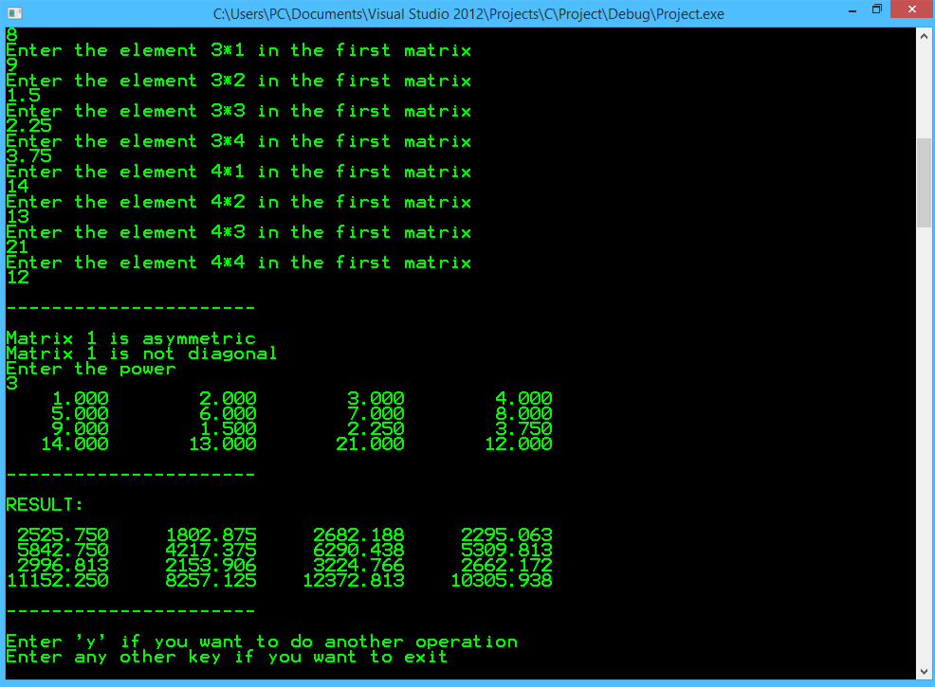
1.1 Single Matrix operation (square matrix) 1.1.6 Power matrix:

Slide 10
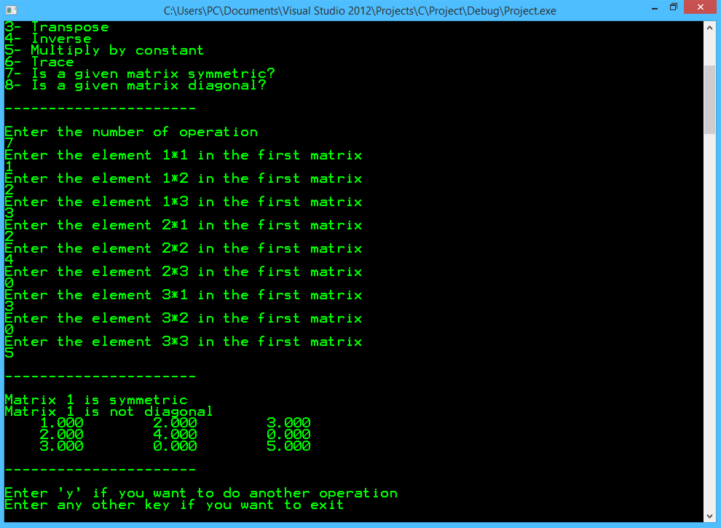
1.1 Single Matrix operation (square matrix) 1.1.7 Symmetric matrix:

Slide 11
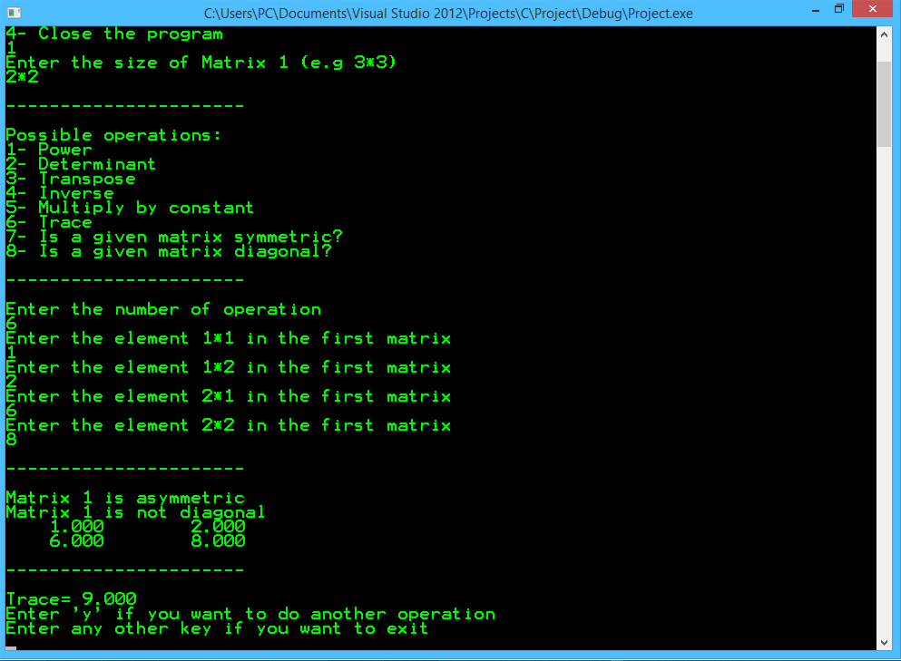
1.1 Single Matrix operation (square matrix) 1.1.8 Trace:

Slide 12
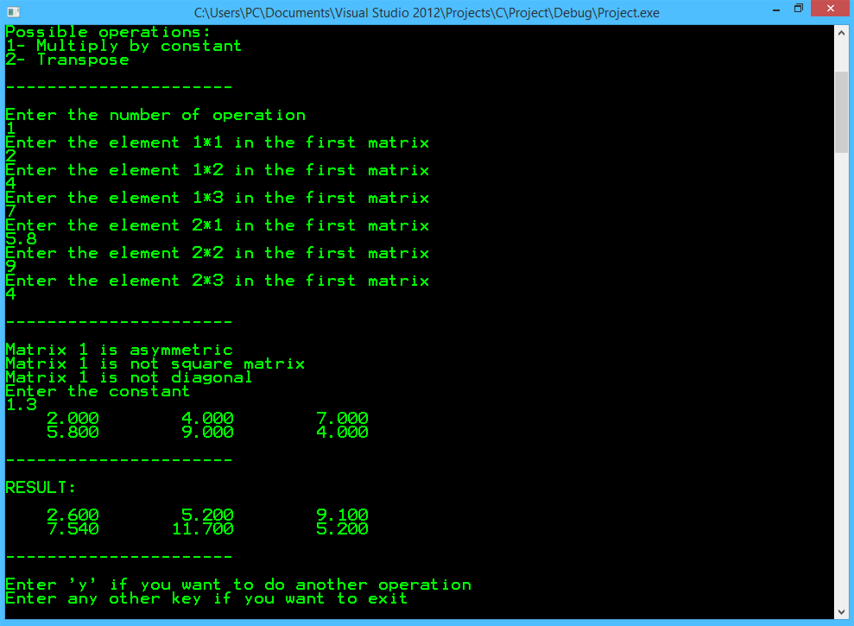
1.2 Single Matrix operation (not square matrix) 1.2.1 Multiply by constant :

Slide 13
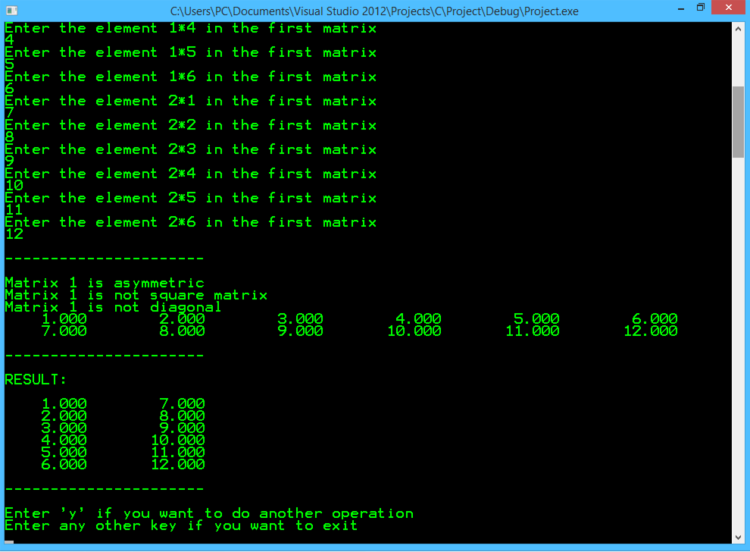
1.2 Single Matrix operation (not square matrix) 1.2.2 Transpose matrix :

Slide 14
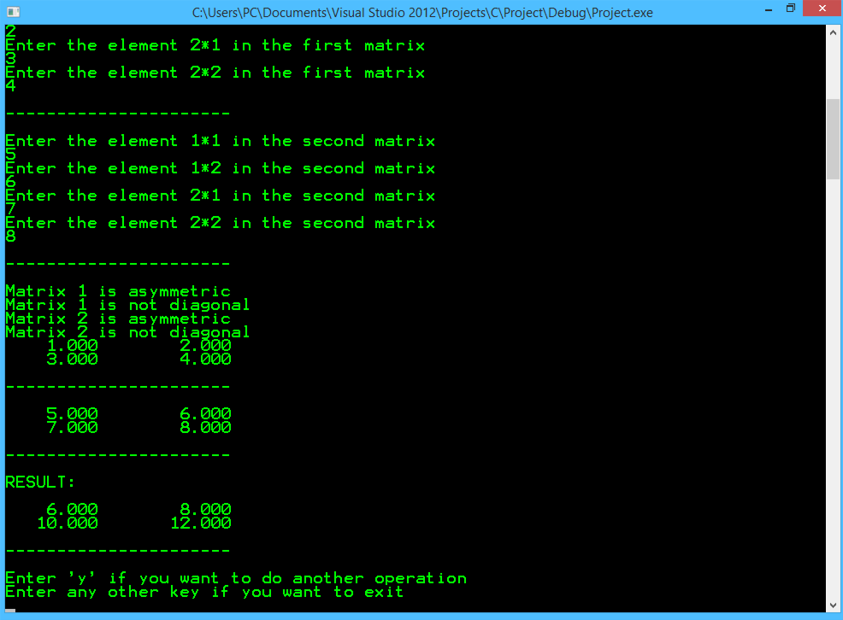
2.2 Two Matrices operation (square matrices ) 2.1.1 Summation :

Slide 15
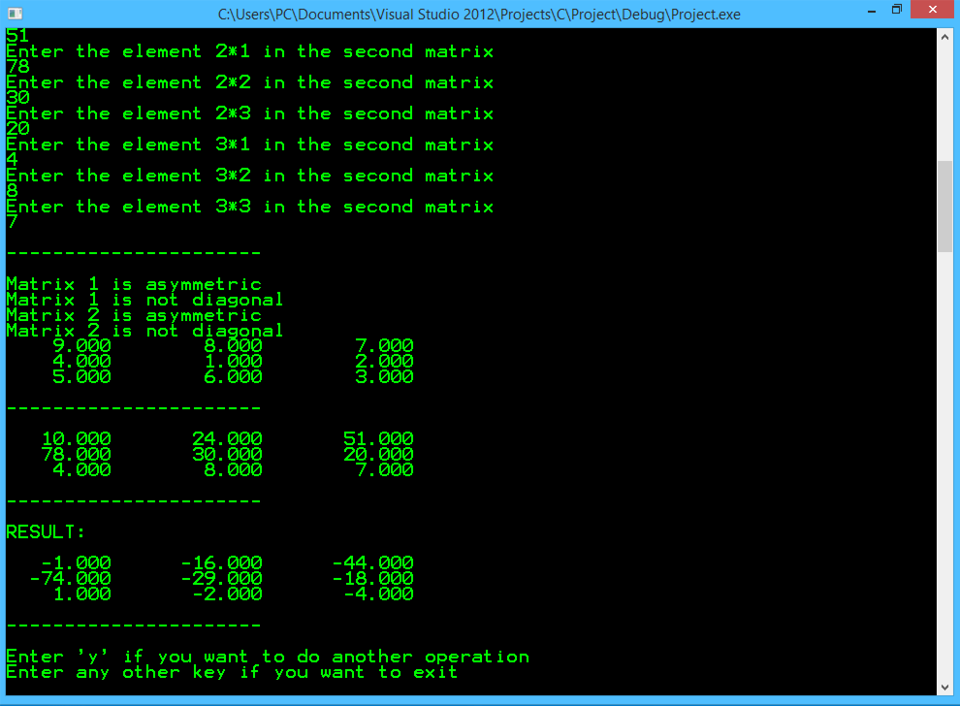
2.2 Two Matrices operation (square matrices ) 2.1.2 Subtraction :

Slide 16
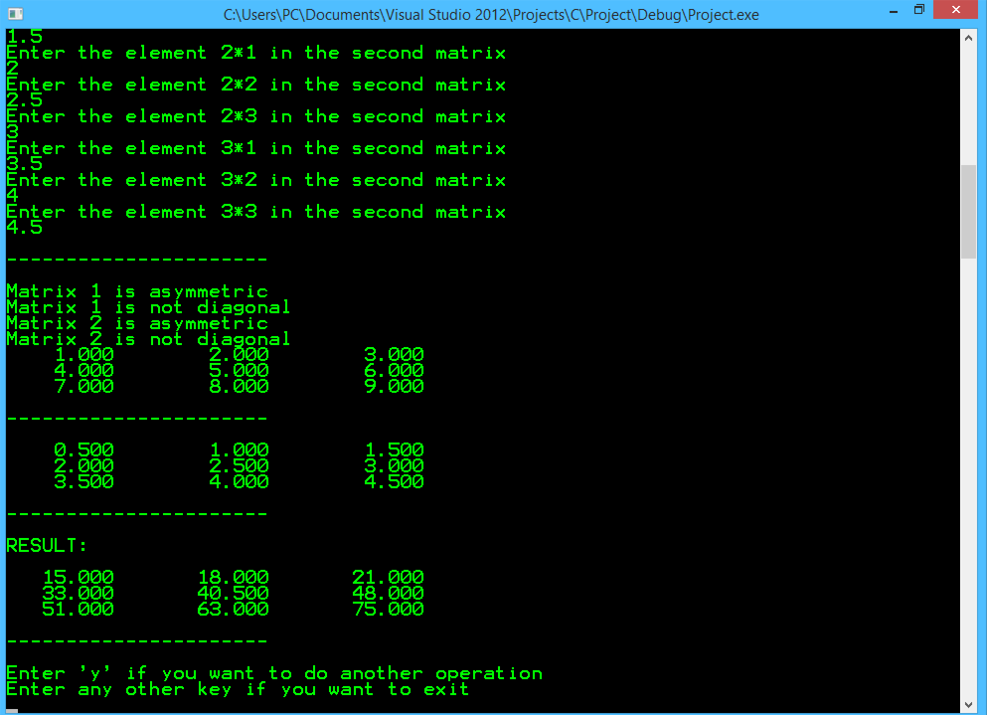
2.2 Two Matrices operation (square matrices ) 2.1.3 Multiplication:

Slide 17
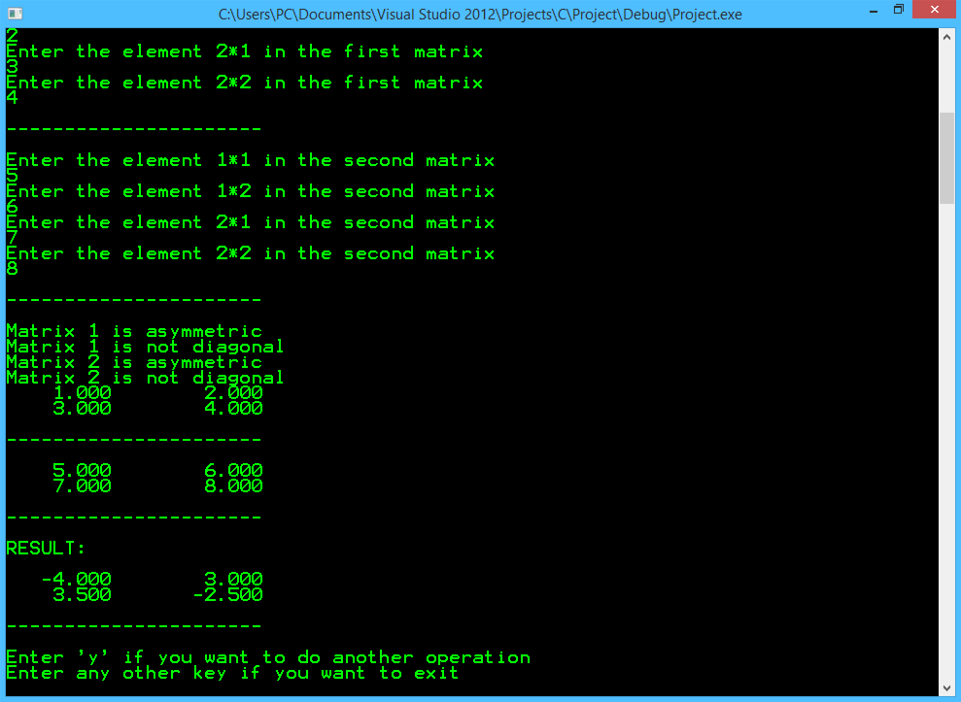
2.2 Two Matrices operation (square matrices ) 2.1.4 Division:

Slide 18
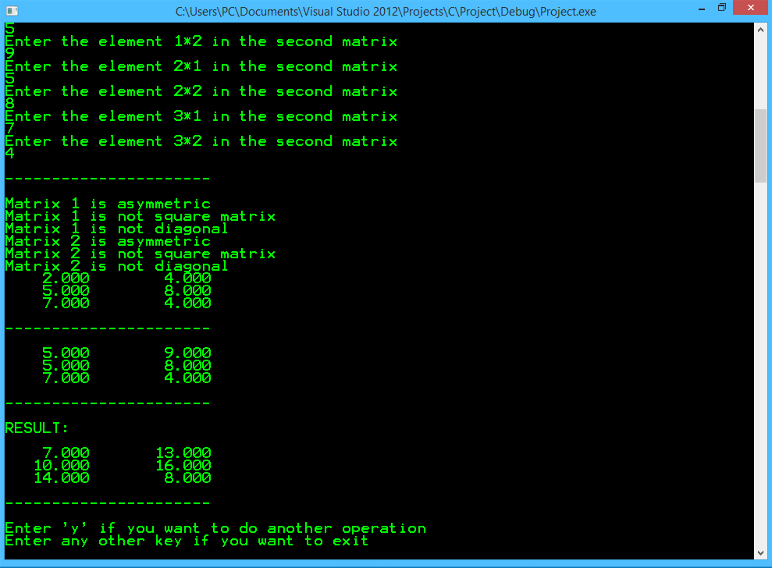
2.2 Two Matrices operation (same size) 2.2.1 Summation :

Slide 19
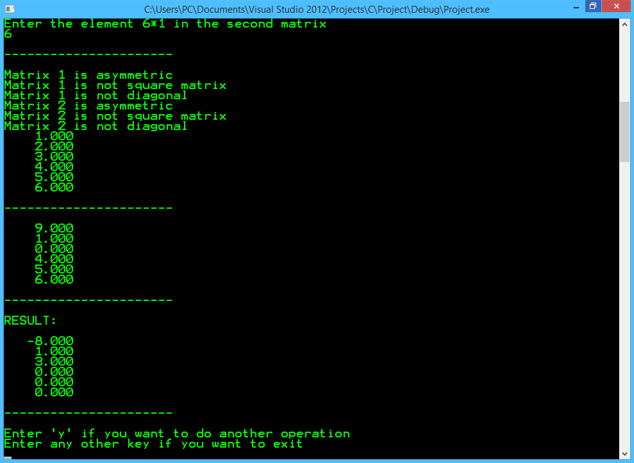
2.2 Two Matrices operation (same size) 2.2.2 Subtraction:

Slide 20
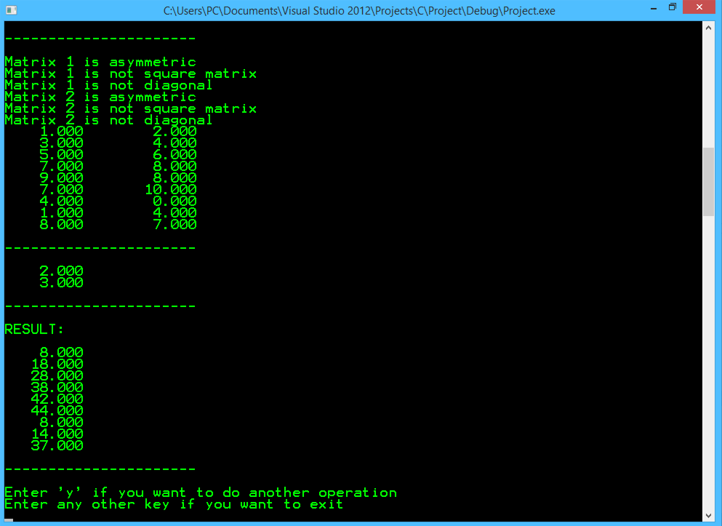
2.2 Two Matrices operation (column = row) 2.3.1 Multiplication:

Slide 21
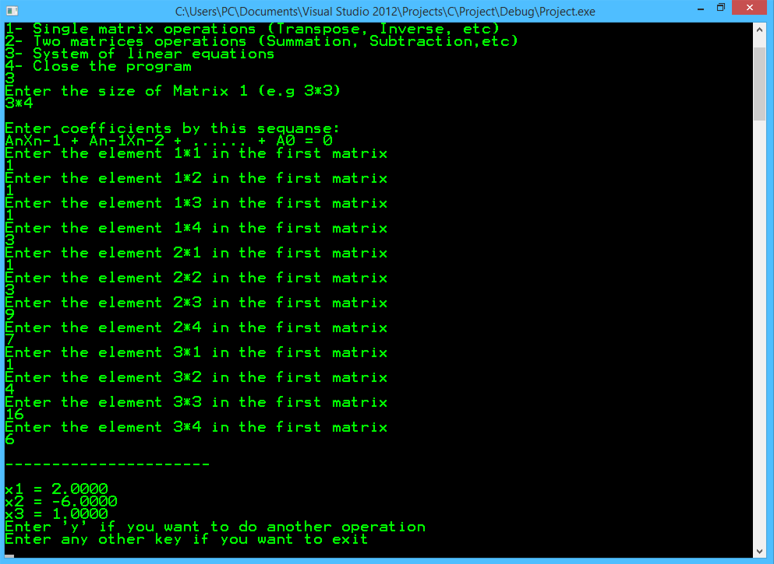
3.1 System of linear equations One solution:

Slide 22
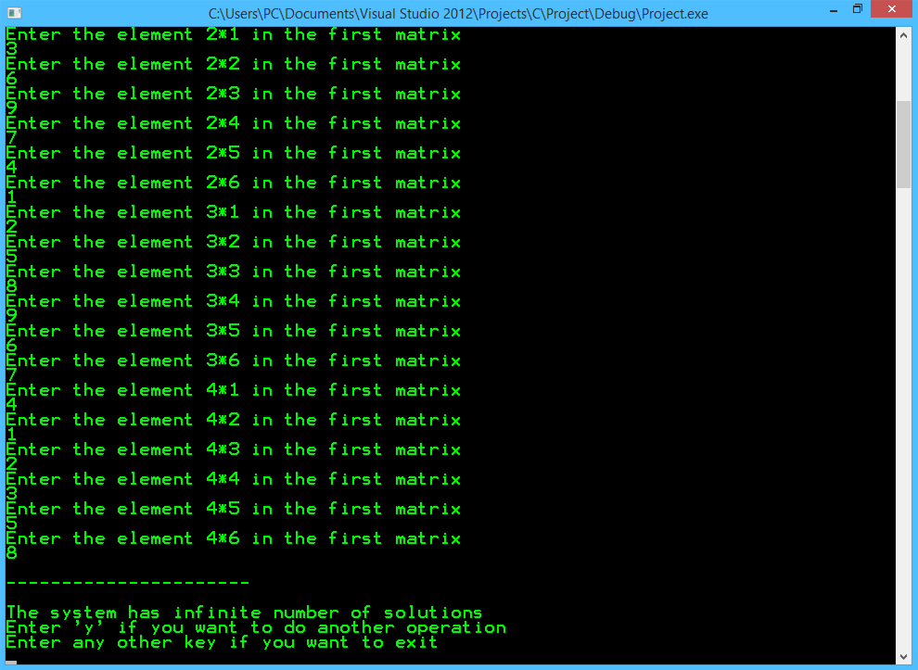
3.2 System of linear equations More than one solution:

Slide 23
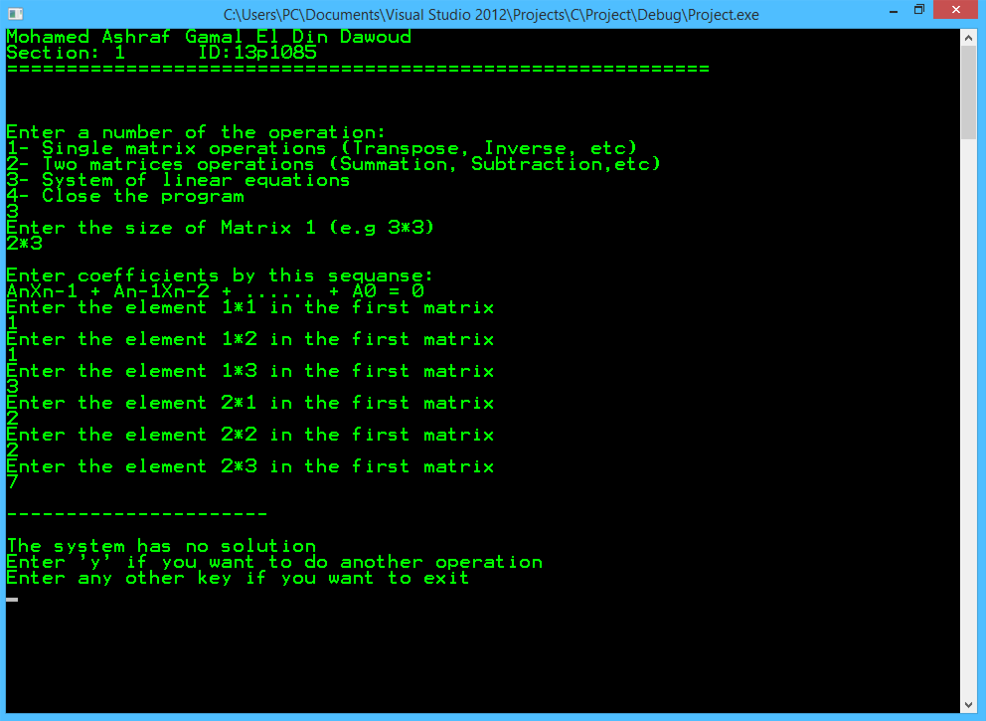
3.3 System of linear equations No solution:

