Slide 1

SHEFAA
Smart Healthcare Entry & Facility Automation Assistant
Software Engineering Project Presentation
Supervised by / Dr. Samar Ashraf
SHEFAA - Team 1

Slide 2
Team Members
Team: TEAM 1
محمد أيمن فتحي عبد الغنى (Leader ( 921220115
محمد خالد سعد كامل منصور 921220117
عمر أمجد عبد العزيز عبد السلام 921220092
محمود صلاح عبد المعز حسن السلكاوي 921220139
كريم أحمد سعد محمد أبو العزم 921220105
عمر هاني صابر فضل 921220099

Slide 3
Agenda
Overview
Problem Statement
System Requirements
System Design
Testing Strategy
Future Evolution
Conclusion
Q&A
SHEFAA - Team 1

Slide 4
Overview
Project Title: SHEFAA (Smart Healthcare Entry & Facility Automation Assistant)
Objective: Automate hospital management with a focus on patient, doctor, and admin needs
Key Features: Patient registration, appointment booking, medical history access, chatbot support
Target Users: Patients, Doctors, Administrator of hospital
SHEFAA - Team 1

Slide 5
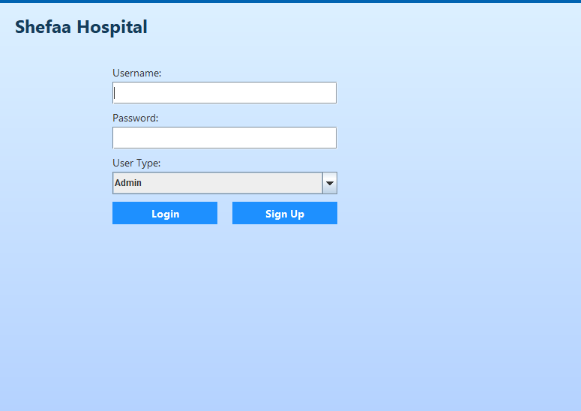
Hospital interface
LOG IN

Slide 6
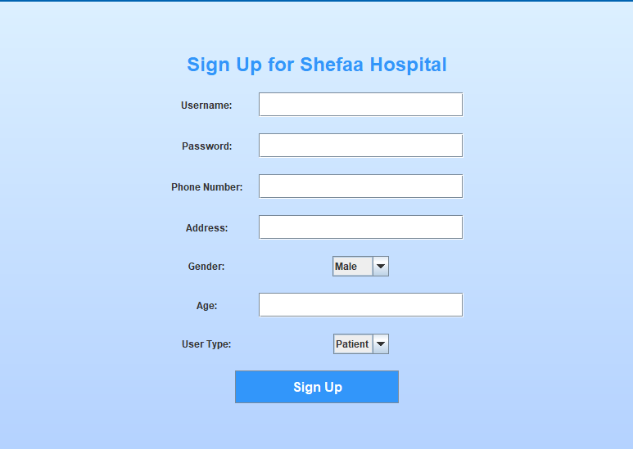
Hospital interface
SIGN-UP

Slide 7
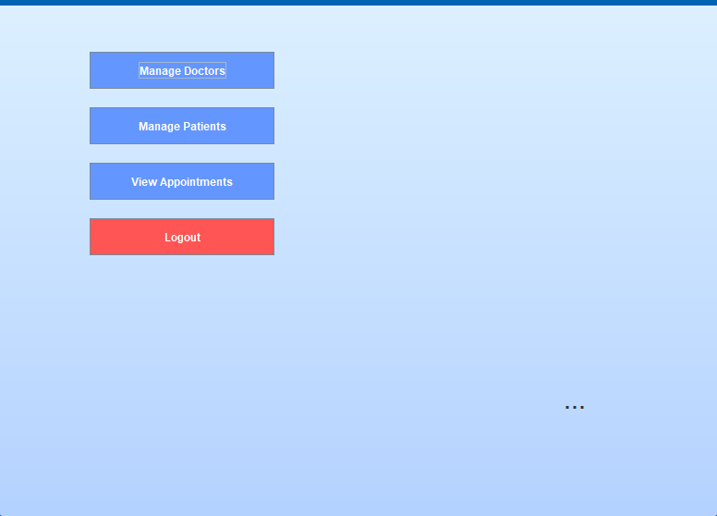
Hospital interface
Admin Dashboard

Slide 8
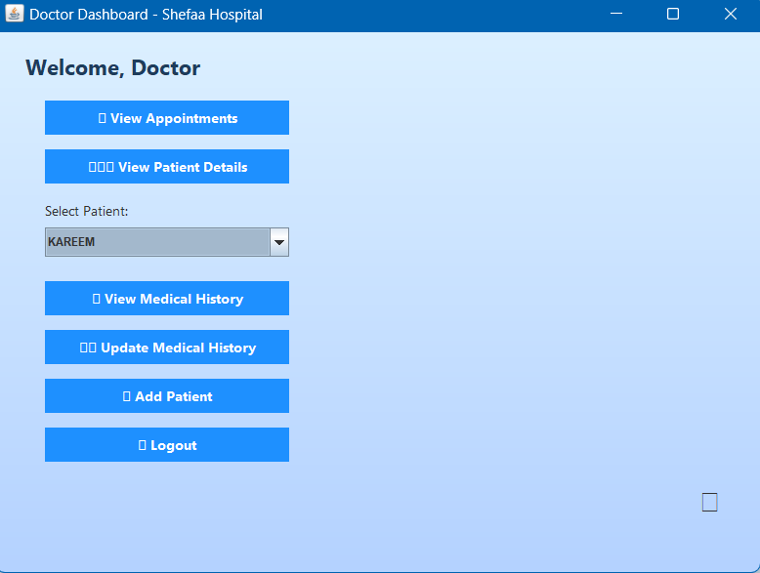
Hospital interface
Doctor Dashboard

Slide 9
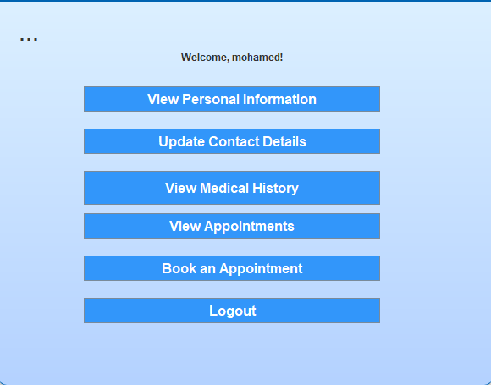
Hospital interface
Patient Dashboard

Slide 10
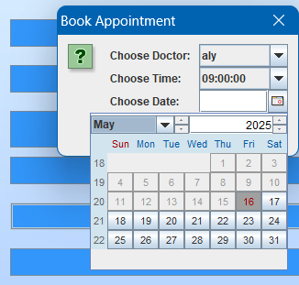
Hospital interface
Booking Appointment

Slide 11
Problem Statement
Challenges:
1- Manual patient registration, scheduling.
2- record-keeping Frequent delays.
3- data discrepancies.
4- Long wait times and lack of appointment transparency.
Impact:
1- Reduced patient satisfaction
2- Increased healthcare quality issues Communication breakdowns and human errors
Solution: SHEFAA: A smart, centralized Hospital Management System
SHEFAA - Team 1

Slide 12
System Requirements
SHEFAA - Team 1

Slide 13
System Requirements

Slide 14
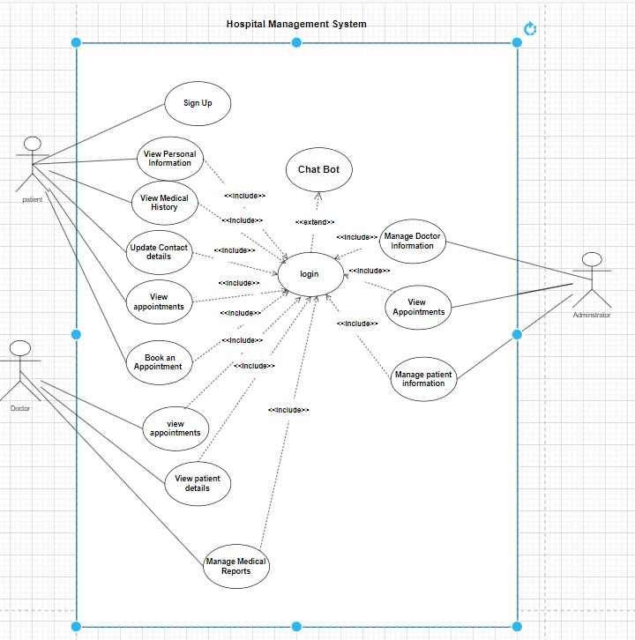
System Design
USE-CASE DIAGRAM
SHEFAA - Team 1

Slide 15
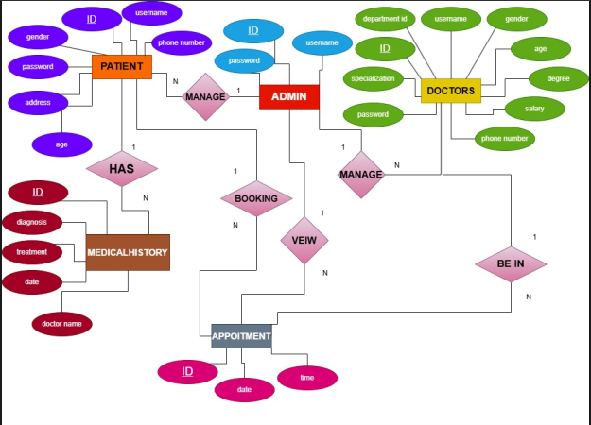
System Design
ER Diagram

Slide 16
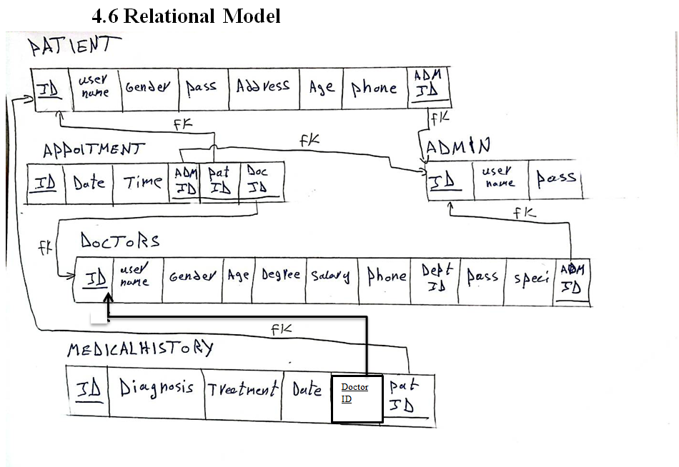
System Design
RELATIONAL MODEL

Slide 17
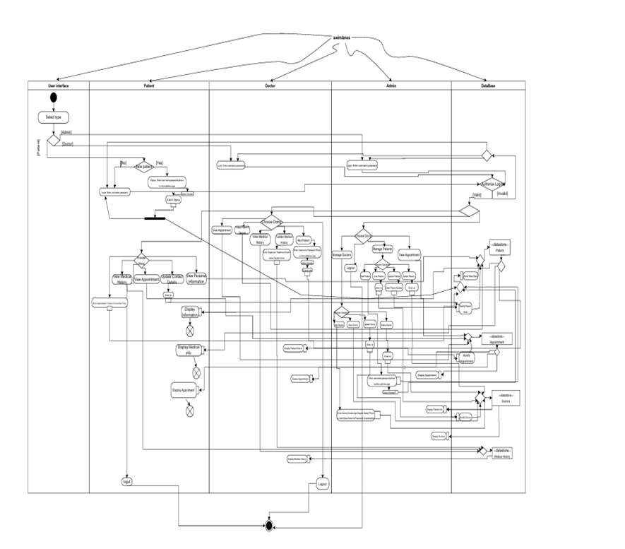
System Design
Activity Diagram
Activity diagram High Quality : click the link and download Activity diagram for High Quality
{ https://drive.google.com/file/d/1TdmAyYR5l3x722_ZqerIxIvtu9m7ZV53/view?usp=drive_link }

Slide 18
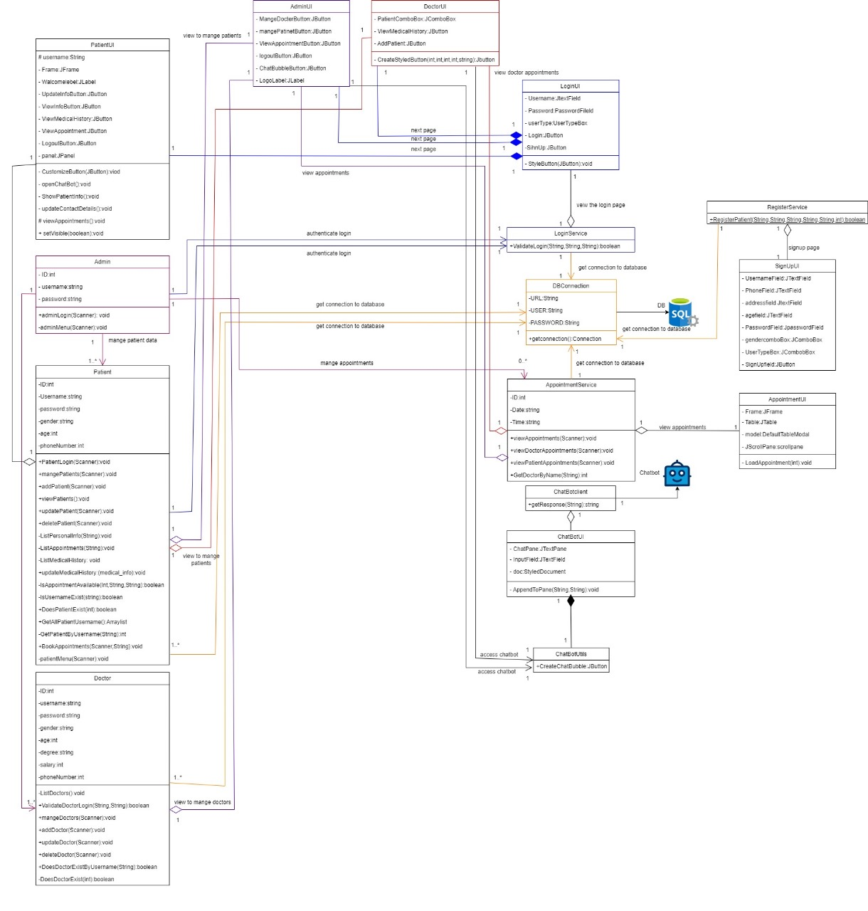
Class Diagram
Class diagram High Quality : click the link and download Class diagram for High Quality{https://drive.google.com/file/d/1FkM8FV5xWTAh-qLEL0l2yT6RvccktvsK/view?usp=drive_link }

Slide 19
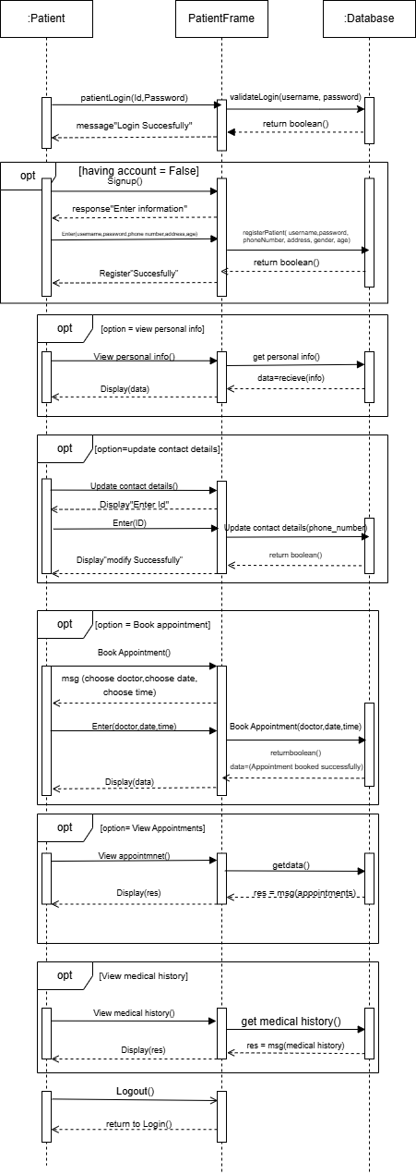
Patient Sequence Diagram

Slide 20
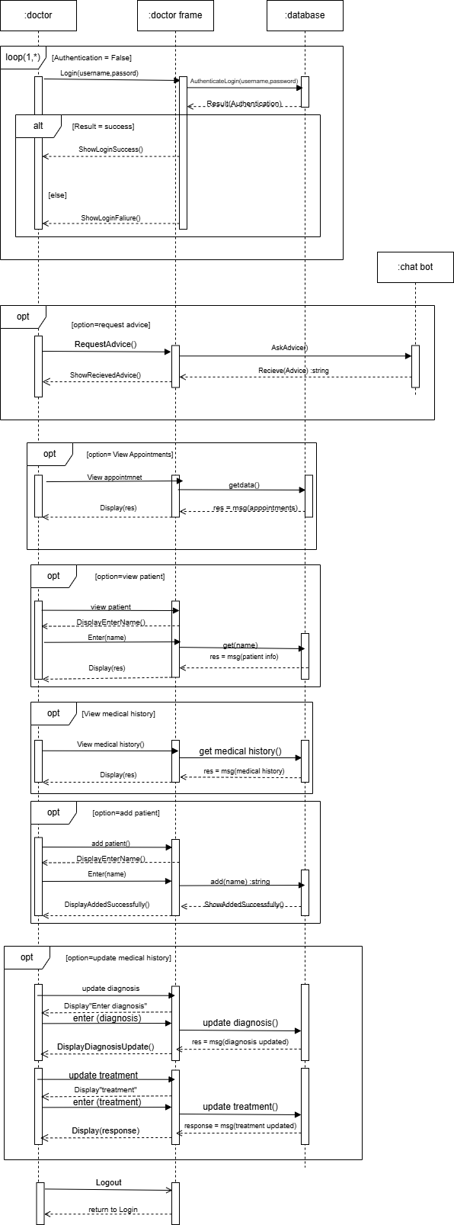
Doctor Sequence Diagram

Slide 21
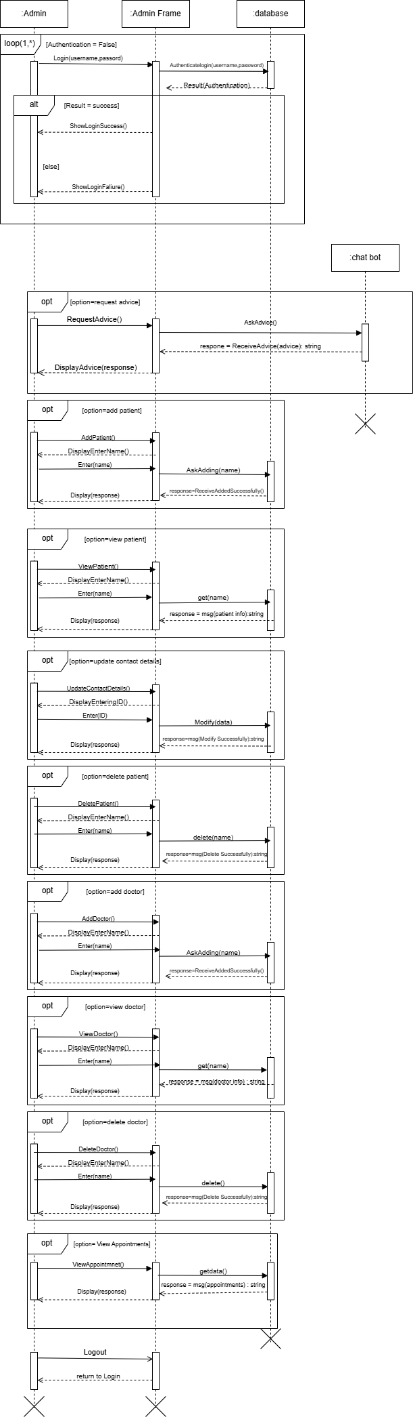
Admin Sequence Diagram

Slide 22
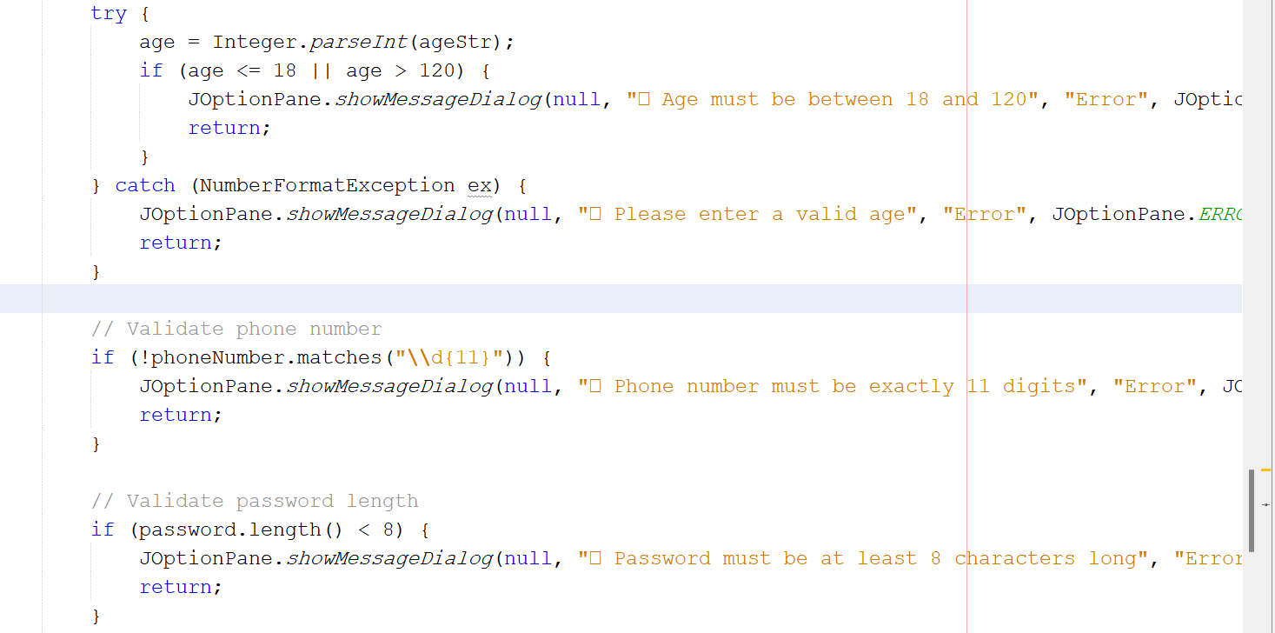
Testing Strategy
Approach: TDD, Black-box, White-box testing
Types: Unit, Integration, System, Usability
Quality Factors: Correctness, Usability, Maintainability
SHEFAA - Team 1

Slide 23
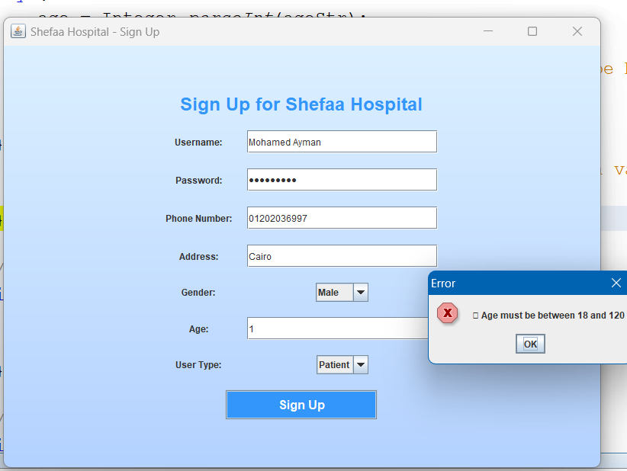
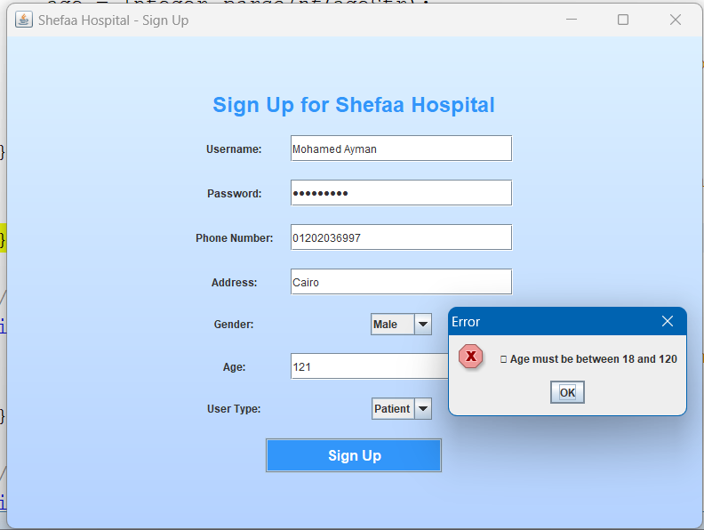
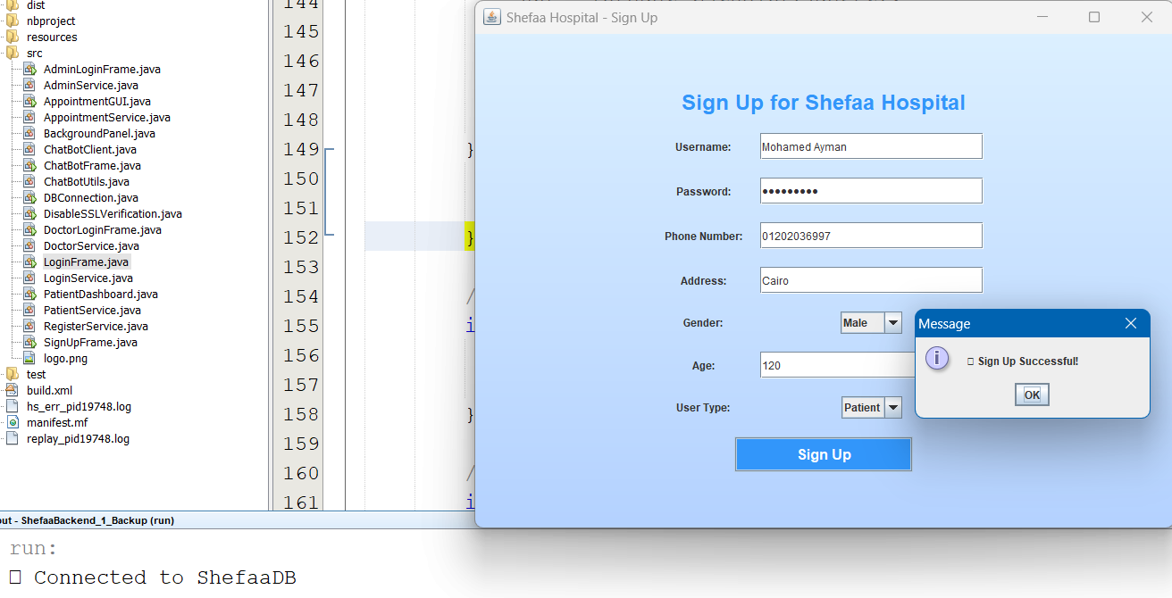
  Black-box
  Boundary Value Testing: Tested limits age inputs ( 1,120, 121).

Slide 24
Future Evolution
SHEFAA - Team 1

Slide 25
Conclusion
Summary: SHEFAA improves efficiency, security, and accessibility
Achievements: Comprehensive design, and testing
زNext Steps: Full implementation, multi-branch support
SHEFAA - Team 1

Slide 26
Q&A
THANK YOU!
SHEFAA - Team 1

