Slide 1
Home Credit Default Risk
The future
is exciting
Ready?
Can you predict how capable each applicant is of repaying a loan?

Slide 2
Methodology
STEP 1
STEP 2
STEP 4
STEP 6
Feature Engineering
& Data Imputation
Data Preparation
Problem understanding
Data Exploration
Data Modeling
Data Validation
STEP 3
STEP 5

Slide 3

methodology Problem understanding
Overview:
Home Credit makes use of a variety of alternative data including telco and transactional information to predict their clients' repayment abilities. This competition is currently hosted on Kaggle
Problem statement:
The objective of this competition is to use historical loan application data to predict to predict their clients' repayment abilities (whether an applicant will be able to repay a loan). This is a standard supervised classification task
Scope:
Due to the computational and time constraint as well as the unavailability of a spark cluster to work on only the main dataset (application_train.csv) will be used.

Slide 4

methodology Data Validation
Validate Data for
Missing Values
Duplicate rows and redundant columns
Outliers and illogical entries
Co- correlation of the independent variables

Slide 5
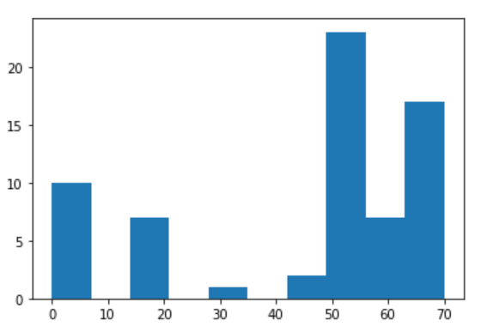
methodology Data Validation
No duplications were found in the dataset
A lot of missing values were found and after observing the distributions (showed below) I decided to make my cutoff at 50% (any column that has 50% or more missing values are cut)
Because of the computational challenge I had while running the project on my local machine I decided to get rid of some the missing values to make it easier to imputer later on (from the majority only as not to under sample the minority class further)
Frequency
Percentage of missing values

Slide 6
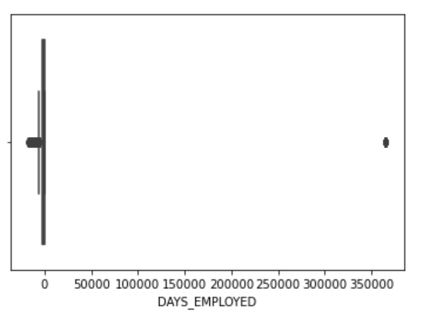
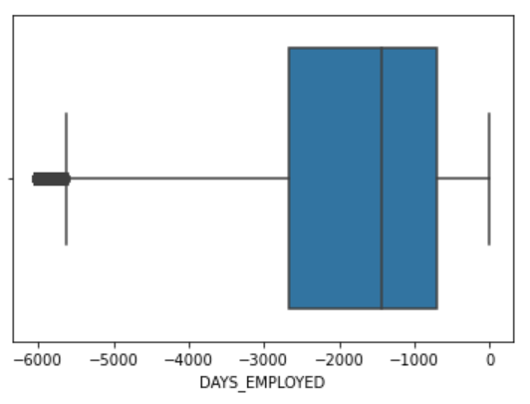
methodology Data Validation
A lot of outliers was observed across the dataset (please check the interactive EDA)
So a good approach is to either remove it or correct it
My approach was a combination of the two
I removed all outliers from the majority classes for computational reasons
I changed the value of the rest to NAN to be amputated (correction) later on
I observed a column that contains outliers to see the results of my transformations
Before Transformation
After Transformation

Slide 7
methodology Feature Engineering & Data Imputation
Created two flags (is_missing & Days_Employed_anom) to capture the info lost when we amputate them
Tried multiple imputation methods such as KNN and MICE but again I was limited by my computational means and both those methods are expensive to compute on large datasets
So I wanted to use a less expensive technique (without going the traditional mean or median route)
I opted to use a clustering technique to lessen the burden while imputing

Slide 8
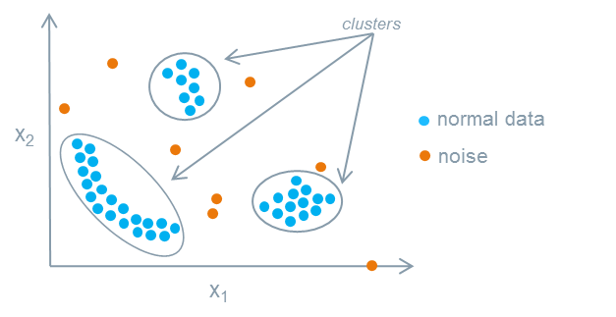
Data Imputation Clustering
Clustering is the task of grouping a set of objects in such a way that objects in the same group (called a cluster) are more similar (in some sense) to each other than to those in other groups (clusters). It is a main task of exploratory data mining
Limitations: Highly dimensional data is hard to visualize and interpret

Slide 9
Methodology Data EXPLORATION
We profile and analysis the data column by column to identify patterns and relations and wrapped in an interactive framework. (EDA_report.html)
We infer the importance & relationship of each feature to the target
Profiling
Missing values were analyzed with respect to the target
Records with missing values were isolated and profiled using a clustering method
Missing Values
Filled data was clustered and segmented for further analysis later on and centroid can be taken and presented to the business
This part was omitted from the notebook since it needs business intervention to be interpreted
Cluster Analysis

Slide 10

Feature significance Feature importance & Correlation
Feature Importance is the process where automatically features are select which contribute most to the prediction variable. Redundant or irrelevant features are removed without incurring much loss of information.
Pearson Correlations capture linear relationships between two variables X and Y. It has a value between +1 and −1. A value of +1 is total positive linear correlation, 0 is no linear correlation, and −1 is total negative linear correlation.

Slide 11
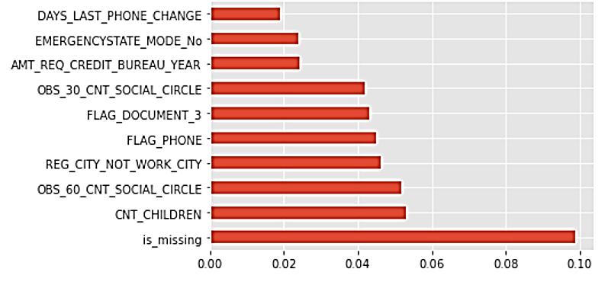
Feature importance for predicting the Target
Observations:
Though no feature have an overwhelming importance, it appears it was a good idea from our side to add the is_missing flag which indicate that the missing values are not random

Slide 12
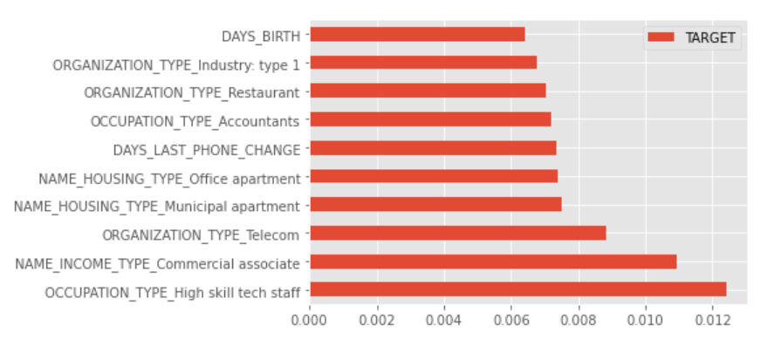
Positive Correlation With predicting the Target
Observations:
All positive correlations are really weak

Slide 13
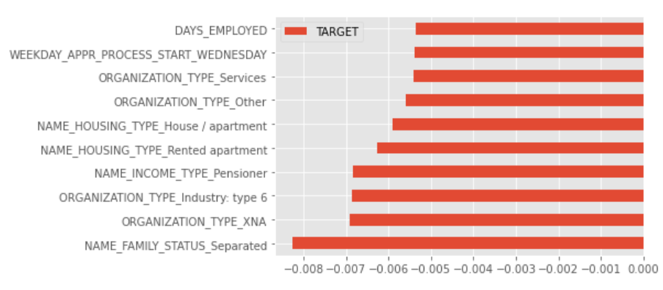
Negative Correlation With predicting the Target
Observations:
All negative correlations are really weak

Slide 14
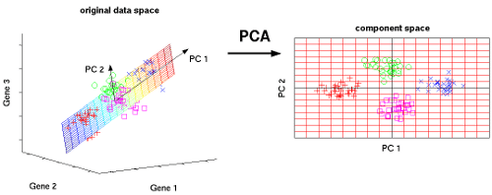
Methodology Data preparation
I prepared the data by scaling, reduction and up sampling:
I scaled the data using the minmax scaler to insure all are on the same scale
I used Principal component analysis (PCA) to reduce the data from 200 feature to only 80 while preserving almost 100% the info (explainable) of the data
I up sampled using SMOTE a method for synthetic data creation that is used for solving datasets with imbalance target classes

Slide 15
Methodology Data modeling
Main Metric used for evaluation : F1
Secondary Metrics: Precision, Recall and accuracy
Baseline Model used: Logistic Regression
Model used: Random Forest
Tuning method used: Random Search
Suggested next trials:
Try Light GBM for modeling
Try Bayesian optimization for tuning
Try down sampling

Slide 16

Thank you

