Slide 1


PWM/Timer Module
Presented by : Digitrons Team

Slide 2
Agenda
BLOCK DIAGRAM
Wishbone Slave Interface
Clock Divider
PWM
Timer
Simulation & Result

Slide 3
BLOCK DIAGRAM

Slide 4
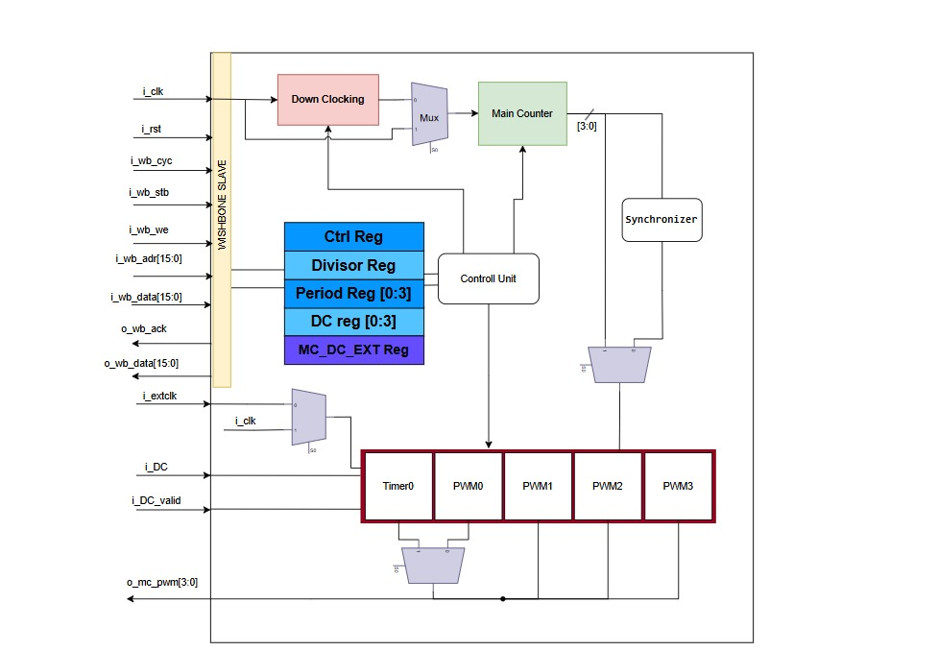
Top view of the design

Slide 5
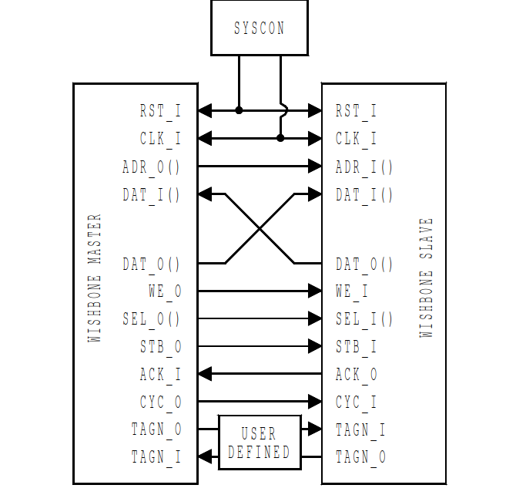
WISHBONE slave interface

Slide 6
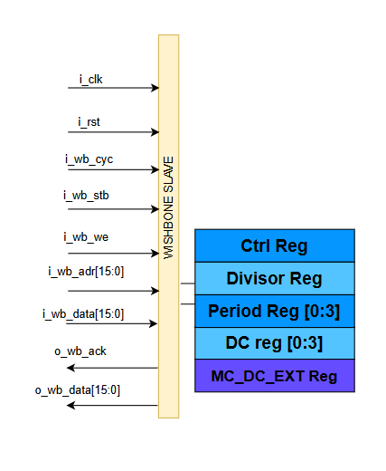
WISHBONE slave interface
compliant with Wishbone B4
Synchronous Active High RST
Synchronous slave
Standard SINGLE READ / WRITE Cycles

Slide 7
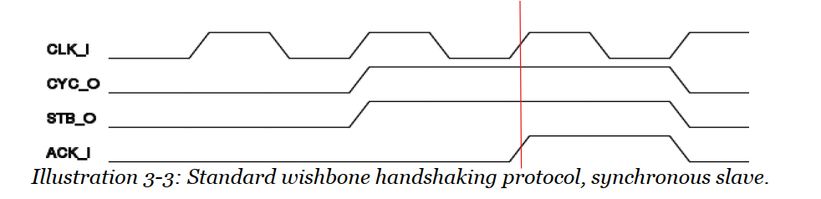
WISHBONE slave interface
Synchronous slave

Slide 8
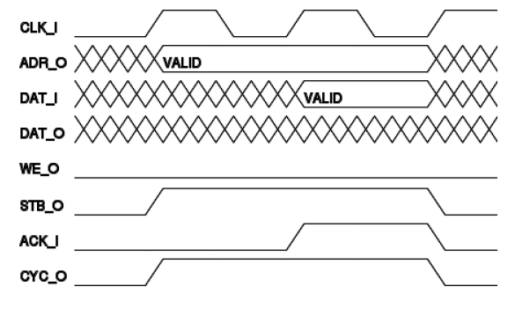
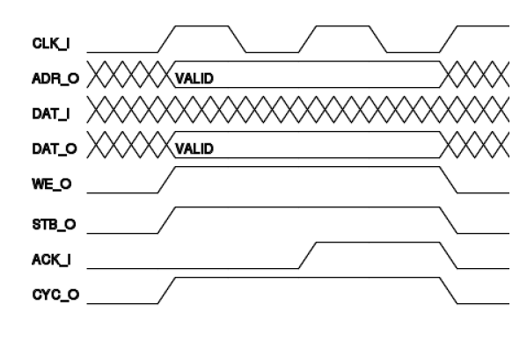
WISHBONE slave interface
Standard Cycles
SINGLE READ Cycle
SINGLE Write Cycle

Slide 9
Clock Divider
Clk_ref
Div_ratio
Inputs
Rst_n
Clk Divider
Clk_out
Outputs
Clk_en
9

Slide 10
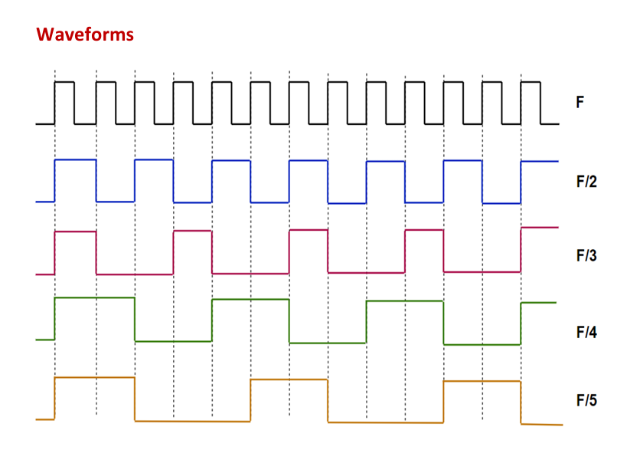
CLOCK divider
10

Slide 11
Multi-Channel PWM
11

Slide 12
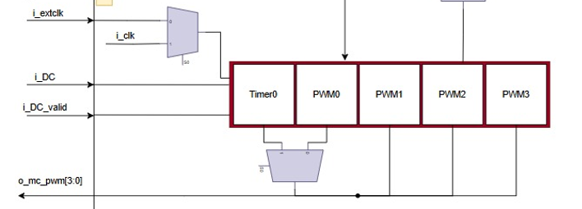
PWM
12

Slide 13
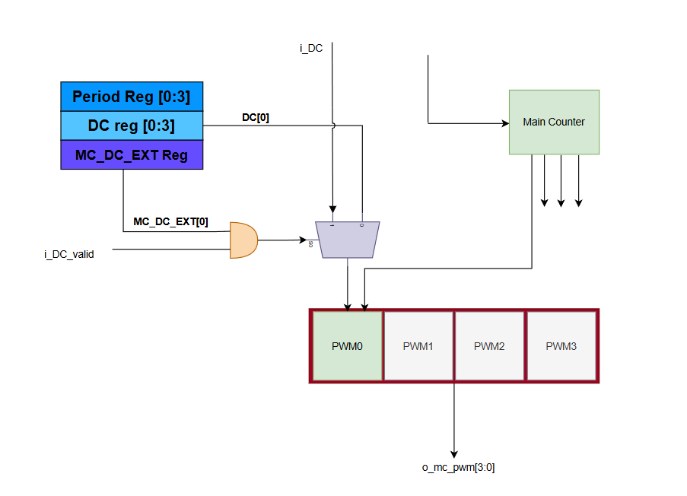
Multi-Channel PWM

Slide 14
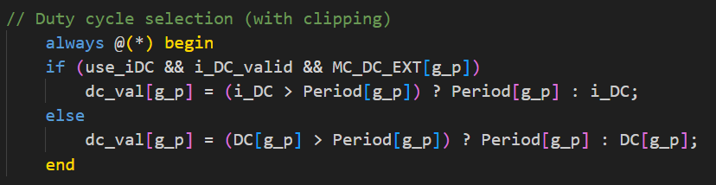
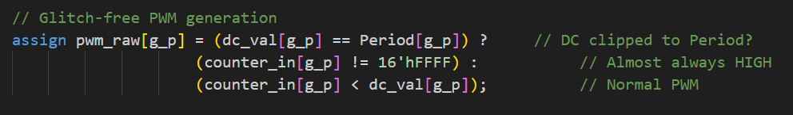
When Duty cycle > period
To handle this error, we first clipped the value of DC_reg to Period register.
Checked if the DC_reg is maximum value, modify condition to be 100% set.
Running the counter till it equals the value and generate the full cycle ON.

Slide 15
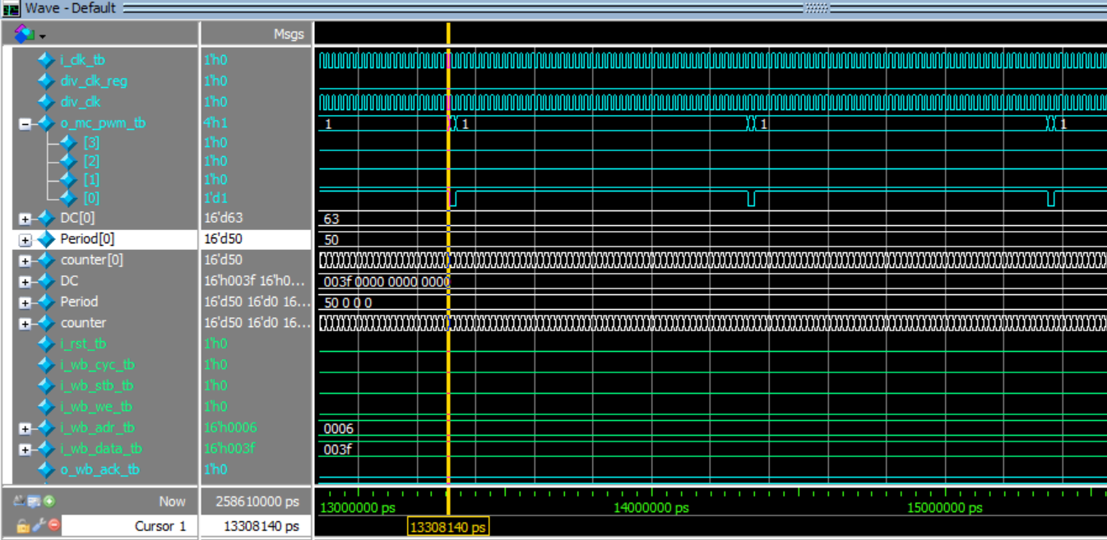
Simulation before

Slide 16
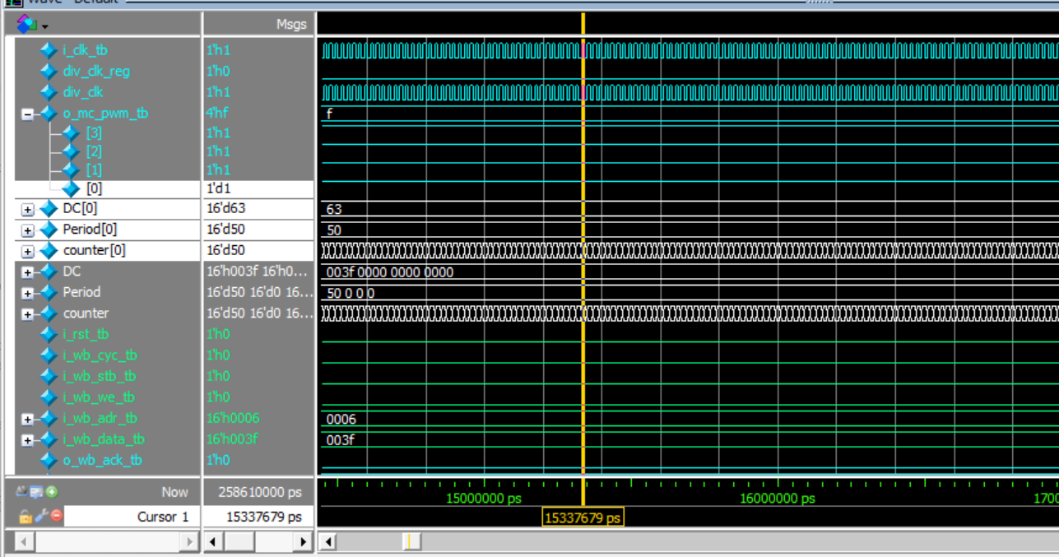
Simulation After

Slide 17
Timer
Mode_sel
EN
Inputs
Rst
Timer
o_mc_pwm
Outputs
Clk_en

Slide 18
Multi-Clock Domains

Slide 19
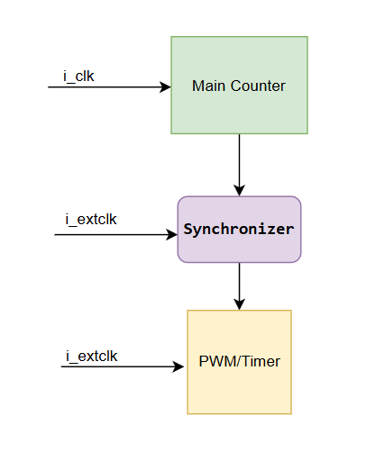
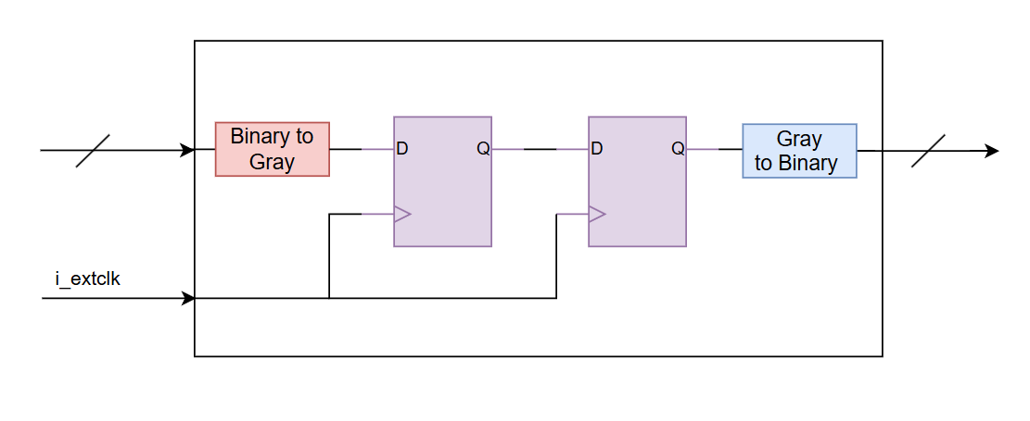
2-FF Synchronizer
Synchronizer

Slide 20
Simulation & Result

Slide 21
Verification Plan
Description | Stimulus Generation | Design Requirement Description
PWM, Testing 50%, 25%, Corner case (DC > Period), Four Channels. | Directed, at the start of simulation. | Can change Duty Glitch free, all high Multiple outputs
Timer and Main counter | Directed, at the middle of simulation. | One-shot timer Interrupt clear Continuous timer
Clock Divider (down clocking) | Directed, at the middle of simulation. | Increasing the period by factor of 2 and 10. Even and Odd duty cycles.
Wishbone interface | Directed, at the middle of simulation. | Reading and Writing in the registers.
Timer with external clock | Directed, at the end of simulation. | Same specs with external clock.

Slide 22
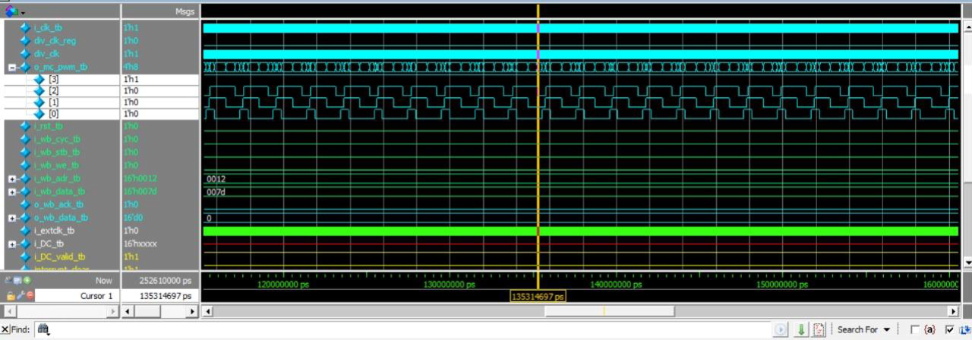
Simulation of 4-channel PWM output

Slide 23
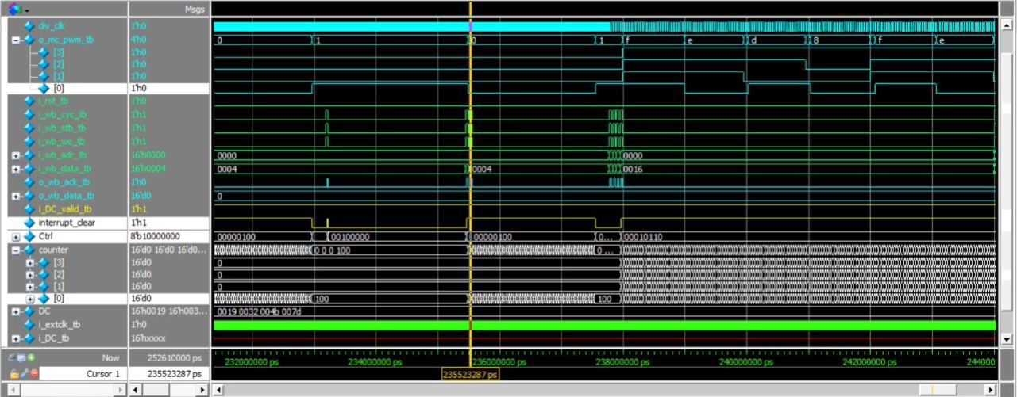
Timer Sim One shot with interrupt clear

Slide 24
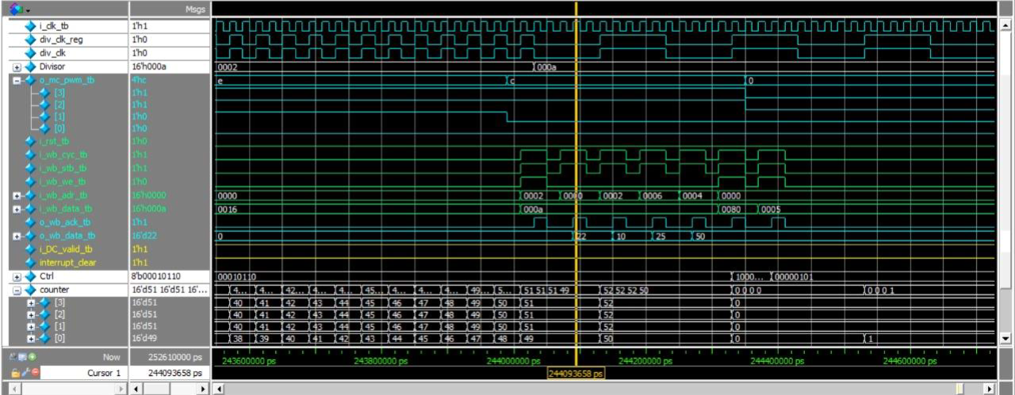
Simulation of Divissor_Sim divsor = 2 and 10

Slide 25
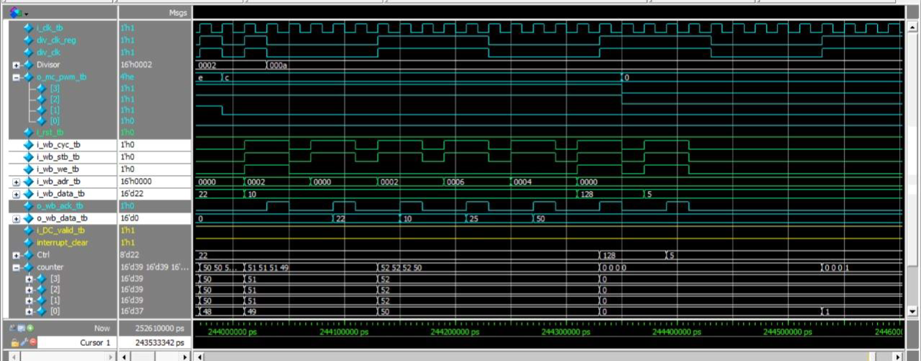
Simulation of Wishbone interface, read write

Slide 26
Thank you
Digitrons

