Slide 1

Why Continuous Delivery ?

Slide 2
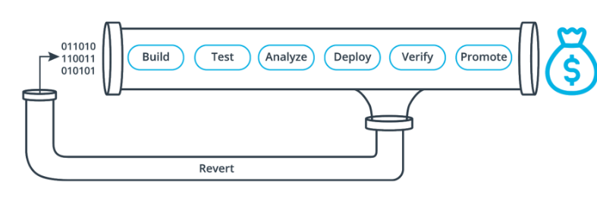
Continuous Delivery
Cont. Delivery = Cont. Integration + Cont. Deployment
CI/CD Stages & Pipeline

Slide 3
Do you need CI/CD ?
Investing more time in a release cycle than delivering value
Going through integration hell every time you finish a feature
Code gets lost because of botched merges
Unit test suite hasn't been green in ages
Deployments contribute to schedule slip
Friction between ops and development departments
Only one engineer can deploy a system
Deployments are not cause for celebration

Slide 4
CD Facts
LESS
Bugs in production
Time in testing
Human error
Time to market
Downtime from deploy-related crash/bug
Costs from unused resources

Slide 5
CD Benefits
Fundamental Cost Reduction
Extra Cost avoidance
Revenue Protection
Revenue Increase
Customer Satisfaction Increase

Slide 6
Thank you

