Slide 1
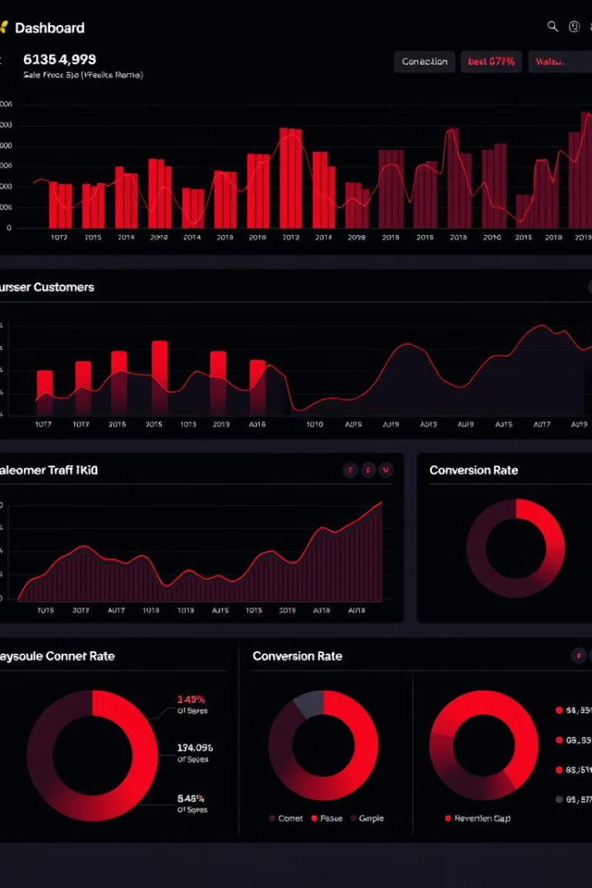
Employee Insights Dashboard
An interactive dashboard built with Python and Streamlit to explore workforce trends, technical preferences, and compensation benchmarks using survey data.

Slide 2




Project Foundation: Data and Tools
Cleaned CSV Data
Python Ecosystem
Key Purpose
Analyze demographics, tech, and salary
Employee responses for analysis
Streamlit, Seaborn, Matplotlib, Pandas
Our project leverages a robust dataset of employee responses, processed and analyzed using the powerful Python ecosystem, including Streamlit for interactivity, and Seaborn/Matplotlib for compelling visualizations. This setup allows us to precisely analyze demographic trends, technology adoption, and salary distributions across the workforce.

Slide 3

Project Overview-:
The goal of this project was to build an Employee Insights Dashboard that provides a comprehensive analysis of workforce data collected between 2018 and 2020.
We focused on exploring key employee attributes such as job titles, locations, salaries, technologies used, and seniority levels to uncover trends and patterns.
The process involved:
Data cleaning and preprocessing to handle missing values and standardize formats.
Merging multiple datasets to create a unified view of the employee data.
Using advanced visualizations to present insights in an intuitive and interactive way, enabling stakeholders to make informed decisions about talent management, compensation, and technology adoption.

Slide 4
About the Data Our dataset contains information about employees collected between 2018 and 2020. It includes various features such as:
Job Titles
Cities
Yearly Salaries
Main Technologies Used
Seniority Levels (e.g., Junior, Middle, Senior)
Gender
Age
This data provides valuable insights into employee demographics, technology preferences, and compensation trends across different positions and locations.

Slide 5
After collecting the raw data, we performed a thorough data cleaning process to ensure accuracy and consistency. The main steps included:
Correcting date formats and standardizing all date-related fields for uniformity.
Remove Duplicate
Calculating key statistical metrics such as average age, total years of experience, and average salary to better understand the overall workforce profile.
Handling missing values in numeric columns by replacing them with the average values of their respective fields, ensuring no important data was lost.
For missing values in textual fields, we replaced them with the placeholder "No Data" to clearly indicate absence of information without causing errors during analysis.
This cleaning process helped us improve data quality and prepared the dataset for meaningful analysis and visualization.

Slide 6
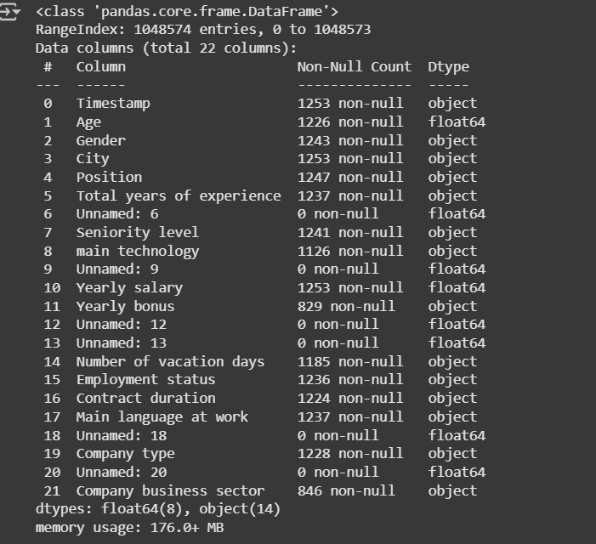
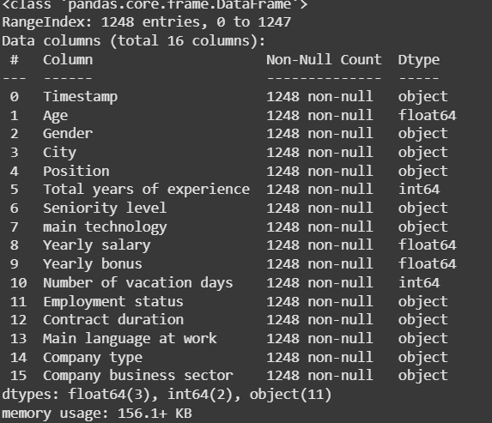
Before Cleaning
After Cleaning

Slide 7
Data Merging (Appending)
After cleaning the data, the next step was to append multiple datasets into a single consolidated dataset. To ensure a smooth and accurate merge, we followed these important rules:
The datasets to be appended must have the same number of columns.
The columns must be in the same order across all datasets.
Each column must have the same data type and format to avoid inconsistencies.
By strictly adhering to these conditions, we ensured that the merged dataset maintained integrity and was ready for further analysis and visualization.

Slide 8
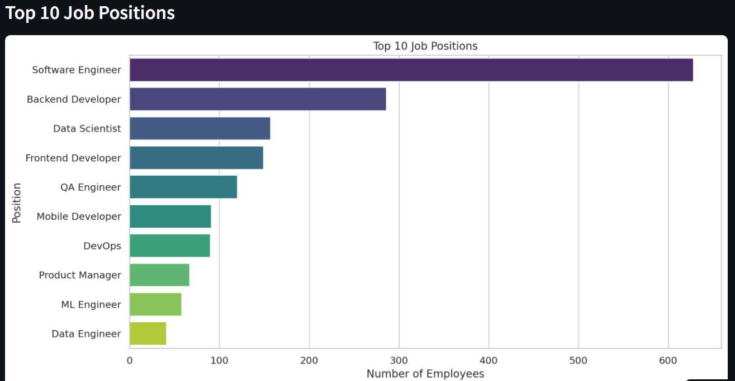
Simple for Exploratory Data Analysis (EDA)
Exploratory Data Analysis (EDA) was conducted to uncover key patterns in the workforce data. One of the first analyses focused on identifying the Top 10 Most Common Job Positions across the dataset.
This helped us understand:
Which roles are most in demand
How frequently each position appears
The diversity of job titles in the tech industry
These early insights guided the structure of the dashboard and selection of relevant filters for job roles.

Slide 9
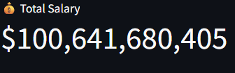
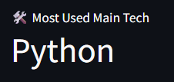
Simple for Streamlit Card Dashboard
Two main cards were included in the dashboard:
Total Sales: Displays the overall salary sum or average, giving a quick snapshot of the financial scale of the data.
Most Common City: Highlights the city with the highest number of job entries, helping users understand where most tech roles are concentrated.

Slide 10
Next Steps & Improvements-:
Real-Time Data Integration: Connect to live databases or APIs for continuously updated salary and employment data.
Predictive Analytics: Use machine learning models to forecast salary trends and demand for specific roles or skills.
Mobile-Friendly Interface: Optimize the dashboard layout for smartphones and tablets to increase accessibility.

