Slide 1

GenAI for Education Hackathon 2026
Automated Adversarial Architecture Review Platform
ARCHGUARD AI

Slide 2
this presentation was made possible by,
CSE 332s – SOFTWARE ENGINEERING
NAME
Mohamed Ibrahim El-Noby
Walaa Omar Hassan
Mariam Tarek Hamada
Malak Adel Fouad
Rahma Mohamed Sayed

Slide 3
PROBLEM
• Late Discovery
Architectural flaws are often discovered after significant development effort.
• Evaluation Gap
Students lack an interactive environment to stress-test their architecture before the final defense.
• Manual Bottlenecks
Architecture reviews depend on limited expert time and may miss cross-functional risks.
• Static Feedback
Traditional reviews provide feedback, but rarely challenge the designer interactively.
ARCHITECTURE
DEVELOPMENT
HIDDEN FLAW
LATE DISCOVERY
EXPENSIVE FIX

Slide 4
OUR SOLUTION
• The Concept
An AI-powered platform that simulates an adversarial technical architecture review board.
• Visual Intelligence
AI analyzes uploaded architecture diagrams and extracts system components and connections.
• Multi-Agent Review
Specialized AI agents challenge the architecture from security, reliability, and cost perspectives.
• Active Defense
Students must defend their engineering decisions and respond to critical questions.
ARCHGUARD AI
CYBERSEC
SRE
FINOPS
STUDENT DEFENSE
IMPROVED ARCHITECTURE

Slide 5
HOW IT WORKS
01 UPLOAD
Architecture Diagram / ERD
05 REPAIR
AI generates an improved architecture
02 ANALYZE
Multimodal AI extracts the architecture
03 DEBATE
Specialized AI agents challenge the design
04 DEFEND
The student responds to critical questions

Slide 6
AI AGENT JURY
CYBERSEC AGENT
Focuses on:
• Authentication
• Attack Surface
• Network Exposure
• Data Protection
FINOPS AGENT
Focuses on:
• Resource Efficiency
• Over-Provisioning
• Scaling Costs
• Infrastructure Waste
SRE AGENT
Focuses on:
• Availability
• Scalability
• Single Points of Failure
• Disaster Recovery
ARCHITECTURE
CYBERSEC
FINOPS
SRE
MULTI-AGENT DEBATE
Each agent challenges the architecture from a different engineering perspective.
AI DEBATE
TOP RISKS

Slide 7
DEFENSE ARENA
• Critical Question
The system identifies the most important architectural weakness.
• Student Defense
The student explains how the identified risk should be mitigated.
• Adaptive Follow-Up
AI challenges the student's reasoning with follow-up questions.
• Technical Evaluation
The response is evaluated for risk understanding, mitigation quality, and engineering trade-offs.
AI JURY
Why did you choose a single database without replication?
STUDENT
Because the project is small and has limited traffic.
AI FOLLOW-UP
How would your design behave if the database becomes unavailable?

Slide 8
EVALUATION & CORRECTION
BEFORE
AFTER
Load Balancer
Frontend
Backend 1
Backend 2
Backend
Database
Database + Replica
SINGLE POINT OF FAILURE
IMPROVED RESILIENCE

Slide 9
FINAL OUTPUT
Risk Assessment
Engineering Feedback
Defense Score
Improved Architecture

Slide 10
TECHNICAL ARCHITECTURE
USER
Frontend: React + Tailwind CSS
Backend: FastAPI + Python
AI Engine: Google Gemini
Agent Orchestration: LangGraph
Database: SQLite / PostgreSQL
REACT / FRONTEND
FASTAPI
GEMINI VISION
AI AGENTS
CYBERSEC
FINOPS
SRE
DATABASE LAYER
STRUCTURED JSON
SQLite / PostgreSQL

Slide 11
IMPACT & CONCLUSION
• Proactive
Finds architectural risks before deployment.
• Adversarial
AI agents actively challenge design decisions instead of simply describing them.
• Interactive
Students must defend their engineering decisions.
• Generative
The system proposes an improved architecture, not just a list of problems.
DON'T JUST REVIEW
YOUR ARCHITECTURE.
ATTACK IT.
ARCHGUARD AI

Slide 12
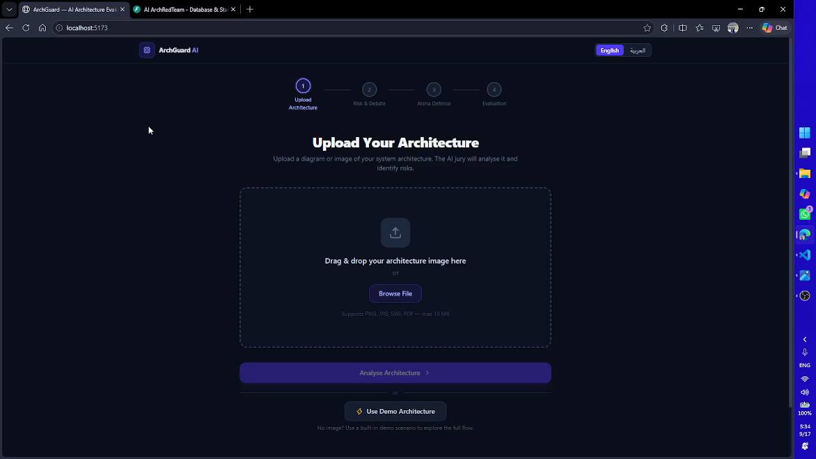
Time to Defend: Live Demonstration

Slide 13
THANK YOU
DON'T JUST REVIEW YOUR ARCHITECTURE.
ATTACK IT.
Click (GitHub) to go to project

