Slide 1
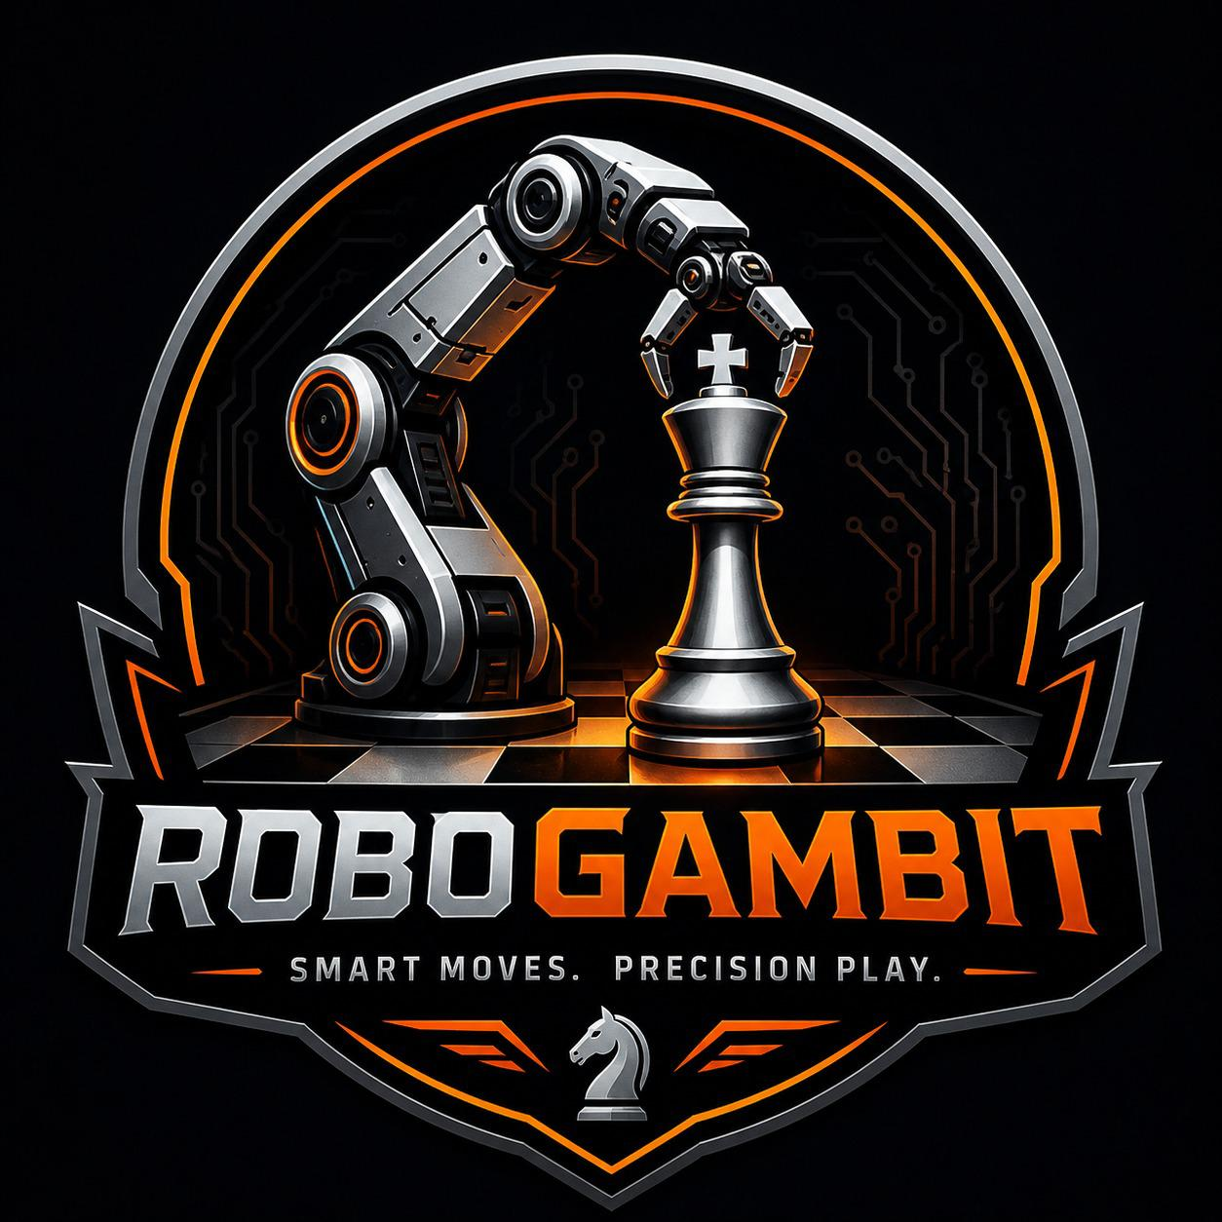
ROBOGAMBIT
Smart Moves. Precision Play.
AI Chess Robot • Computer Vision • ROS 2 • PySide6 GUI
Intelligent Robotics Course — Final Project

Slide 2



What is RoboGambit?
A robot that plays chess on a real board.
SEE
Camera + OpenCV
A camera watches the game. Computer vision detects your move. Stockfish thinks. A 5-DOF robotic arm physically picks up and places the piece — while a polished GUI mirrors everything in real time.
THINK
Stockfish AI
MOVE
Robotic Arm

Slide 3



System Architecture
Modular pipeline. Loosely coupled. ROS 2 between layers.
Camera
GUI + Vision
AI Engine
ROS 2 Nodes
Robot Arm
DroidCam / USB
PySide6 + OpenCV
Stockfish
IK + Serial
Arduino + 5 Servos
Communication via ROS 2 topics: /robogambit/move → /nano_serial
🧩 Each layer can be swapped or tested independently
🔄 Standard ROS topics — easy to extend with feedback loops
💻 Same GUI works in fake-mode (no hardware) or real-mode

Slide 4
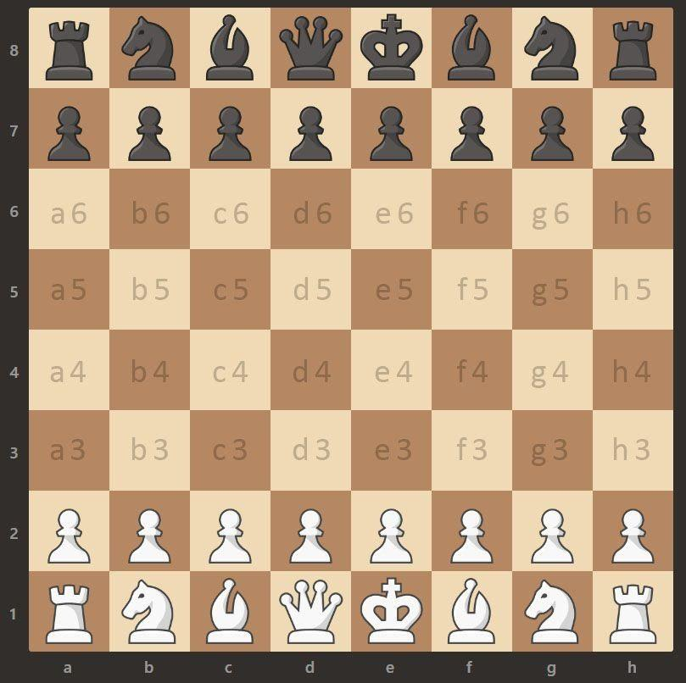


Computer Vision — Detecting Moves on a Real Board
Board Calibration
Frame Differencing
Click 4 corners → maps every chess square to a pixel polygon (sqdict.json).
Compare before/after frames → finds the 2 changed squares = your move.
Auto-Detect Mode
Live Preview
Motion-then-stillness state machine: just play, no buttons to click.
Camera feed embedded in the GUI — see exactly what the system sees.
64-square pixel calibration

Slide 5



AI Engine & Game Modes
Four Game Modes
Stockfish Engine
World-class chess engine integrated via python-chess
Three difficulty levels: Easy / Medium / Hard
Skill levels mapped to Stockfish skill setting
Smart move hints — toggleable per player
Full chess rule support: captures, castling, en passant, promotion
Move legality validation — invalid moves are gracefully rejected
Player vs AI (Robot)
Player vs AI
Real board, real arm
On-screen vs Stockfish
Player vs Player
AI vs AI Demo
Two humans + hints
Watch Stockfish self-play

Slide 6
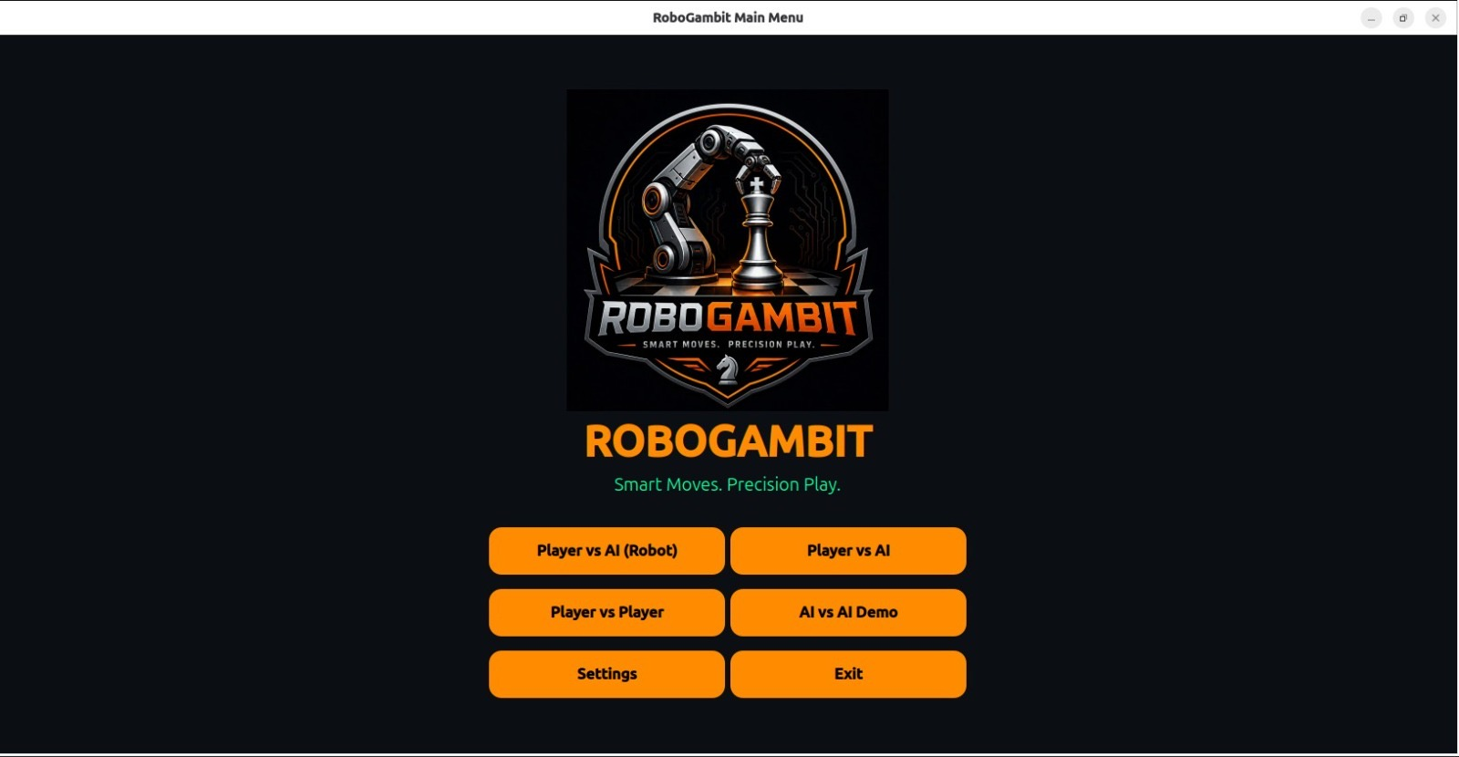
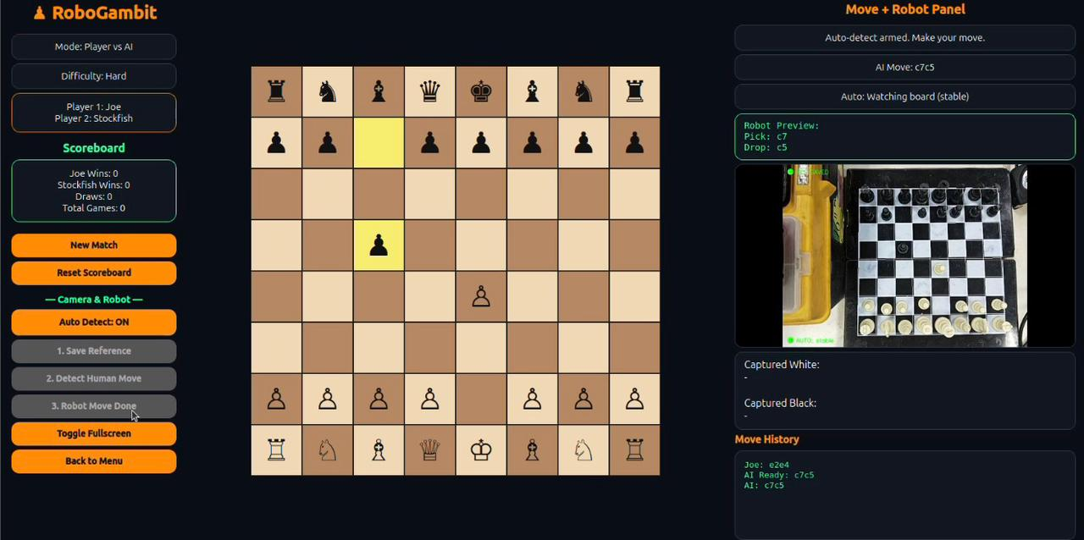
GUI Showcase
Built with PySide6 — dark theme, fullscreen, and live camera feed.
Main Menu
In-Game View
Game-mode selection with branded logo
Board + live camera + history + robot status
🎯 Capture highlighting
📜 Move history
🏆 Scoreboard
💡 Per-player hints
🖥 Fullscreen mode

Slide 7

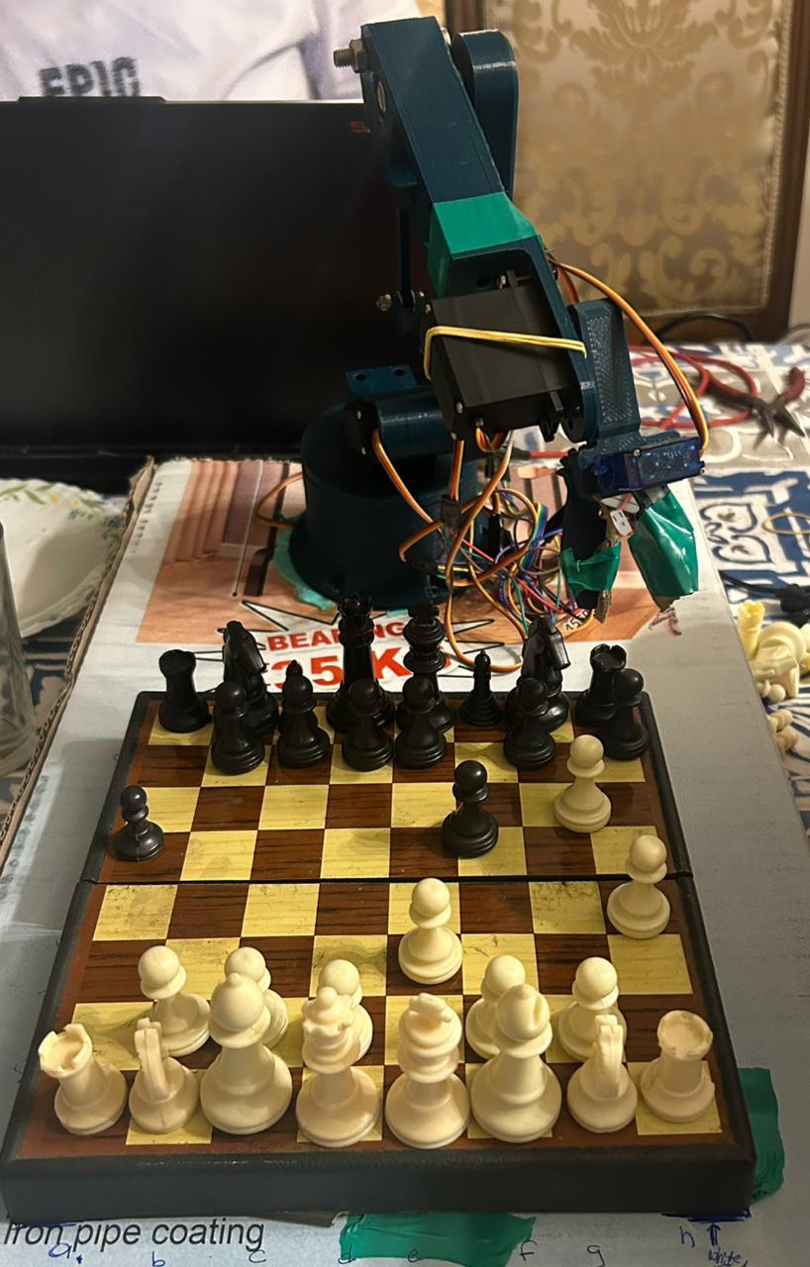
Hardware & Arduino Firmware
The Arm — 5 DOF
5 servos: base, shoulder, elbow, wrist, gripper
Arduino Nano controller (9600 baud serial)
External 5V supply for servo power rail
Smooth interpolated movement with per-servo limits
Single-command protocol: e.g. "S1 165\n" sets servo 1 to 165°
Two off-board zones for captured pieces (left / right)

Slide 8
ROS 2 Control Pipeline
From chess move to servo angles — three nodes, two topics, one robot.
1
GUI Publisher
main.py → robot/ros_robot.py
Publishes UCI move strings
/robogambit/move → "e2e4"
2
IK Translator Node
Calibrated lookup table per square
Chess square → servo commands
/nano_serial → "S2 140" · "S1 180"
3
Serial Bridge Node
Auto-detects Arduino by VID/PID
Forwards commands to Arduino over USB

Slide 9
The Team
Intelligent Robotics Course — Final Project
M
Mohamed Eldairouty
Y
Youssef Waleed
221001719
221000928
GUI • Vision • AI Integration
Computer Vision • Calibration
Z
Ziad Magdi
M
Mohamed Ossama
221010033
221003216
GUI Design • Game Logic
Hardware • ROS 2 • Firmware

Slide 10
SEE. THINK. MOVE.
Live demo coming up next.
♟ RoboGambit
Thank you • github.com/MohamedEldairouty/RoboGambit

