Slide 1
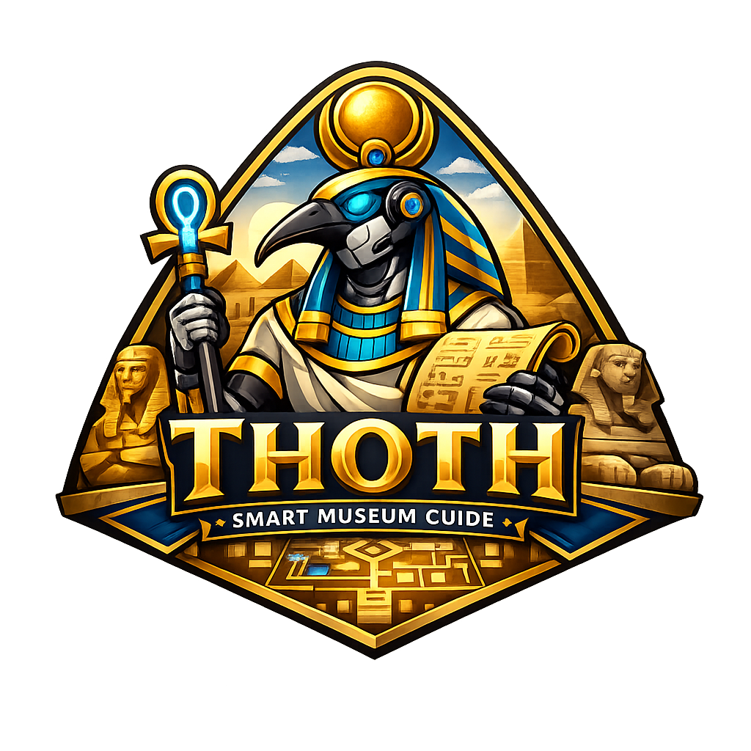
THOTH
Smart Museum Guide Robot
Graduation Project I — Final Presentation
Computer Engineering Department · AASTMT
Supervised by Dr. Marwa Elshenawy · Dr. Mohamed Elhabrouk
Presented by Leena Gouda – Nayrouz Ahmed – Habiba Ghoneim – Youssef Waleed – Saged Khaled – Mohamed Eldairouty
2026 - 2027
THOTH — Smart Museum Guide
01 / 00

Slide 2
01
Introduction
THOTH — Smart Museum Guide
02 / 00

Slide 3
Introduction
In its first month, the Grand Egyptian Museum became the third most-visited museum in the world — drawing up to 19,000 visitors a day.
About 45% of those visitors come from outside Egypt, often without a personal guide. Audio handsets play the same one-language script to a child and a researcher, can't answer a follow-up question, and leave international visitors without usable narration.
THOTH is an autonomous robot built for this gap: it walks visitors through the halls, talks with them in their own language, reads their mood to adjust how it speaks, and is accessible by design.
Autonomous Navigation
LLM Conversation
Mood + Age Awareness
Multilingual (EN · AR · FR …)
THOTH — Smart Museum Guide
03 / 00

Slide 4
02
Problem Statement
THOTH — Smart Museum Guide
04 / 00

Slide 5
Problem Statement
Not Enough Human Guides
Language Barriers
Museums can't staff a personal guide for every visitor. At peak hours most people walk through with no narration at all.
Tours run in one or two languages. International visitors get a leaflet and silence.
One Script for Everyone
Accessibility Gaps
Audio guides play the same monologue to a curious 9-year-old, a researcher, and a passing tourist.
Visitors who are deaf, blind, in wheelchairs, or non-native speakers are treated as edge cases, not as the default.
These are not minor inconveniences — they affect millions of museum visits every year.
THOTH — Smart Museum Guide
05 / 00

Slide 6
03
Aims & Objectives
THOTH — Smart Museum Guide
06 / 00

Slide 7
Aims & Objectives
01
Build an autonomous robot that navigates a real museum floor with live obstacle avoidance.
02
Hold a real conversation in English, Arabic, French, and more — by text or voice.
03
Read the visitor's mood and age in real time, and adjust tone and pace.
04
Ship a production-grade touchscreen web app: exhibit browsing, map, chat, settings.
05
Treat accessibility as default: captions, large fonts, audio narration, RTL support.
06
Design it customizable — one system, many venues: museums, airports, hospitals, expos.
THOTH — Smart Museum Guide
07 / 00

Slide 8
04
Literature Survey
THOTH — Smart Museum Guide
08 / 00

Slide 9
Literature Survey
System | Strengths | What It Lacks
Pepper (SoftBank) | Social interaction, multilingual touchscreen | No autonomous navigation in large halls
Cruzr (UBTECH) | Conversation, face recognition, mobility | General-purpose — not built for museums
CAPIO (Carnegie Mellon) | Museum tour scripts, speech interaction | No emotion detection, no personalization
InBot Museum Guide | Touchscreen tours, exhibit info | Fixed paths only, no real autonomy
No existing system combines autonomous navigation, conversational LLM, real-time mood / age recognition, and full multilingual support. THOTH does.
THOTH — Smart Museum Guide
09 / 00

Slide 10
05
Proposed Model
THOTH — Smart Museum Guide
10 / 00

Slide 11
System Architecture
Sensors & Hardware
LiDAR · RGB-D · Mic · Speaker
Web App
React · FastAPI · PostgreSQL
Navigation
ROS 2 · Nav2 · SLAM
Central Brain
Mini-PC
AI Conversation
Gemini LLM · Whisper · edge-tts
Power & Motors
DC motors · drivers · LiPo
Vision
OpenCV · DeepFace (mood + age)
THOTH — Smart Museum Guide
11 / 00

Slide 12
ROS 2 — Node & Topic Graph
ROS node
Process group
Runtime communication: sensing → Nav2 navigation → web-app docent stack
Topic (pub → sub)
LiDAR Driver
Camera
/scan
/image_raw
Nav2 Stack
Age Node
Mood Node
AMCL
Map Server
/age
/mood
Planner +
Controller
BT Navigator
/amcl_pose
Docent Stack
Web App + LLM
FastAPI · React · Gemini
Tour Coordinator
/goal_pose
/cmd_vel
Serial Node
Prompt Builder
"age + mood + exhibit"
Database /
Exhibit Loader
serial
Arduino + Motors
THOTH — Smart Museum Guide
12 / 00

Slide 13
Project I — What We Built
Six independent modules, all ready to integrate in Project II.
Full-Stack Web App
Conversational AI & Voice
Mood Recognition
Mohamed Abdallah Eldairouty
Leena Gouda
Nayrouz Ahmed
React + FastAPI + PostgreSQL. The integration layer that ties together the LLM chat, vision models (mood + age), navigation, and simulation map — one demoable system.
LLM pipeline (Gemini) + Whisper STT + edge-tts TTS. Multilingual in three languages, exhibit-aware prompts.
Real-time facial emotion recognition using OpenCV and a deep-learning model. Streams predictions to the robot brain.
Age Recognition
Simulation & Navigation
Hardware Prototype
Youssef Waleed
Saged Khaled & Youssef Waleed & Habiba Amr
Habiba Amr & Leena Gouda
Real-time age estimation from a single camera frame. Used to tune the robot's tone for kids vs. adults.
Full Gazebo museum environment and ROS 2 navigation stack — used to validate routes before hardware.
Working campus delivery robot — proves the base, motors, and control loop in real corridors.
THOTH — Smart Museum Guide
13 / 00

Slide 14
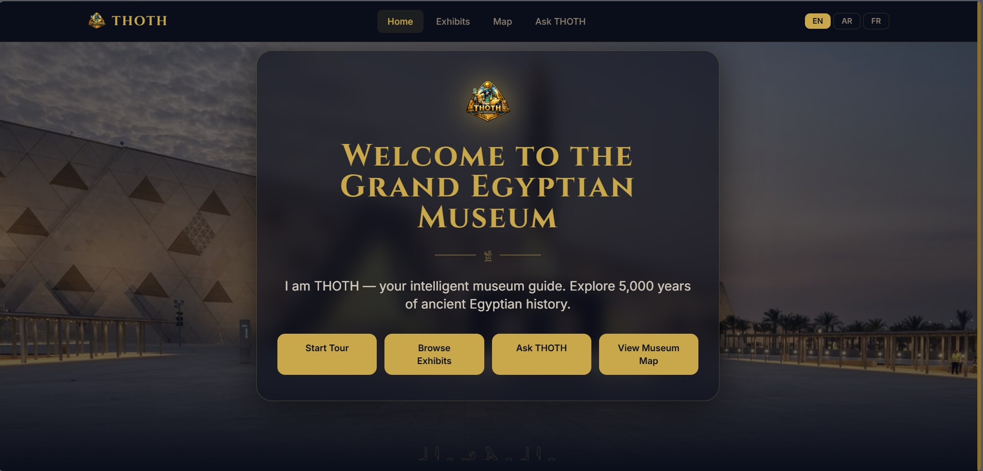
Touchscreen Web Application
Mohamed Abdallah Eldairouty - Full-Stack Web Application
The visitor's window into the museum.
Production-grade architecture, not a mock-up.
Same code runs on a kiosk, a phone, or the robot.
Multilingual content resolved server-side — frontend stays simple.
All AI calls go through the backend — easy to swap providers.
Wires the LLM chat to the vision models — THOTH adapts how it speaks to who's in front of it (mood + age).
Connects to the same ROS 2 navigation and simulation we built.
THOTH home page — running locally against the real backend.
THOTH — Smart Museum Guide
14 / 00

Slide 15
Web App — Architecture & Pages
Stack
Pages
Frontend
React · Vite · TypeScript · Tailwind
Home
Welcome, language switch, quick actions
API Layer
FastAPI · Pydantic
Exhibits
Search · filter by hall, era, category
Exhibit Detail
Story, media, audio narration, chat link
Service Layer
Business logic · AI orchestration
Museum Map
Live robot marker, route preview
Data Layer
SQLAlchemy · Alembic · PostgreSQL
Ask THOTH
Text + voice chat, plays back TTS reply
AI Services
Gemini · Whisper · edge-tts
Settings
Language, font size, captions, audio
THOTH — Smart Museum Guide
15 / 00

Slide 16
Speech Interaction Architecture
Leena Gouda - LLM · Speech-to-Text · Text-to-Speech
Every visitor interaction follows a fixed 3-stage pipeline:
Visitor Speaks → [STT] → [LLM] → [TTS] → Robot Speaks Back
Each stage feeds directly into the next — errors at any stage propagate forward
All three components share one critical requirement: strong Egyptian Arabic + English support
STT (Speech-to-Text): Converts the visitor's voice to text
LLM (Large Language Model): Understands the question and generates a response as a museum guide
TTS (Text-to-Speech): Converts the response to natural spoken audio
THOTH — Smart Museum Guide
16 / 00

Slide 17
Speech To Text (STT)
Leena Gouda - LLM · Speech-to-Text · Text-to-Speech
OpenAI Whisper Large V3
Why we chose it:
Free and open-source — no API costs, runs fully locally on-device
Supports 99+ languages including Egyptian colloquial Arabic dialect, not just Modern Standard Arabic
Automatically detects Arabic vs. English with no manual switching needed
Designed for noisy environments — critical for a busy museum with ambient sound
Runs offline — no internet dependency for this stage of the pipeline
THOTH — Smart Museum Guide
17 / 00

Slide 18
Speech To Text (STT)
Leena Gouda - LLM · Speech-to-Text · Text-to-Speech
Alternatives we evaluated and rejected:
Alternative | Why Rejected
Deepgram Nova-3 | Paid API, weak Arabic dialect documentation, no offline mode
Google Chirp 2 | Most expensive option ($16/1000 min), worst accuracy-to-cost ratio, cloud-only
AssemblyAI Universal-2 | Paid, Egyptian colloquial Arabic performance undocumented in literature
Azure Speech (cloud) | Paid, cloud-dependent, same concerns as Chirp 2
Facebook MMS | Not optimized for real-time interactive applications
Amazon Transcribe | No free tier for Arabic, limited dialect support
THOTH — Smart Museum Guide
18 / 00

Slide 19
Large Language Model (LLM)
Leena Gouda - LLM · Speech-to-Text · Text-to-Speech
Google Gemini 2.5 Flash
Why we chose it:
Arabic and English are both Tier-1 supported languages — not an afterthought
Understands mid-sentence code-switching (visitor mixes Arabic and English naturally)
Optimized for speed — responds in 1–2 seconds, essential for real-time conversation
Generous free tier: 1,500 requests/day — zero cost for development and dem
Behavior fully controllable through a system prompt that defines the robot's identity, language rules, answer length, and topic constraints
System prompt is: A fixed instruction block that wraps every visitor question — invisible to the visitor. It transforms a general AI into THOTH, a named museum guide that speaks the visitor's language, stays on topic, and keeps answers concise. This is how real-world AI applications are built — not by training new models, but by carefully instructing existing ones.
THOTH — Smart Museum Guide
19 / 00

Slide 20
Large Language Model (LLM)
Leena Gouda - LLM · Speech-to-Text · Text-to-Speech
Alternatives we evaluated and rejected:
Alternative | Why Rejected
GPT-4o | Paid API after free tier, higher cost per token, no advantage in Arabic over Gemini
Claude (Anthropic) | No substantial free tier for development, Arabic support less documented
Llama 3.1 8B (local) | Requires GPU to run at acceptable speed — not feasible on current hardware
Qwen3-235B | Far too large for any local deployment, impractical for this project stage
Jais 70B | Arabic-specialized but 70B parameters — impossible to run locally
THOTH — Smart Museum Guide
20 / 00

Slide 21
Text To Speech (TTS)
Leena Gouda - LLM · Speech-to-Text · Text-to-Speech
Microsoft Edge-TTS
Why we chose it:
Uses Microsoft's neural voice technology — natural-sounding, not robotic
Since Whisper already detected the visitor's language, Edge-TTS automatically picks the correct voice — no manual switching
THOTH — Smart Museum Guide
21 / 00

Slide 22
Large Language Model (LLM)
Leena Gouda - LLM · Speech-to-Text · Text-to-Speech
Alternatives we evaluated and rejected:
All free — no API costs for development or demos
All support Egyptian Arabic specifically — not generic Arabic
All modular — any component can be swapped independently in Phase 2 (e.g., replace Gemini with a local LLM once GPU hardware is available)
Alternative | Why Rejected
ElevenLabs Turbo v2.5 | Highest voice quality but paid after small free tier — not sustainable for a research prototype
Azure TTS (cloud API) | Paid after free credits, same neural voices as Edge-TTS but with added cost and cloud dependency
Fish Speech V1.5 | Good open-source option, but Egyptian Arabic voice quality not documented; Edge-TTS is more established
Google Cloud TTS | Paid, no dedicated Egyptian dialect voice
THOTH — Smart Museum Guide
22 / 00

Slide 23
Mood Recognition
Nayrouz Ahmed - Real-Time Facial Emotion Recognition
THOTH — Smart Museum Guide
23 / 00

Slide 24
Age Recognition
Youssef Waleed - Real-Time Age Estimation
THOTH — Smart Museum Guide
24 / 00

Slide 25
Simulation & Navigation
Saged Khaled · Youssef Waleed · Habiba Ghoneim - Gazebo, RS 2, Maps
Designed a custom 2D occupancy map and converted it into a 3D Gazebo Sim world using ROS 2 Nav2
Simulated TurtleBot3 robot operating within the same environment in Gazebo Sim
Utilized RViz2 for real-time visualization of robot poses, sensor data, and navigation states
Integrated the Nav2 navigation stack for autonomous path planning and obstacle avoidance
THOTH — Smart Museum Guide
25 / 00

Slide 26
Simulation & Navigation
Saged Khaled · Youssef Waleed · Habiba Ghoneim - Gazebo, RS 2, Maps
THOTH — Smart Museum Guide
26 / 00

Slide 27
Hardware Prototype
Habiba Ghoneim · Leena Gouda - Campus Delivery Robot
THOTH — Smart Museum Guide
27 / 00

Slide 28
06
Business Model
THOTH — Smart Museum Guide
28 / 00

Slide 29
Business Model
Value Proposition · An always-on multilingual guide that adapts to every visitor — built for museums, but ready to serve airports, hospitals, malls, campuses, and expos with the same platform.
Revenue Streams
Target Customers
Per-museum licensing (annual)
Maintenance & support contract
Premium exhibit content packs
Visitor analytics dashboard
Museums & heritage sites (primary — GEM)
Airports & metro stations
Academic & medical campuses
Expos, malls & smart-city installations
Cost Structure
Channels
Per-venue licensing (annual)
Custom domain pack (museum / airport / hospital / retail)
Maintenance & support contract
Visitor analytics dashboard
Government & tourism partnerships
Trade fairs & tech expos
Pilot deployments per industry
Direct B2B sales
THOTH — Smart Museum Guide
29 / 00

Slide 30
07
Gantt Chart
THOTH — Smart Museum Guide
30 / 00

Slide 31
Project Timeline — Grad I & Grad II
Work across 12 months — Grad I delivered Feb–May, Grad II runs Jun–Jan.
Grad I
Grad II
Feb
Mar
Apr
May
Jun
Jul
Aug
Sep
Oct
Nov
Dec
Jan
Research & Lit Survey
Web App (Grad I)
AI / Voice (Grad I)
Vision (Mood + Age)
Sim & Navigation
Hardware Assembly
Full Integration
Testing in Museum
Final Demo
Completed (Grad I)
In Progress
Planned (Grad II)
THOTH — Smart Museum Guide
31 / 00

Slide 32
Thank You
THOTH — Smart Museum Guide Robot
Questions & Discussion
github.com/MohamedEldairouty/THOTH
THOTH — Smart Museum Guide
32 / 00

