Slide 1
MLTICLASSIFICATION
GrapeLeaves_trasfer_learning

Slide 2


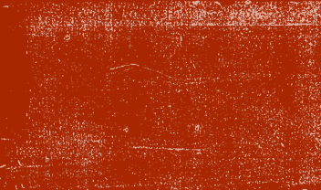
مبادرة ألف مهندس ذكاء اصطناعي التعلم العميق
Group members:
Mohamed Eslam Abdel-Rahman
Abdullh Hsn Agah
Supervised by Dr. Hesham Asem

Slide 3
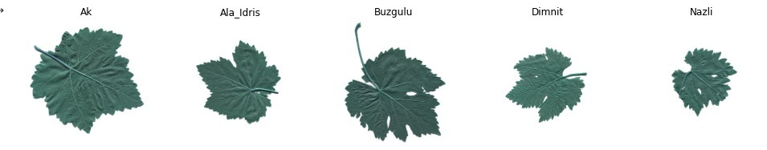
INTRODUCTION

Slide 4

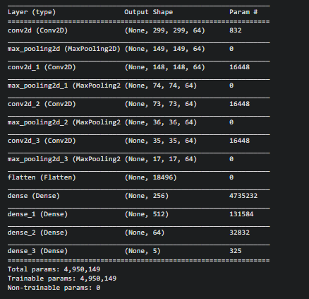
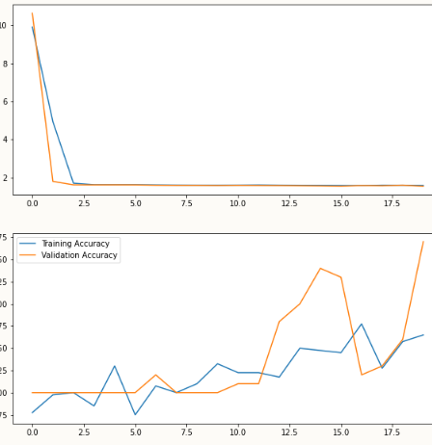
CNN

Slide 5
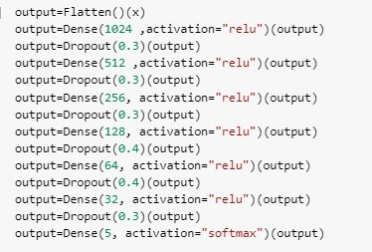
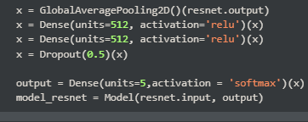


TRANSFER LEARNING
ResNet50
Structure:
Freezing: the last layers
MobileNet:
Structure:
Freezing:

Slide 6
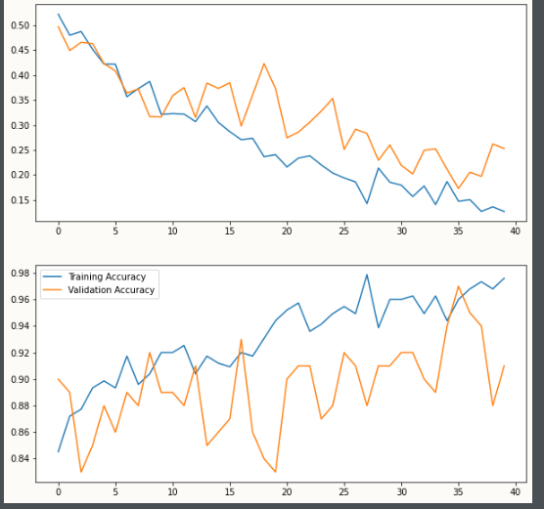
RESNET50
- Train_accuracy : 0.9760
val_accuracy : 0.9100
- Test_ accuracy : 0.8800
When Changing the epoch form
30 🡪35 🡪 40:
Train_acc : 84🡪85 🡪97
val_acc : 84-🡪84🡪 91
test_acc : 79🡪80🡪 88 .

Slide 7
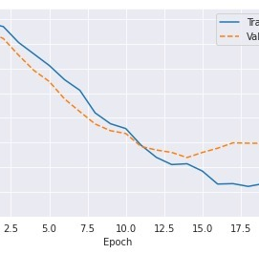
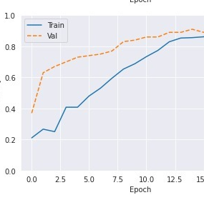
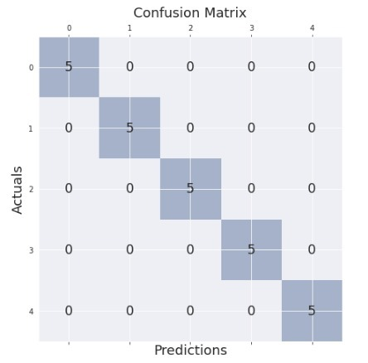
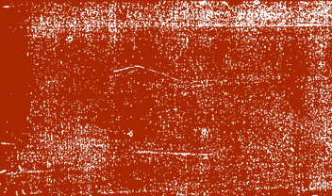
MOBILENET

Slide 8
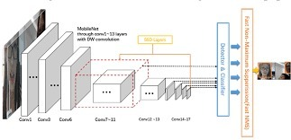
MOBILNET

Slide 9
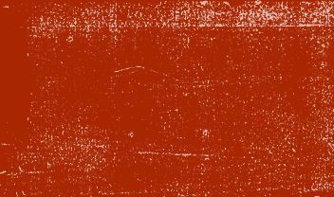
CONCLUSION
When increasing the epochs the accuracy increased.
Some pre-trained model give high bias with this data like Inception Model.
When trying to train the models in the same Augmented data the accuracy was bad .by scearcing find that each pre-trained model need to augment by its roles.
Project link:Notebook_link

Slide 10


