Slide 1
OOP

Slide 2
Prototype
every javascript object has an internal property called [[prototypell.
the prototype object is used to define properties and methods that should be shared among all instances of a constructor function.

Slide 3

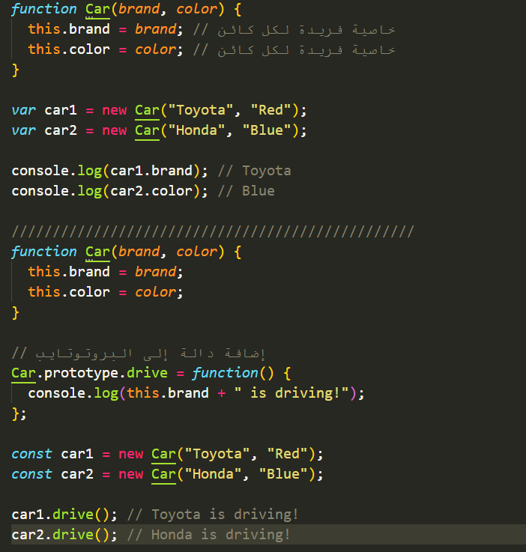
Prototype in Constructor Functions
when you create a constructor function, its prototype property is automatically set to an object where you can define methods and properties. these will then be shared by all objects created with that constructor.
Example:

Slide 4
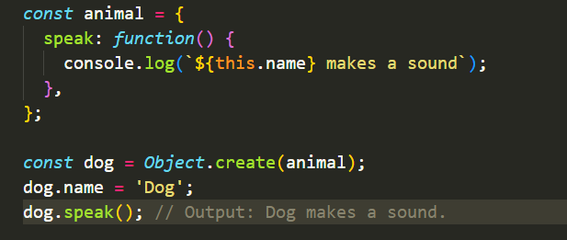
object .create
you can manually create an object with a specified prototype usingobject.create()
example:

Slide 5
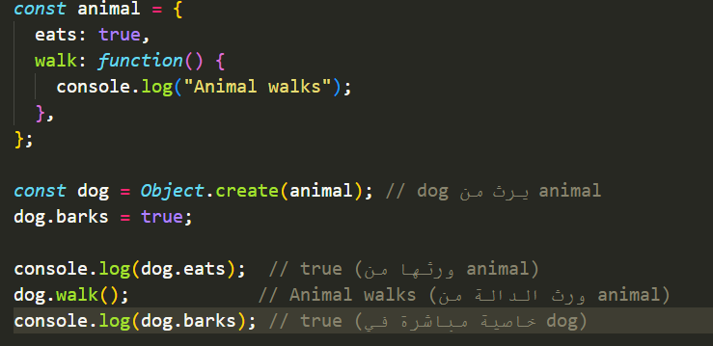
Prototype Chain
when you try to access a property or method on an object:
javascript first checks the object itself.
if it doesn't find it, it checks the object's prototype.
this process continues up the prototype chain untilobject.prototype is reached or the property/method is found.
example :

Slide 6
Advantages of Prototype
memory efficiency: methods are shared among instances rather than being duplicated.
inheritance: allows objects to share behavior through prototype chaining.

Slide 7
inheritance
What is Inheritance?
A programming concept where an object can inherit properties and methods from another object.
Goals of Using Inheritance:
1. Code Reusability: Avoid writing the same code multiple times.
2. Code Organization: Divide tasks between objects in an organized way.
3. Extend Functionality: Create new objects based on existing ones, adding new features.

Slide 8
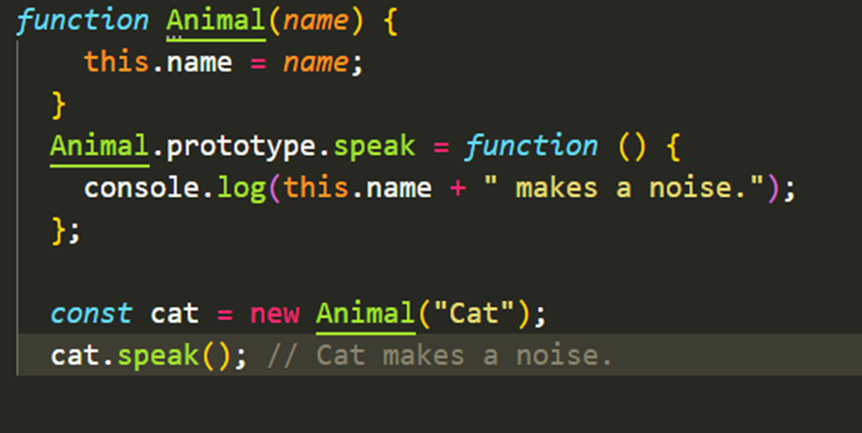
Prototypal Inheritance
n JavaScript, inheritance is implemented using Prototypal Inheritance.
Every object has a hidden [[Prototype]] property that points to another object.
If JavaScript doesn’t find a property in the object itself, it searches the prototype chain.
Example

Slide 9
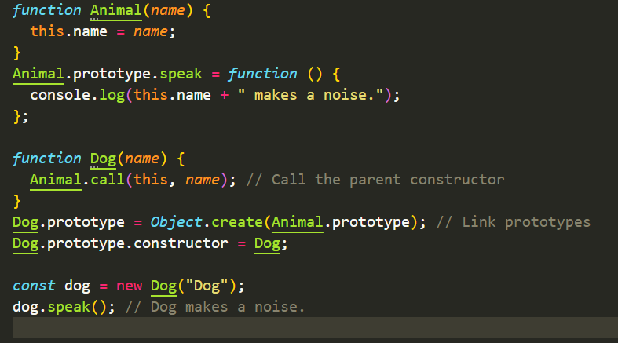
Inheritance Using Constructor Functions
how to implement inheritance using constructor functions:
inherit properties using call.
inherit methods using object.create.
Example:

Slide 10
Encapsulation
in javascript is a concept that involves bundling data (attributes) and the methods (functions) that operate on that data into a single unit, known as an object.
this bundling restricts direct access to some of the object's components, preventing unintended interference and misuse.
.encapsulation helps in organizing and managing the complexity of code and promotes the principle of data hiding, where the internal details of an object are hidden from external code.

Slide 11


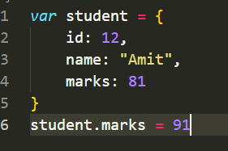
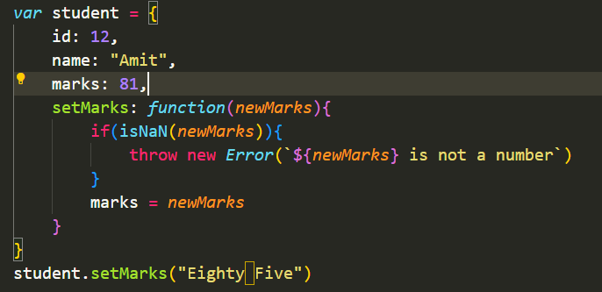
How we can apply Encapsulation
1.
2.

Slide 12
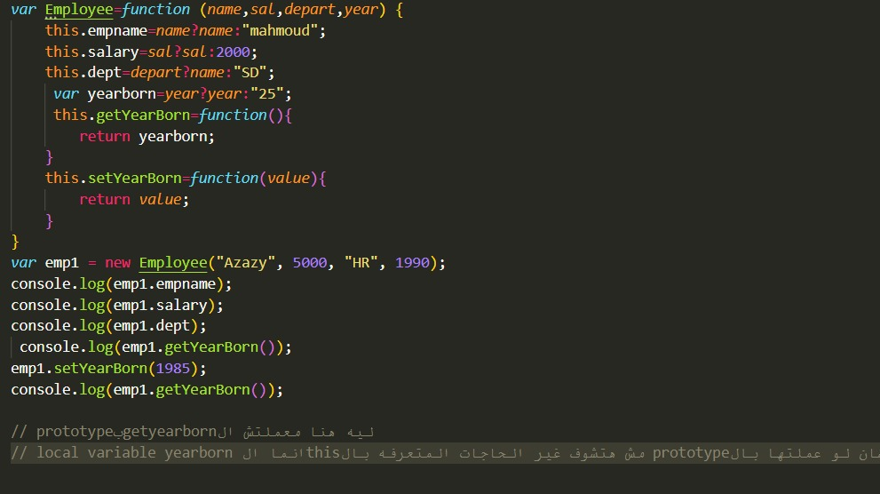

Slide 13
Polymorphism
allows objects or functions to take on multiple forms by sharing common interfaces or adapting behavior dynamically.
Focus:
method overriding: redefining methods in derived objects.
method overloading: simulating multiple methods with the same name (not directly supported in javascript).

Slide 14
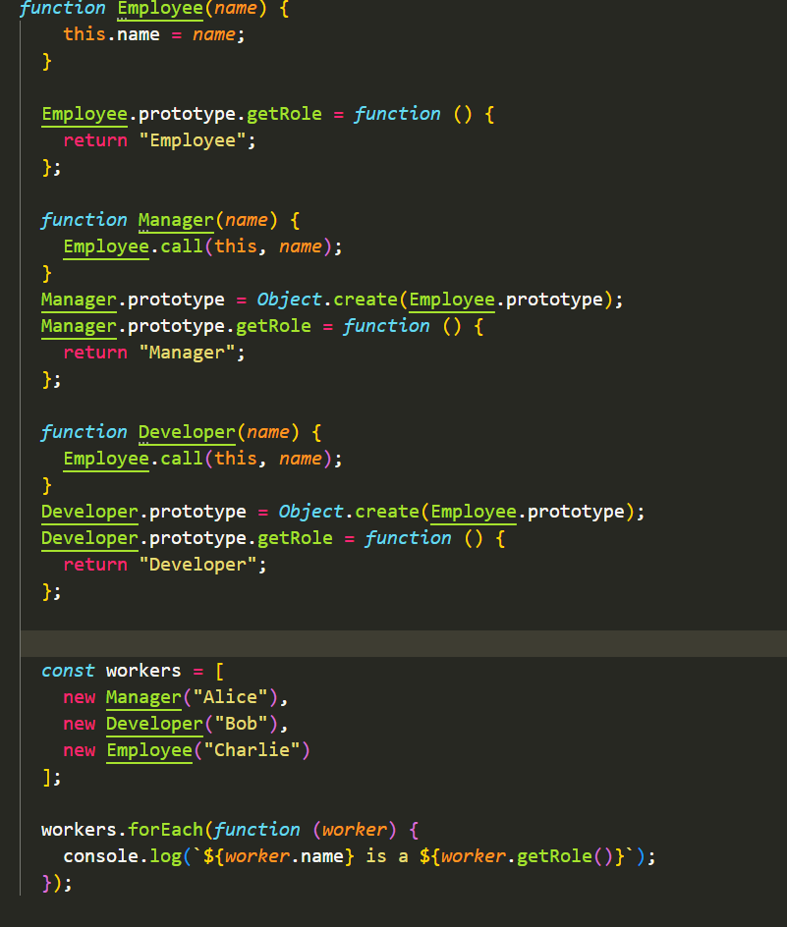
Method Overriding
A child object or constructor redefines a method inherited from a parent object.
Key Points:
Enables specific behavior in derived objects.
Dynamic method resolution occurs at runtime.
Example:

Slide 15
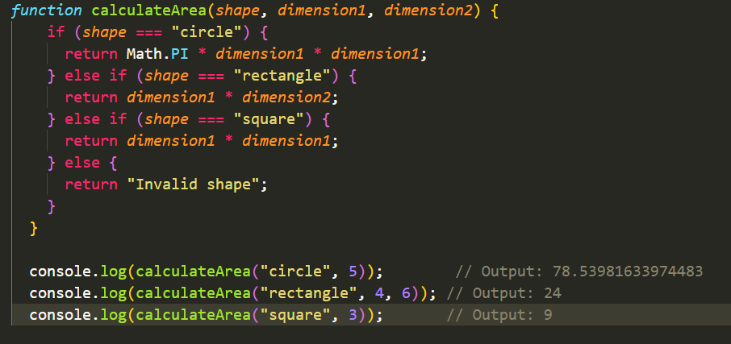
Method Overloading
method overloading means creating multiple methods with the same name but different parameters.
Example:

Slide 16
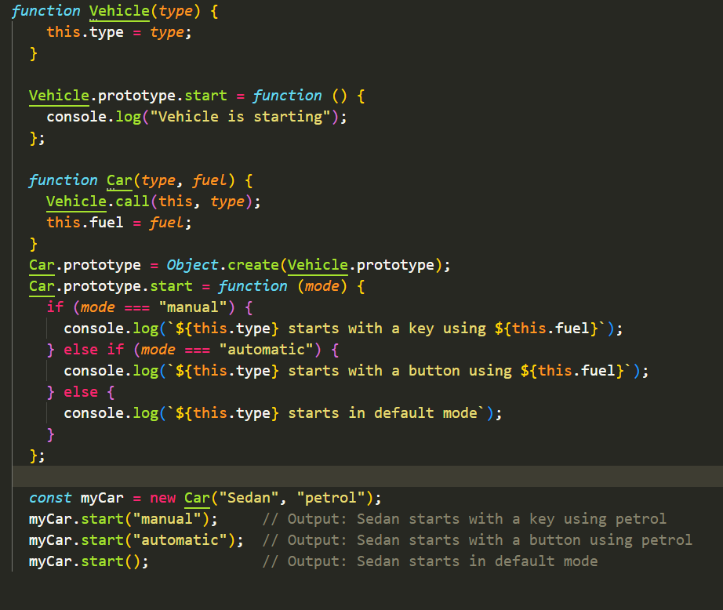
Combining Override and Overload

Slide 17
abstraction
abstraction in oop is the process of hiding implementation details and exposing only essential functionality.
Importance
simplifies code by showing only what is necessary.
improves maintainability and reduces complexity.
focuses on "what" an object does rather than "how" it does it.
increase security of code

Slide 18
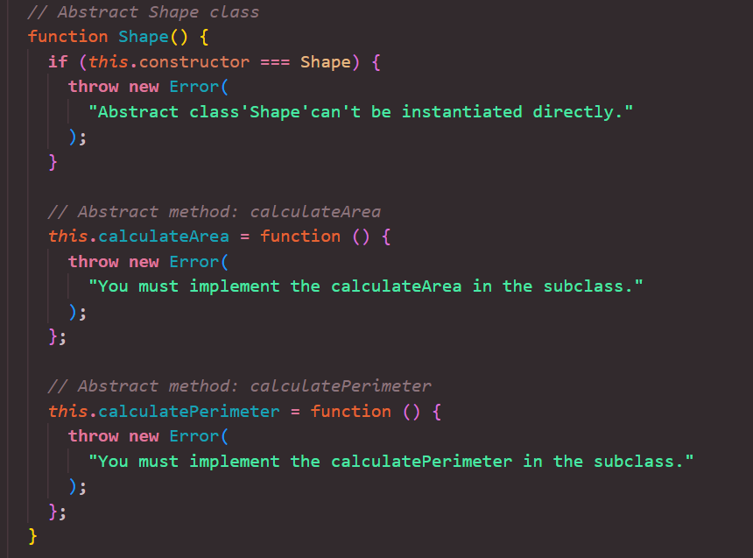
How can we apply Abstraction
Use an error in the constructor to prevent direct instantiation.
Methods in an abstract class that must be implemented by child classes

Slide 19
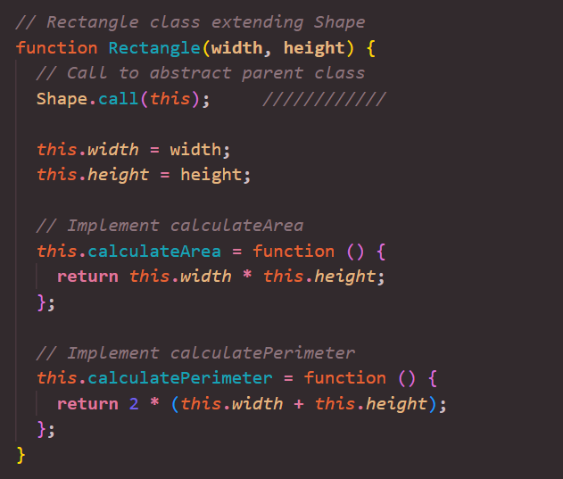

Slide 20
