Slide 1
Smart Attendance and Lecture Management System
Documentation of the system for automated attendance tracking and lecture management in a university environment using AI-powered facial recognition.

Slide 2


System Overview
This is a mobile application designed to streamline university lecture management and attendance tracking for students and professors.
Mobile-Based Application
AI-Powered Attendance Automation
Comprehensive Lecture Management
Flexible and portable user interface for quick access.
Eliminates manual roll call and provides accurate, real-time records.
Tools for course scheduling, content management, and reporting.
This prototype version runs the backend locally and uses ngrok to expose it publicly over HTTPS, allowing the Flutter mobile app on physical devices to connect seamlessly to the local server for end-to-end testing with a small dataset .

Slide 3
Technical System Architecture
Technologies used to power the initial system, focusing on seamless integration between components.
Mobile Application
User interface for registration, face enrollment, login, and attendance viewing.
Flutter
Backend API
Handles authentication, data processing, AI orchestration, and database operations.
FastAPI (Python)
Database
Stores users, embeddings, courses, lectures, and attendance records.
PostgreSQL
AI Module
Face detection, embedding generation, and matching.
InsightFace, OpenCV
Local Testing
Backend exposed via ngrok for mobile connectivity.
Uvicorn + pyngrok

Slide 4
Key User Roles and Features
The system supports two main roles, each with a set of features designed to simplify their interaction with the system.
Students
Doctors (Professors)
Registration and Face Enrollment: Register using university email and capture 5 facial images (different angles and lighting).
Course and Lecture Management: Register courses and schedule lectures.
Automated Attendance Reports: Receive instant reports after each lecture.
Attendance Tracking: Securely review personal attendance records.
Engagement Statistics: Overview of student statistics and engagement.

Slide 5
Technical Pillar: AI Module
The AI module is the core innovation driving attendance automation.
Image Processing
Face Detection and Embedding Generation
Images uploaded from the mobile application are processed through the backend.
Faces are detected using InsightFace/OpenCV, and embedding vectors (Embeddings) are generated.
Embedding Matching
Attendance Confirmation
Cosine Similarity matching is performed against stored vectors.
Attendance is automatically recorded based on exceeding defined similarity thresholds.

Slide 6
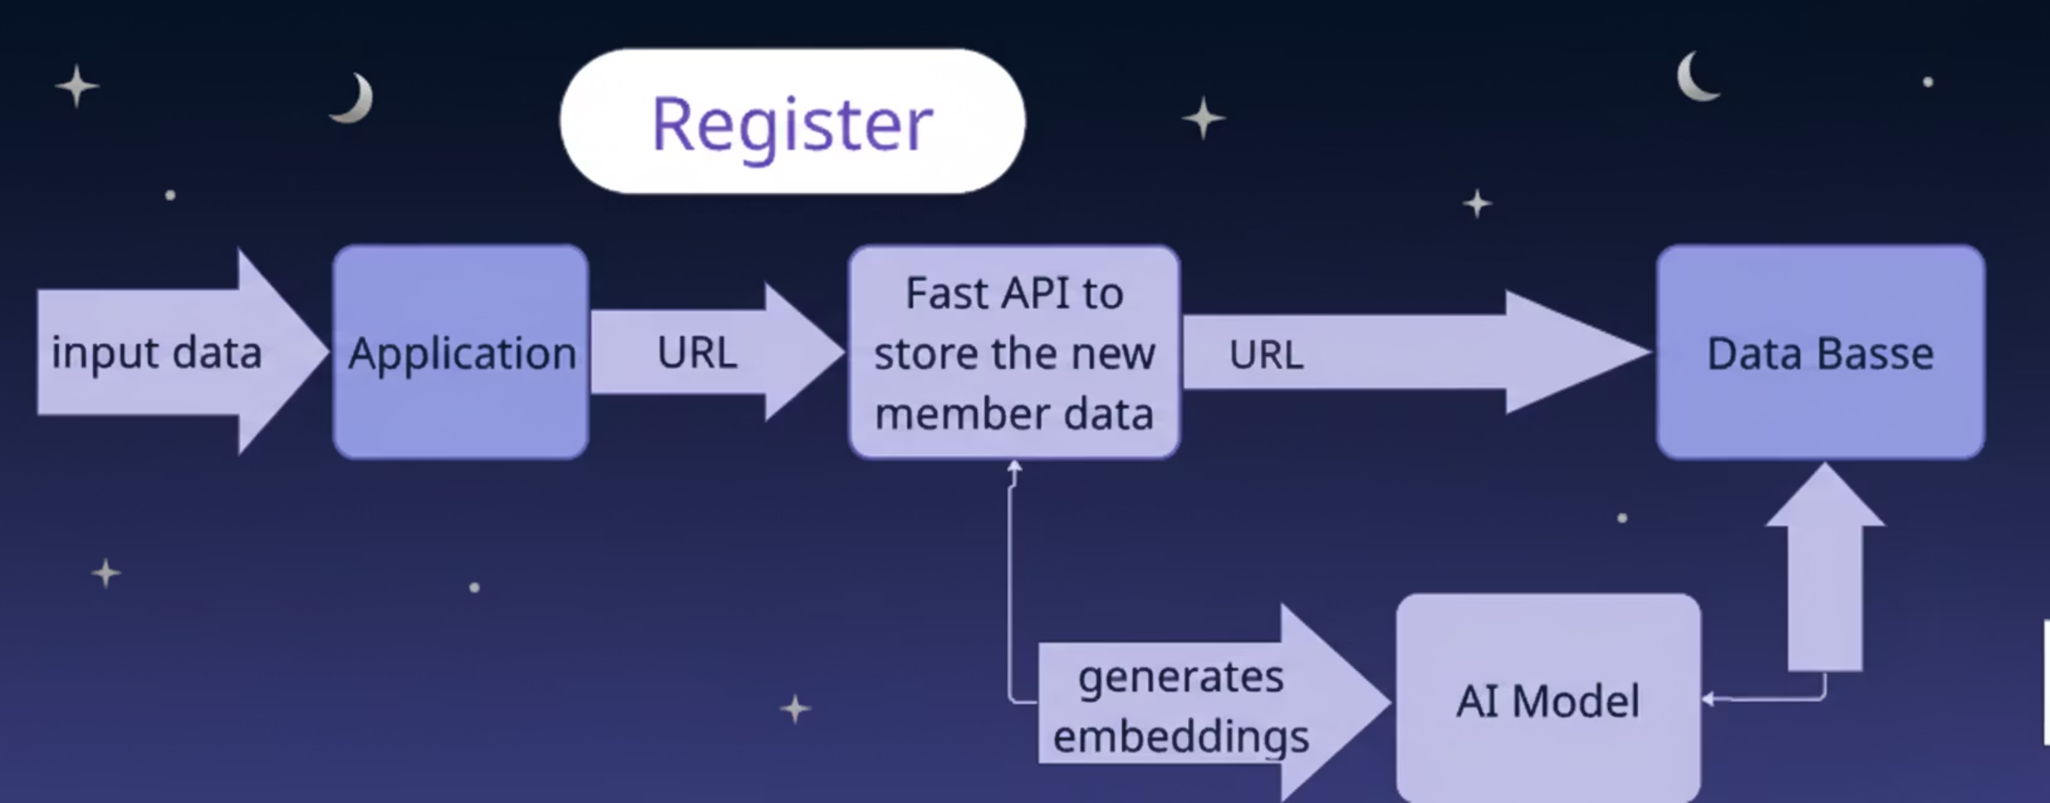
Detailed Data Flow: Registering

Slide 7

Detailed Data Flow: Face Enrollment
Steps to convert captured images into embedding vectors usable in the database.
Capture Images
The mobile application captures 5 face images (from different angles).
Convert to Base64
Images are converted to Base64 strings for sending via POST /enroll.
Decode and Process
AI Module decodes Base64 using OpenCV in the backend.
Generate Embeddings
InsightFace is used to generate embedding vectors for each image.
Store Data
Embeddings are converted to JSON strings and stored in the embeddings table linked to user_id.

Slide 8
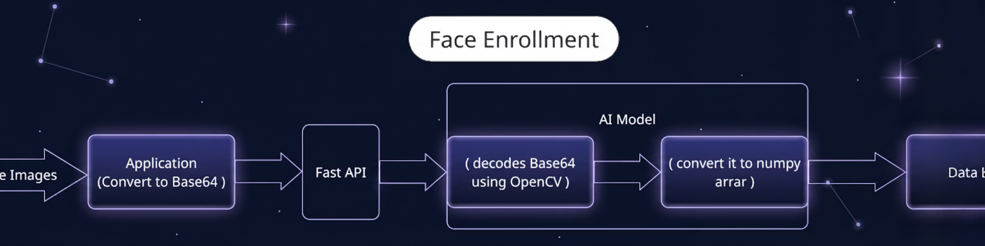

Slide 9
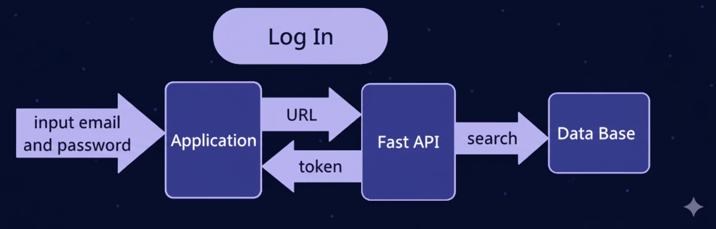
Detailed Data Flow: Login

Slide 10


Detailed Data Flow: Taking Attendance
A step-by-step process outlining how the attendance system operates.
2. Activate Live Camera
1. Log in to Application
Upon successful login, the doctor presses a trigger within the application to activate the live camera feed, preparing for capture.
The doctor logs into the attendance tracking system via the dedicated application, authenticating their credentials.
4. Record Attendance in Database
3. Capture Images and Process Attendance
The processed attendance data, including identified individuals and their attendance status, is securely stored in the central database.
The application captures images from the live camera. These images are then processed to identify individuals and record attendance.

Slide 11
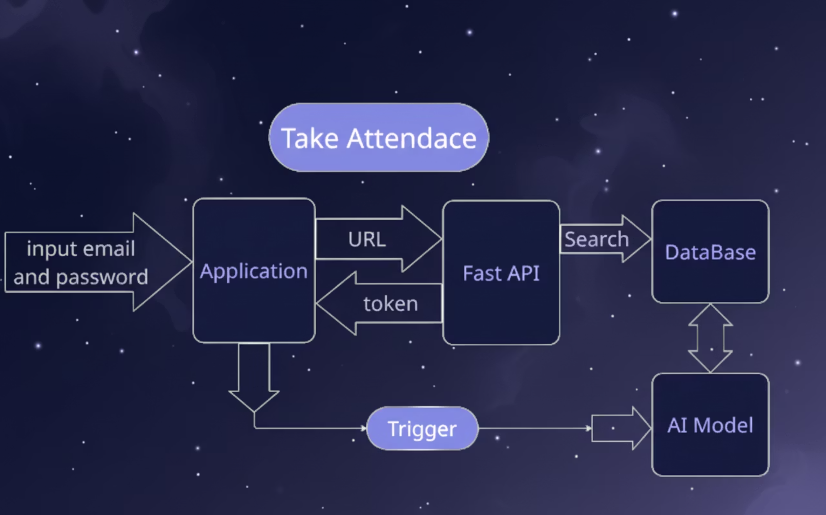

Slide 12


Development Process
Flexible Timeline
Agile Approach
The original timeline outlined weekly goals, but in practice, tasks overlapped, priorities shifted, and some phases took longer than expected.
We followed an Agile approach throughout the project, working in short iterations with frequent feedback and adjustments rather than a fixed plan.
Mobile Testing with ngrok
Integration Focus
We extensively used ngrok through share_api.py to create a temporary public HTTPS tunnel, enabling real-device testing without needing both devices on the same local network.
The majority of development time was spent on backend and component integration — connecting Flutter to FastAPI, handling base64 image flow, debugging AI model loading, and fixing JWT authentication.

Slide 13
Key Challenges We Faced
During the development process, we encountered several challenges that required flexible problem-solving and iterative adjustments.
Integration Complexity
Data Consistency
Integration complexity between Flutter, FastAPI, InsightFace, and PostgreSQL.
Ensuring consistent base64 decoding and AI processing across environments.
Dynamic Network Endpoints
AI Performance Balance
Frequent ngrok URL changes requiring updates in the Flutter app during testing sessions.
Balancing AI accuracy with prototype performance constraints.

Slide 14
Development Team and Responsibilities
The team consists of engineers specialized in computer vision, mobile application development, and backend engineering.
Mohamed Fouad : Computer Vision Engineer - Leading face recognition implementation and model integration.
Mina Waheed: Computer Vision & Backend Engineer - Working on the AI processing pipeline and handling embeddings.
Mark Raafat : Mobile Application Developers (Flutter) - Developing core screens, UI, and image capture flows.
Ahmed Yuosry : Mobile Application Developers (Flutter) - Developing core screens, UI, and image capture flows.
Mina Naseeh: Backend Engineer - Designing the database schema and core API logic.
Ayad: Backend Engineer - Handling authentication, component integration, and deployment setup.

Slide 15
Thank You for Your Focus

