Slide 1
Addressing Deafness with Innovative Solutions
Using AI for Enhanced Accessibility
By :Mohamed Elnakshbandy
ID: A20000755
Under Supervised by:
Dr. Mai Ramadan

Slide 2
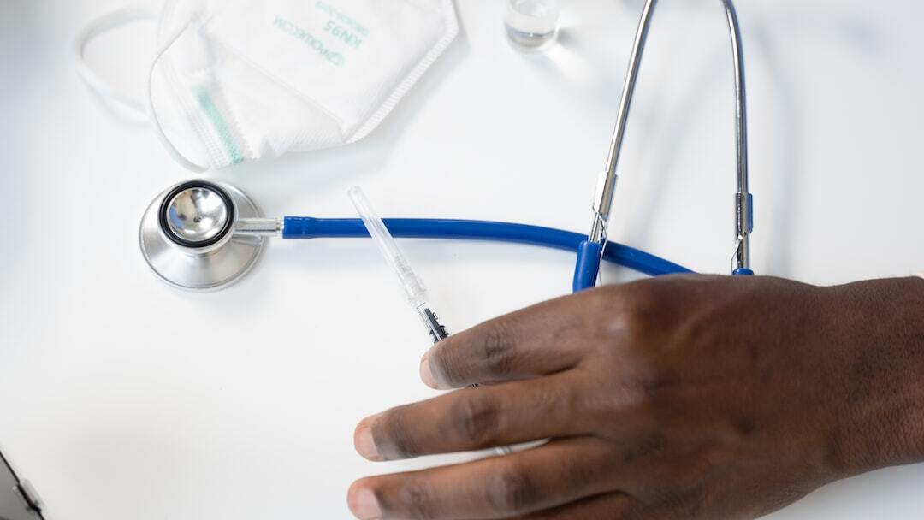
Deafness and Hearing Loss
Introduction to Deafness: Understanding the causes, types, and prevalence of deafness and hearing loss globally.
Project Goals: Develop a tool to summarize YouTube video transcripts for the hearing impaired.
Technologies Used: Utilized YouTubeTranscriptApi, Hugging Face Transformers, Google Generative AI, and LSTM models.

Slide 3
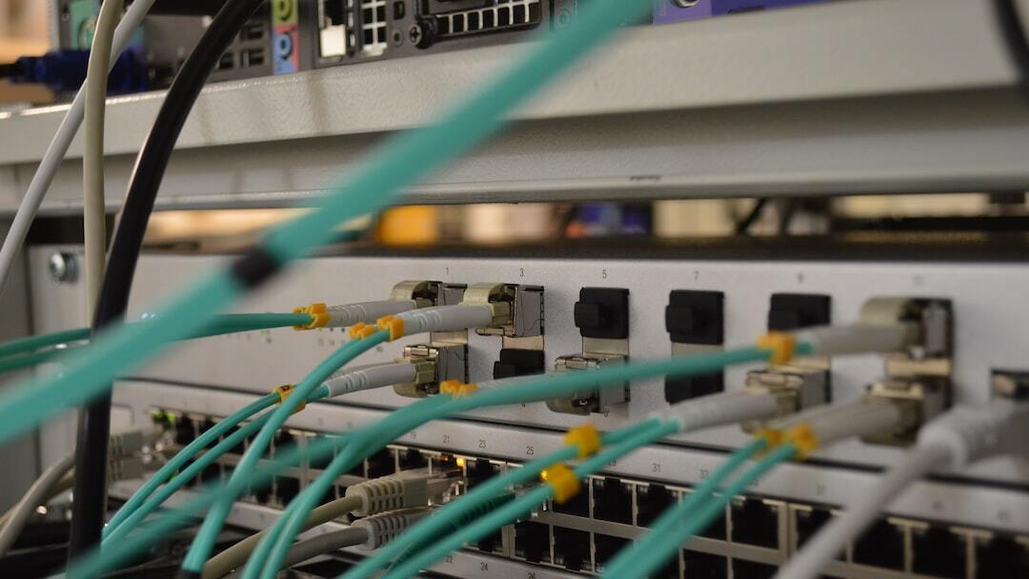
Integration Points
YouTube Transcript Extraction: Utilized YouTubeTranscriptApi to extract detailed transcripts from YouTube videos.
Summarization Models: Integrated multiple summarization models including Hugging Face Transformers and LSTM.
Google Generative AI: Used Google Gemini model for generating comprehensive summaries.
Streamlit App: Developed a Streamlit application to provide a user-friendly interface for video summarization.

Slide 4
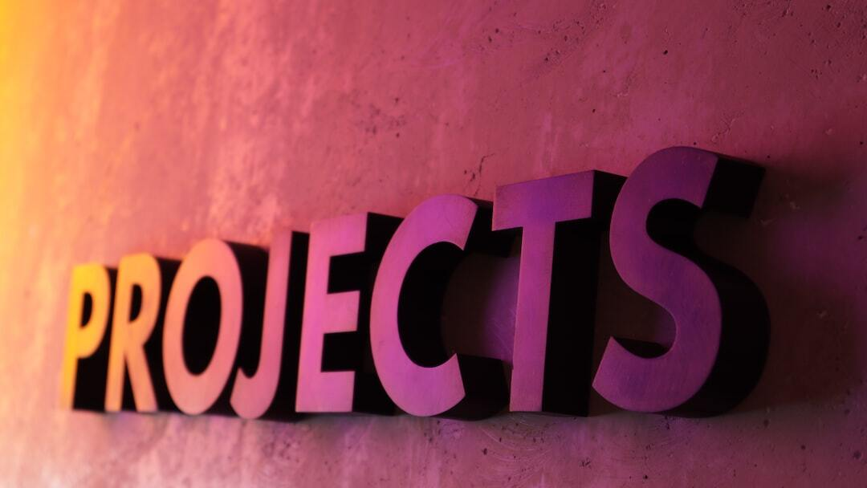
Project Benefits
Accessibility: Improves accessibility for the hearing impaired by providing text summaries of video content.
Efficiency: Reduces time spent on video content by summarizing key points quickly.
Technology Integration: Showcases the integration of advanced AI models for practical applications.
User-Friendly Interface: Offers a simple and intuitive interface for users through the Streamlit app.

Slide 5
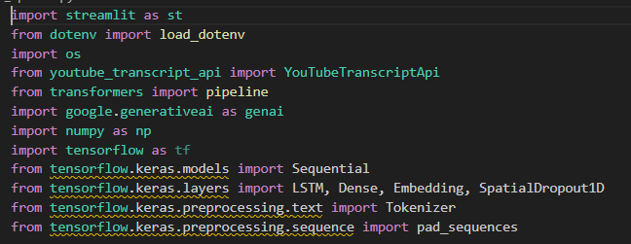
Code Snapshots :
Importing Required Libraries:
Imports the Streamlit library for building web applications.
Import the function to load environment variable from a ‘.env’file.
Imports the ‘os’ module for interacting with the operating system.
Imports the YouTube Transcript API for extracting video transcripts.
Imports the pipeline function from the Hugging Face transformers library for creating NLP pipelines.
Imports the Google Generative AI library.
Imports the NumPy library for numerical operations.
Imports the TensorFlow library for building and training machine learning models.
Imports the Sequential model class from Keras (a high-level API for TensorFlow).
Imports specific layers from Keras: LSTM, Dense, Embedding, and SpatialDropout1D.
Imports the Tokenizer class for text preprocessing.
Imports the pad_sequences function for sequence padding.

Slide 6
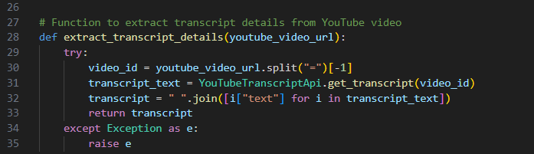
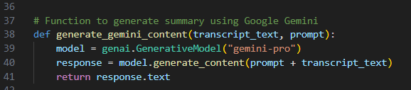
Code Snapshots :
1. Configuring Google Generative AI
4. Defines a function to extract transcript details from a YouTube video URL. It retrieves the video ID, gets the transcript, and joins the text.
2. Initializing Summarization Pipeline using model from Hugging Face.
3. Defines a prompt to instruct the model to summarize transcript text.
5. Defines a function to generate a summary using Google Gemini by concatenating the prompt with the transcript text and returning the response text.

Slide 7
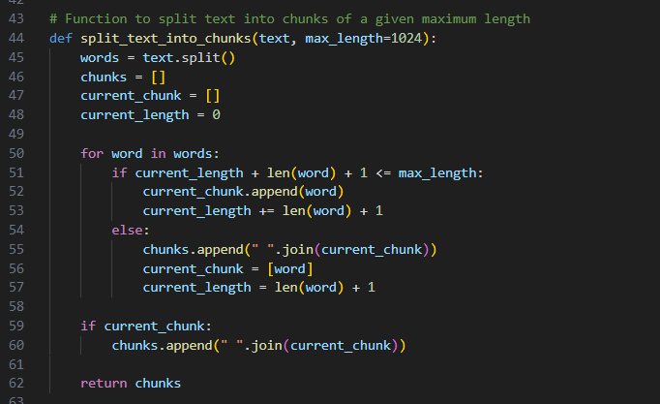
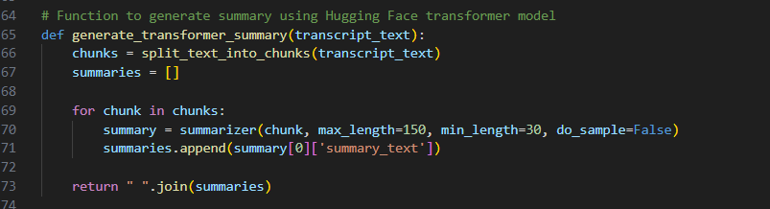
Code Snapshots :
6. Defines a function to split text into chunks of a specified maximum length. This helps in processing long texts in smaller parts.
7. Defines a function to generate a summary using the Hugging Face transformer model. It splits the transcript into chunks, generates summaries for each chunk, and joins them.

Slide 8
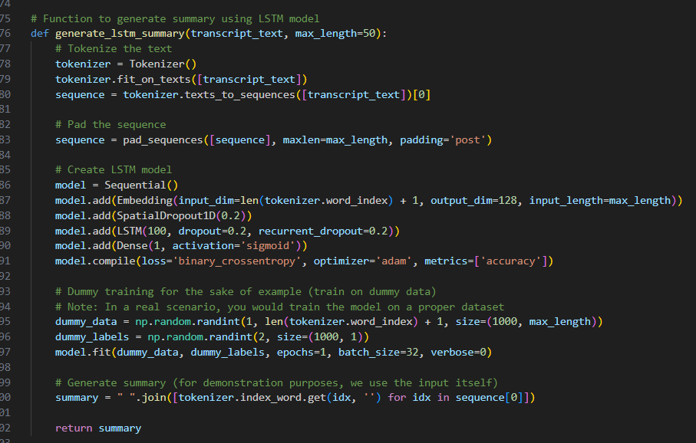
Code Snapshots :
8. Defines a function to generate a summary using an LSTM model. It tokenizes the transcript, pads the sequence, creates and trains an LSTM model, and generates a summary.

Slide 9
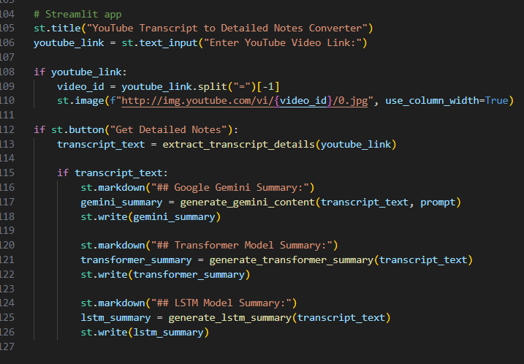
Code Snapshots :
9.Creates a Streamlit app with a title and a text input field for entering a YouTube video link. If a link is provided, it displays the video's thumbnail and provides buttons to generate and display detailed notes using different summarization models.

Slide 10

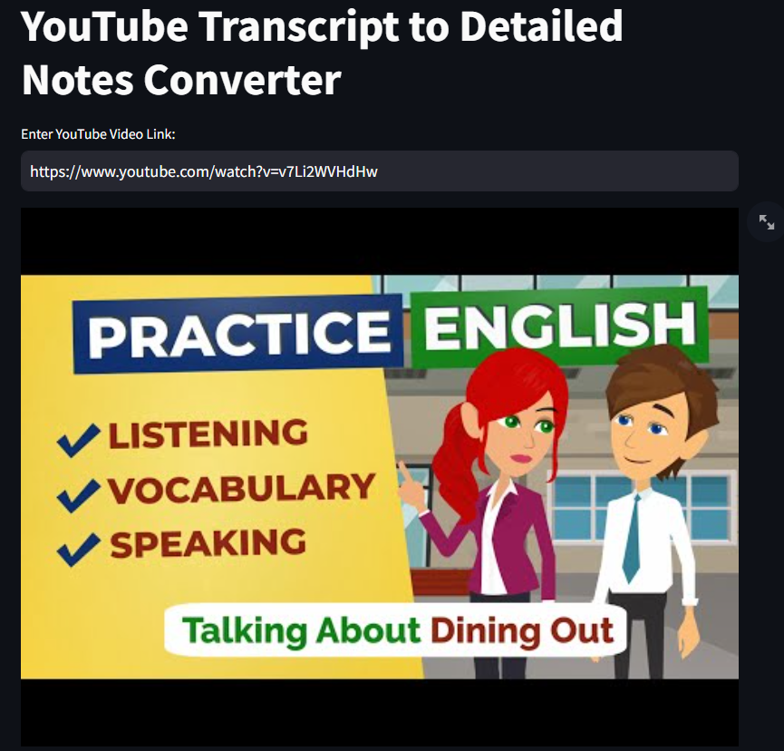
Outputs Snapshots:

Slide 11
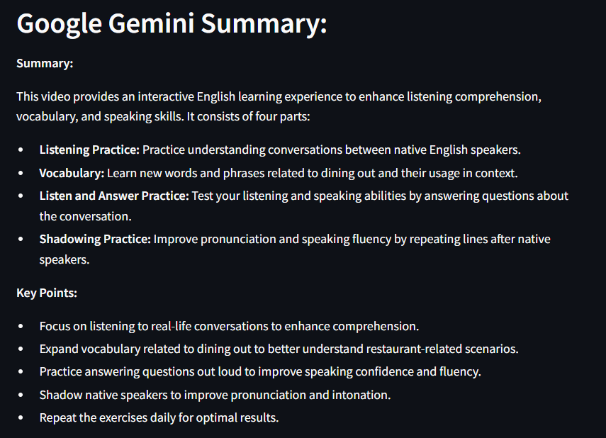
Outputs Snapshots:

Slide 12
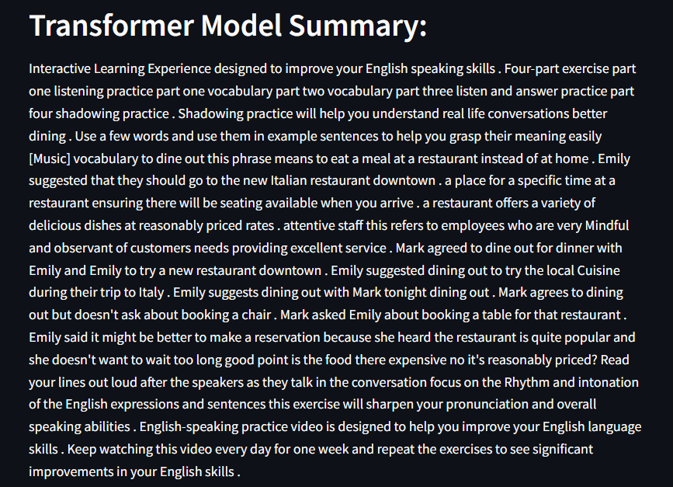
Outputs Snapshots:

Slide 13
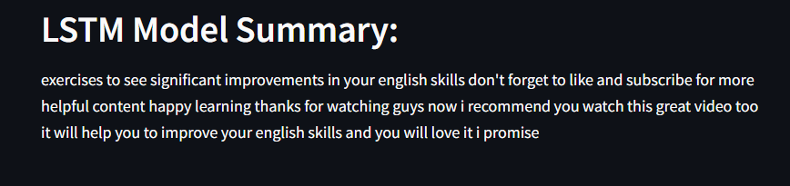
Outputs Snapshots:

Slide 14

Conclusion
Summary: The project successfully integrated AI technologies to create a tool that enhances accessibility for the hearing impaired.
Future Work: Further improvements include refining transcription accuracy and expanding the summarization capabilities.
Impact: This project demonstrates the potential of AI in creating inclusive and accessible solutions for diverse user needs.

