Slide 1

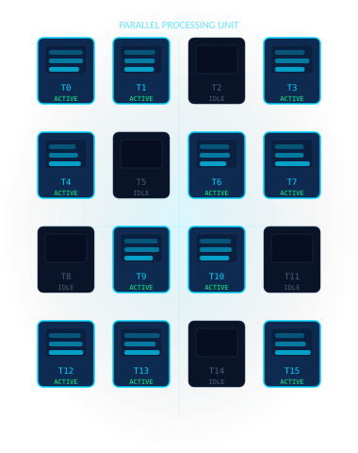
CSCI465 Introduction to Parallel Computing
AutoCluster-OMP
A Lightweight Source-to-Source OpenMP Auto-Parallelizer
for K-Means and Fuzzy C-Means Clustering
Research Team
Mohamed Yasser Goma
Mohamed Saleh
Abdullah Ismail
Ahmed Sayed
Mohamed Khaled
AutoCluster-OMP · Parallel Computing Research · 2025

Slide 2





WHY THIS MATTERS
Motivation
Clustering at Scale
Multicore Potential
K-Means & Fuzzy C-Means are core to ML, data science, and pattern recognition — but runtime explodes with scale.
Modern CPUs have 8–64 cores. OpenMP unlocks them — but harnessing that power requires expertise.
Manual Parallelization
Automation Opportunity
Developers must manually identify safe loops, understand data dependencies, and avoid race conditions.
Source-to-source auto-parallelization can generate correct OpenMP code without manual effort.
02

Slide 3



THE CHALLENGE
Problem Statement
01
02
03
Manual Loop
Identification
Safety
Analysis
Race Condition
Risk
Research Question
How can we automatically detect and parallelize common clustering loop patterns using OpenMP while preserving correctness?
03

Slide 4
PRIOR ART
Related Work & Research Gap
EXISTING WORK
RESEARCH GAP
Multicore K-Means parallelization with OpenMP
Manual Only
All approaches rely on hand-coded parallelism
OpenACC-based K-Means for GPU acceleration
No Auto-Generator
No source-to-source OpenMP pragma inserter exists
OpenMP Fuzzy C-Means for large-scale datasets
VS
No Classification
Clustering loop types are not automatically classified
Thread-parallel centroid computation studies
No Unified Framework
K-Means and FCM require separate ad-hoc solutions
04

Slide 5








OUR APPROACH
Proposed Solution
AutoCluster-OMP: An end-to-end automatic OpenMP parallelization prototype for clustering workloads.
01
02
03
04
Read Sequential
C Code
Detect
For-Loops
Classify Loop
Patterns
Safety &
Workload Check
05
06
07
08
Generate
OpenMP Code
Compile
& Build
Benchmark
& Validate
Export Reports
& Plots
05

Slide 6
ARCHITECTURE
System Pipeline
1
2
3
4
5
6
Sequential
C Code
Loop
Detection
Pattern
Classification
Safety
Check
OpenMP
Generation
Benchmark
& Validate
IN
OUT
Input
Analyzer
Analyzer
Validator
Generator
Output
OpenMP C Files
CSV Reports
JSON Analysis
Performance Plots
06

Slide 7

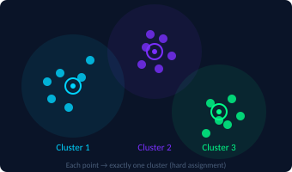
HARD CLUSTERING
K-Means Auto-Parallelization
SEQUENTIAL CODE
WHY IT'S SAFE
for (int i = 0; i < n; i++) {
...
labels
[i] = best_cluster;
}
Each point processed independently — no shared state
Each iteration writes to unique labels[i] memory location
Centroids are read-only during the assignment step
AUTO-GENERATED OPENMP
#pragma omp parallel for schedule(static)
for (int i = 0; i < n; i++) {
...
labels
[i] = best_cluster;
}
07

Slide 8


SOFT CLUSTERING
Fuzzy C-Means Auto-Parallelization
SEQUENTIAL CODE
for (int i = 0; i < n; i++) {
for (int c = 0; c < k; c++) {
...
membership[i*k+c] = value;
}
}
AUTO-GENERATED OPENMP
Each point owns a separate membership row
#pragma omp parallel for schedule(static)
for (int i = 0; i < n; i++) {
for (int c = 0; c < k; c++) {
...
membership[i*k+c] = value;
}
}
Threads write to different memory cells
No two threads update the same membership[i*k+c]
08

Slide 9


SAFETY ENGINE
Loop Classification & Safety
kmeans_assignment_loop
PARALLELIZE
UNSAFE EXAMPLE
centroid_counts[cluster]++;
centroid_sums[cluster*d+f] +=
points[i*d+f];
fuzzy_membership_update_loop
PARALLELIZE
centroid_update_loop
WARN
⚠ Multiple threads may update the same centroid accumulator simultaneously — causing a race condition.
possible_reduction_loop
WARN
unknown_loop
SKIP
Safe — auto-parallelized
Warning — manual review needed
Unsafe — skipped
09

Slide 10
IMPLEMENTATION
Implementation Details
C Kernels
Python Tool Modules
Main Outputs
kmeans_seq.c
kmeans_manual_omp.c
kmeans_auto_omp.c
fcm_seq.c
fcm_manual_omp.c
fcm_auto_omp.c
analyzer detects and classifies loops
generator inserts OpenMP pragmas
compiler compiles C files with GCC
benchmark measures runtime and speedup
reports exports CSV / JSON files
plotting generates figures
→ Auto-generated OpenMP C files
→ Benchmark CSV files
→ Analysis JSON reports
→ Runtime, speedup & efficiency plots
11

Slide 11
PERFORMANCE DATA
Benchmark Results
5.12x
80.47%
100%
8
Peak Speedup
Runtime Reduction
Correctness
Thread Configs
8 threads
All checksums passed
1, 2, 4, 8 threads
11

Slide 12
INSIGHTS
Result Discussion
Runtime reduced from 4.281s to 1.369s — a 68% improvement at 8 threads
All OpenMP configurations passed checksum correctness validation
1-thread OMP was slower (5.188s vs 4.281s) due to OpenMP runtime overhead
Efficiency drops at 8 threads due to Amdahl's Law: remaining sequential sections limit scaling
Amdahl's Law governs the ceiling. The sequential centroid-update phase limits maximum theoretical speedup regardless of thread count.
12

Slide 13
HORIZON
Limitations & Future Work
CURRENT LIMITATIONS
FUTURE ROADMAP
✗ Pattern-based parser, not a full AST compiler
Clang AST Analysis
v2.0
Replace regex parser with full compiler frontend
✗ Best suited for controlled C code patterns
Auto Centroid Transform
v2.1
Automatic local-buffer reduction patterns
✗ Complex pointer aliasing not fully analyzed
Smart Schedule Selection
v3.0
Dynamic vs static scheduling based on workload
✗ Centroid-update loops require manual review
GPU Acceleration
v4.0
OpenACC and CUDA code generation support
13

Slide 14








IMPACT
Key Contributions
C1
C2
C3
C4
Source-to-Source Prototype
K-Means Loop Detection
FCM Loop Detection
Safety Classification
End-to-end lightweight OpenMP auto-parallelizer
Automatic identification of safe assignment loops
Soft clustering membership-update loop classification
Red/yellow/green decision engine for race conditions
C5
C6
C7
C8
Workload-Aware Decisions
Full Benchmark Suite
Reproducible Evaluation
Paper-Ready Plots
Parallelization threshold based on loop size
Runtime, speedup, efficiency, and correctness metrics
CSV and JSON export for research reproducibility
Publication-quality performance visualizations
14

Slide 15

CONCLUSION
AutoCluster-OMP
demonstrates that clustering loop patterns can be detected and
parallelized automatically — without human intervention.
Auto Detection
Safe Parallelism
Correct Output
3.13× Speedup
Zero Race Conditions
Mohamed Yasser Goma · Abdullah Ismail · Mohamed Khaled · Mohamed Saleh · Ahmed Sayed
CSCI465 · Introduction to Parallel Computing
Thank You

