Slide 1
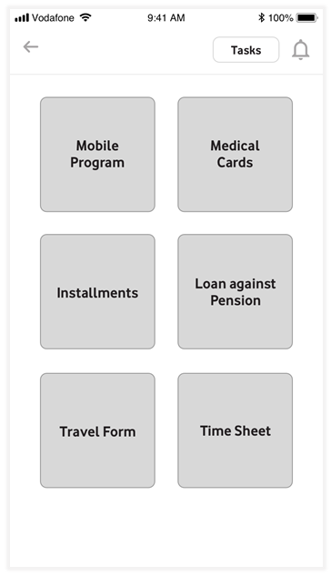

Slide 2
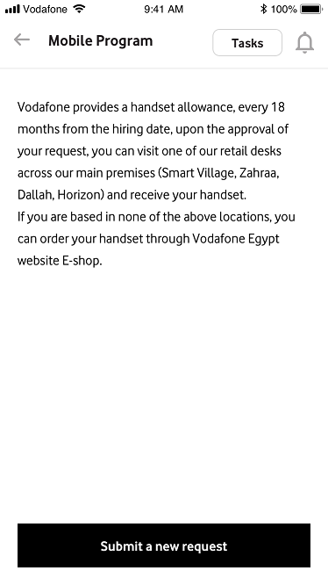
Notes:
HR:
Option 1:
On the same page, add the below intro: -> (Done)
Vodafone provides a handset allowance, every 18 months from the hiring date, upon the approval of your request, you can visit one of our retail desks across our main premises (Smart Village, Zahraa, Dallah, Horizon) and receive your handset.
If you are based in none of the above locations, you can order your handset through Vodafone Egypt website E-shop.
Option 2:
A pop up appears before this page: Is this your first time requesting a phone program?
Yes/No
If yes: another pop up appears with this message:
Vodafone provides a handset allowance, every 18 months from the hiring date, upon the approval of your request, you can visit one of our retail desks across our main premises (Smart Village, Zahraa, Dallah, Horizon) and receive your handset.
If you are based in none of the above locations, you can order your handset through Vodafone Egypt website E-shop.
If no: he will reach Figure 1.1
+++ change ‘Add a new request’ to ‘Submit a new request’ -> (Done)

Slide 3
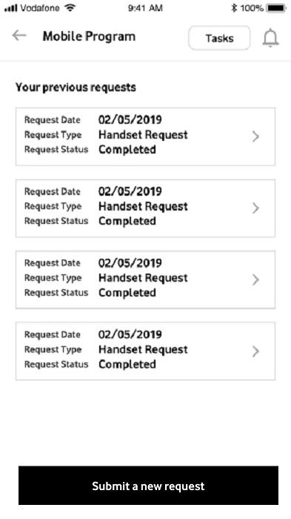
Notes:
HR:
Typo: Request NOT Reqest -> (Done)
What does ‘See all’ refers to? We want to see its page -> (Done)

Slide 4
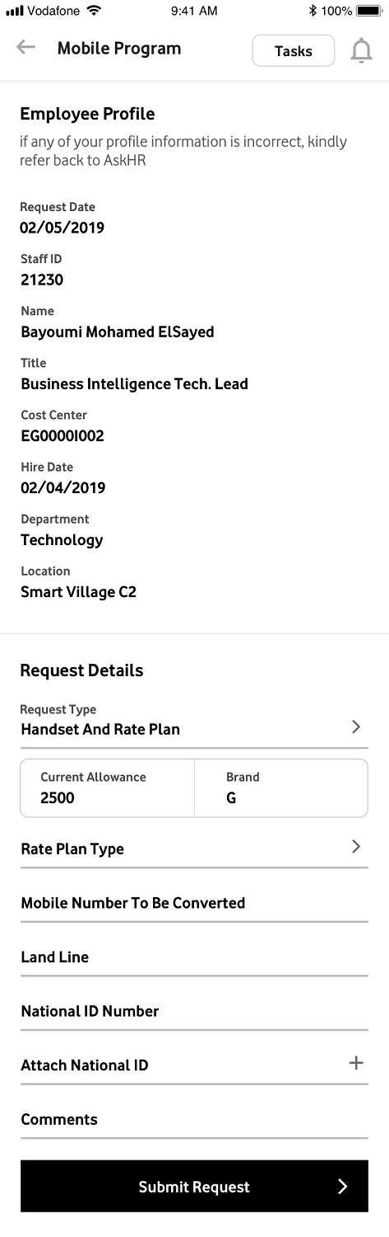
Notes:
HR:
Remove ‘Employee Profile and add its data in ‘Request Details’ -> (Done)
Remove Request Details tab as the page directly refers to this tab already -> (Done)

Slide 5
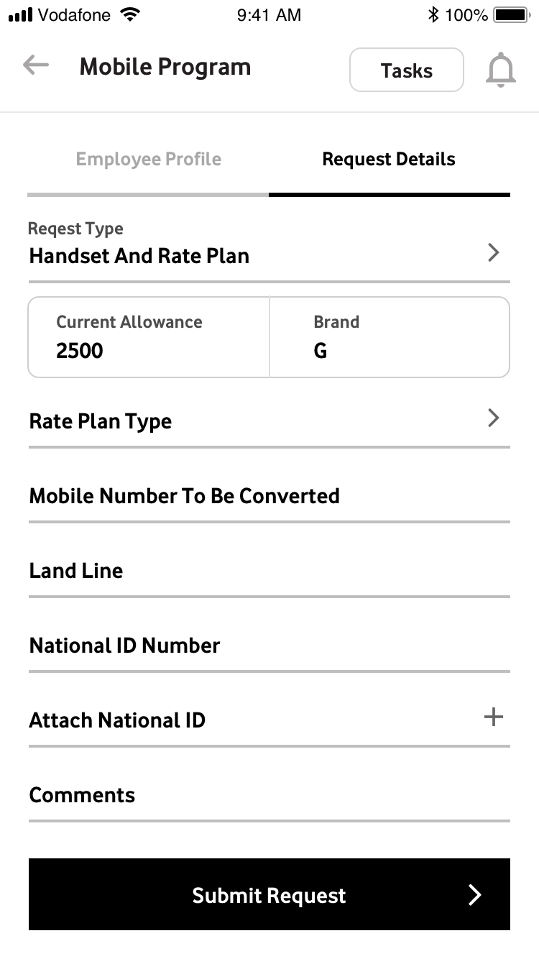
Notes:
HR: -> (This screen is removed)
Request NOT Reqest
Before ‘Request type’: Add Employee Profile with a drop down info arrow – add sentence ‘if any of your profile information is incorrect, kindly refer back to AskHR’

Slide 6
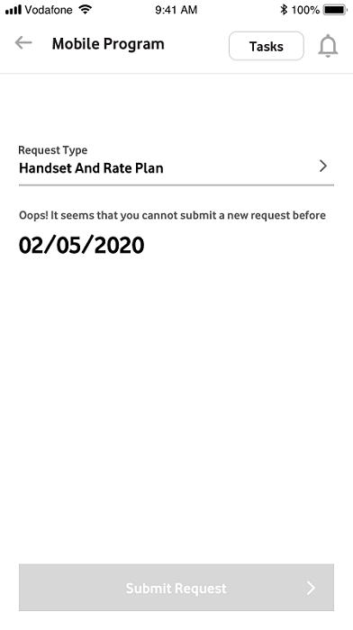
Notes:
HR:
Request NOT Reqest -> (Done)
Change the above disclaimer to : Oops! It seems that you cannot submit a new request before (date) -> (Done)

Slide 7
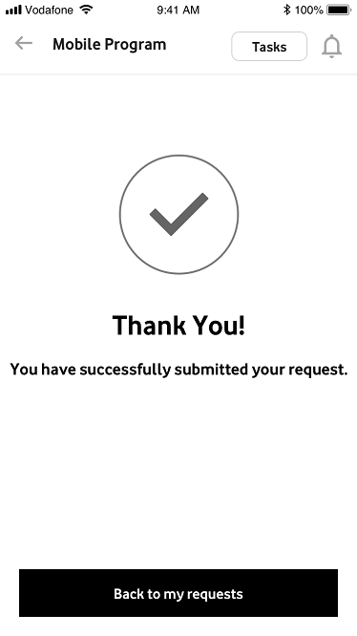
Notes:
HR:
You have successfully submitted your request. -> (Done)
:” Back to my requests” instead of “back” -> (Done)

Slide 8
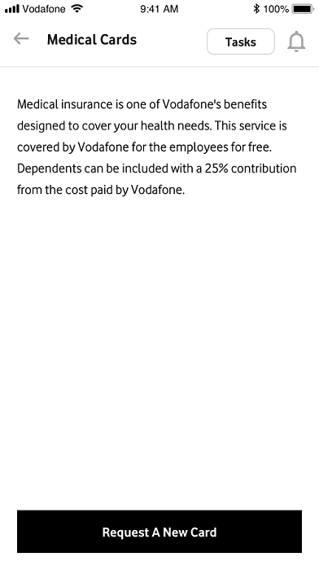
Notes:
HR:
Same scenario of mobile program intro -> (Done)
Medical insurance is one of Vodafone's benefits designed to cover your health needs. This service is covered by Vodafone for the employees for free. Dependents can be included with a 25% contribution from the cost paid by Vodafone. -> (Done)

Slide 9
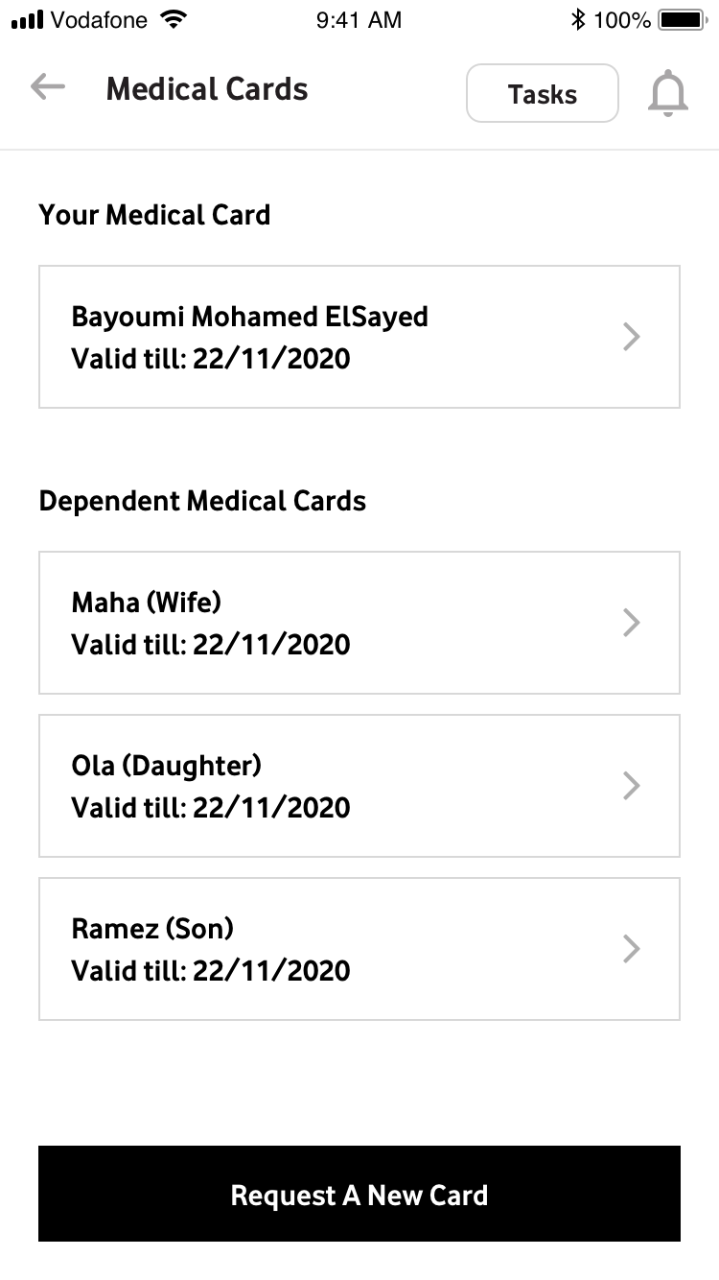
Notes:
New Screen

Slide 10
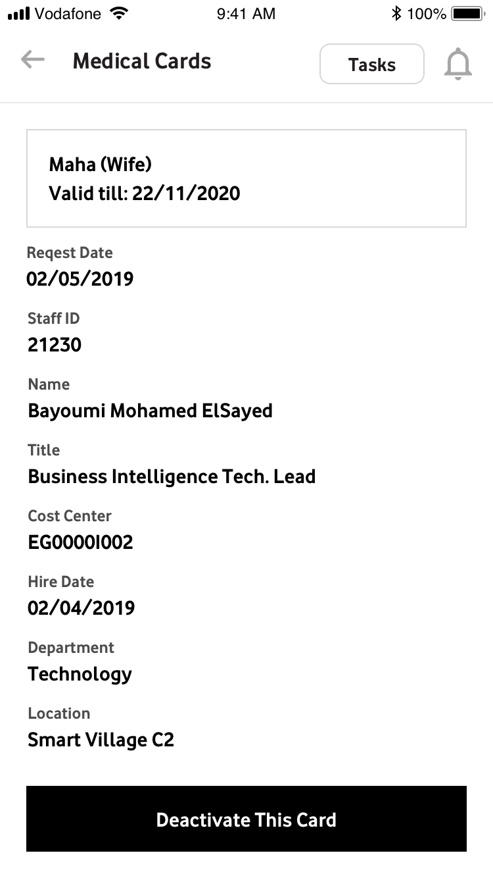
Notes:
HR:
Write details of Maha’s card request and remove the employee’s data
Vendor:
Need the details of that card request

Slide 11
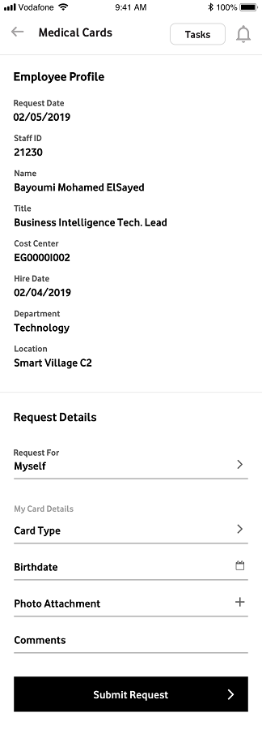
Notes:
HR:
Same scenario of mobile program request -> (Done)

Slide 12
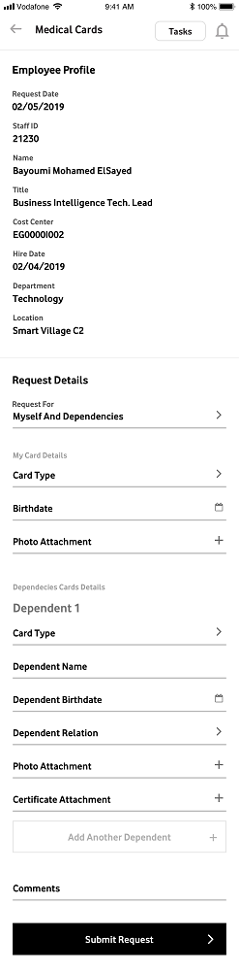

Slide 13
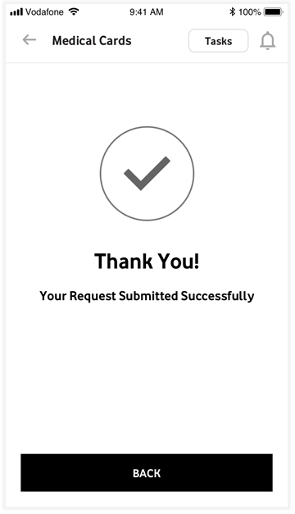

Slide 14
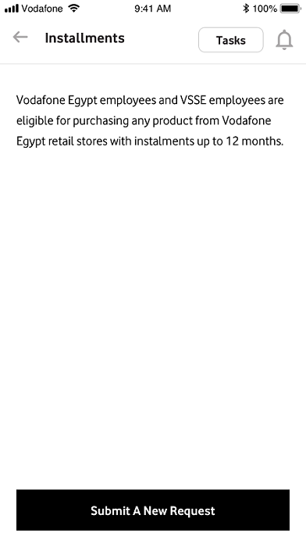
Notes:
HR:
Same intro scenario -> (Done)
Vodafone Egypt employees and VSSE employees are eligible for purchasing any product from Vodafone Egypt retail stores with instalments up to 12 months. -> (Done)

Slide 15
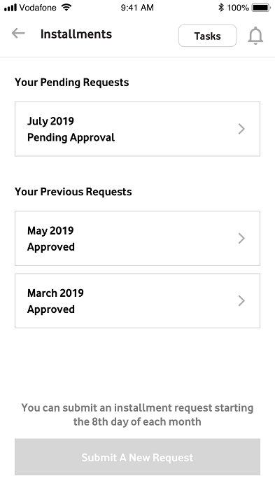
Notes:
HR:
Same as phone program -> (Done)
You can submit an installment request starting the 8th day of each month ….. -> (Done)

Slide 16
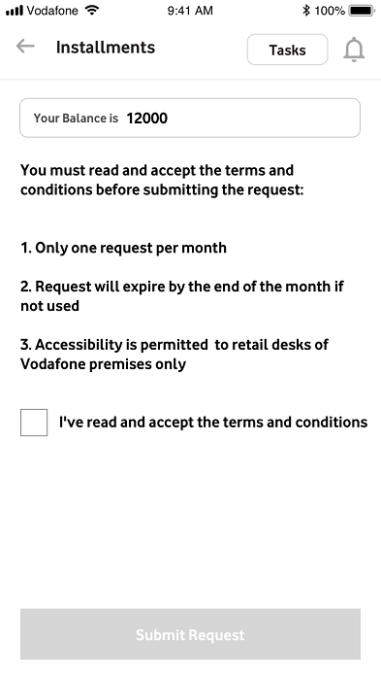
Notes:
New Screen

Slide 17
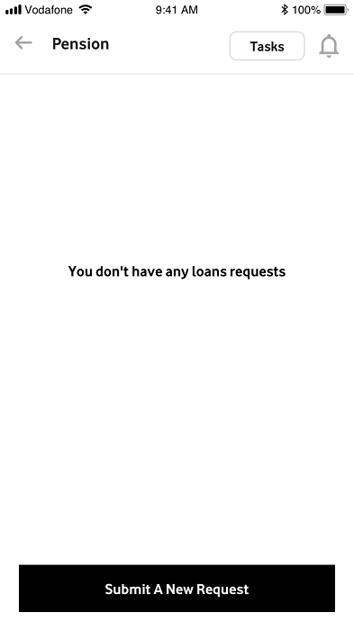
Notes:
HR:
Pension not loan against pension -> (Done)
You don’t have any pension requests – same intro scenario -> (Done)

Slide 18
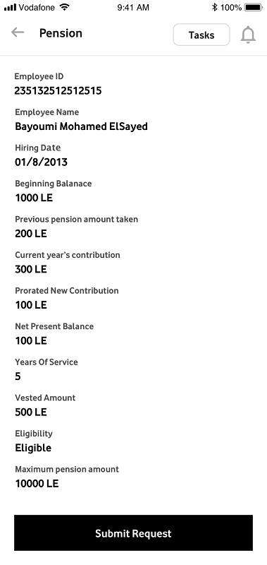
Notes:
HR:
Employee ID ???? -> (Done)
Balance (typo) -> (Still Exists)
Hiring Date instead of hire date -> (Done)
Previous pension amount taken instead of previous loan taken -> (Done)
Current year’s contribution instead of current year contribution -> (Done)
Net present value?? -> (Clarify more)
Maximum pension amount instead of maximum lean amount -> (Done)

Slide 19
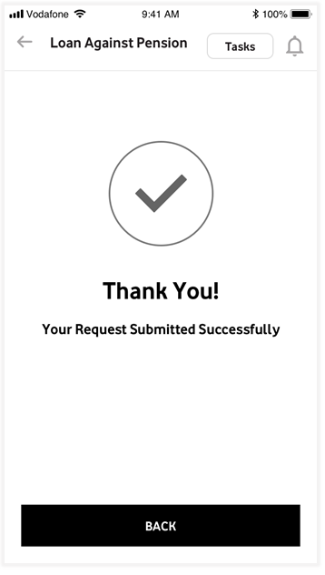
Notes:
HR:
Same exit scenario (back to) -> (Not Done)

Slide 20
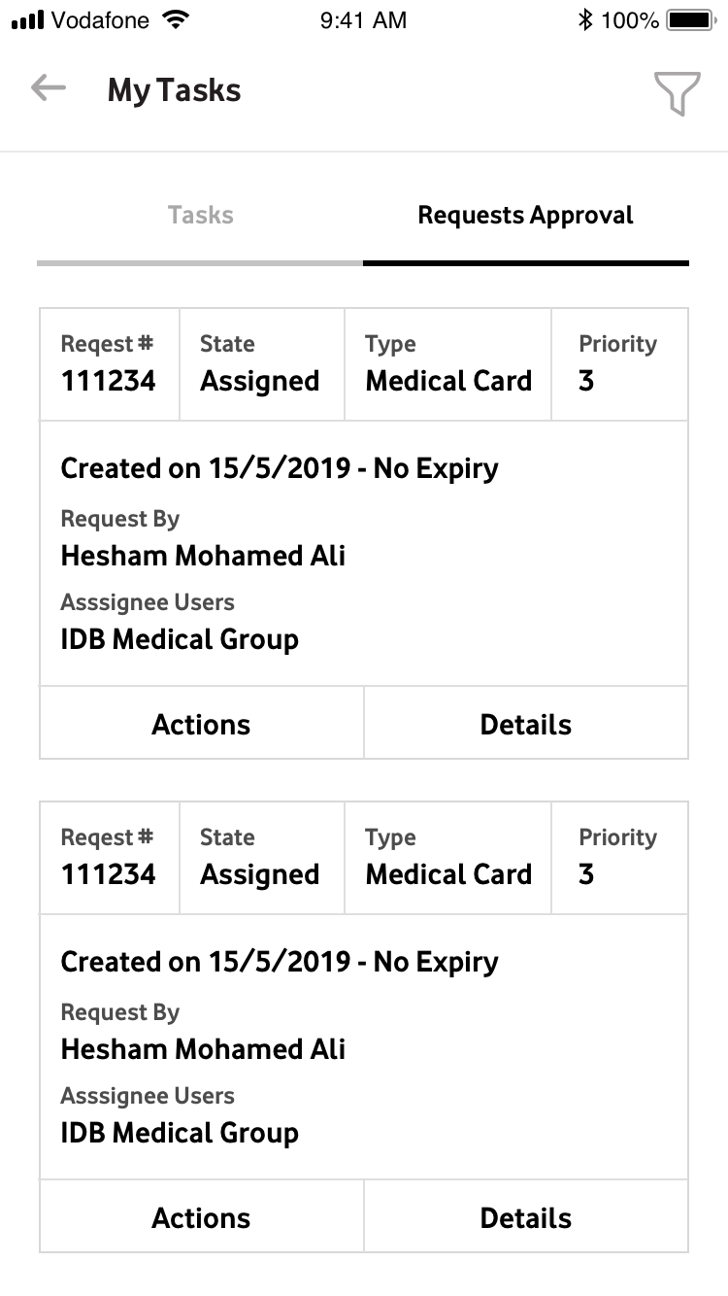
Notes:
HR Comments:
Request Status not approval -> (Not Done)

