Slide 1


Cyber
Protect
Data
Threat
Security
Attack
Firewall
Malware
FortiGate
Security Profiles
Protecting the Digital World
Thynk Unlimited
@reallygreatsite

Slide 2
Enter Password
*
*
*
*
*
*
*
*
*
*

Slide 3


VULNSHARKS
UNLOCKED

Slide 4

INTRODUCTION
What are Security Profiles?
are a set of features used to inspect and control network
traffic to protect against threats and enforce security policies. They are applied to firewall
policies and include tools such as

Slide 5
Cont.
Types of Security Profiles
• Antivirus ✓
• Web Filtering ✓
• Application Control ✓
• File Filter
• Intrusion Prevention System (IPS)
• DNS Filtering
• Email Filtering
• Data Loss Prevention (DLP)
Applied = ✓ not Applied =

Slide 6
Antivirus Profile

Slide 7
Antivirus Profile

Slide 8
Antivirus Profile
What is it?
It is a protection module that scans network traffic for malware. It is applied inside a Firewall Policy to inspect traffic passing through the FortiGate.

Slide 9

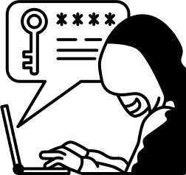




Antivirus Profile
Purpose
− scanning files, emails, and web traffic to detect and block malware, viruses,
spyware, Trojans, Checks downloads, email attachments, uploads, and file transfers

Slide 10
Antivirus Profile
Main Features
− Flow-based or Proxy-based scanning
− Signature-based detection
− Heuristics & behavior analysis
− Cloud sandbox for zero-day

Slide 11
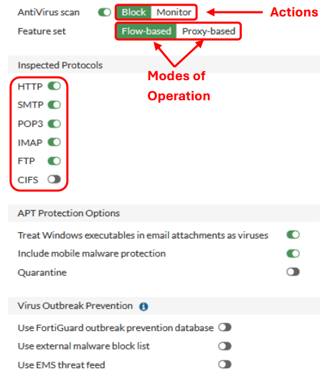
Flow-Based − scans packets in
real-time they pass through without
buffering, providing faster performance but
less in-depth analysis
Proxy-Based − buffers and rebuilds
entire files or messages before inspecting
them, offering more thorough analysis and
more actions, but at the cost of higher
latency and resource usage
Signature-based − detection in FortiGate
(and most antivirus engines) works
by matching known malicious patterns

Slide 12
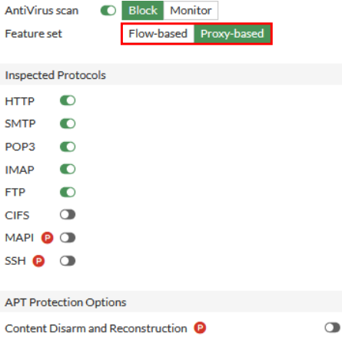
Proxy-Based Mode – all features with
the letter are added in this mode (more features exist)
MAPI − Allows FortiGate to inspect and scan
email attachments and content sent over MAPI
for malware or threats, supported in
proxy-based antivirus mode (from FortiOS 6.2+)
FortiGate can scan email traffic using protocols
POP3 / IMAP / SMTP − traditional email
protocols.
SSH − Allows FortiGate to inspect and block
certain commands (e.g. SCP file transfer)
Content Disarm and Reconstruction − Strips
potentially malicious active content from files
(like macros, scripts, embedded links).
Reconstructs a "clean" version of the file for
the user. (Microsoft Office docs, PDFs, RTF,
file images − limited), Deliver the clean version
of the file to the user while the infected one was
discarded or quarantined.

Slide 13
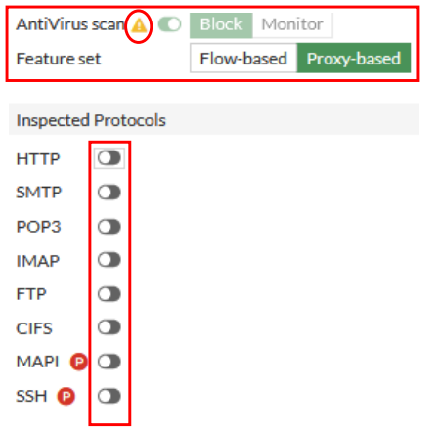
Antivirus scan− should be at least one protocol active to be applied, whatever the mode of
operation is applied (Flow-based / Proxy-based)
Advanced Options – Heuristics:
detects unknown or zero-day malware by
analyzing behavior and patterns, Adds an
extra layer of detection beyond signature
matching.
Extended Threat Database:
Use a larger, more comprehensive database of
virus signatures from FortiGuard, which
increases detection rate, especially for lesser-known or region-specific threats, but slightly
higher resource usage

Slide 14
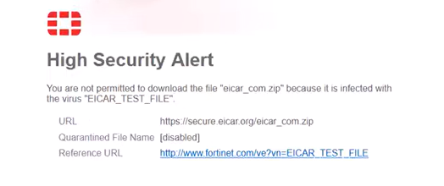
Here Antivirus basically blocked the file as it scanned the behavior of the file downloaded “tested file from eicar.org” and it was blocked as it is malware file

Slide 15
Web Filter Profile

Slide 16
Web Filter Profile

Slide 17
Web Filter Profile
What is it?
It is a protection module that controls and monitors web (HTTP/HTTPS) traffic.

Slide 18
Web Filter Profile
Purpose
− It is used to block harmful websites, limit categories, enforce safe browsing, content filtering and apply URL filtering.

Slide 19
Web Filter Profile
Main Features
− Flow-based or Proxy-based scanning
− URL Filtering
− Category-based Filtering
− Web Content Filtering

Slide 20
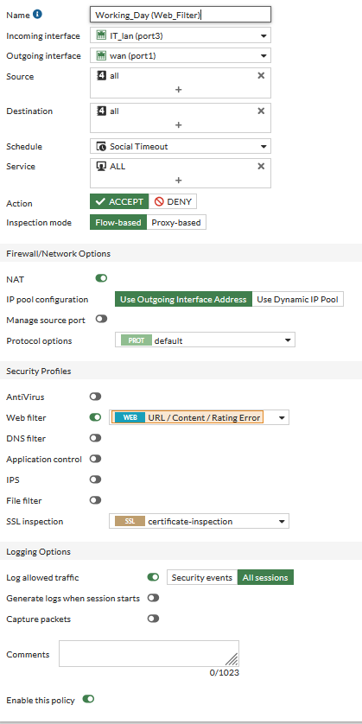
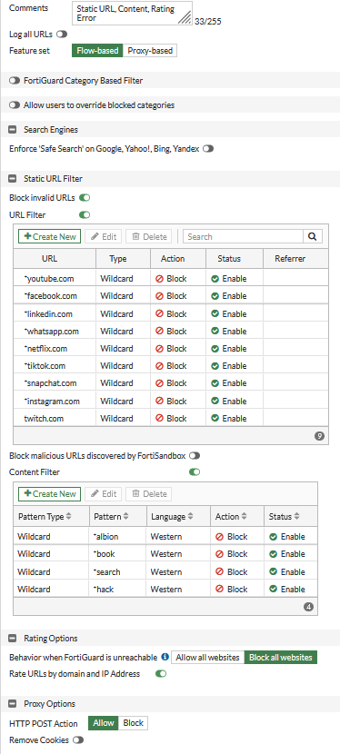
Web Filter Profile
Policy/Config

Slide 21
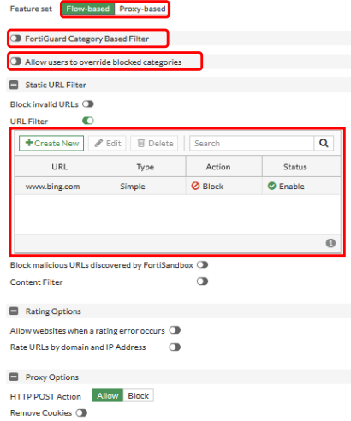
FortiGuard Category − has pre-defined
Categories (default) & pre-defined actions
Like block, monitor, allow, warning,
Authenticate (username + password before
Access warned website).
Static URL Filter – Highest Priority to filter
Can added URL to take actions on specially,
Type – Simple for (Domain Action Only)
– Regular Expression (RegEx)
(e.g. ^https?:\/\/(www\.)?youtube\.com\/edu.*)
–Action took on Bing.com of type simple as
this URL only but if something is in subdomain
or another URL leads to same webpage it
can access)
– Another Type and better is Wildcard as the URL itself plus any subdomain for this domain
can be blocked so more secured than simple

Slide 22
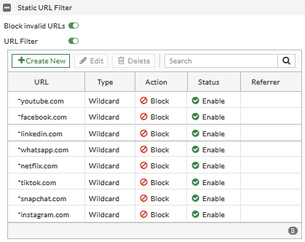
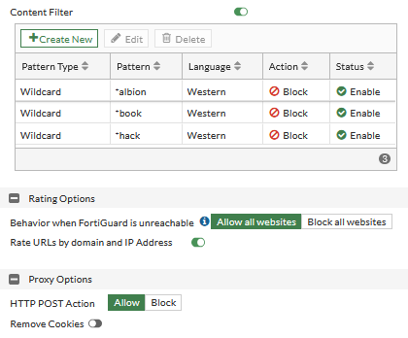
Actions can be done are:
– Exempt (Allow + Log ✓) can pass anything
– Block (Block the URL + log ✓)
– Allow (Allow the URL + no log)
– Monitor (Allow the URL+ log ✓)
-here we used Wildcard type plus any
subdomain of canva.com or facebook.com will
be blocked
- Block malicious URLs discovered
by Forti Sandbox if we use it auto block this
URLs Discovered
Content Filter – to block the webpage or site by
finding the pattern, you insert to search for
If we add like albionOnline (game website for
testing) so, itwill find “albion” + whatever it
comes after due to “*” it will block.

Slide 23
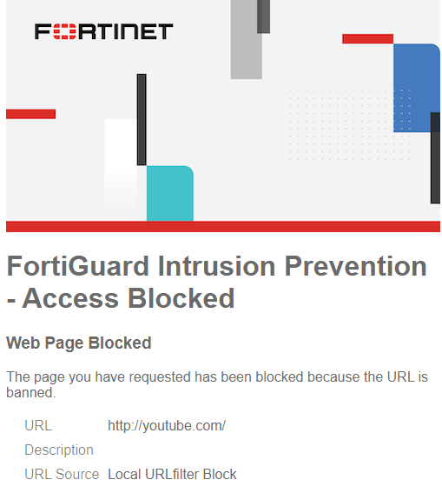
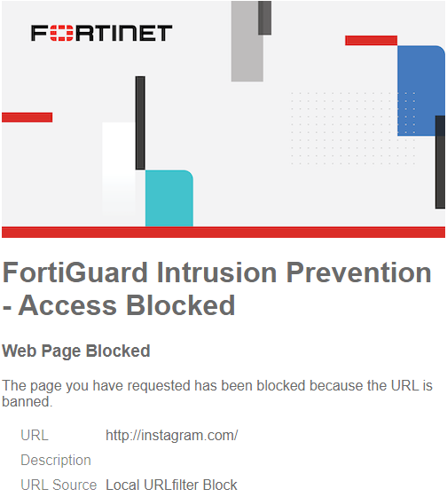
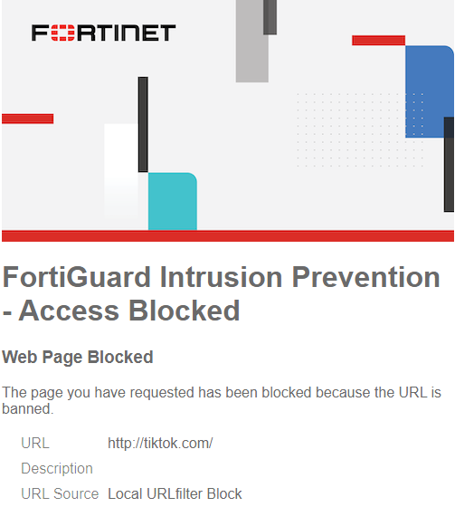
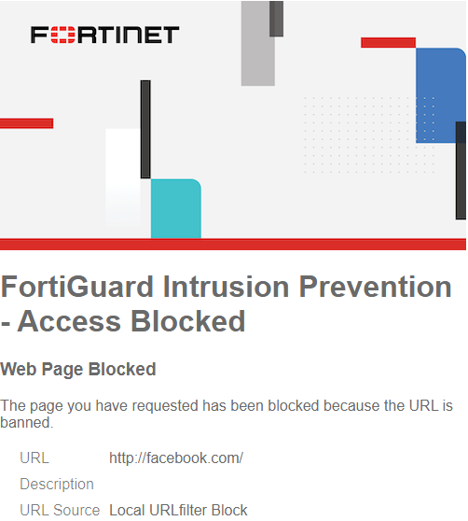
Keep in Mind!
Certificate Inspection – doesn’t decrypt the
HTTPS traffic instead, it only checks the
certificate information of the HTTPS site:
- Domain name (CN/SAN)
- Issuer (CA used)
- Certificate expiration and category using
SNI (Server Name Indication)
Deep Inspection – decrypts HTTPS traffic, inspects
it, then re-encrypts it.
acts like a “man-in-the-middle” proxy.
- Full URL path (not only domain)
- File downloads (PDF, EXE, ZIP, ..)
- Malware (via Antivirus)
- Web content (keywords or patterns)
- App control inside HTTPS
- Intrusion Prevention signatures (IPS)

Slide 24
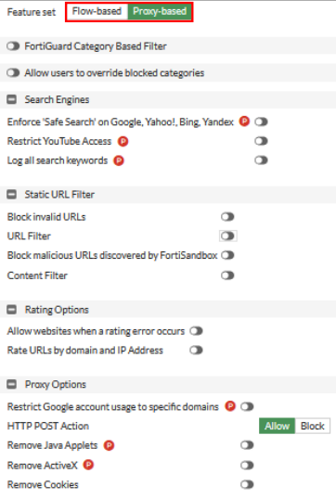
Proxy- Based – doesn’t decrypt the
HTTPS traffic instead, it only checks the
- Restrict access to some sites in YouTube
- Log all keywords you searched with
just by typing…
- Restrict some harmful or sexual and
so, on sites in google, yahoo, Bing.
Advanced Options – Web rating
Overrides: Customize website categories manually.
Example: Mark facebook.com as “Blocked”
or “Allowed” Gives full control beyond
FortiGuard Database.
– Web Profile Overrides: Temporary or
user-specific changes to web filtering.
Example: Allow a user to access a block
site for 1 hour. Adds flexibility without
changing the main policy

Slide 25
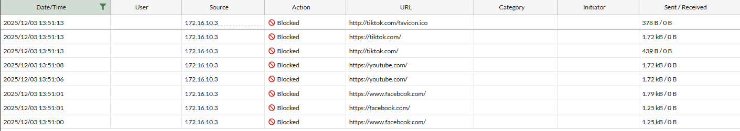
LOGS!
Security Events

Slide 26
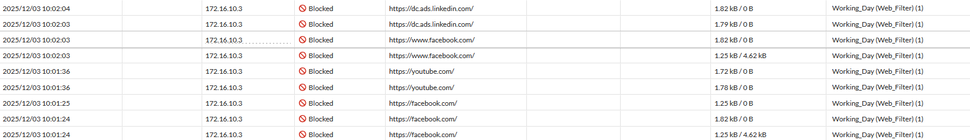
LOGS!
Forward Traffic shows Working Day (Web Filter) ➔ Firewall Policy

Slide 27
Application Control Profile

Slide 28
Application Control Profile

Slide 29
Application Control Profile
What is it?
It is a security profile used to identify, allow, block, or shape traffic based on the application being used, not just ports or IPs.

Slide 30
Application Control Profile
Purpose
It uses deep packet inspection (DPI) to recognize applications even if they use ports that are not standard

Slide 31
Application Control Profile
Main Features
− Block unwanted applications
− Allow only approved apps for business.
− Restrict risky applications.
− Apply bandwidth limits on specific apps
− Monitor application usage

Slide 32
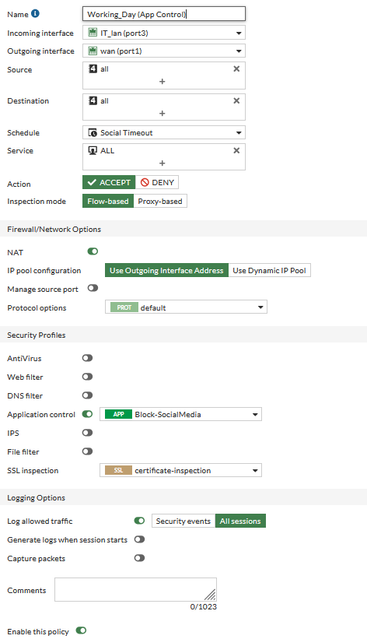
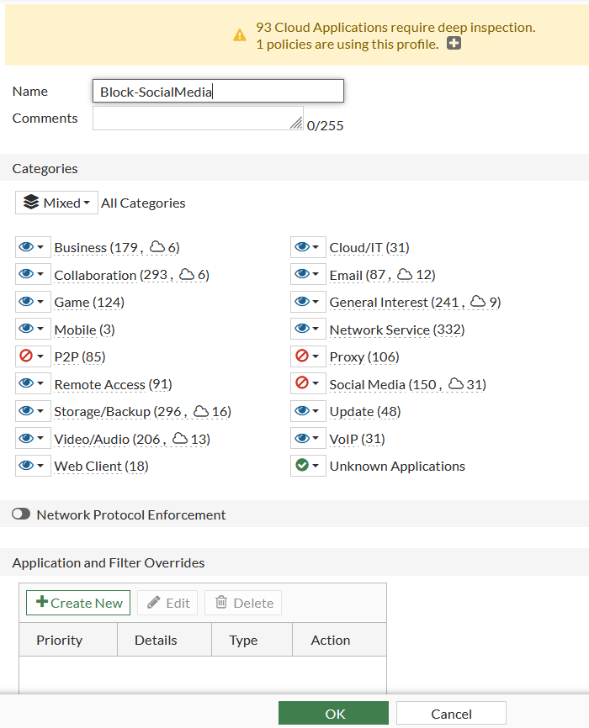
App Ctrl Profile
Policy/Config

Slide 33
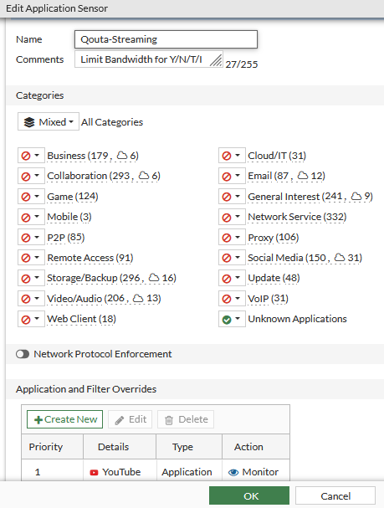
App Ctrl Profile
Policy/Config

Slide 34
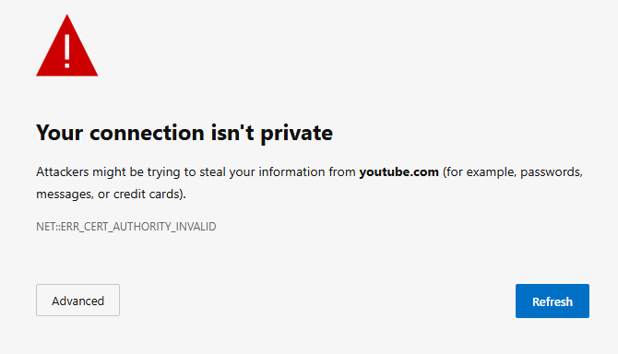
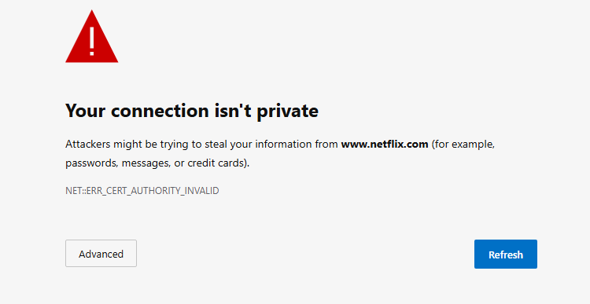
Application and Filter Override – in this option you
can add special effect or filter to the application
you use like YouTube for example you can block
all social media categories and Streaming but
YouTube and specify what you need from this
application no just allow
Here I put example for Netflix and YouTube
Another Options – Block Apps detected on non-
default ports, like app using http but port
number not 80 you can customize it.
– Logging and allowing DNS traffic
– QUIC a transport protocol used by applications like
HTTP/3 that can bypass traditional security
measures because it runs over UDP (User Datagram
Protocol) and uses encryption so, here you can block
or allow this protocol, in newer FortiOS versions this
protocol is blocked by default
– Replacement Messages for HTTP-based Apps
can show it or hide as you like

Slide 35
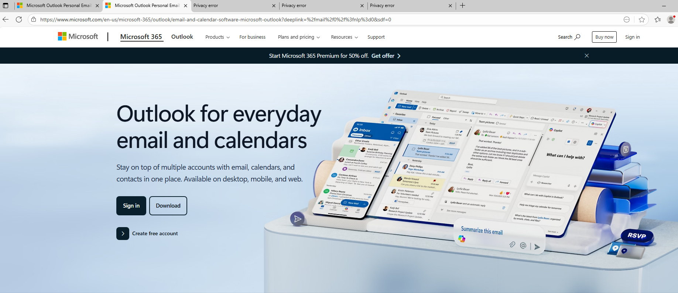
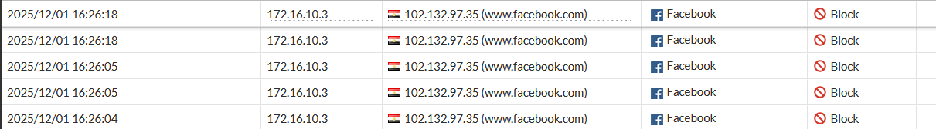
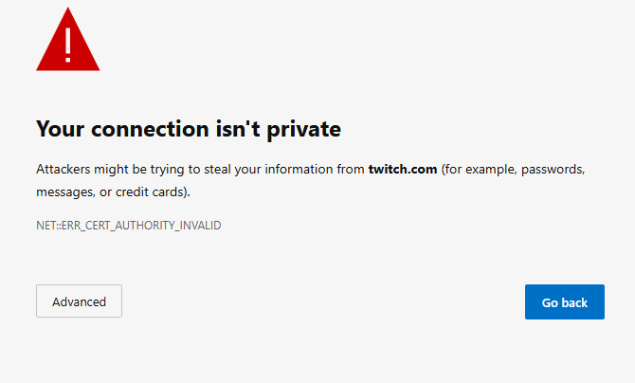
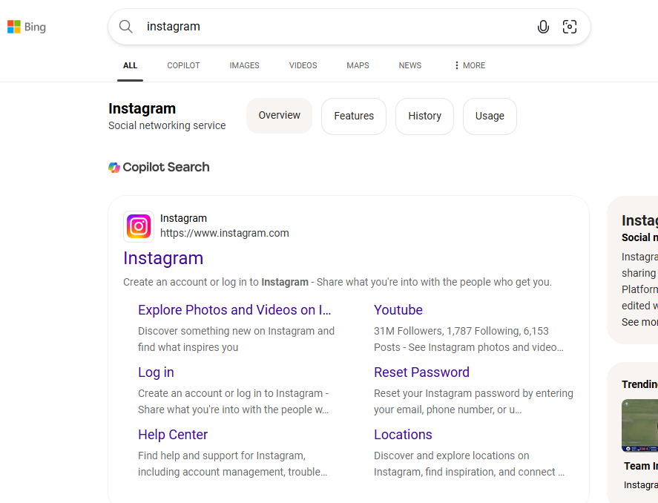
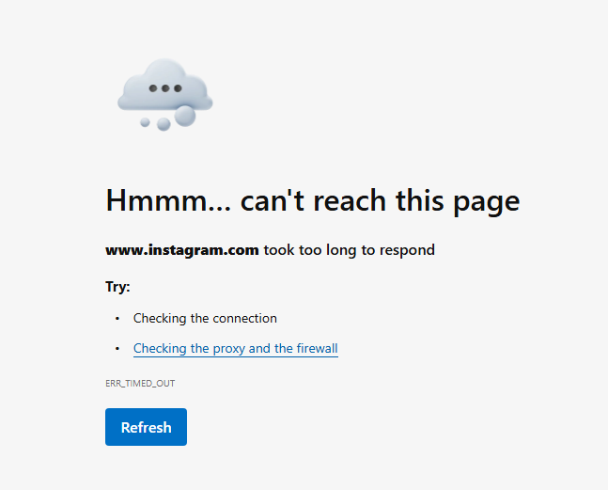
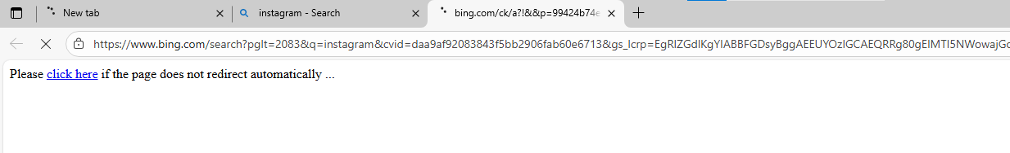
Keep in Mind > Deep inspection required!
As provided, Microsoft Outlook is working as
mentioned work-only (App control profile) used
While any streaming app is not working or social
media
even trying to access Instagram from bing.com
it still blocked

Slide 36
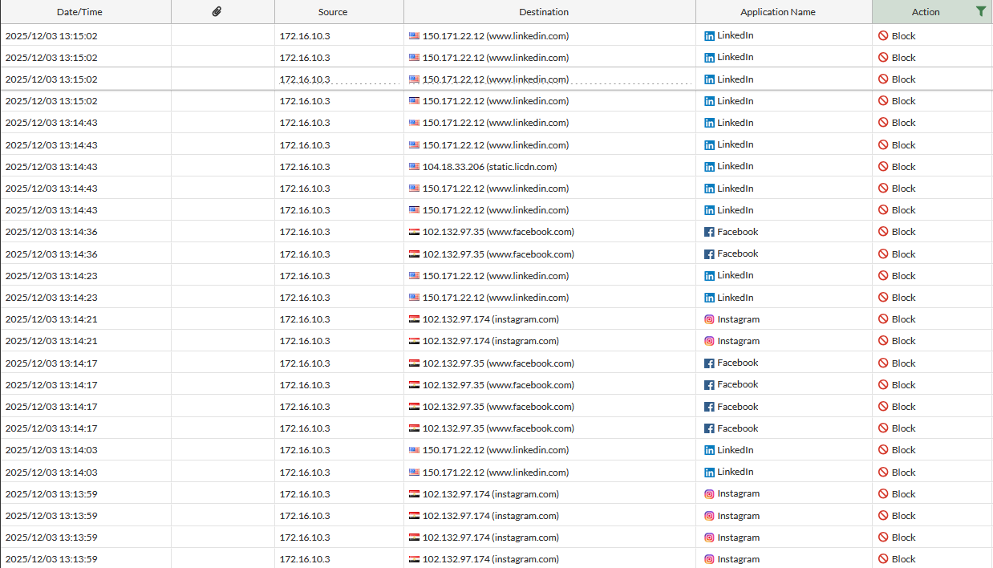
LOGS!
Security Events

Slide 37
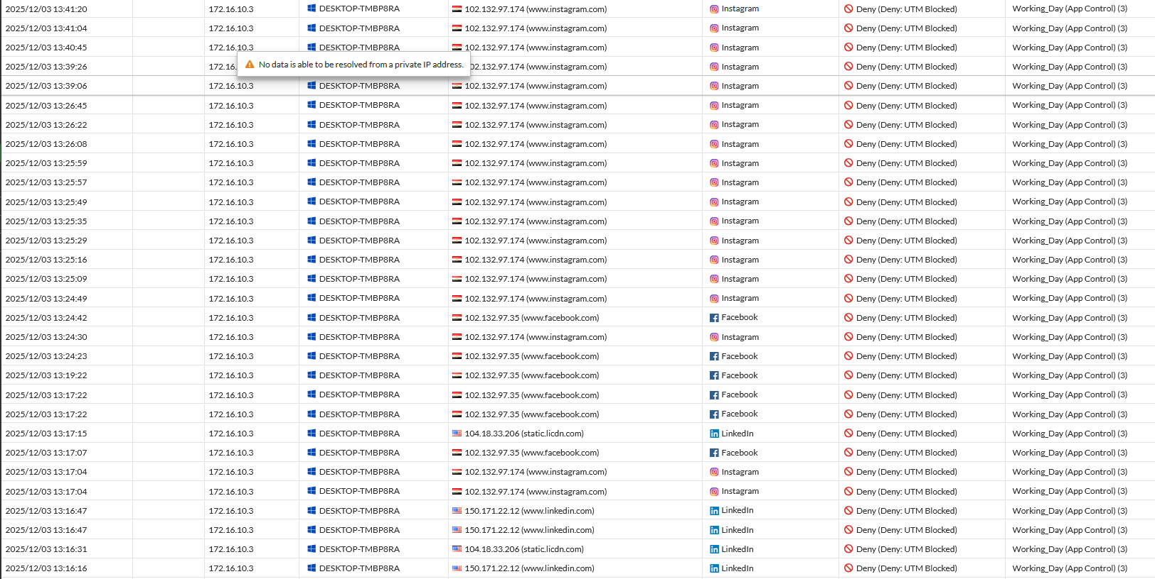
LOGS!
Forward Traffic shows Working Day (App Control) ➔ Firewall Policy

Slide 38
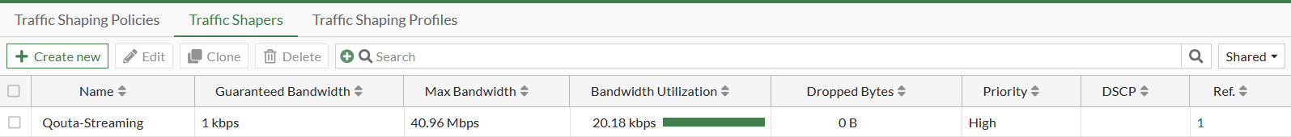
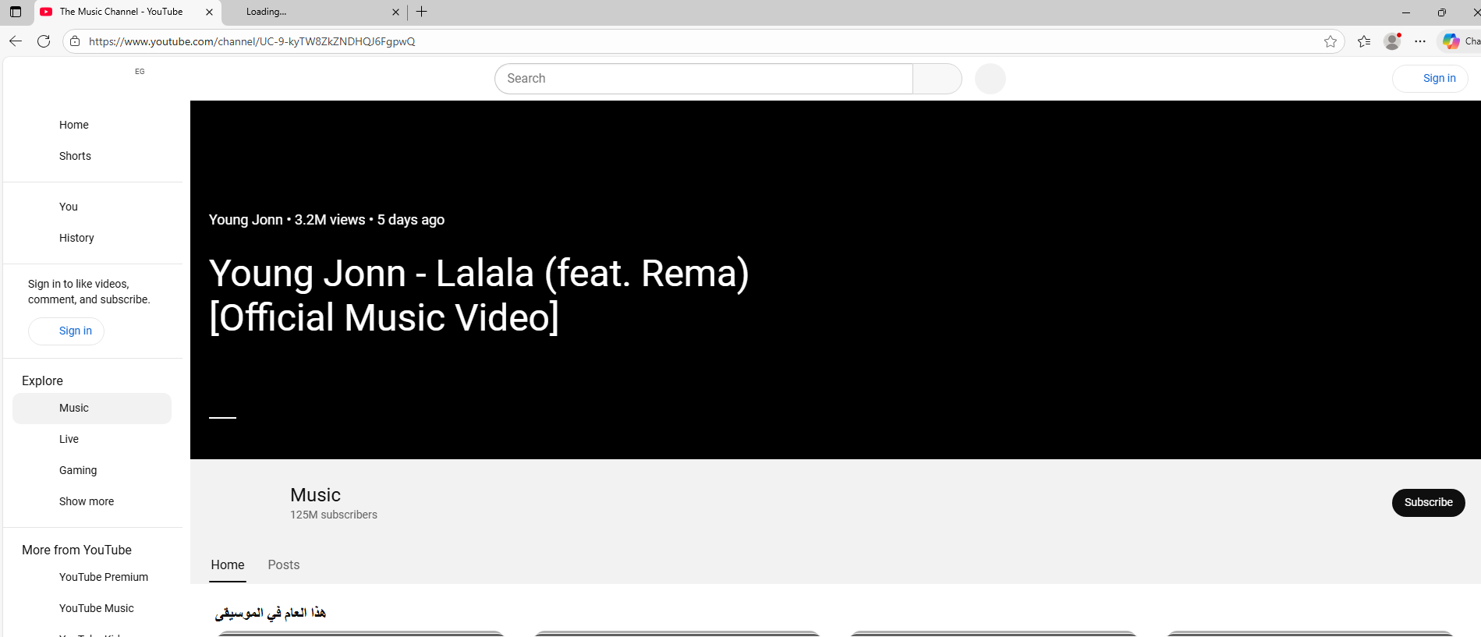
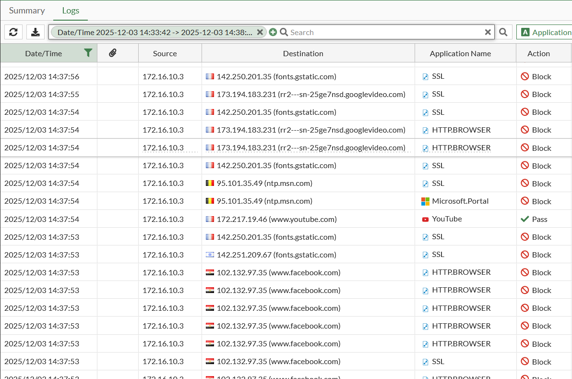
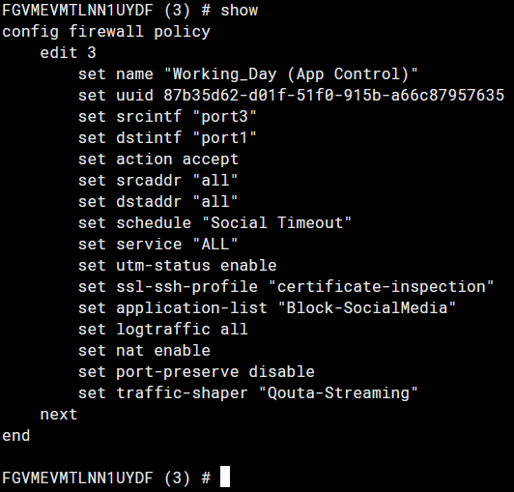
Traffic Shaper on Firewall Policy that gives any address using this policy 40.96 MB max bandwidth to use YouTube
Any other site will be blocked
To show the GUI option of traffic shaper we used following command
#config firewall policy
#(policy) edit 3 ((ID of Policy))
#(3) set traffic-shaper “Qouta-Streaming”
Between double quotation name of traffic
shaper used

Slide 39
Additional Configurations

Slide 40
Additional Configurations

Slide 41
Additional Configurations
- Overall Firewall Policies & Security Profiles used
- Schedule of Firewall Policies
- Tester Administrator (Profile for Test)

Slide 42
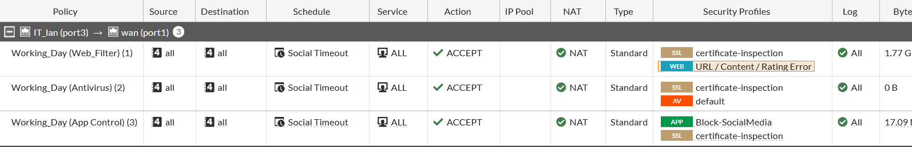
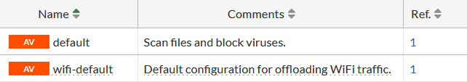
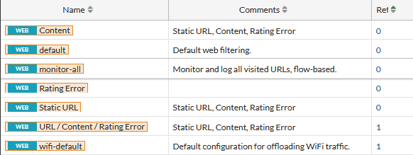
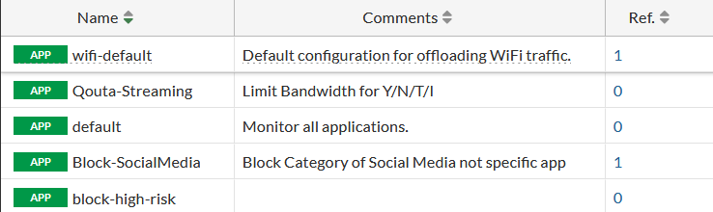
Overall Firewall Policies & Security Profiles used

Slide 43
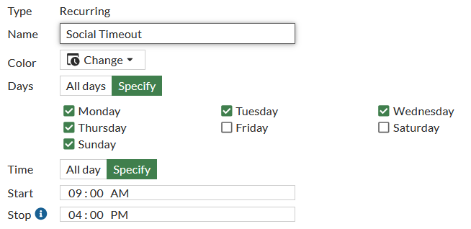
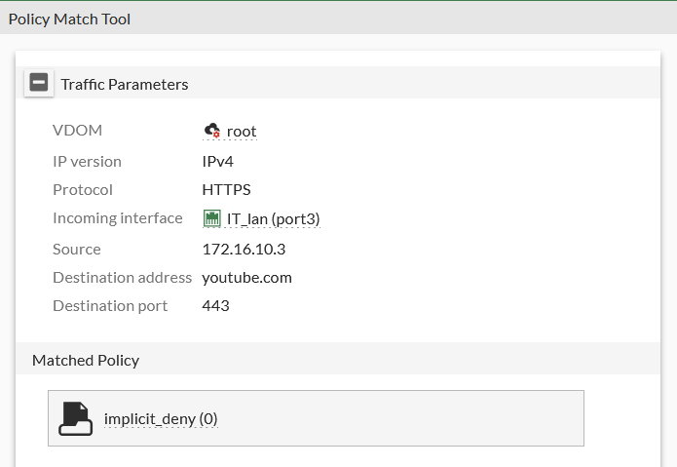

Schedule of Firewall Policies
When You search which policy used
You will find that Implicit policy deny applied Because all above are treated as disabled
Since the System time exceeds the stop time of Schedule used in Policy then STOP work is done for today

Slide 44
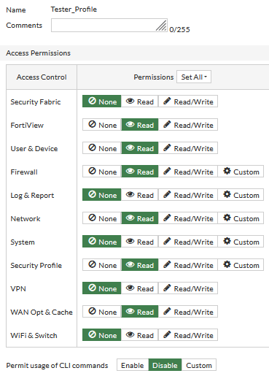
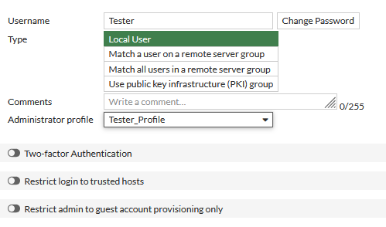
Tester Administrator
Tester Administrator Created (For more security) if you want to test it by yourself
Credentials:
Username : Tester
Password : Fortinet1!

Slide 45
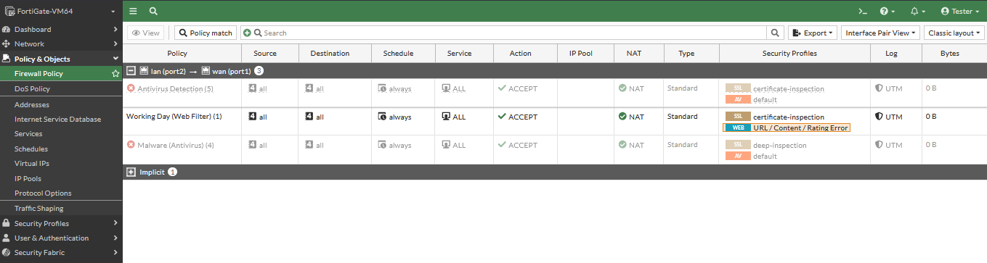
Tester Administrator
Tester Administrator Created (For more security) if you want to test it by yourself
Credentials:
Username : Tester
Password : Fortinet1!

Slide 46
Special Thanks
Wael
Our Instructor
Afaf
Eng. Afaf Wael
Verified

Slide 47
Team Worked
Team Worked
Mohamed Hassan Mahitab Fathy
Ahmed Yasser
Shimaa Saeed
Fadi Magdy
Asmaa Adel
Shaker Taha
VULN SHARKS TEAM
Verified

