Slide 1


Stock Genie
Your Trusted Trading Partner
Presented By:
Ahmed Hany
Alaa Alhalaby
Mohamed Sayed

Slide 2
About US
Company Name: Stocks Genie
Primary Color: Blue
Tagline: “Your trusted trading partner”
Mission: To provide users with powerful tools and insights to make informed stock trading decisions.
Competitive Advantage: Comprehensive analysis tools, user-friendly interface, and real-time data integration.

Slide 3
Our services
Stock Performance Overview: Real-time metrics like current price, daily change, and volume.
Portfolio Summary: Detailed view of portfolio performance, including total value and asset allocation.
Market Trends: Visualizations of market trends and patterns.
Stock Analysis Tools: Interactive charts, financial ratios, fundamental analysis, comparative analysis, news feed, and sentiment analysis.
Custom Alerts: Notifications for price, volume, and technical indicator movements.
Your personal trading coach
Your personal advisor
Your Stock Trading Platform
Featuring:

Slide 4

DOW Jones Index
30
KPI
Calculation: The DJIA is a price-weighted index, meaning that higher-priced stocks have a greater impact on the index's performance.
1896
Composition: 30 large, publicly-owned companies from various industries, excluding transportation and utilities.
Purpose: KPI for the U.S. stock market and the economy.
€€
Historical Significance: Established in 1896 by Charles Dow and Edward Jones.
The Dow Jones Industrial Average (DJIA), is commonly known as the Dow Jones or simply the Dow.
A stock market index that tracks 30 prominent publicly traded companies listed on stock exchanges in the United States.

Slide 5

Introduction to S&P 500 Index
Market Benchmark
The S&P 500 serves as a benchmark for assessing the overall performance of the U.S. stock market.
Investment Strategy
Utilizing the S&P 500 aids investors in developing strategies for long-term investment based on historical trends.
Diversification Tool
The index offers a diversified portfolio option, minimizing risk by spreading investments across various sectors.
Economic Indicator
Changes in the S&P 500 provide insight into economic health and investor sentiment within the U.S. economy.

Slide 6

Comparison with Dow Jones Industrial Average
 | Dow Jones Industrial Average | S&P500 | Comparison
Number of Stocks | 30 large, publicly-owned companies | 500 leading U.S. companies | DJIA has 30 stocks, while S&P 500 includes 500 stocks
Market Capitalization | Price-weighted index | Market capitalization-weighted index | DJIA is price-weighted; S&P 500 is market cap-weighted
Sector Representation | Excludes transportation and utilities sectors | Includes all sectors of the economy | S&P 500 offers broader sector representation
Investment Vehicle | Often used as a benchmark for blue-chip stocks | Widely regarded as the best single gauge of large-cap U.S. equities | S&P 500 is considered a more comprehensive measure of the U.S. stock market

Slide 7
Investment Vehicles: ETFs and Index Funds
Diversification ETFs and index funds offer exposure to multiple sectors within the S&P 500
Automatic Rebalancing
Index funds automatically adjust holdings and maintain alignment with the S&P 500
Cost-Effective
Lower expense ratios compared to actively managed funds enhance investor returns
Tax Efficiency
ETFs usually encounter lower capital gains rates due la their structure
Investment Minimums
Many index funds require minimal initial investments, making them accessible tor all investors
Passive Management Both vehicle types use a passive investment strategy that Tracks index performance
Long-Term Growth Investing in these vehicles can help achieve solid long term capital appreciation
Liquidity ETFs are traded like stocks, allowing for real time buying and selling.

Slide 8

How does it work Let’s Stock trade

Slide 9
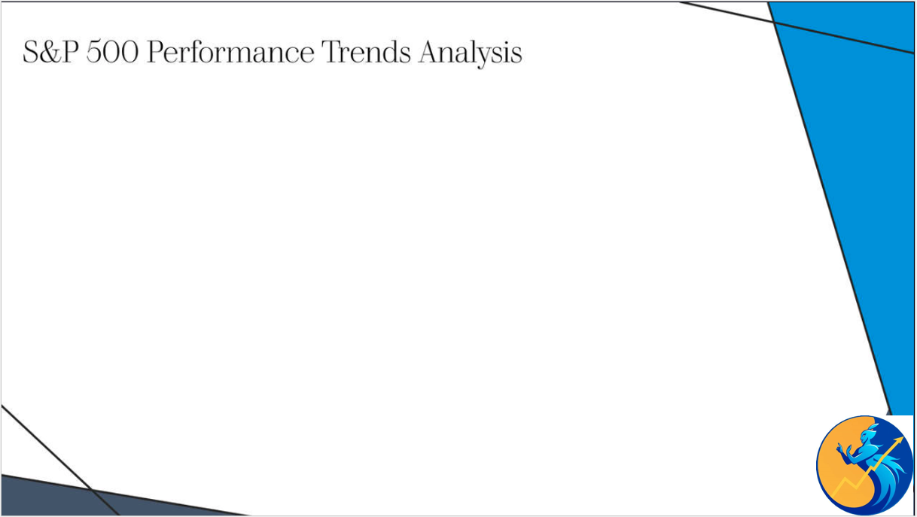


Slide 10
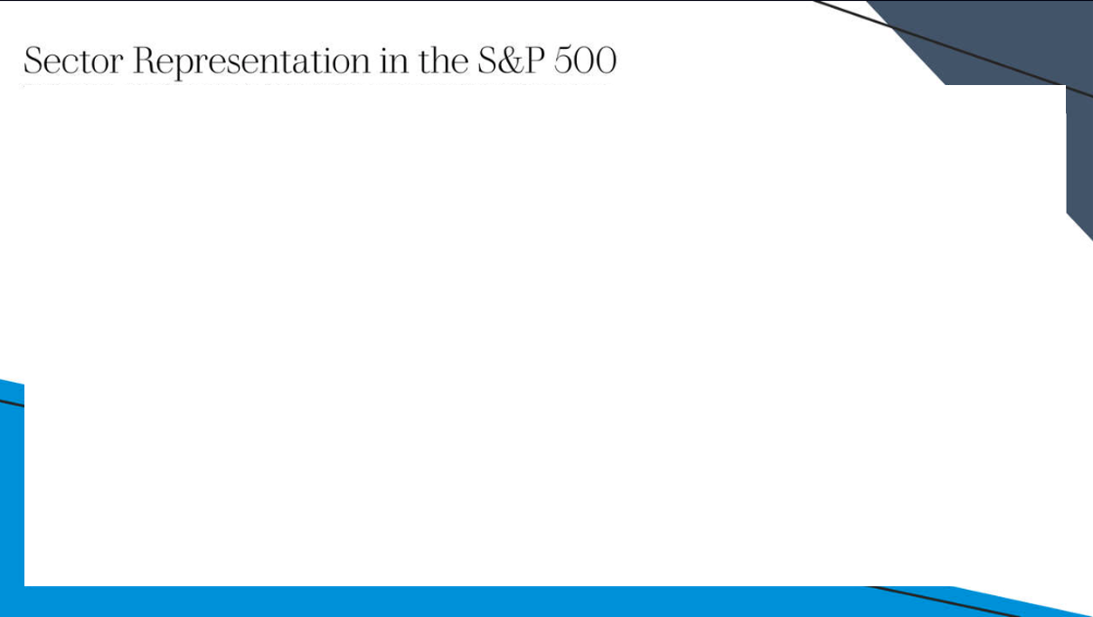

Slide 12
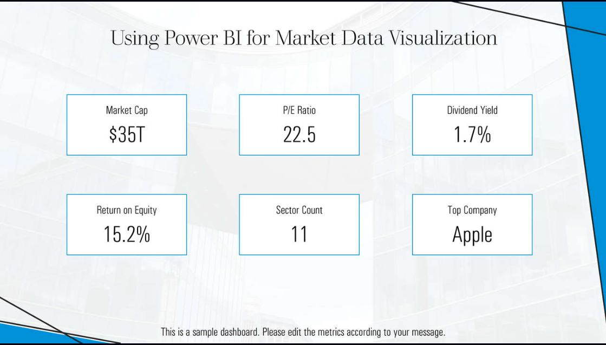

Slide 13
Insights and Recommendations for Investors
Market Trends Monitor key sectors to identify emerging investment opportunity
Historical Performance
Review past data to gauge potential future movements of the index
Diversification Investing across sectors reduces risk and enhances overall portfolio stability
Cost-Effective ETFs Use index funds or ETFs for low-cost exposure to the broader market
Long-Term Strategy
Focus on tong term growth instead of short-term market fluctuations
Risk Assessment Evaluate personal risk tolerance when investing in the S&P 500

Slide 14
Conclusion and Future Outlook
for S&P 500
S&P 500, DJIA serves as a key benchmarks for overall U.S. market health.
The indecies includes significant representation across various seders and industries
Investors can access the index through index funds and ETFs for diversification
Historicity, technology now represents the largest component of the S&P 500

Slide 15




Address
123 Market Street, Springfield, IL
Email Address
contact@stockgenie.com
Contact Number
(555) 1234567

