Slide 1
Numerical Methods (Root Finding Algorithms)

Slide 2
Team Members
Mohamed Emary
Mohamed Abdelfattah
Abdelfattah Zakaria
Sara Reda
Dalia Abdallah
Shrouk Elsayed

Slide 3
Agenda
Secant Method
Trisection
Hybrid Algorithm 1
Fixed Point
False-Position

Slide 4
Introduction
Numerical methods refer to algorithms that allow us to find approximate solutions to mathematical problems. They are important when the problems are too complex to have analytical solutions. One common numerical technique is root finding, which aims to find the roots or zeros of functions.
Root finding methods are used to solve equations. They start with an initial guess for the root and repeatedly improve the approximation until convergence to the root. Some common root finding algorithms include:

Slide 5
Common Root Finding Algorithms:
Bisection method
Secant method
Newton's method
False-Position
Fixed Point
Trisection
Hybrid Algorithm

Slide 6
Secant Method

Slide 7
Secant Method
The secant method is a root-finding numerical algorithm used for approximating the roots of a real-valued function.
It iteratively refines two initial guesses to converge towards a more accurate estimate of the root.
Secant method is similar to the Newton-Raphson method, but does not require calculating derivatives. Instead, it uses a linear approximation based on two previous iterates to estimate the next root.

Slide 8
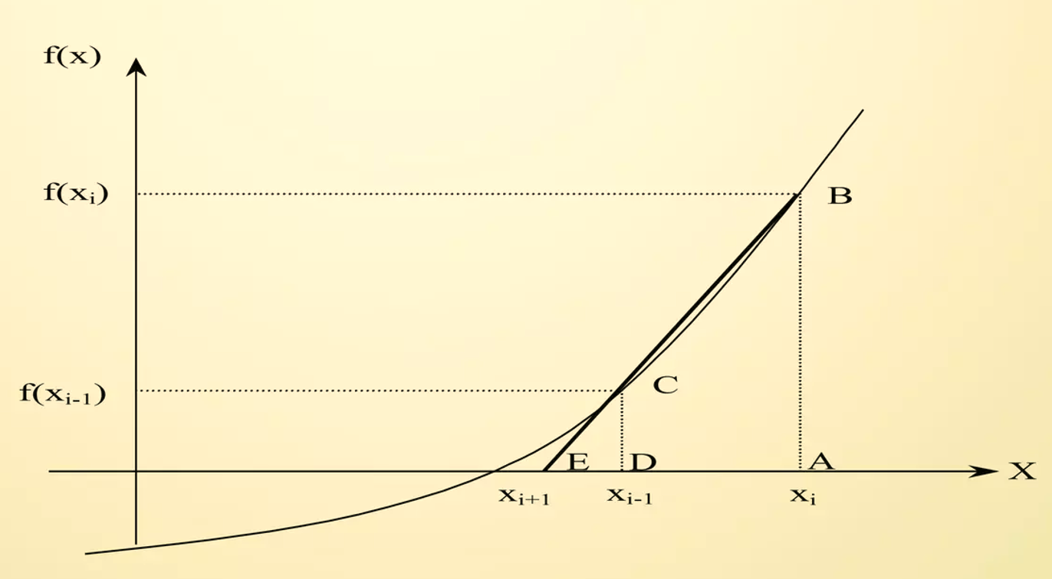
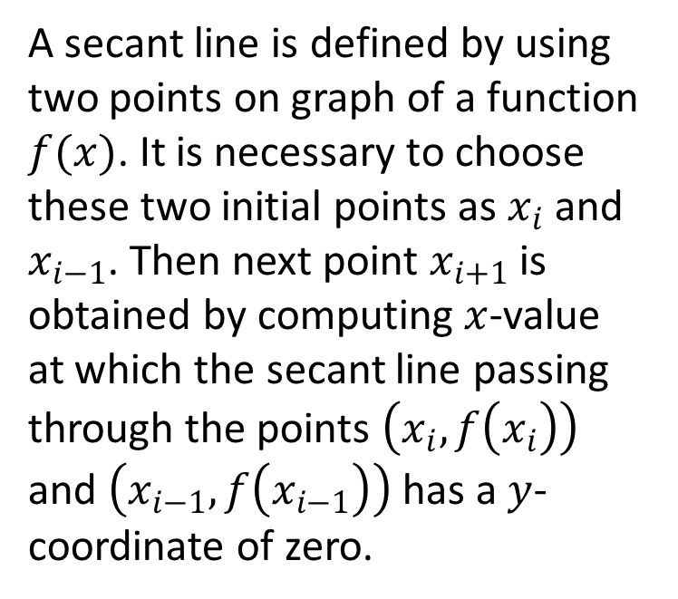
How does it works:
A secant line is defined by using two points on graph of a function $f(x)$. It is necessary to choose these two initial points as $x_{i}$and $x_{i−1}$. Then next point $x_{i+1}$ is obtained by computing $x$-value at which the secant line passing through the points $\left.\left(x_{i}, f\left.\left(x_{i}\right.\right)\right.\right)$ and $\left.\left(x_{i−1}, f\left.\left(x_{i−1}\right.\right)\right.\right)$ has a $y$-coordinate of zero.

Slide 9
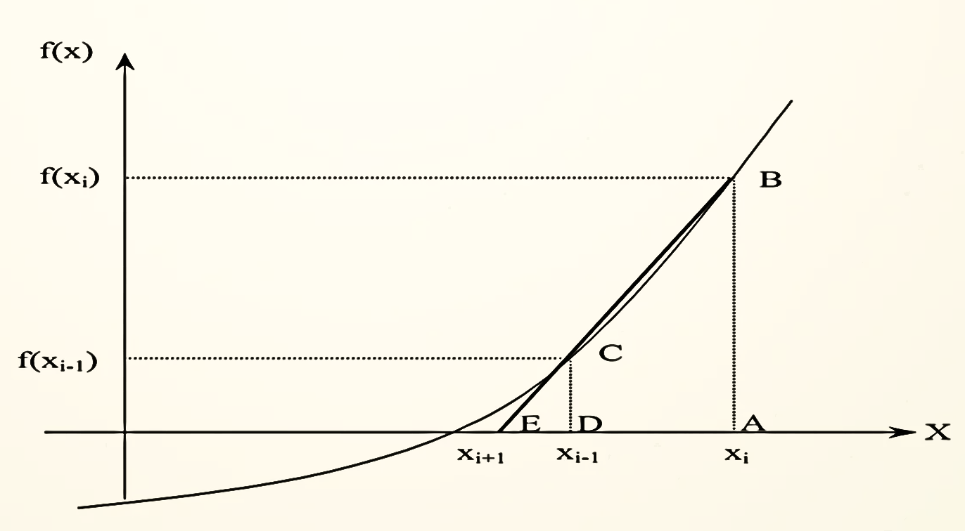
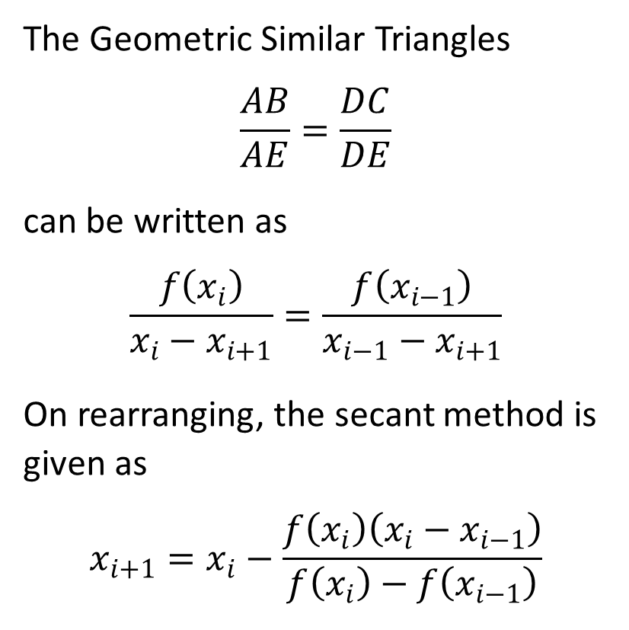
The Geometric Similar Triangles
$$\frac{AB}{AE}=\frac{DC}{DE}$$
can be written as
$$\frac{f\left(x_{i}\right)}{x_{i}−x_{i+1}}=\frac{f\left(x_{i−1}\right)}{x_{i−1}−x_{i+1}}$$
On rearranging, the secant method is given as
$$x_{i+1}=x_{i}−\frac{f\left(x_{i}\right)\left(x_{i}−x_{i−1}\right)}{f\left(x_{i}\right)−f\left(x_{i−1}\right)}$$

Slide 10
Advantages
Versatility: The secant method is versatile and applicable to a wide range of functions.
Generally converges faster than the bisection method
Requires two guesses that don’t need to bracket the root.
No Derivative Required: Unlike some other numerical methods, the secant method does not require the computation of derivatives which makes it better as in some cases derivative become very hard to find.

Slide 11
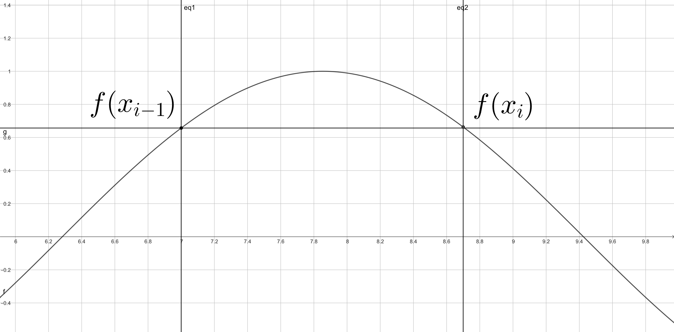
Disadvantages
Convergence: Convergence may not be guaranteed for all functions or initial guesses.
Sensitivity to Initial Guesses: The choice of initial guesses can affect convergence speed and the possibility of convergence.
Division by zero

Slide 12
Trisection Method

Slide 13
Definition
The trisection method is an iterative numerical technique used to approximate the root of a mathematical function. Similar to the bisection method, the trisection method divides the interval into three subintervals instead of two, making it potentially faster in converging towards the root

Slide 14
Steps :
1 . Initialization:
Choose an initial interval [a, b] where the root of the function lies.
Set a tolerance level (epsilon) to determine the desired accuracy of the result.
Initialize a counter (n) to keep track of the number of iterations.
2 . Iteration:
Divide the interval [a, b] into three subintervals: [a, (a + b) / 3], [(a + b) / 3, 2 * (a + b) / 3], and [2 * (a + b) / 3, b].
Evaluate the function at the two trisection points: f((a + b) / 3) and f(2 * (a + b) / 3).
Determine the subinterval with a sign change (i.e., one trisection point has a different sign than the other).
Update the interval: Set a or b to the corresponding trisection point based on the sign change.
Increment the iteration counter (n).

Slide 15
Example :
Function:
f(x)=x^3−6x^2+11x−6
Initial Interval:
[a,b]=[1,3]
Tolerance:
ϵ=10^−6

Slide 16
Iterations :
Iteration 1:
Subintervals: [1,2], [2,2.6667], [2.6667,3]
Evaluate f(1), f(2), and f(2.6667)
Choose the subinterval with a sign change: [2,2.6667]
Iteration 2:
Subintervals: [2,2.2222], [2.2222,2.4444], [2.4444,2.6667]
Evaluate f(2), f(2.2222), and f(2.4444)
Choose the subinterval with a sign change: [2,2.2222]
Iteration 3:
Subintervals: [2,2.0741],[2.0741,2.1482], [2.1482,2.2222]
Evaluate f(2), f(2.0741), and f(2.1482)
Choose the subinterval with a sign change: [2,2.0741]
….Continue iterations until the interval width is smaller than the tolerance (∣a−b∣<ϵ).

Slide 17
When end ?
Repeat the iteration until the absolute difference between a and b is smaller than the tolerance level (|a - b| < epsilon) or until a maximum number of iterations is reached.
The midpoint of the final interval [a, b] can be considered as an approximate root of the function.

Slide 18
Advantages and Disadvantages:
Advantages:
Potentially faster convergence compared to the bisection method because it divides the interval into three parts.
Useful for functions with complex behavior where a single interval might not capture the root effectively.
Disadvantages:
Requires more function evaluations per iteration compared to the bisection method.
Not always more accurate than the bisection method, especially if the function's behavior doesn't favor the trisection approach.

Slide 19
Hybrid Algorithm 1

Slide 20
What is Hybrid Algorithm
Hybrid Algorithm typically refers to a combination of different numerical techniques or methods to solve a particular problem. Hybrid algorithms are designed to leverage the strengths of multiple methods, enhancing the overall efficiency and accuracy of the solution. Hybrid Algorithm 1 (HA1) is a specific instance of such an approach, where two or more numerical methods are combined in a unique way to solve a given problem.

Slide 21
The exact details of Hybrid Algorithm 1
can vary based on the specific problem it is applied to. However, the general idea behind any hybrid algorithm is to use different methods at different stages of the computation or to combine their results in a way that takes advantage of their individual strengths. For example, consider a problem of solving a complex mathematical equation or system of equations. Hybrid Algorithm 1 might involve an initial approximation using a simple and fast method, such as the bisection method or the secant method. Once an approximate solution is obtained, a more accurate but computationally intensive method like Newton-Raphson method or the method of conjugate gradients might be applied to refine the solution further.

Slide 22
The Nature of Hybrid Algorithm 1
The hybrid nature of this approach lies in the strategic use of different methods: simpler methods for initial approximation and more complex methods for fine-tuning the solution. This combination allows for faster convergence and improved accuracy compared to using any single method alone.
It's important to note that the success of a hybrid algorithm depends on the careful selection of methods and the logic used to switch between them during the computation. The goal is to strike a balance between computational efficiency and solution accuracy, making hybrid algorithms a valuable tool in numerical analysis and scientific computing.

Slide 23
How does Hybrid Algorithm work?
Hybrid algorithms work by combining the strengths of different numerical methods to solve a given problem. The general idea is to use multiple methods strategically at different stages of the computation, taking advantage of their individual strengths to improve the overall efficiency, accuracy, and convergence of the solution. Here's a step-by-step explanation of how a typical hybrid algorithm might work:

Slide 24
Step 1: Initialization
The hybrid algorithm starts by initializing the problem, setting up the initial conditions, and selecting appropriate initial guesses or approximations for the solution. This step is crucial as it provides the starting point for the computation.

Slide 25
Step 2: Application of Initial Method(s)
The algorithm applies one or more simple and fast numerical methods in the initial stages of the computation. These methods are chosen for their speed and ease of implementation. Examples include the bisection method, secant method, or even simpler techniques like linear interpolation. These methods provide rough approximations to the solution and help in narrowing down the search space.

Slide 26
Step 3: Assessment of Approximation
After applying the initial methods, the algorithm assesses the quality of the obtained approximation. If the approximation is accurate enough or falls within a predefined tolerance level, the computation might terminate, and the obtained solution is considered satisfactory.

Slide 27
Step 4: Refinement with Complex Methods
If the initial approximation does not meet the desired accuracy criteria, the algorithm switches to more complex and accurate numerical methods. These methods, such as Newton-Raphson method, conjugate gradient method, or others depending on the problem, are computationally more intensive but provide highly accurate solutions. The initial approximation serves as the starting point for these methods, allowing them to converge faster towards the true solution.

Slide 28
Step 5: Iterative Improvement
The complex numerical methods are applied iteratively, refining the solution in each iteration. The algorithm continuously evaluates the progress and checks if the solution has converged to the desired accuracy level. If the solution meets the convergence criteria, the algorithm terminates, and the refined solution is obtained.

Slide 29
Step 6: Post-Processing (Optional)
Depending on the specific problem, post-processing steps might be applied to further enhance the solution or extract additional information from the results. Post-processing could involve error analysis, visualization, or other techniques relevant to the problem domain.

Slide 30
Step 7: Termination
The algorithm terminates when the solution meets the predefined accuracy requirements, or a maximum number of iterations are reached without achieving the desired accuracy.
The effectiveness of a hybrid algorithm lies in the intelligent selection and combination of methods, as well as the logic used to transition between them. This approach allows the algorithm to benefit from the simplicity of initial methods and the accuracy of complex methods, leading to efficient and precise solutions for a wide range of numerical problems.

Slide 31
Fixed Point Method

Slide 32


Introduction
The fixed point iteration method one of the open methods that use initial point to find the root of equation . It uses the concept of a fixed point in a repeated manner to compute the solution of non-linear equation. A fixed point is a point in the domain of a function g such that g(x) = x. In the fixed point iteration method, the given function f(x) = 0 is algebraically converted in the form of g(x) = x.

Slide 33
Topic one
Fixed Point Iteration Method

Slide 34
Fixed Point Iteration Method :
Suppose we have an equation f(x) = 0, for which we have to find the solution. The equation can be expressed as x = g(x). Choose g(x) such that |g’(x)| < 1 at x = x_{o} where x_{o} is some initial guess called fixed point iterative scheme. Then the iterative method is applied by successive approximations given by x_{i+1} = g(x_{i} )
i= 0,1,2,… ,that is, x₁ = g(x_{o}), x₂ = g(x₁) and so on.

Slide 35
Topic Two
Algorithm of Fixed Point Iteration Method

Slide 36
Algorithm of fixed point iteration method to find the root of f (x) = 0 :
Input:
-The function f(x),
-The interval [a, b] where the root lies in ,which f(a) < 0 and f(b)>0.
-The absolute error (eps).
Output:
-The root (x),
-The value of f(x)
-Numbers of iterations (n)

Slide 37
1-Choose the initial value x_{o} for the iterative method. One way to choose x_{o} is, take x_{o} as the average of a and b. 2- Express the given equation, in the form x = g(x) such that |g’(x)| < 1 at x = x_{o}. If there more than one possibility of g(x), choose the g(x) which has the minimum value of g’(x) at x = x_{o} 3- Use an initial guess of the root x_{i} to estimate the new value of the root x_{i + 1}using the formula: x_{i+1} = g(x_{i} ) . 4- Go to step 3 until | x_{i+1} - x_{i}|<= and/or | g(x_{i+1} ) |<=

Slide 38
Topic Three
Fixed point example

Slide 39
Example:
Given f(x) = x – cos(x) , eps = 10^-4 , x_{o} = 1
_{Solution}
Rarrange to f(x) in the form x = g(x) and verify that
|g’(x)| < 1 at x = x_{o} such that :
x = x+cos(x) /2
Estimate the new values of the root by using this formula:
x_{i+1} = x_{i} + cos(x_{i}) / 2

Slide 40
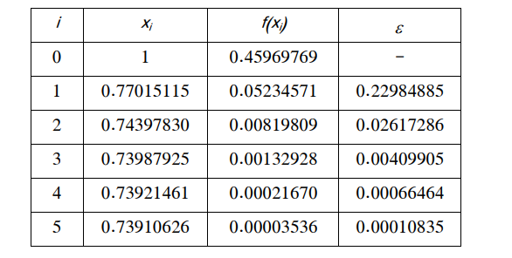
- we note that the value of f(x)~=0, and the value of eps reached to 10^-4 - the values of x are converging.

Slide 41
Topic Four
Advantages and Disadvantages of Fixed point method.

Slide 42
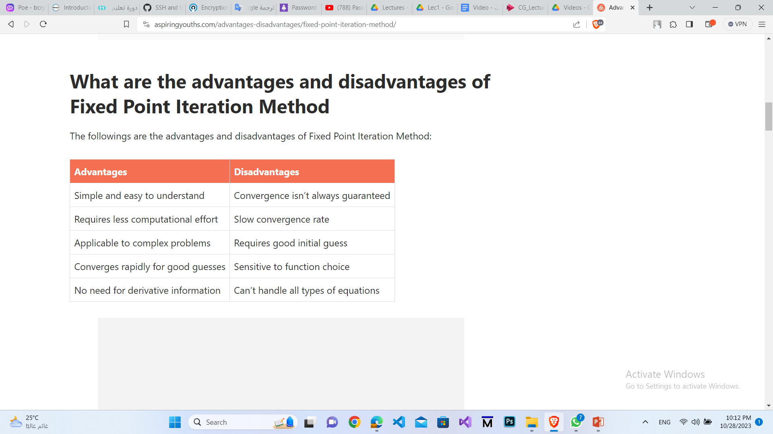
Advantages and Disadvantages of Fixed point method:

Slide 43
Encryption Algorithms

Slide 44
Agenda
AES
Diffie–Hellman
RSA
SHA-3
DES
SHA-256

Slide 45
Introduction
Encryption is the process of encoding information in such a way that only authorized parties can access it. Encryption algorithms play a vital role in protecting data in today's digital world.
There are several encryption techniques that use mathematical algorithms to transform plain text into ciphertext.

Slide 46
Introduction Cont.
Some common types of encryption algorithms include:
Symmetric-key algorithms where the same key is used for encryption and decryption. Examples are AES, DES, 3DES etc.
Asymmetric or public-key algorithms that use a public and private key pair for encryption and decryption. RSA and ECC are examples.
Hash functions that generate a digest of the input message. Algorithms like SHA-256 and MD5 are often used.

Slide 47
AES (Advanced Encryption Standard)

Slide 48
What is AES
The Advanced Encryption Standard (AES) is a symmetric block cipher chosen by the U.S. government to protect classified information.
The National Institute of Standards and Technology (NIST) started development of AES in 1997 when it announced the need for an alternative to the Data Encryption Standard (DES), which was starting to become vulnerable to brute-force attacks.
AES is the industry standard as of now as it allows 128 bit, 192 bit and 256 bit encryption.

Slide 49
How AES encryption works
AES includes three block ciphers:
AES-128 uses a 128-bit key length to encrypt and decrypt a block of messages.
AES-192 uses a 192-bit key length to encrypt and decrypt a block of messages.
AES-256 uses a 256-bit key length to encrypt and decrypt a block of messages.
AES relies on a series of linked operations which involves replacing and shuffling of the input data.
Each cipher encrypts and decrypts data in blocks of 128 bits using cryptographic keys of 128, 192 and 256 bits, respectively.

Slide 50
Symmetric, also known as secret key, ciphers use the same key for encrypting and decrypting. The sender and the receiver must both know -- and use -- the same secret key.
There are 10 rounds for 128-bit keys, 12 rounds for 192-bit keys and 14 rounds for 256-bit keys. A round consists of several processing steps that include substitution, transposition and mixing of the input plaintext to transform it into the final output of ciphertext.

Slide 51
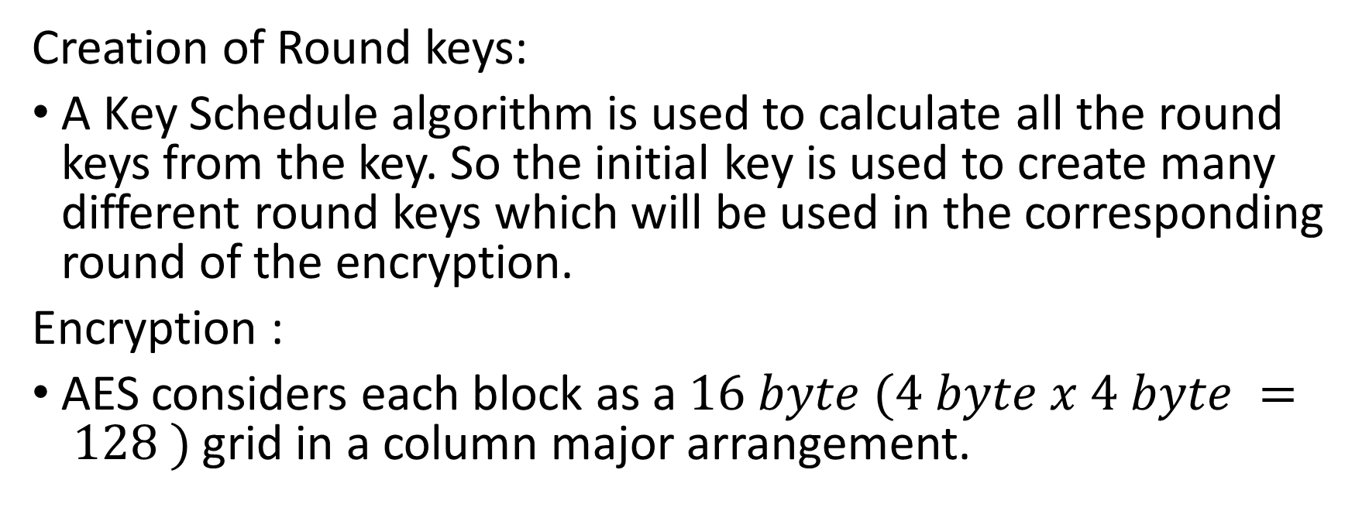
Steps :
Creation of Round keys:
A Key Schedule algorithm is used to calculate all the round keys from the key. So the initial key is used to create many different round keys which will be used in the corresponding round of the encryption.
Encryption :
AES considers each block as a $16 byte (4 byte x 4 byte = 128 )$grid in a column major arrangement.

Slide 52
Like this one:
[ b0 | b4 | b8 | b12 |
| b1 | b5 | b9 | b13 |
| b2 | b6 | b10| b14 |
| b3 | b7 | b11| b15 ]
Each round comprises of 4 steps :
SubBytes
ShiftRows
MixColumns
Add Round Key
The last round doesn’t have the MixColumns round.

Slide 53
Add Round Key: You pass the block data stored in the state array through an XOR function with the first key generated (K0). It passes the resultant state array on as input to the next step.
Sub-Bytes: In this step, it converts each byte of the state array into hexadecimal, divided into two equal parts. These parts are the rows and columns, mapped with a substitution box (S-Box) to generate new values for the final state array.
Shift Rows: It swaps the row elements among each other. It skips the first row. It shifts the elements in the second row, one position to the left. It also shifts the elements from the third row two consecutive positions to the left, and it shifts the last row three positions to the left.

Slide 54
Mix Columns: It multiplies a constant matrix with each column in the state array to get a new column for the subsequent state array. Once all the columns are multiplied with the same constant matrix, you get your state array for the next step. This particular step is not to be done in the last round.
Add Round Key: The respective key for the round is XOR’d with the state array is obtained in the previous step. If this is the last round, the resultant state array becomes the ciphertext for the specific block; else, it passes as the new state array input for the next round.

Slide 55
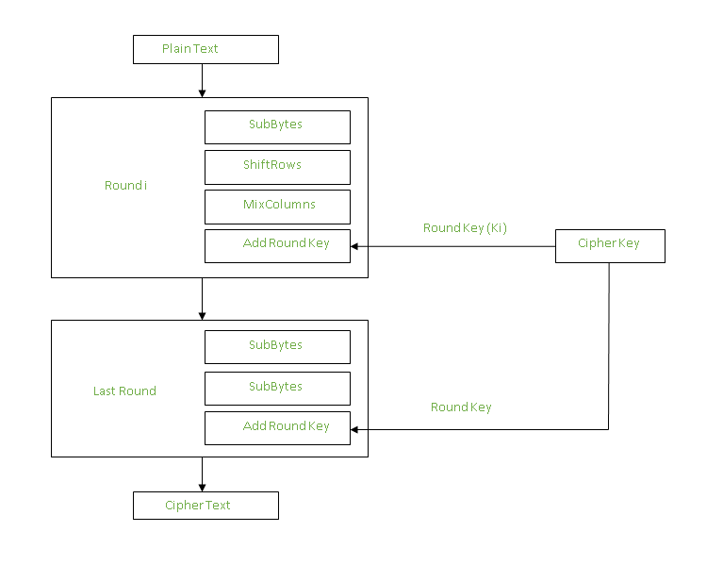

Slide 56
Applications
Wireless security: AES is used in securing wireless networks, such as Wi-Fi networks, to ensure data confidentiality and prevent unauthorized access.
Database Encryption: AES can be applied to encrypt sensitive data stored in databases. This helps protect personal information, financial records, and other confidential data from unauthorized access in case of a data breach.
Secure communications: AES is widely used in protocols like such as internet communications, email, instant messaging, and voice/video calls.It ensures that the data remains confidential.
Data storage: AES is used to encrypt sensitive data stored on hard drives, USB drives, and other storage media, protecting it from unauthorized access in case of loss or theft.

Slide 57
Virtual Private Networks (VPNs): AES is commonly used in VPN protocols to secure the communication between a user’s device and a remote server. It ensures that data sent and received through the VPN remains private and cannot be deciphered by eavesdroppers.
Secure Storage of Passwords: AES encryption is commonly employed to store passwords securely. Instead of storing plaintext passwords, the encrypted version is stored. This adds an extra layer of security and protects user credentials in case of unauthorized access to the storage.
File and Disk Encryption: AES is used to encrypt files and folders on computers, external storage devices, and cloud storage. It protects sensitive data stored on devices or during data transfer to prevent unauthorized access.

Slide 58
RSA

Slide 59
Introduction
RSA encryption algorithm is the most common public-key algorithm that is also called the Asymmetric algorithm. Named after its inventors Rivest, Shamir, and Adelman (RSA). Asymmetric algorithms are those algorithms in which sender and receiver use different keys for encryption and decryption. Each sender is assigned a pair of keys:
Public key
Private key
The Public key is used for encryption, and the Private Key is used for decryption.

Slide 60
Topic one
Encryption / Decryption using public and private key

Slide 61
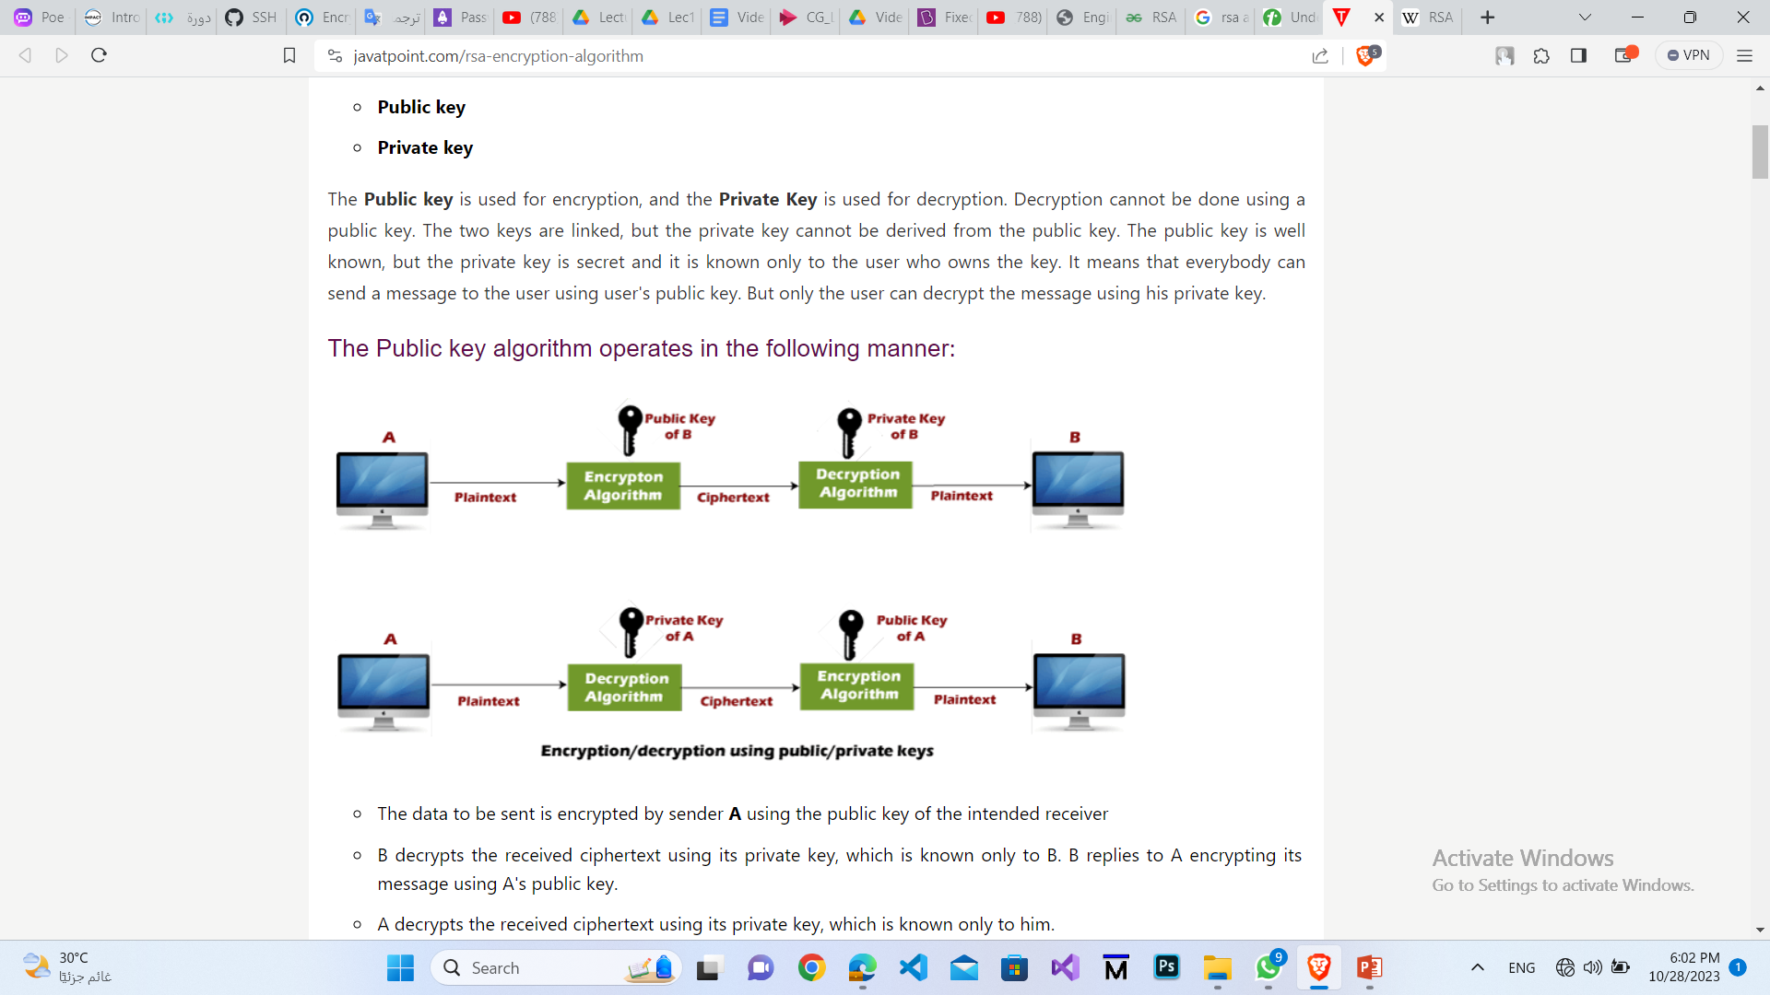
Encryption / Decryption using public and private key :

Slide 62
Encryption / Decryption using public and private key :
The data to be sent is encrypted by sender A using the public key of the intended receiver B.
B decrypts the received ciphertext using its private key, which is known only to B.

Slide 63
Topic Two
RSA encryption algorithm.

Slide 64
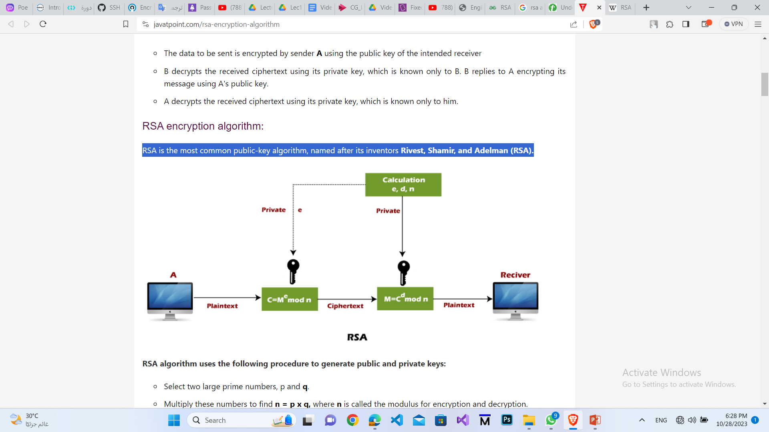
RSA encryption algorithm :

Slide 65
Steps of RSA algorithm :
1- Generate Public and Private Keys.
2- Encryption.
3- Decryption.

Slide 66
Generate Public and Private Keys :
1- Select two large prime numbers, p and q : p != q .
2- Multiply these numbers to find n = p x q .
3- calculate euler Φ(n) = (P-1)(Q-1) .
4- choose e : e must be an integer : Φ(n),e are co-prime,
gcd(e, Φ(n)) = 1 , 1 < e < Φ(n). better to be prime number.
5- Now to calculate Private Key compute d : such that e*d=1 mod ϕ(n) , d = e^-1 mod ϕ(n) .
-Public Key is made of n and e PU =(n,e)
- Private Key is made of n and d PU =(n,d)

Slide 67
Encryption :
To encrypt a message m, we need to convert it to an integer . This can be done using a reversible encoding scheme, such as ASCII or UTF-8.
Once we have the integer representation of the message, we compute the ciphertext c (encrypted message) as
c = m^e (mod n).

Slide 68
Decryption :
To decrypt the ciphertext c, we compute the plaintext m as
m = c^d (mod n).

Slide 69
Topic Three
some advantages and disadvantages of RSA.

Slide 70
Advantages and Disadvantages of RSA :
Advantages:
Security.
Asymmetric encryption.
- Digital signatures.
Disadvantages:
-Computational complexity.
Key management.
- Key size and storage.

Slide 71
DES

Slide 72
Intro about DES
DES, or Data Encryption Standard, is a symmetric-key encryption algorithm. DES became widely used for various applications, including securing electronic communications and financial transactions.
DES operates on blocks of data and uses a symmetric key, meaning the same key is used for both encryption and decryption. The standard key size for DES is 56 bits. In DES, the plaintext is divided into blocks of 64 bits, and the encryption process consists of several rounds of permutation, substitution, and transposition operations.

Slide 73
Key Features:
Symmetric Encryption: Uses the same key for both encryption and decryption.
Block Cipher: Operates on fixed-size blocks of data (64 bits).
Key Size: Original DES uses a 56-bit key.
Block Size: Processes data in 64-bit blocks.
Feistel Network: DES employs a Feistel network structure in its encryption process.
Rounds: Consists of 16 rounds of encryption operations.

Slide 74
Encryption Process:
Initial Permutation (IP): Rearranges the 64-bit input block.
Key Generation: Generates 16 subkeys for each round using the original 56-bit key.
16 Rounds of Operations: Each round includes Expansion, Substitution (using S-Boxes), Permutation, and XOR operations with the round key.
Final Permutation (FP): Rearranges the data after the 16 rounds.
Output: The result after the final permutation is the ciphertext.

Slide 75
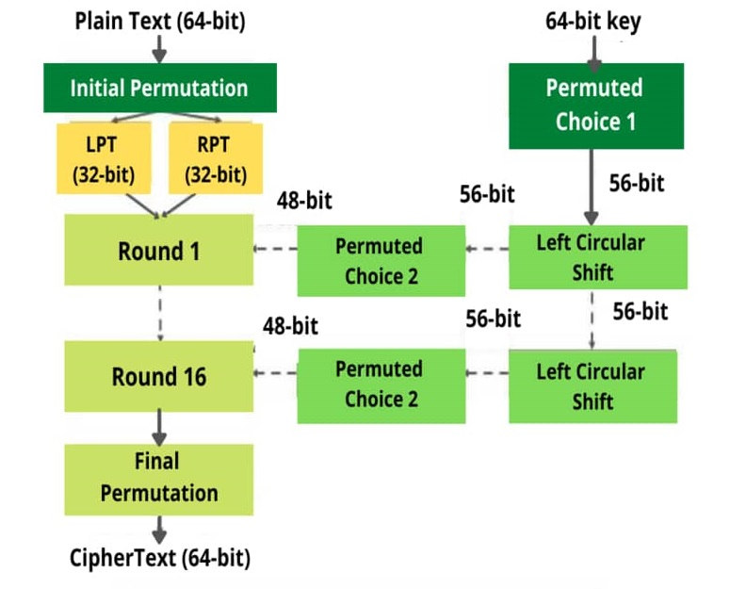
Algorithm of DES

Slide 76
Security Mechanisms:
Confusion and Diffusion: Achieved through complex substitution (S-Boxes) and permutation operations in each round.
S-Boxes: Substitution boxes provide non-linearity and enhance DES's resistance against various attacks.

Slide 77
Vulnerabilities and Limitations:
Small Key Size: 56-bit key size became vulnerable to brute-force attacks as computing power increased.
Known Vulnerabilities: Certain weaknesses, especially due to the fixed S-Box design, were discovered over time.
Limited Block Size: Fixed block size might not be suitable for all types of data.

Slide 78
Legacy and Transition:
Triple DES (3DES): Used as an interim solution by applying DES three times with different keys, enhancing security.
Successor: Eventually replaced by more advanced encryption standards like AES (Advanced Encryption Standard) with larger key sizes and increased security.
DES 3DES AES

Slide 79
Diffie-Hellman Exchange

Slide 80
Introduction
Diffie-Hellman is a widely used cryptographic protocol that allows two parties to securely share a secret key, without actually transmitting the key over an insecure channel. It is based on the mathematical problem of finding discrete logarithms in a finite group, and it provides a secure way for two parties to derive a shared secret key from a public parameter.

Slide 81
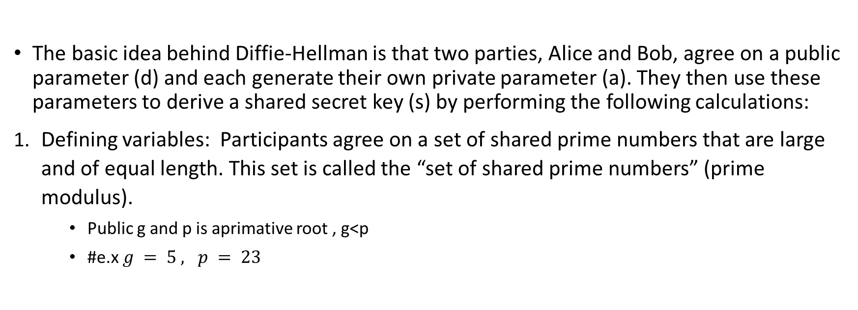
Idea of Diffie-Hellman
The basic idea behind Diffie-Hellman is that two parties, Alice and Bob, agree on a public parameter (d) and each generate their own private parameter (a). They then use these parameters to derive a shared secret key (s) by performing the following calculations:
Defining variables: Participants agree on a set of shared prime numbers that are large and of equal length. This set is called the “set of shared prime numbers” (prime modulus).
Public g and p is aprimative root , g<p
#e.x $g = 5 , p = 23$

Slide 82
Key generation: Each subscriber chooses a secret, random number called the “private key” Each participant calculates a shared public key called the “public key” using the primary root, the private number, the set of shared prime numbers, applying the exponentiation process, and mathematical calculations related to the difficult problem of calculating the ascending logarithm, Public keys are exchanged between participants.
a. Alice calculates = g^a mod p (a = 4)
b. Bob calculates = g^b mod p (b = 3)
Alice calculates = 5^4 mod23 = 4
Bob calculates = 5^3 mod23 = 10

Slide 83
Generate the secret key: Each participant calculates the secret key using the other public key, his own number, and the set of shared prime numbers, and applies the decimal exponentiation process and mathematical calculations related to the difficult problem of calculating the ascending logarithm.
KS (Alice)= g^ab mod p
KS(Bob)= g^ab mod p
KS (Alice)= KS(Bob)

Slide 84
4. Secret key exchange: Secret keys are exchanged between subscribers.
a = d log⁡(g,p) (g^amodp)
b = d log⁡(g,p) (g^bmodp)
4. Shared account: Once each subscriber has the other's secret key, they can use it to encrypt and decrypt messages exchanged between them.

Slide 85
Additional details about Diffie-Hellman
1. Security: Diffie-Hellman is considered to be a secure protocol for key exchange because it relies on the mathematical problem of finding discrete logarithms in a finite group, which is believed to be difficult to solve efficiently. The security of Diffie-Hellman depends on the choice of the prime number p and the generator d of the finite group Z\_p. If p is large enough and d is chosen appropriately, then it is believed that an attacker would need exponential time and resources to factorize p and compute d^(-1) mod p.
2. Efficiency: Diffie-Hellman is an efficient protocol for key exchange because it only requires a single exchange of values over an insecure channel, rather than multiple exchanges of large amounts of data. This makes it well-suited for use in real-time communication systems where speed and efficiency are important.
3. Key management: In order to use Diffie-Hellman effectively, both parties need to manage their private parameters (a and b) securely. This typically involves deriving these values from a longer secret key using a one-way function such as a hash function or a public key encryption algorithm (e.g., RSA). The shared secret key (s) can then be used to encrypt or authenticate messages between Alice and Bob.

Slide 86
Additional details about Diffie-Hellman Cont.
4. Variations: There are several variations of the Diffie-Hellman protocol that have been developed over the years in response to specific security concerns or performance requirements. Some examples include:
* ECDiffie-Hellman (also known as ECDH), which uses elliptic curve cryptography instead of integer arithmetic; this can improve efficiency for certain applications while maintaining strong security guarantees.
* Quantum Diffie-Hellman, which uses quantum mechanics principles to perform key exchange more efficiently; however, this approach is still under development and has not yet been widely adopted due to technical challenges and potential vulnerabilities.

