Slide 1
Numerical Methods

Slide 2
Secant Method

Slide 3
Secant Method
The secant method is a root-finding numerical algorithm used for approximating the roots of a real-valued function.
It iteratively refines two initial guesses to converge towards a more accurate estimate of the root.
Secant method is similar to the Newton-Raphson method, but does not require calculating derivatives. Instead, it uses a linear approximation based on two previous iterates to estimate the next root.

Slide 4
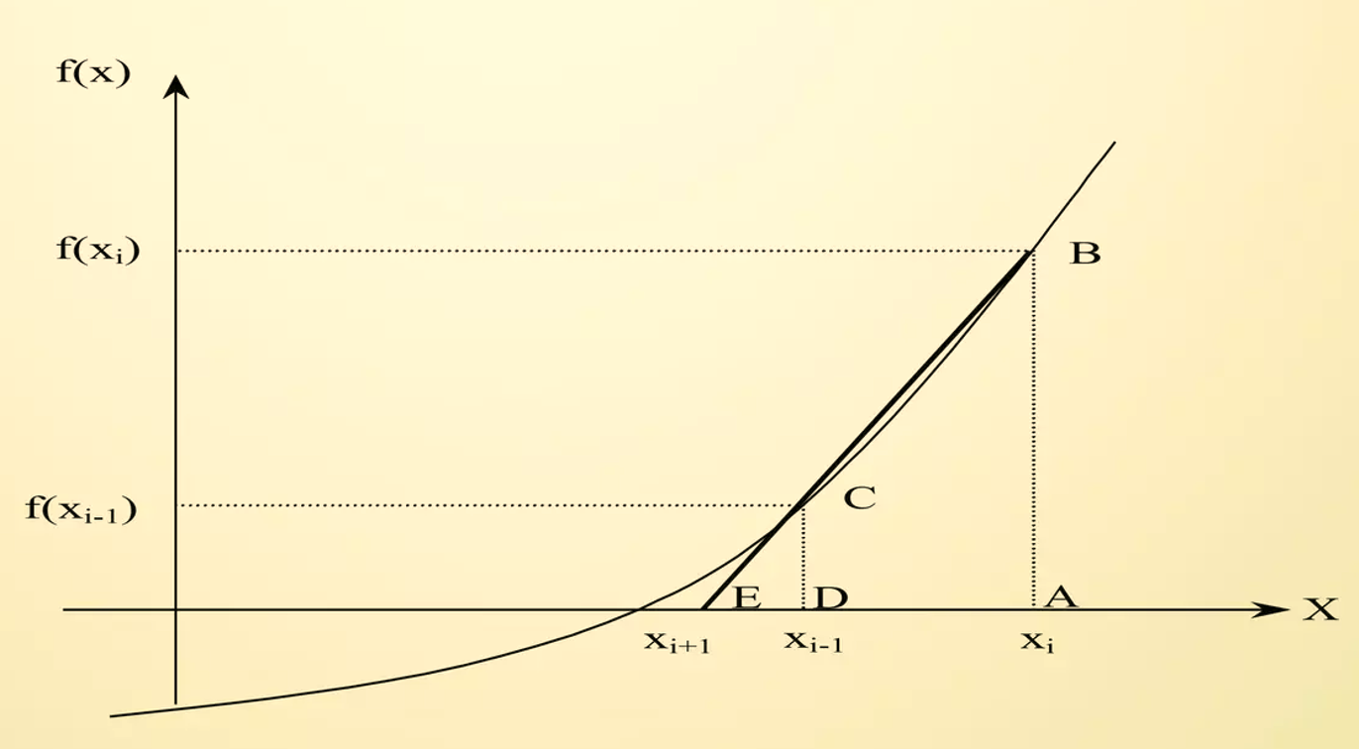
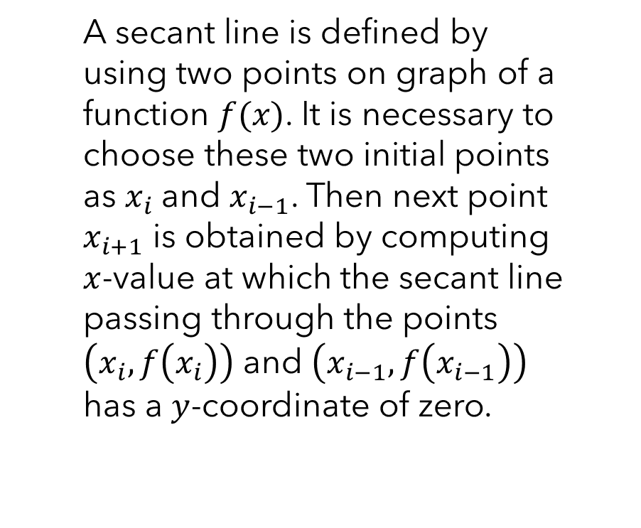
How does it works:
A secant line is defined by using two points on graph of a function $f(x)$. It is necessary to choose these two initial points as $x_{i}$and $x_{i−1}$. Then next point $x_{i+1}$ is obtained by computing $x$-value at which the secant line passing through the points $\left.\left(x_{i}, f\left.\left(x_{i}\right.\right)\right.\right)$ and $\left.\left(x_{i−1}, f\left.\left(x_{i−1}\right.\right)\right.\right)$ has a $y$-coordinate of zero.

Slide 5
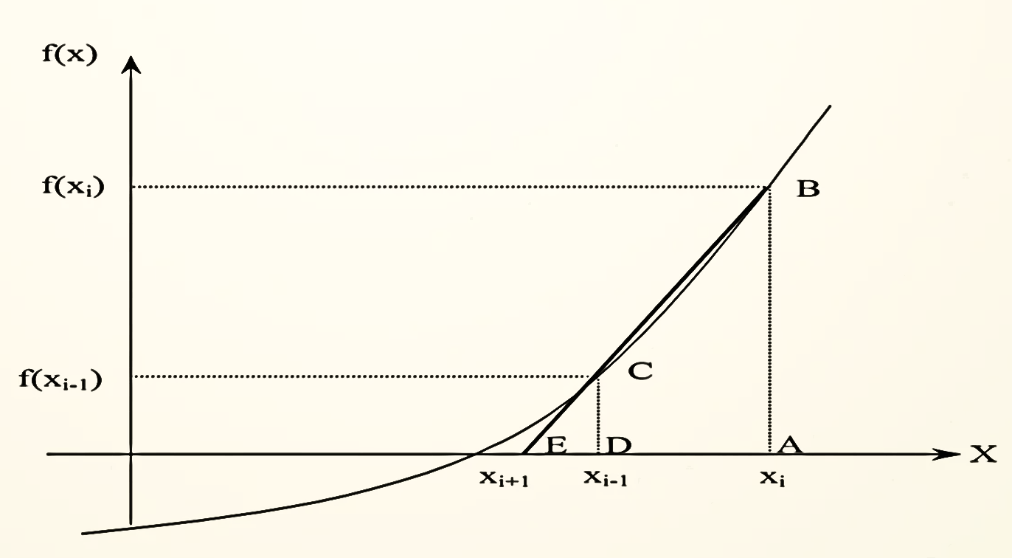
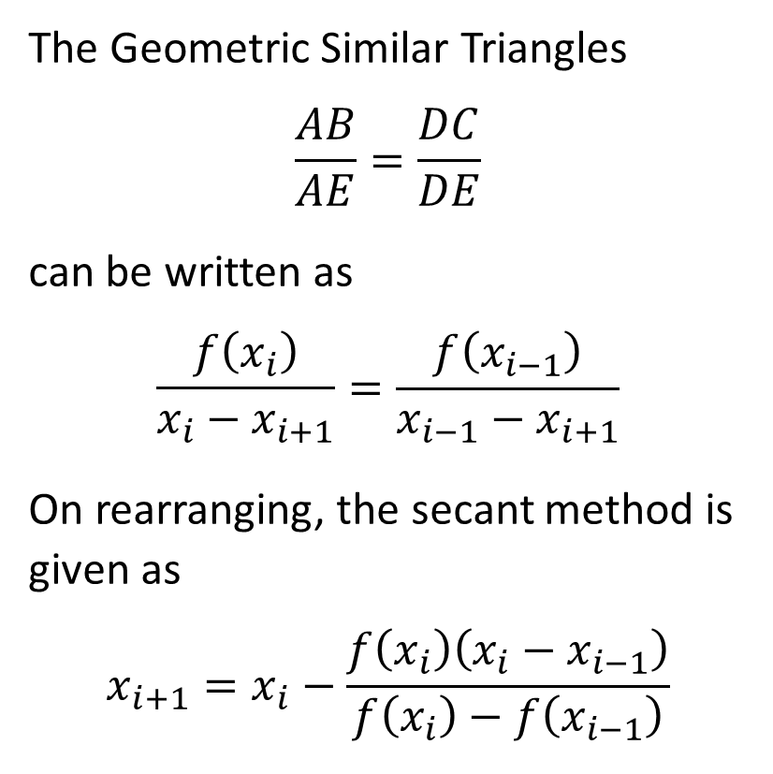
The Geometric Similar Triangles
$$\frac{AB}{AE}=\frac{DC}{DE}$$
can be written as
$$\frac{f\left(x_{i}\right)}{x_{i}−x_{i+1}}=\frac{f\left(x_{i−1}\right)}{x_{i−1}−x_{i+1}}$$
On rearranging, the secant method is given as
$$x_{i+1}=x_{i}−\frac{f\left(x_{i}\right)\left(x_{i}−x_{i−1}\right)}{f\left(x_{i}\right)−f\left(x_{i−1}\right)}$$

Slide 6
Advantages
Versatility: The secant method is versatile and applicable to a wide range of functions.
Generally converges faster than the bisection method
Requires two guesses that don’t need to bracket the root.
No Derivative Required: Unlike some other numerical methods, the secant method does not require the computation of derivatives which makes it better as in some cases derivative become very hard to find.

Slide 7
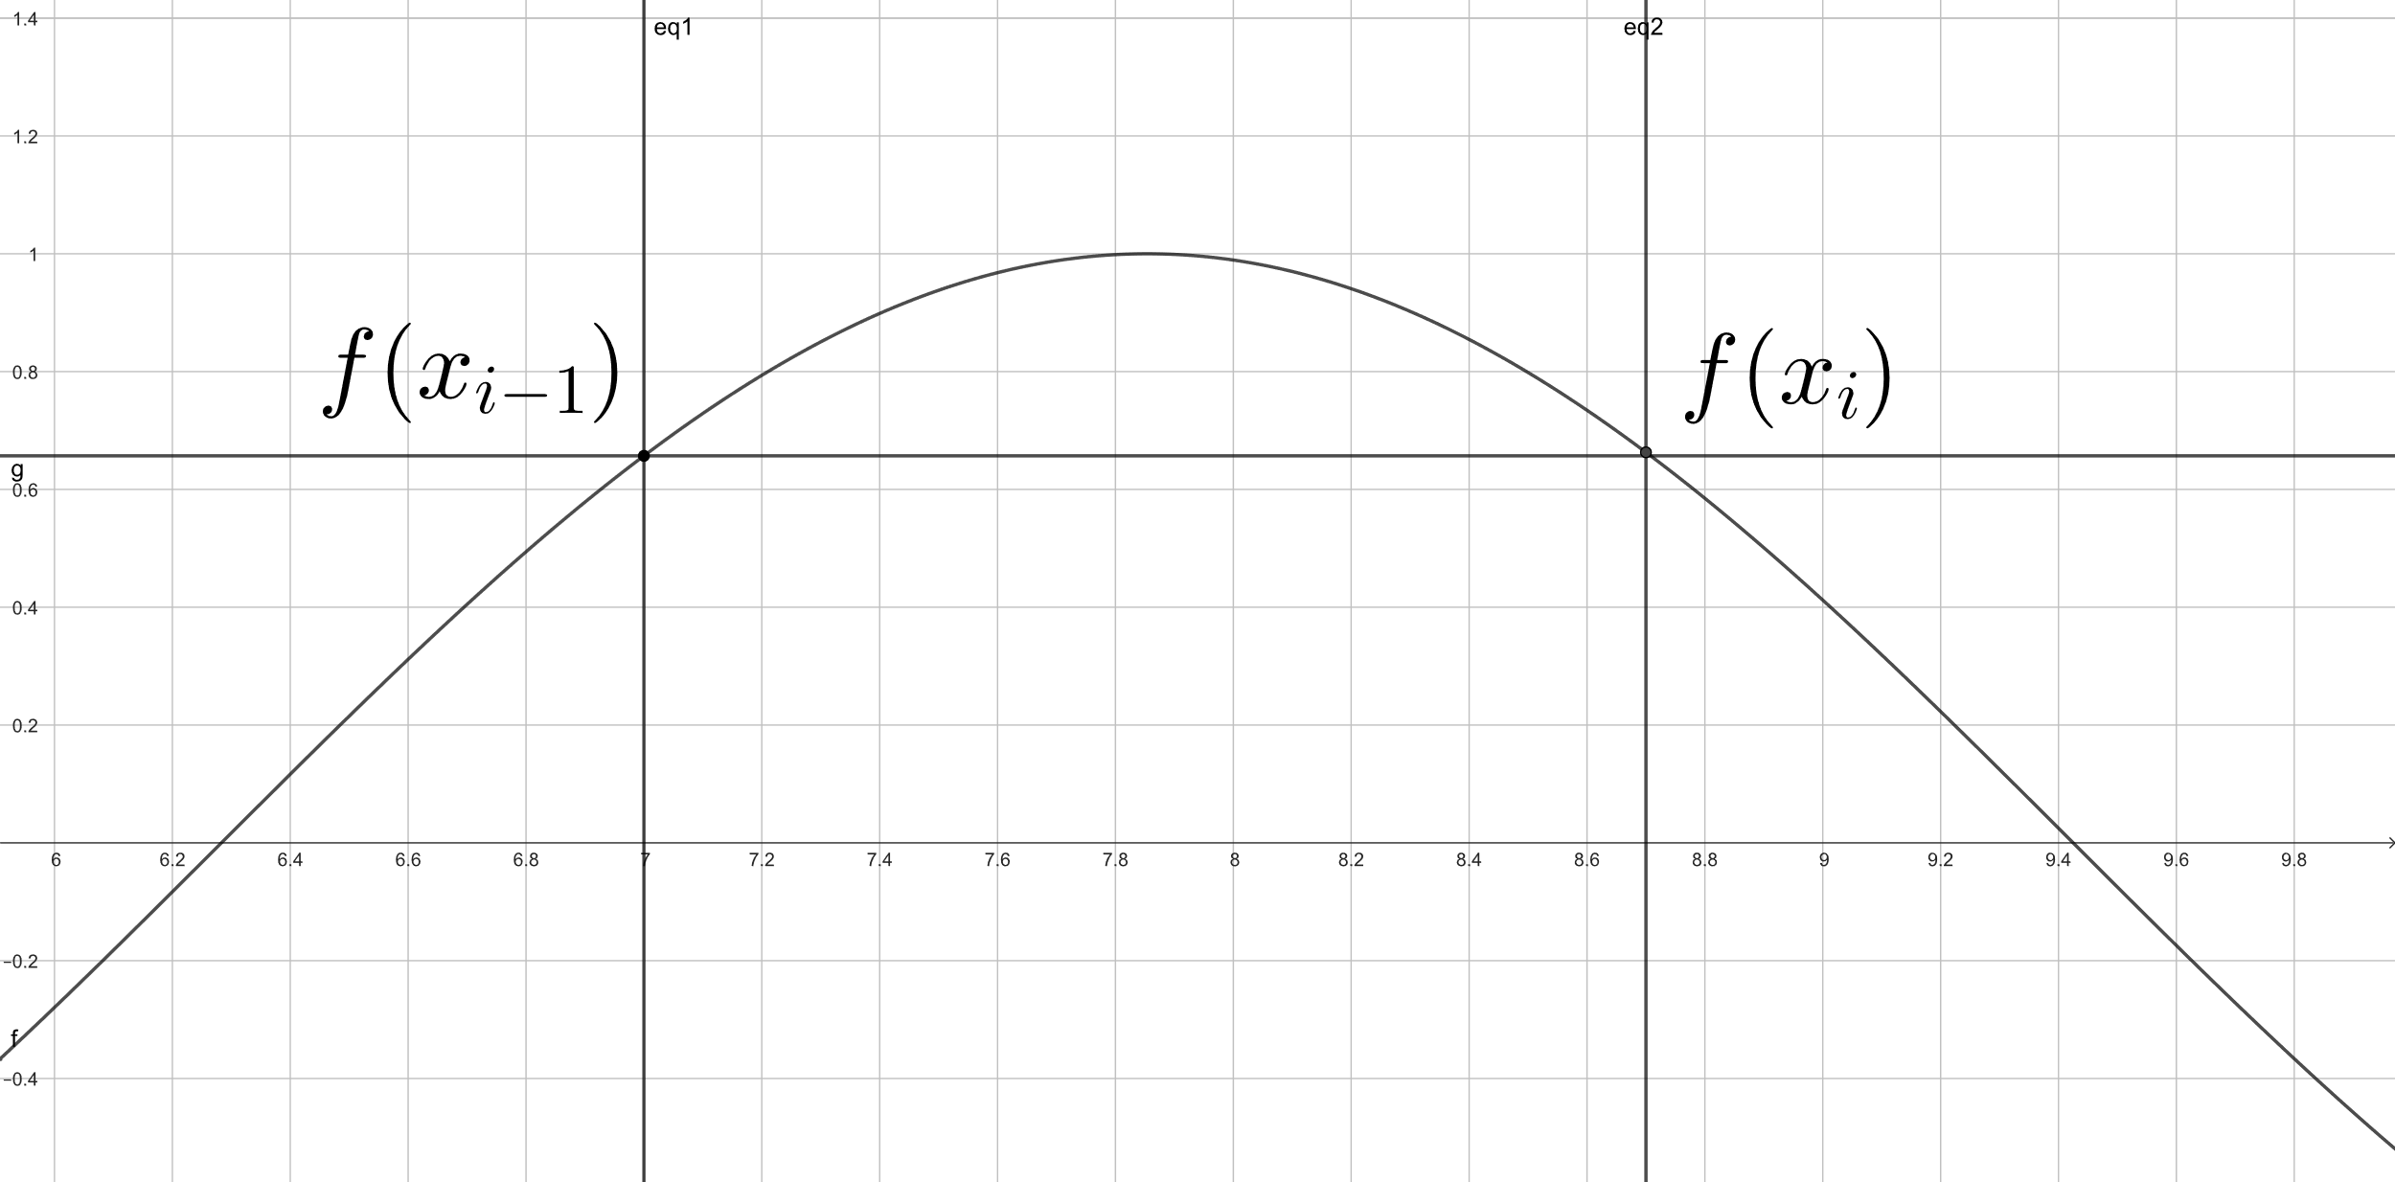
Disadvantages
Convergence: Convergence may not be guaranteed for all functions or initial guesses.
Sensitivity to Initial Guesses: The choice of initial guesses can affect convergence speed and the possibility of convergence.
Division by zero

Slide 8
Encryption Algorithms

Slide 9
AES (Advanced Encryption Standard)

Slide 10
What is AES
The Advanced Encryption Standard (AES) is a symmetric block cipher chosen by the U.S. government to protect classified information.
The National Institute of Standards and Technology (NIST) started development of AES in 1997 when it announced the need for an alternative to the Data Encryption Standard (DES), which was starting to become vulnerable to brute-force attacks.
AES is the industry standard as of now as it allows 128 bit, 192 bit and 256 bit encryption.

Slide 11
How AES encryption works
AES includes three block ciphers:
AES-128 uses a 128-bit key length to encrypt and decrypt a block of messages.
AES-192 uses a 192-bit key length to encrypt and decrypt a block of messages.
AES-256 uses a 256-bit key length to encrypt and decrypt a block of messages.
AES relies on a series of linked operations which involves replacing and shuffling of the input data.
Each cipher encrypts and decrypts data in blocks of 128 bits using cryptographic keys of 128, 192 and 256 bits, respectively.

Slide 12
Symmetric, also known as secret key, ciphers use the same key for encrypting and decrypting. The sender and the receiver must both know -- and use -- the same secret key.
There are 10 rounds for 128-bit keys, 12 rounds for 192-bit keys and 14 rounds for 256-bit keys. A round consists of several processing steps that include substitution, transposition and mixing of the input plaintext to transform it into the final output of ciphertext.

Slide 13
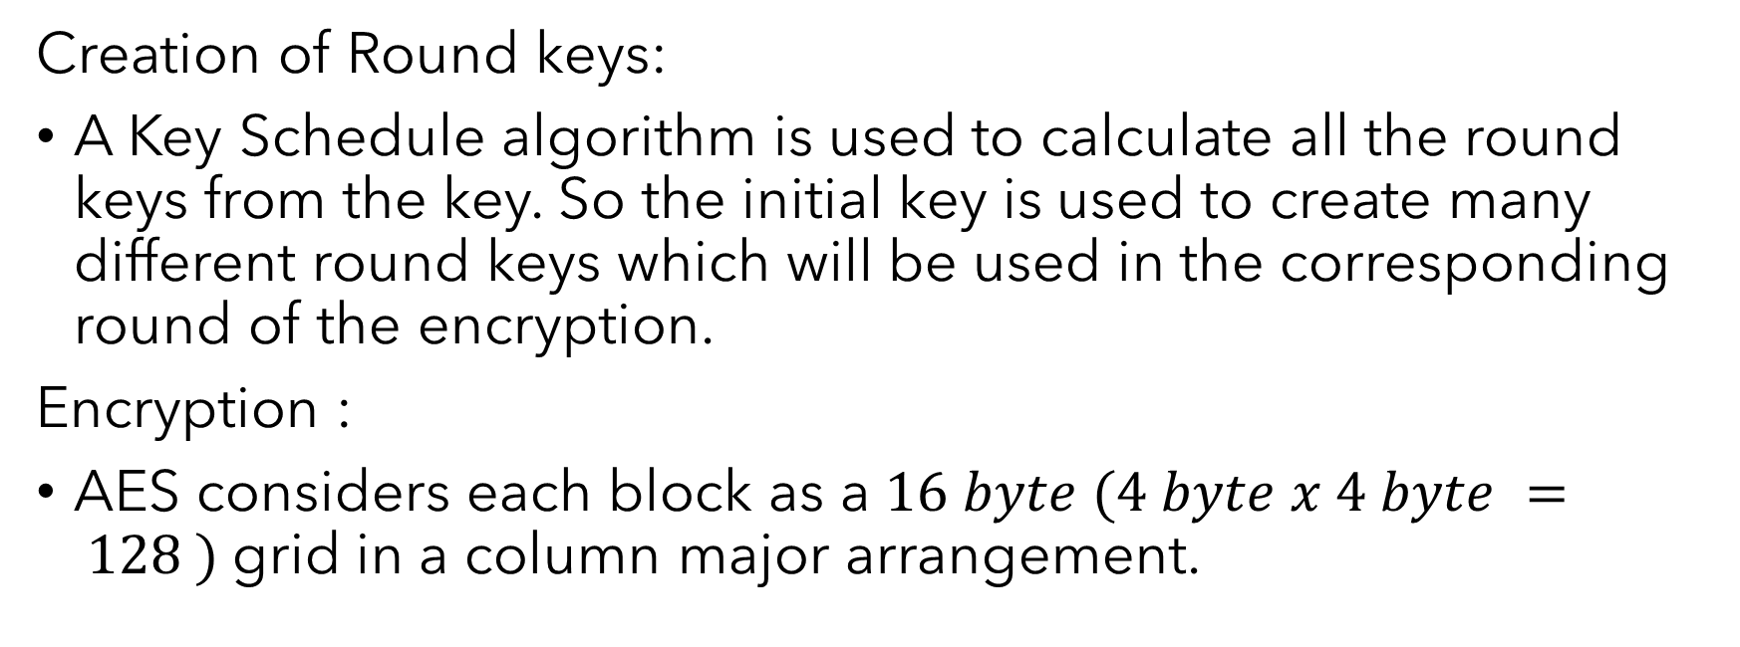
Steps :
Creation of Round keys:
A Key Schedule algorithm is used to calculate all the round keys from the key. So the initial key is used to create many different round keys which will be used in the corresponding round of the encryption.
Encryption :
AES considers each block as a $16 byte (4 byte x 4 byte = 128 )$grid in a column major arrangement.

Slide 14
Like this one:
[ b0 | b4 | b8 | b12 |
| b1 | b5 | b9 | b13 |
| b2 | b6 | b10| b14 |
| b3 | b7 | b11| b15 ]
Each round comprises of 4 steps :
SubBytes
ShiftRows
MixColumns
Add Round Key
The last round doesn’t have the MixColumns round.

Slide 15
Add Round Key: You pass the block data stored in the state array through an XOR function with the first key generated (K0). It passes the resultant state array on as input to the next step.
Sub-Bytes: In this step, it converts each byte of the state array into hexadecimal, divided into two equal parts. These parts are the rows and columns, mapped with a substitution box (S-Box) to generate new values for the final state array.
Shift Rows: It swaps the row elements among each other. It skips the first row. It shifts the elements in the second row, one position to the left. It also shifts the elements from the third row two consecutive positions to the left, and it shifts the last row three positions to the left.

Slide 16
Mix Columns: It multiplies a constant matrix with each column in the state array to get a new column for the subsequent state array. Once all the columns are multiplied with the same constant matrix, you get your state array for the next step. This particular step is not to be done in the last round.
Add Round Key: The respective key for the round is XOR’d with the state array is obtained in the previous step. If this is the last round, the resultant state array becomes the ciphertext for the specific block; else, it passes as the new state array input for the next round.

Slide 17
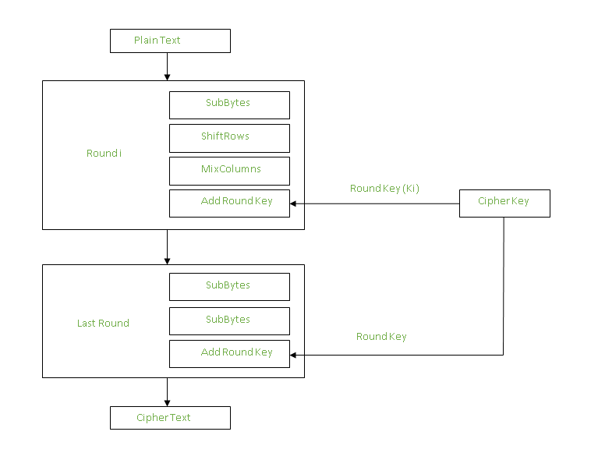

Slide 18
Applications
Wireless security: AES is used in securing wireless networks, such as Wi-Fi networks, to ensure data confidentiality and prevent unauthorized access.
Database Encryption: AES can be applied to encrypt sensitive data stored in databases. This helps protect personal information, financial records, and other confidential data from unauthorized access in case of a data breach.
Secure communications: AES is widely used in protocols like such as internet communications, email, instant messaging, and voice/video calls.It ensures that the data remains confidential.
Data storage: AES is used to encrypt sensitive data stored on hard drives, USB drives, and other storage media, protecting it from unauthorized access in case of loss or theft.

Slide 19
Virtual Private Networks (VPNs): AES is commonly used in VPN protocols to secure the communication between a user’s device and a remote server. It ensures that data sent and received through the VPN remains private and cannot be deciphered by eavesdroppers.
Secure Storage of Passwords: AES encryption is commonly employed to store passwords securely. Instead of storing plaintext passwords, the encrypted version is stored. This adds an extra layer of security and protects user credentials in case of unauthorized access to the storage.
File and Disk Encryption: AES is used to encrypt files and folders on computers, external storage devices, and cloud storage. It protects sensitive data stored on devices or during data transfer to prevent unauthorized access.

