Slide 1
Dalia Abdallah
Presenter Name

Slide 2
Agenda
Topic one : Encryption / Decryption using public and private key .
Topic two : RSA encryption algorithm.
Topic three : some advantages and disadvantages of RSA.

Slide 3


Introduction
RSA encryption algorithm is the most common public-key algorithm that is also called the Asymmetric algorithm. Named after its inventors Rivest, Shamir, and Adelman (RSA). Asymmetric algorithms are those algorithms in which sender and receiver use different keys for encryption and decryption. Each sender is assigned a pair of keys:
Public key
Private key
The Public key is used for encryption, and the Private Key is used for decryption.

Slide 4
Topic one
Encryption / Decryption using public and private key

Slide 5
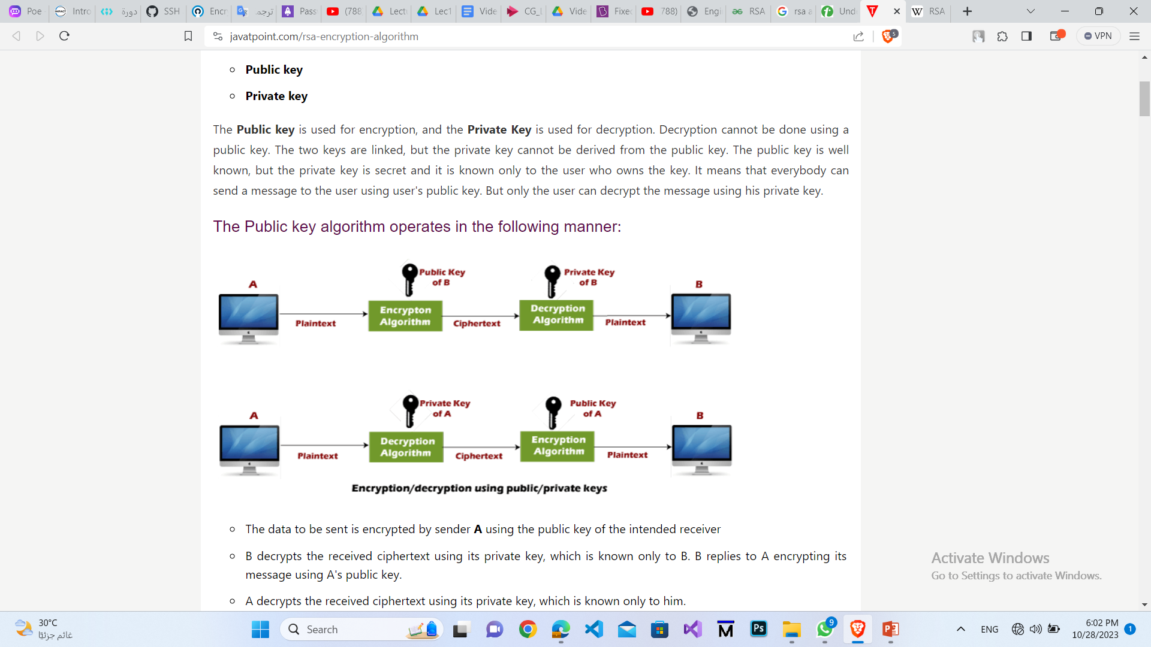
Encryption / Decryption using public and private key :

Slide 6
Encryption / Decryption using public and private key :
The data to be sent is encrypted by sender A using the public key of the intended receiver B.
B decrypts the received ciphertext using its private key, which is known only to B.

Slide 7
Topic Two
RSA encryption algorithm.

Slide 8
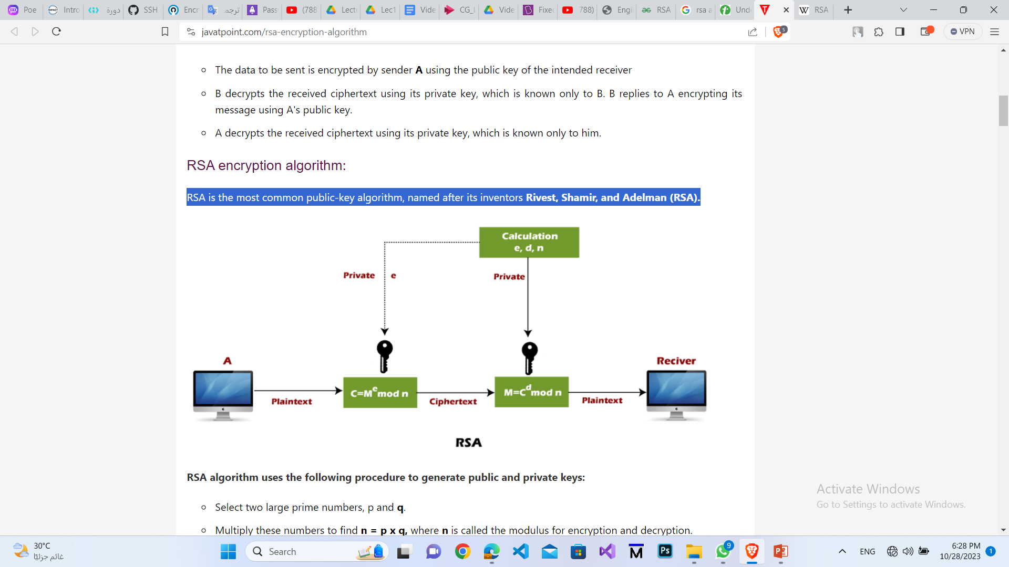
RSA encryption algorithm :

Slide 9
Steps of RSA algorithm :
1- Generate Public and Private Keys.
2- Encryption.
3- Decryption.

Slide 10
Generate Public and Private Keys :
1- Select two large prime numbers, p and q : p != q .
2- Multiply these numbers to find n = p x q .
3- calculate euler Φ(n) = (P-1)(Q-1) .
4- choose e : e must be an integer : Φ(n),e are co-prime,
gcd(e, Φ(n)) = 1 , 1 < e < Φ(n). better to be prime number.
5- Now to calculate Private Key compute d : such that e*d=1 mod ϕ(n) , d = e^-1 mod ϕ(n) .
-Public Key is made of n and e PU =(n,e)
- Private Key is made of n and d PU =(n,d)

Slide 11
Encryption :
To encrypt a message m, we need to convert it to an integer . This can be done using a reversible encoding scheme, such as ASCII or UTF-8.
Once we have the integer representation of the message, we compute the ciphertext c (encrypted message) as
c = m^e (mod n).

Slide 12
Decryption :
To decrypt the ciphertext c, we compute the plaintext m as
m = c^d (mod n).

Slide 13
Topic Three
some advantages and disadvantages of RSA.

Slide 14
Advantages and Disadvantages of RSA :
Advantages:
Security.
Asymmetric encryption.
- Digital signatures.
Disadvantages:
-Computational complexity.
Key management.
- Key size and storage.

