Slide 1
Presenter name
Shrouk Elsayed

Slide 2
Agenda
DES encryption
Trisection Method

Slide 3
Topic one
Data Encryption Standard

Slide 4
Intro about DES
DES, or Data Encryption Standard, is a symmetric-key encryption algorithm. DES became widely used for various applications, including securing electronic communications and financial transactions.
DES operates on blocks of data and uses a symmetric key, meaning the same key is used for both encryption and decryption. The standard key size for DES is 56 bits. In DES, the plaintext is divided into blocks of 64 bits, and the encryption process consists of several rounds of permutation, substitution, and transposition operations.

Slide 5
Key Features:
Symmetric Encryption: Uses the same key for both encryption and decryption.
Block Cipher: Operates on fixed-size blocks of data (64 bits).
Key Size: Original DES uses a 56-bit key.
Block Size: Processes data in 64-bit blocks.
Feistel Network: DES employs a Feistel network structure in its encryption process.
Rounds: Consists of 16 rounds of encryption operations.

Slide 6
Encryption Process:
Initial Permutation (IP): Rearranges the 64-bit input block.
Key Generation: Generates 16 subkeys for each round using the original 56-bit key.
16 Rounds of Operations: Each round includes Expansion, Substitution (using S-Boxes), Permutation, and XOR operations with the round key.
Final Permutation (FP): Rearranges the data after the 16 rounds.
Output: The result after the final permutation is the ciphertext.

Slide 7
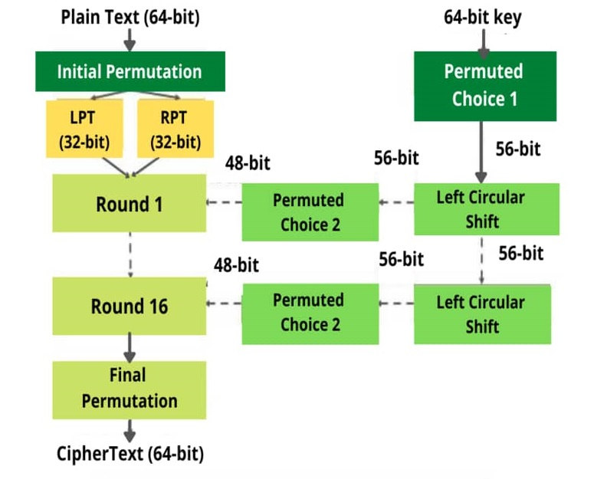
Algorithm of DES

Slide 8
Security Mechanisms:
Confusion and Diffusion: Achieved through complex substitution (S-Boxes) and permutation operations in each round.
S-Boxes: Substitution boxes provide non-linearity and enhance DES's resistance against various attacks.

Slide 9
Vulnerabilities and Limitations:
Small Key Size: 56-bit key size became vulnerable to brute-force attacks as computing power increased.
Known Vulnerabilities: Certain weaknesses, especially due to the fixed S-Box design, were discovered over time.
Limited Block Size: Fixed block size might not be suitable for all types of data.

Slide 10
Legacy and Transition:
Triple DES (3DES): Used as an interim solution by applying DES three times with different keys, enhancing security.
Successor: Eventually replaced by more advanced encryption standards like AES (Advanced Encryption Standard) with larger key sizes and increased security.
DES 3DES AES

Slide 11
Topic two
Trisection Method

Slide 12
Definition
The trisection method is an iterative numerical technique used to approximate the root of a mathematical function. Similar to the bisection method, the trisection method divides the interval into three subintervals instead of two, making it potentially faster in converging towards the root

Slide 13
Steps :
1 . Initialization:
Choose an initial interval [a, b] where the root of the function lies.
Set a tolerance level (epsilon) to determine the desired accuracy of the result.
Initialize a counter (n) to keep track of the number of iterations.
2 . Iteration:
Divide the interval [a, b] into three subintervals: [a, (a + b) / 3], [(a + b) / 3, 2 * (a + b) / 3], and [2 * (a + b) / 3, b].
Evaluate the function at the two trisection points: f((a + b) / 3) and f(2 * (a + b) / 3).
Determine the subinterval with a sign change (i.e., one trisection point has a different sign than the other).
Update the interval: Set a or b to the corresponding trisection point based on the sign change.
Increment the iteration counter (n).

Slide 14
Example :
Function:
f(x)=x^3−6x^2+11x−6
Initial Interval:
[a,b]=[1,3]
Tolerance:
ϵ=10^−6

Slide 15
Iterations :
Iteration 1:
Subintervals: [1,2], [2,2.6667], [2.6667,3]
Evaluate f(1), f(2), and f(2.6667)
Choose the subinterval with a sign change: [2,2.6667]
Iteration 2:
Subintervals: [2,2.2222], [2.2222,2.4444], [2.4444,2.6667]
Evaluate f(2), f(2.2222), and f(2.4444)
Choose the subinterval with a sign change: [2,2.2222]
Iteration 3:
Subintervals: [2,2.0741],[2.0741,2.1482], [2.1482,2.2222]
Evaluate f(2), f(2.0741), and f(2.1482)
Choose the subinterval with a sign change: [2,2.0741]
….Continue iterations until the interval width is smaller than the tolerance (∣a−b∣<ϵ).

Slide 16
When end ?
Repeat the iteration until the absolute difference between a and b is smaller than the tolerance level (|a - b| < epsilon) or until a maximum number of iterations is reached.
The midpoint of the final interval [a, b] can be considered as an approximate root of the function.

Slide 17
Advantages and Disadvantages:
Advantages:
Potentially faster convergence compared to the bisection method because it divides the interval into three parts.
Useful for functions with complex behavior where a single interval might not capture the root effectively.
Disadvantages:
Requires more function evaluations per iteration compared to the bisection method.
Not always more accurate than the bisection method, especially if the function's behavior doesn't favor the trisection approach.

