Slide 1

Churn_modeling Machine Learning Model
Mohamed Ahmed Emary

Slide 2
Base Models
The model uses stacking technique to make a meta model that consists of 3 base models: 1. Decision Tree
2. Random Forest
3. Support Vector Machine

Slide 3

Decision Tree Model
The model has accuracy score of $88.05\%$ on Training Data and $83.07\%$ on Testing Data.
F1 Score, Recall Score, and Precision Score of the Model are all nearly the same: $0.83$

Slide 4
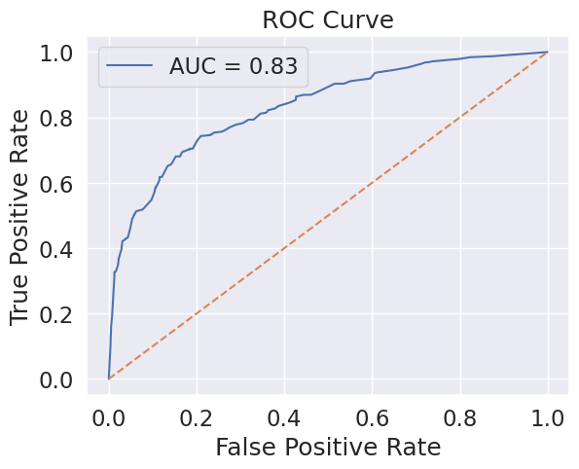
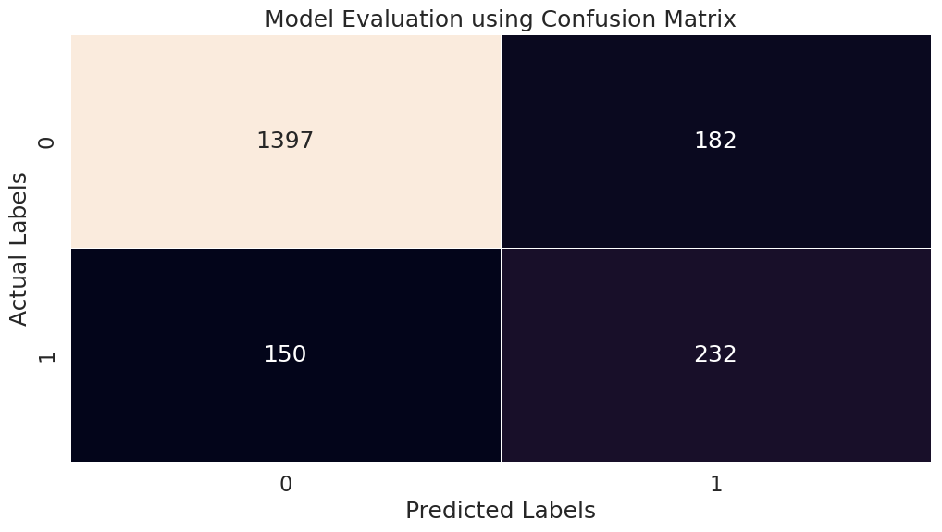
Model ROC & Confusion Matrix

Slide 5

Random Forest Model
The model has accuracy score of $89.37\%$ on Training Data and $83.73\%$ on Testing Data.
F1 Score, Recall Score, and Precision Score of the Model are all nearly the same too with $0.83$

Slide 6
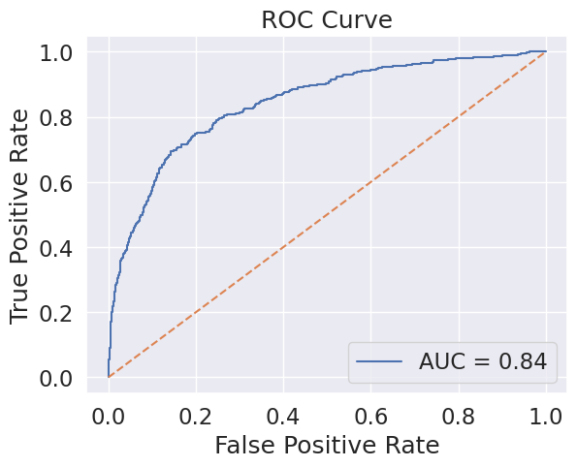
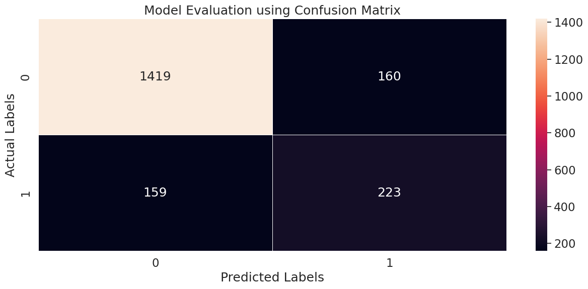
Model ROC & Confusion Matrix

Slide 7

KNN Model
The model has accuracy score of $100.0\%$ on Training Data and $62.52\%$ on Testing Data.
F1 Score, Recall Score, and Precision Score of the Model are all nearly the same too with $0.62$

Slide 8
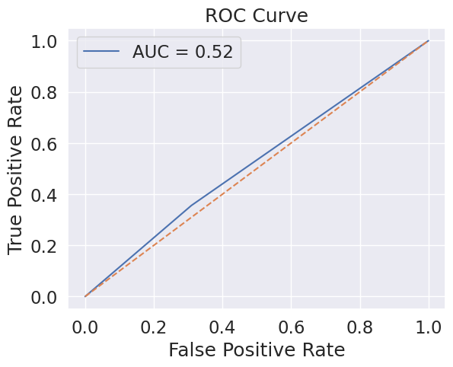
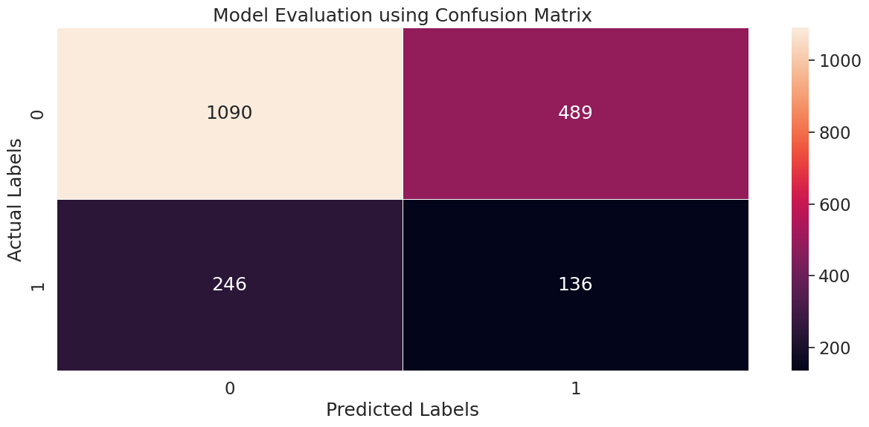
Model ROC & Confusion Matrix

Slide 9
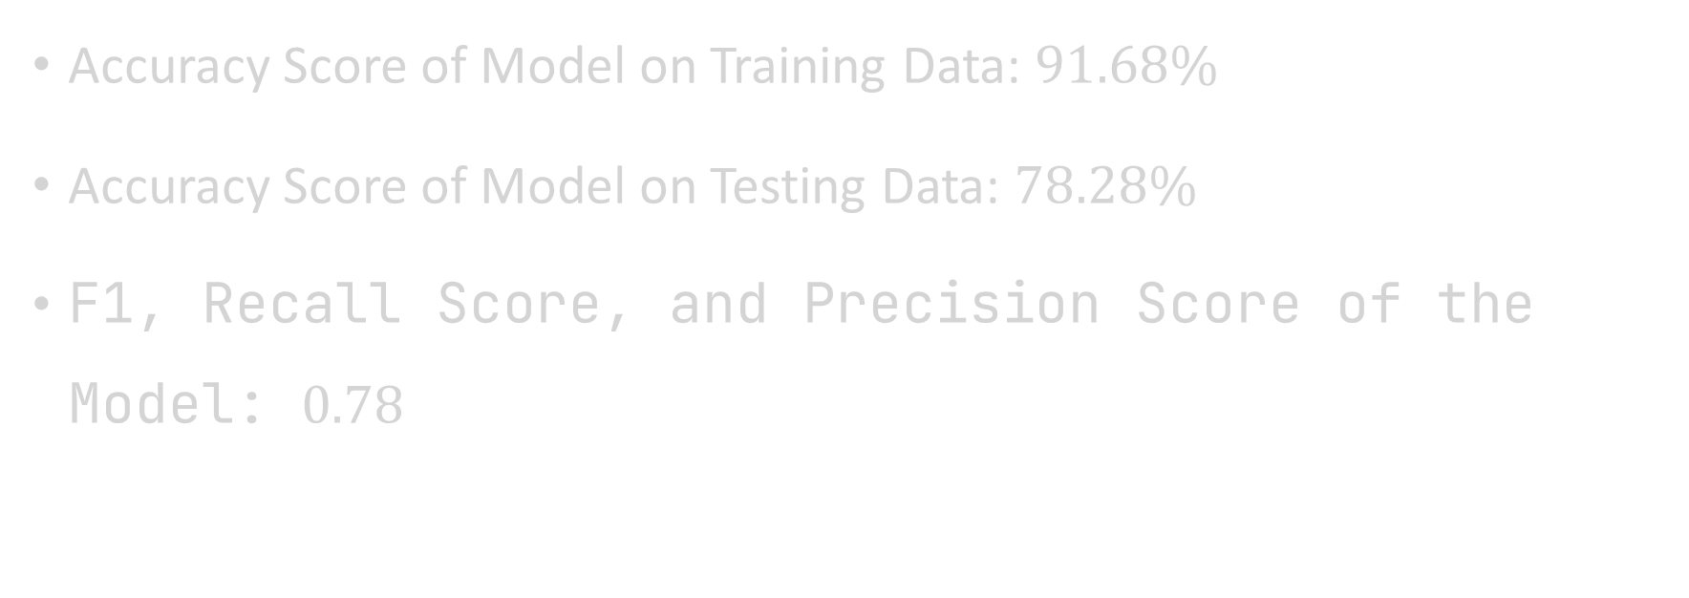
Overall Model Performance
Accuracy Score of Model on Training Data: $91.68\%$
Accuracy Score of Model on Testing Data: $78.28\%$
F1, Recall Score, and Precision Score of the Model: $0.78$

