Slide 1


Faculty of computers and artificial intelligence
Cairo university
Assignment 1
Part 1 - task (1,2)
CS251 :- Introduction to Software Engineering
Section :- S(23,24)
Course Instructors: Dr. Mohammad Ei-Ramiy.
Team Members | ID's | Emails
Abdelrahman Mohamed Gabr | 20231098 | gabrabdo908@gmail.com
Mohamed Essam Abdelhamed | 20231147 | mohamedesam157953@gmail.com
Mahmoud Ibrahim Mahmoud | 20231152 | askr3556@gmail.com
Team leader:- Mohamed Essam Abdelhamed
Leader number:- 01068399881

Slide 2
App 1 (Mohamed Essam)
1. Main Idea
• Text Processing & Word Management:
The program processes input text by splitting it into words, removing punctuation, converting them to lowercase, and storing them in a list. It also maintains a set for unique words.
• Interactive User Interface:
It provides a command-line menu for two different sentence inputs, allowing users to manipulate the word collections (e.g., add, remove, sort, search, and perform set operations such as union and intersection).
2. Algorithm Overview
• Initialization:
o The constructor receives a text string. o Splits the text into words using whitespace as the delimiter. o Removes punctuation from each word and converts them to lowercase. o Stores each processed word in an ArrayList (s).
• Core Functionalities:
o Insertion & Removal:
Methods allow adding a new word (after processing) and removing a word from the list.
o Display & Size:
Methods to show the list of words, unique words (via a HashSet), and to return the size of the list.
o Set Operations:
■ Union: Combines words from two instances while ensuring uniqueness.
■ Intersection: Finds common words between two instances.
o
Additional Operations:

Slide 3
■ Finding the longest word.
■ Sorting words in ascending and descending order.
■ Converting all words to uppercase.
■ Searching for a specific word within the list. o Similarity Calculation:
A method calculates similarity using a formula based on the number of unique words and the size of the list.
• User Interaction:
o Uses a command-line menu to let users choose actions for each sentence. o Processes user input in a loop until the user opts to break out of the menu.

Slide 4
App 2(Abdelrahman Gabr)
1. Main Idea
• Game Implementation:
Implements the classic Rock Paper Scissors game with options for player vs. computer or two players.
• Interactive Gameplay:
Uses command-line inputs to allow users to choose game mode, input their moves, and decide whether to play another round.
• Score Keeping:
Maintains and displays scores for each participant (player(s) and computer) after each round.
2. Algorithm
• Input Validation:
o Checks if the user's choice is valid (between 1 and 3 for moves and 1 or 2 for selecting the opponent).
• Game Rules & Scoring:
o Displays the game rules before starting. o Determines the winner based on predefined rules:
■ Rock beats Scissors.
■ Paper beats Rock.
■ Scissors beat Paper.
o Updates scores using a dedicated Score method.
• Game Flow:
o Prompts the user to choose their move. o Depending on the opponent choice, either:
■ Generates a random move for the computer.
■ Accepts a second player's move.

Slide 5
o
Compares moves to determine the outcome (win, lose, or draw).
o Displays the updated scores. o Asks if the players want to play another round.

Slide 6
App 3(Mahmoud Ibrahim)
1. Main Idea
• Modular Workout App:
This project is an Android workout app that demonstrates modular design by separating the application into distinct layers:
o Activities: Manage UI and navigation.
o Domain Classes: Represent data models (workouts and lessons). o Adapter: Binds workout data to RecyclerView items for display.
• User Flow:
The user is first greeted with an introduction screen (IntroActivity). Once they click "start," they are taken to the MainActivity where a list of workouts is displayed. Each workout item can be clicked to view detailed lessons.
2. Algorithm Overview Activity Flow and Navigation:
• IntroActivity:
o Setup: Uses view binding to inflate the layout and applies full-screen window flags.
o Navigation: Listens for a button click to transition to MainActivity using an Intent.
• MainActivity:
o Data Preparation: Contains methods that generate sample data:
■ getData(): Creates a list of workouts.
■ getLesson_1(), getLesson_2(), getLesson_3(): Build lesson lists for each workout.

Slide 7
o Display: Likely uses a RecyclerView (with WorkoutAdapter) to show workout items, enabling smooth scrolling and user interaction.
Data Handling:
• Workout Domain Class:
o Encapsulates details such as title, description, image path, calorie count, and associated lessons.
o Implements Serializable to pass objects between activities.
• Lession Domain Class:
o Holds properties like title, duration, video link, and image path. o Provides getters and setters for encapsulated data.
Adapter Operations:
• WorkoutAdapter:
o Binding Data:
■ Uses view binding to populate each view holder with workout details.
■ Loads images dynamically using the Glide library based on resource names.
o User Interaction:
■ Sets click listeners on workout items to open the detailed WorkoutActivity, passing the selected workout data via Intent.

Slide 8



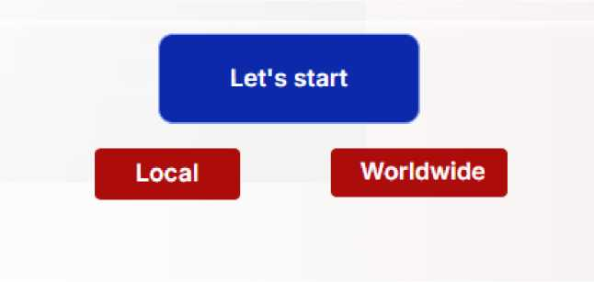
LCNC:
It is implemented through BUBBLE program, which offers great features such as workflow, ease of drag and drop, and formatting. The idea of the website is simply that it is a football website that has a competition to solve questions for a certain number of points and allows the user to choose whether he wants local or international questions by clicking on the "Let's start" button.
Are you a football expert ?
Think you know football? It's time to put your knowledge to the test! Whether you're a die-hard football fan or just enjoy the game, our quiz will challenge your knowledge of the world's most popular sport. From famous players and historic tournaments to fun facts about football, we've got it all
M
A
G
I
C

Slide 9
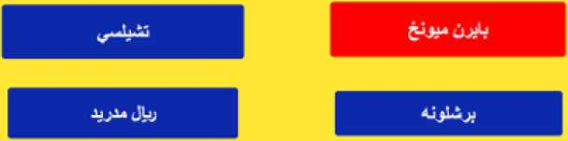
After the selection is made, the game begins, and each correct question gets a point until the 10 questions are finished. A red light is placed on the wrong question until the correct answer is chosen.
SCORE : 1
'■2012 t-jjjt ₄ jiliil Jjjill
SCORE : 2
?2017/2018 ^
AtbjJl '-‘A¹
App link :- https://football-players-76986.bubbleapps.io/version-test

Slide 10
Comparison between two tools of LCNC:-
BUBBLE and Quixy
Feature | Bubble | Quixy
User Interface | Drag-and-drop visual editor for UI design. | Drag-and-drop interface with advanced UI design support.
Integrations | Supports external API integrations. | Seamless integrations with other tools and data.
Workflow Automation | Custom workflow creation support. | Advanced workflow and process management tools.
Pricing | Flexible pricing plans suitable for different needs. | Flexible pricing plans, with more advanced features in higher tiers.

Slide 11
Project 1 (Personal Budgeting Software):
1. Market and Gap Analysis:
Global Practices
Many international solutions exist for personal finance management, each tailored
to regional needs:
• Europe: Apps like Emma and Money Dashboard utilize Open Banking for secure, real-time tracking and multi-currency support.
• Asia: Super apps like WeChat and Alipay integrate budgeting with payments, investments, and social media.
• India: Apps such as Walnut and Money View focus on bill reminders, expense categorization, and local economic insights.
These solutions offer key features like security, real-time transaction tracking,
multilingual support, and bill reminders.
Egypt's Market
Egypt has growing personal finance solutions:
• Banking Apps: Major banks integrate budgeting tools like transaction categorization and spending summaries.
• Fintech Startups: Local startups address cash transactions and inflation-related budgeting.
• Arabic Language Support: Apps like Wally and Money Lover are localized for Arabic users.
• Tailored Expense Categories: Some apps categorize spending based on local habits, such as transportation and social activities.
While these solutions are useful, gaps remain in functionality.
Gap Analysis
Key challenges in Egypt's market include:
• Limited Integration with Banks: Many apps lack seamless connectivity with local banks and wallets.
• Cash-Based Transactions: Most solutions don't effectively manage cash flow, requiring better manual entry and categorization tools.
• Economic Adjustments: Budgeting apps rarely adapt to inflation or provide financial advice on economic changes.

Slide 12
• Financial Education: There's a lack of localized financial literacy and advisory tools.
• Data Security: Stronger security measures and compliance with local data protection laws are needed.
Proposed Solution
To compete effectively, a new product should focus on:
• Secure, legally compliant financial management.
• User-friendly, localized budgeting tools.
• Smart categorization for cash expenses.
• Financial education and advisory features.
2. Market Segmentation & Research Customer Segments
The program targets various users, including parents saving money and individuals managing household expenses. However, the primary focus is on Investors and Entrepreneurs.
Demographics
• Age: 25-50 years
• Income: Moderate to high, varying with business cycles
• Education: Well-educated, often in business, finance, or tech
• Tech Usage: Highly tech-savvy, preferring mobile-first solutions and seamless financial integrations
Why Investors & Entrepreneurs Will Be Interested
• Real-Time Insights & Automation: Instant transaction tracking reduces errors and enhances decision-making.
• Customizable Reporting & Analytics: Personalized dashboards provide deep insights into cash flow, ROI, and spending.
• Strategic Financial Planning: Goal setting, forecasting, and investment tracking help optimize financial growth.
• Scalability & Adaptability: The software evolves with business needs, making it suitable for startups and established enterprises alike.
3. Domain Analysis:

Slide 13
A personal budget acts as a financial roadmap, helping individuals achieve stability, freedom, and financial goals by making informed money decisions. However, managing income, expenses, savings, and future financial plans remains a challenge for many.
Key User Groups & Their Challenges
1. Young Adults (20-30): Struggle with tracking expenses, saving, and financial independence.
2. Families: Need structured budgeting to manage household expenses like rent, groceries, and utilities.
3. Salaried Employees: Face difficulties saving due to unexpected expenses and lack of financial planning.
4. Entrepreneurs & Small Business Owners: Require tools to manage cash flow, track expenses, and separate personal from business finances.
Smart Budgeting Principles
1. Collect Financial Data: Gather bank statements, bills, receipts, and investment records.
2. Determine Fixed & Variable Expenses: Fixed costs (rent, internet) remain constant, while variable costs (groceries, dining) fluctuate.
Role of Technology in Budgeting
Fintech innovations automate financial tracking, offer insights, and enhance financial security through apps like:
• PayPal, Venmo, Cash App (money transfers & payments)
• Google Pay, Apple Pay (contactless payments)
• Zelle (bank-integrated money transfers)
User Financial Behavior & Challenges
• 65% struggle to stick to a budget.
• 40% overspend due to poor planning.
• 70% prefer automated tracking over manual entry.

Slide 14
• 60% lack financial literacy.
• 75% use mobile apps for budgeting.
• 80% prefer visual reports (graphs & charts) for better expense understanding. Conclusion
There is a strong demand for user-friendly, automated, and insightful budgeting tools that support financial stability, smart spending, and better financial awareness.
4. Proposed Solution for Personal Budgeting Software : Purpose & Goals
The software helps users manage their finances efficiently by tracking income, expenses, and savings while setting financial goals. Key objectives include:
• Presenting financial data clearly and concisely.
• Simplifying budget creation and management.
• Providing graphical insights into spending habits.
• Integrating with banks/payment platforms for automated transaction tracking.
• Encouraging goal-based saving habits.
Key Features & Functionality
• Income & Expense Tracking - Users can log spending on rent, utilities, fuel, etc.
• Budget Management - Set spending limits and monitor adherence.
• Financial Goal Setting - Track savings progress for major goals (e.g., vacation, car purchase).
• Automated Reports & Insights - Visual dashboards with spending trends.
• Bank Account Integration - Sync with bank accounts for real-time transactions.
• Multi-Platform Accessibility - Available as a web & mobile app.
• Security & Privacy - Features biometric login, two-factor authentication, and encryption.

Slide 15
Target Users
• Investors & Entrepreneurs - Need better financial oversight.
• Individuals & Families - Seeking structured budgeting.
• Students - Planning financial independence.
• Small Business Owners - Tracking expenses efficiently.
Technologies Used
• Frontend: React.js (Web), Flutter (Mobile).
• Backend: Node.js (Express) or Django.
• Database: PostgreSQL / MongoDB.
• Authentication: OAuth 2.0, Firebase Auth, Biometrics.
• Banking API Integration: Plaid, Yodlee.
• Hosting & Deployment: AWS, Firebase, or Azure.
This software ensures financial clarity, automation, and security, making personal budgeting easier and more effective.

Slide 16
Task 4 SRS (smartCard)
• Software Purpose
Our purpose in smartCard is to provide users with knowledge, intelligence and how to manage their money.
• Software Scope
smartCard helps individuals track income, expenses, and savings while setting financial goals. It provides budgeting tools, spending insights, and bank integration for automated tracking. Administrators can oversee security, fraud detection, and user support.
• Definitions, acronyms, and abbreviations
Phrase | Definition
Bank Integration | The ability of the software to connect with bank accounts to track transactions automatically.
Budgeting | The process of planning and managing income and expenses to control finances.
Income | Money received from various sources such as salary, business, or investments.
E-Wallet | An electronic device, online service, or software program that allows one party to make electronic transactions with another party bartering digital currency units for goods and services.
Cloud Storage | Online storage that allows users to save and access financial data from anywhere.

Slide 17
Some Functional Requirements
ID | Requirement statement
FR01 | The application Should display a login/sign-up screen upon launch.
FR02 | The application Should provide input fields for username and password for user login.
FR03 | If user chooses to log in he should valid inputs • if Invalid inputs will ask him to Enter Valid one or direct to sign-up page • else System will direct him to his Main page Successfully
FR04 | If User chooses to sign-up System should Ask him for some data • Email • Username • Password • Credit Card Details • Account type (personal user, investor/entrepreneur, project Manger)
FR05 | All input data should be secure
FR06 | If user forget Password we should give him a reset Password option
FR07 | The application should display a user dashboard summarizing total income, expenses, balance, and savings
FR08 | The application will allow users to add, edit, and delete income transactions with details such as source, amount, date, and category.
FR09 | The app will have a filed contains • Previous Payments • Total Money paid in( last month ,last year, total) • Some recommendations in each Payment
FR10 | The application should automatically categorize transactions based on predefined rules, with options for manual re-categorization.
FR11 | The application shall enable users to create and manage budgets by setting spending limits for various expense categories (Food, cloth, Games)
FR12 | The app generates visual reports (charts and graphs) that show spending trends, income-to-expense ratios, and budget adherence.
FR13 | The app enables users to set and track savings goals through visual progress indicators.

Slide 18
Non-Functional Requirements
Measure | Details
Performance | • The Sign-in/sign-up screen should take <= 5 seconds to load • Every phase and operation inside Home page will take <= 10 seconds • Payment and receive money will take <= 15 seconds
Scalability | System should up to 1500 user in same time without any problem
Maintainability | System have a high and good roles in maintenance, The system should have a 85% chance of maintainability for 72 hours. Which means that if a component in the system had a critical issue, there is a 85% chance that this component will be fixed in 3 days.
Reliability and availability | • The system should achieve 99% uptime monthly • Automatic recovery should ensure availability for at least 90% of the time
Portability & Compatibility | • Android: Support Android OS multiple versions • iOS: Support IOS different versions • Support Web Browser
Usability | • Transaction Input Time: Adding a new transaction should not exceed 2 minutes per entry • Sign-In/Sign-Up Error Rate: The error rate during sign-in/up should be less than 5% • Users can transfer between different pages within 2 seconds • User will ask to confirm payment before it processes • User will have a section to manage and see his activity

Slide 19
Some Enriched User Stories
• User Story #1
User Story ID | US #1
User Story Name | User sign-up
Actors | Users
Description | As a user(normal user, entrepreneur) for smartCard I like to be able to sign-up to smartCard So I can access the services and manage my budget
Per condition
Post condition
Acceptance Criteria | Given I am user, entrepreneur and want to sign-up When I fill the sign-up fields (Needed Data) Then the system signs me in
• Scenarios Normal Scenario
Actor Action | System Response
1- User Enter program 2- User clicks sign-up
 | 3- System displays fields will be filled 4- System ask user to enter his data
5- User enter his data
 | 6- System process and verify data 7- System saves new data in database
Exceptional Scenario
Actor Action | System Response
1- User Enter program 2- User clicks sign-up
 | 3- System displays fields will be filled 4- System ask user to enter his data
5- user input random (not correct data)
 | 6- System process and Verify data

Slide 20
7- Data isn't correct (email is wrong, etc..)
8- System display message with wrong data and ask for real valid data
• Data Dictionary:
Element Label | Type/Length | Data Validation / Business Rule
Email | <=80 Char | Text must contain @ and extension
Full Name | <= 100 char | Text
Password field | V II NJ | Must include uppercase, number, special char
Credit card | xx/yy/zz | Must be valid Credit card
User Story #2
User Story ID | US #2
User Story Name | Log in
Actors
Description | As a user I like to log in to a app and use services So I will Enter with my email and pass
Per condition | Input data must be valid
Post condition
Acceptance Criteria | Given I’m a logged-out system user and I’m on the Sign-In page When I fill in the "Email” and "Password” fields with my authentication credentials and I click the Sign-In button Then the system signs me in
• Scenarios
Normal Scenario
Actor Action | System Response
1- User Enter program 2- User clicks log-in

Slide 21
 | 3- System displays (Email & password) Fields 4- System ask user to enter log-in data
5- User enter his data
 | 6- System process and verify exists data 7- System enter the user and direct him to home page
• Exceptional Scenario
Actor Action | System Response
1- User Enter program 2- User clicks log-in
 | 3- System displays (Email & password) Fields 4- System ask user to enter log-in data
5- User Enters invalid (Email or password)
 | 6- System process and Verify (Email or password) 7- Email doesn't exist in database or wrong password 8- System display message with problem and ask user to fix it
• User Story #3
User Story ID | US #3
User Story Name | Add income
Actors
Description | As a user I like to enter my income and budget to be managed So I will Enter with my total income and different resources to it
Per condition | Already loged-in
Post condition
Acceptance Criteria | Given a enter income page or option When I enter my total income Then the system saves it and display a success message

Slide 22
• User Story #4
User Story ID | US #4
User Story Name | Set Budget
Actors
Description | As a user I like to set a monthly budget for different categories So I can control my spending.
Per condition
Post condition
Acceptance Criteria | Given page for save money When I enter my income and target Then the system start make a calculations to reach my target
• User Story #5
User Story ID | US #5
User Story Name | Automatic Bill Payments
Actors | User
Description | As a user I like to set up recurring bill payments So I don't have to manually enter them every month.
Per condition
Post condition
Acceptance Criteria | Given page for Recurring Payments When I select a time period Then the system should deduct the amount automatically on the due date.
• User Story #7
User Story ID | US #7
User Story Name | View Spending Reports
Actors
Description | As a user I like to see and monitor my treatments and mange my budget

Slide 23
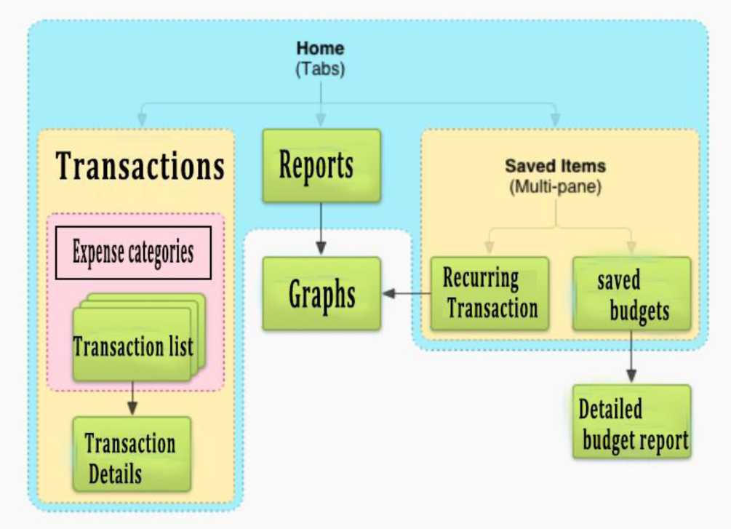
 | So I can analyze my financial situation.
Per condition
Post condition
Acceptance Criteria | Given page for report When I select a time period Then the system must display graphs, summary for this period
System Navigation Map

