Slide 1
Thermax Minimizing Reject during Water Purification
PIP2001 Capstone Project
Final - Review
Batch Number: CAI-G38
Roll Number’s | Student Name
20211CAI0030 20211CAI0106 20211CAI0059 20211CAI0130 20211CAI0176 | Asif Pasha. B Ismail Ahmed Khan Mohamed Azeem Fardeen pasha Aftab Hussain Beldona Visweswara
Under the Supervision of,
Professor/Guide: Mr. John Bennet
Reviewer: Josephine John
School of Computer Science and Engineering
Presidency University
Name of the Program: Capstone Project
Name of the HoD: Zafar Ali Khan
Name of the Program Project Coordinator:
Name of the School Project Coordinators: Dr. Sampath A K / Dr. Abdul Khadar A / Mr. Md Ziaur Rahman

Slide 2
Introduction
Introduce the need for improving water purification systems. Discuss the current challenge of high reject water production in Reverse Osmosis (RO) and other water filtration systems. Highlight the role of the Thermax company in developing efficient solutions and the significance of reducing water waste in terms of sustainability and cost-effectiveness.
Brief introduction to the project, highlighting the significance of minimizing reject water in purification systems and the sustainability goals.

Slide 3
Literature Review
The efficient use of water resources is critical for addressing the global water scarcity crisis. Research in water purification technologies has consistently focused on improving filtration techniques, minimizing reject water, and optimizing overall process efficiency. This literature review highlights key studies in membrane technology, reject water reduction, and fouling control.
Advances in Membrane Technology for Water Purification J. Smith, L. Johnson, and R. Kim (2021) explored recent advancements in membrane technology, focusing on improving water recovery and efficiency. Their work highlights the development of high-rejection and low-fouling membranes, which have significantly enhanced the efficiency of Reverse Osmosis (RO) and Nano-Filtration systems. These innovations aim to improve water quality while reducing operational costs and reject water.
Challenges and Opportunities in Reverse Osmosis Desalination A. Green, M. Brown, and C. Davis (2020) examined the challenges faced in RO desalination systems, particularly high energy consumption and significant brine reject. They proposed integrating energy recovery devices and optimizing system parameters as effective solutions to reduce water wastage and improve overall system sustainability.

Slide 4
Contd… (Litreature Review)
Minimization of Brine Reject in RO Systems P. Roberts and K. Watson (2019) conducted a study on process optimization techniques for reducing brine reject in RO systems. Their research focused on enhancing system recovery rates by adjusting flow rates, optimizing chemical dosing, and employing multi-stage treatment systems. Their findings demonstrated the potential to reduce reject water while maintaining water quality standards.
Fouling Control in Membrane-Based Water Purification Systems S. Patel, M. Zang, and H. Lee (2020) investigated fouling control mechanisms in membrane-based systems. They discussed how biofouling and scaling are major challenges in RO systems, leading to increased reject water and reduced efficiency. The study highlighted the importance of pre-treatment methods, anti-scalant dosing, and periodic cleaning to maintain system performance and minimize water loss.
Summary and Research Gap
While significant progress has been made in improving membrane technology and optimizing system performance, existing methods still face challenges in reducing reject water without compromising water quality. This project seeks to address these gaps by integrating a booster pump within a multi-stage filtration system, enhancing both efficiency and water recovery.

Slide 5
Existing method Drawback
Existing Method: Reverse Osmosis (RO) System
Reverse Osmosis (RO) is one of the most widely used methods for water purification. It employs a semi-permeable membrane to remove contaminants, providing clean water. While effective, this method has several drawbacks, especially concerning reject water and system efficiency.
Drawbacks of the Existing Method
High Reject Water Ratio
RO systems typically reject 40-50% of the input water as waste, leading to significant water wastage. This is particularly problematic in areas with limited water availability.
Energy Intensive
The process requires high pressure to push water through the membrane, resulting in significant energy consumption, making the system expensive to operate.
Fouling and Scaling of Membranes
Over time, membranes in RO systems are prone to fouling and scaling due to contaminants, reducing their efficiency and increasing maintenance costs.

Slide 6
Contd… (Existing method Drawback)
Limited Efficiency in Reject Recovery
Conventional RO systems have minimal mechanisms for recovering and reusing reject water, which adds to the overall inefficiency of the system.
Imbalanced Mineral Content in Purified Water
RO systems often remove essential minerals from the water, leading to demineralized water, which can affect taste and may not be ideal for long-term consumption.
High Maintenance and Operating Costs
Frequent membrane replacement, energy requirements, and system downtime increase the overall operational cost.
Need for Improvement
These drawbacks highlight the need for innovative solutions to optimize water purification systems by reducing reject water, improving energy efficiency, and maintaining water quality. This project addresses these limitations by integrating a booster pump and optimizing the filtration process for better water recovery and cost-effectiveness

Slide 7
Proposed Method
The proposed method aims to optimize a multi-stage water purification system to minimize reject water while maintaining high purification efficiency. The approach integrates innovative modifications into conventional filtration systems with the following key elements:
Multi-Stage Filtration System
The system consists of six filtration stages:
Pre-Filter: Removes large sediments and particles.
Polypropylene Filter: Filters out finer suspended particles.
Pre-Carbon Filter: Adsorbs chlorine and volatile organic compounds (VOCs).
Nano Filter: Ensures ultrafiltration for enhanced water quality.
Alkaline Filter: Balances pH levels and adds essential minerals.
Post-Carbon Filter: Provides final polishing for taste and odor improvement.

Slide 8
Contd.. (Proposed Method)
Integration of a Booster Pump
A booster pump is integrated between Stage 3 (Pre-Carbon Filter) and Stage 4 (Nano Filter).
This pump optimizes water pressure and flow rate, reducing reject water without compromising purification efficiency.
Optimization of Flow Control
Flow controllers and flow valves are used to ensure precise water flow and system stability.
Reject Water Recovery
The system is designed to minimize reject water, achieving a reject-to-purified water ratio of 1:1.3 compared to conventional systems.
Maintaining Water Quality
The pH of the purified water is consistently maintained at 7 (neutral) across all tests, ensuring high-quality and safe drinking water.

Slide 9
Objectives
The primary objectives of this project are:
Reduce Reject Water in Purification Systems
Minimize the amount of reject water generated in multi-stage filtration systems, achieving a reject-to-purified water ratio of 1:1.3.
Improve System Efficiency
Enhance the performance of the purification system by optimizing water flow and pressure through the integration of a booster pump.
Ensure Consistent Water Quality
Maintain the pH of purified water at 7 (neutral) to ensure high-quality, safe, and potable water.
Develop a Cost-Effective Solution
Provide an affordable and scalable purification system suitable for both domestic and industrial applications.

Slide 10
Methodology/Modules
The project is broken down into the following key modules to ensure a systematic and efficient approach to water purification:
Pre-treatment Module
Objective: Prepare the input water by removing large particles and impurities that could harm subsequent filtration stages.
Components:
Pre-filter to remove sediments and large particles.
Polypropylene filter for finer suspended particle removal.
Main Purification Module
Objective: Perform the core purification process to eliminate contaminants and produce clean water.
Components:
Pre-carbon filter to adsorb chlorine and organic compounds.
Nano filter for ultrafiltration to enhance water quality.
Alkaline filter to balance pH and add essential minerals.
Post-carbon filter for final polishing to improve taste and odor.

Slide 11
Contd… (Methodology/Modules)
Reject Recovery Module
Objective: Recover usable water from rejected streams to minimize water wastage.
Features:
Integration of a booster pump between the pre-carbon and nano filter stages to reduce reject water.
Flow controllers to optimize water flow and system efficiency.
Monitoring Module
Track water quality by pH papers
Also checking the reject water

Slide 12
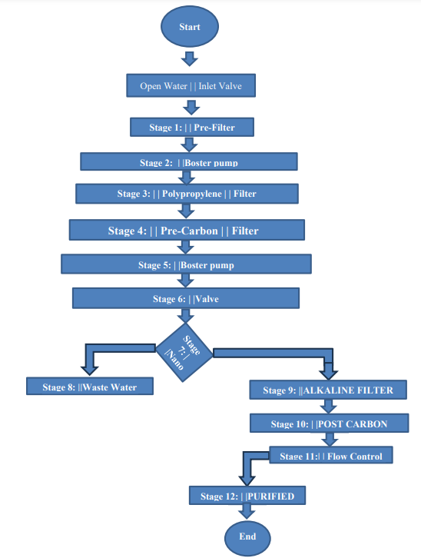
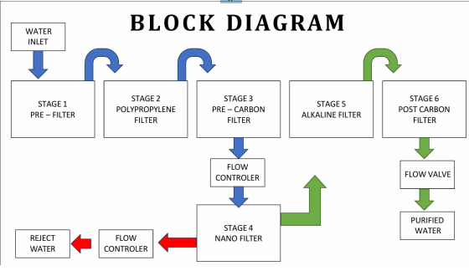
Architecture
Present the architecture diagram illustrating the flow of water through the different stages, from raw water input to purified water output, and reject recovery processes

Slide 13
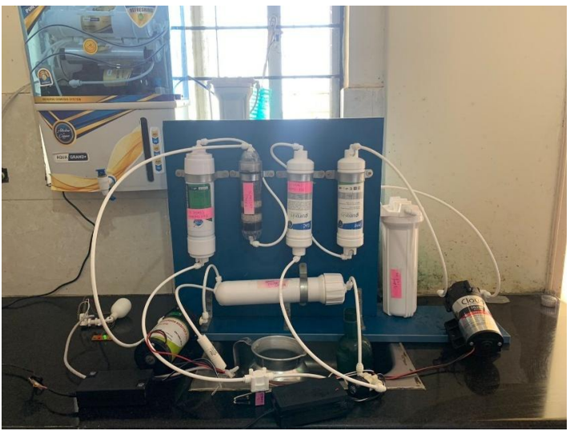
Our Demo Model

Slide 14
Hardware components
Hardware
Pre-Filter: Removes large sediments and particles to protect subsequent filters.
Polypropylene Filter: Filters out finer suspended particles.
Pre-Carbon Filter: Adsorbs chlorine and volatile organic compounds (VOCs).
Nano Filter: Provides ultrafiltration for enhanced water quality.
Alkaline Filter: Balances pH levels and adds essential minerals.
Post-Carbon Filter: Final stage for improving water taste and odor.
Booster Pump (0.5 HP): Increases water pressure between Stage 3 (Pre-Carbon Filter) and Stage 4 (Nano Filter) to optimize flow and reduce reject water.
Flow Controller and Flow Valve: Ensures precise water flow and maintains system stability.

Slide 15
Contd… (Hardware components)
The following hardware components are utilized in the multi-stage water purification system to ensure optimal performance and efficiency:
Pre-Filter
Removes large sediments, dirt, and particles from the input water to prevent clogging of subsequent filters.
Polypropylene (PP) Filter
Captures finer suspended particles, ensuring cleaner water for the next filtration stages.
Pre-Carbon Filter
Adsorbs chlorine, volatile organic compounds (VOCs), and other chemical contaminants, improving water taste and protecting downstream filters.
Nano Filter
Provides ultrafiltration to remove smaller contaminants such as bacteria, viruses, and fine particles, ensuring high-quality water.
Alkaline Filter
Balances the pH of the water by adding essential minerals, making the purified water healthier and more suitable for consumption.

Slide 16
Contd… (Hardware Components)
Post-Carbon Filter
Final stage of filtration that enhances water taste and removes any residual odors, ensuring crystal-clear water.
Booster Pump (0.5 HP)
Increases water pressure between the pre-carbon and nano filter stages, optimizing flow rate and reducing reject water.
Flow Controller and Flow Valve
Regulates water flow to maintain system stability and prevent pressure imbalances during filtration.
Tubing and Connectors
Facilitates the smooth flow of water between different filtration stages and ensures a secure and leak-free system.
Water Storage Tank (Optional)
Stores purified water for later use, ensuring a continuous supply even during high-demand periods.
These hardware components work together to ensure effective water purification, reduce reject water, and maintain system reliability.

Slide 17
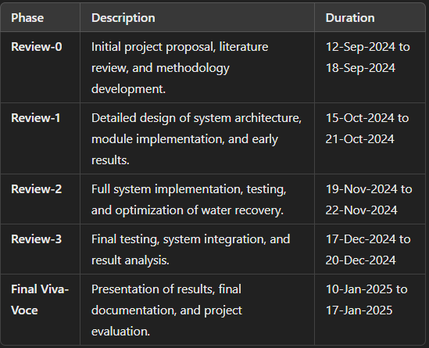
Timeline of Project
Key Milestones
Literature Review Completion: By 18-Sep-2024 (Review-0).
System Design Finalization: By 21-Oct-2024 (Review-1).
Prototype Testing: By 22-Nov-2024 (Review-2).
System Optimization and Final Results: By 20-Dec-2024 (Review-3).
Project Submission and Viva: By 17-Jan-2025.

Slide 18
Expected Outcomes
Expected Outcomes
Reduction in Reject Water
Achieve a reject-to-purified water ratio of 1:1.3, significantly reducing water wastage compared to traditional purification systems.
Improved Water Quality
Consistently produce purified water with a pH of 7 (neutral), ensuring it is safe and suitable for drinking and other applications.
Enhanced System Efficiency
Optimize the flow and pressure of water through the integration of a booster pump, leading to improved overall system performance.

Slide 19
Contd… (Expected Outcomes)
Sustainability and Conservation
Promote sustainable water management by minimizing water waste and supporting the United Nations Sustainable Development Goal (SDG) for clean water and sanitation.
Cost-Effective Solution
Provide an affordable and scalable water purification system suitable for domestic and industrial use.
Demonstration of Real-Time Monitoring
Enable effective monitoring of water flow, quality, and reject ratios through flow controllers and potential future integration of IoT sensors.
Potential for Future Research and Innovation
Lay the groundwork for future advancements in reject water recovery and sustainable filtration technologies.

Slide 20
Conclusion
This project successfully demonstrates an optimized multi-stage water purification system designed to significantly reduce reject water while maintaining high water quality. By integrating a booster pump between the pre-carbon and nano filter stages, the system achieved a reject-to-purified water ratio of 1:1.3, which is a notable improvement over conventional purification systems. Furthermore, the purified water consistently maintained a neutral pH of 7, ensuring its safety and suitability for consumption.
The results highlight the potential for sustainable water management solutions that align with global water conservation goals, particularly Sustainable Development Goal (SDG) 6: Clean Water and Sanitation. The project not only offers a cost-effective and scalable approach for both domestic and industrial applications but also provides a foundation for further innovation, such as real-time monitoring and advanced reject water recovery techniques.
In conclusion, the proposed system contributes to reducing water wastage, promoting efficient resource utilization, and fostering sustainable practices in water purification technology. This work holds promise for addressing global water challenges and encourages further exploration of innovative solutions in this critical field.

Slide 21
Github Link
Github Link
https://github.com/users/issu2009/projects/2/views/1?pane=issue&ite
mId=80108452

Slide 22
References
Consultations with local water purification shops for practical insights on system design and optimization.
Discussions with filter experts on advanced filtration methods and reject water recovery techniques.
Recommendations provided by ChatGPT for technical design improvements and methodology refinement.
Experimental observations and data collected during project implementation and testing.
Research articles and resources on multi-stage water purification systems and sustainable water management strategies:
[Insert the specific research papers or books used, if any, with their authors and publication details].
United Nations Sustainable Development Goals (SDG) documentation for reference to SDG 6 (Clean Water and Sanitation).

Slide 23
Project work mapping with SDG
The project "Thermax Minimizing Reject during Water Purification" aligns with multiple SDGs by addressing global challenges in water conservation, sustainability, and technological innovation.
SDG 6: Clean Water and Sanitation
The project directly contributes to SDG 6 by reducing water wastage and improving water recovery rates. This ensures the availability and sustainable management of clean water, promoting efficient water usage and increased access to purified water for domestic and industrial applications.
SDG 12: Responsible Consumption and Production
By minimizing reject water and enhancing energy efficiency, the project supports sustainable production and consumption practices. It reduces the environmental impact of water purification processes, encouraging resource efficiency and waste reduction..

Slide 24
Contd… (Project work mapping with SDG)
SDG 9: Industry, Innovation, and Infrastructure
The use of innovative technology, such as the integration of a booster pump and potential real-time monitoring systems, fosters sustainable industrialization. It aligns with SDG 9 by promoting resilient infrastructure and advancing innovative practices in water purification systems.
This project highlights the critical role of technology in achieving sustainability goals and contributes to addressing global water and environmental challenges

Slide 25

.
Thank You

