Slide 1


COVID-19 Vaccine Analysis
TEAM MEMBERS:
A.MOHAMED FARIS
M.PRADEEP RAJ
R.MOHAMED NIFRAS
D.G.KRISHNAN
G.MANOJ

Slide 2
PROBLEM STATEMENT:
COVID 19 VACCIN ANALYSIS

Slide 3
SOLUTION:
1
COVID 19 VACCIN ANALYSIS USING PYTHON:
Exploring the data behind the COVID-19 vaccine development and distribution using Python.

Slide 4
Data Collection and Preprocessing
1
PyPI Data Collection
2
Data Cleaning
3
Data Aggregation
Using Python's Package Index to collect data on the latest vaccine research and development packages.
Removing null values, duplicate data, and normalising the data to make it machine-readable.
Aggregating data from various sources, including social media and news outlets, to build a comprehensive understanding of the vaccine landscape.

Slide 5
Modelling and Prediction
Vaccine Demand Modelling
Production Capacity Modelling
Modelling vaccine demand based on factors such as population density and demographic distributions.
Modelling the production capacity required to meet vaccine demand for different countries and regions.
Distribution and Allocation Modelling
Prediction Modelling
Developing algorithms to optimise vaccine distribution and allocation based on supply chain efficiencies.
Developing predictive models to forecast the success of a vaccine roll-out and the impact of the pandemic.

Slide 6

Model Evaluation and Analysis
1
Model Validation
Ensuring that the model provides accurate predictions and detecting and fixing issues.
Risk Assessment and Management
2
Assessing and mitigating the risks associated with vaccine distribution and rollout, including adverse reactions, delays, and authorisation issues.
3
Stakeholder Communication and Engagement
Communicating with stakeholders at all levels to ensure that vaccine distribution is transparent, efficient and equitable.

Slide 7
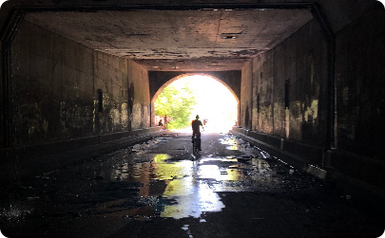
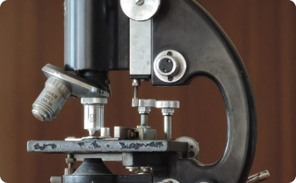

Conclusion and Future Directions
Hope for the Future
Further Research
Thank You to Healthcare Workers
The development and deployment of the COVID-19 vaccine offers hope for a future free of the pandemic's impact.
Continued research into RNA technologies and genetics could prove valuable for future vaccine and treatment development.
We want to express gratitude to the healthcare workers who continue to fight the pandemic every day.

Slide 8
References
Pfizer-BioNTech Covid-19 Vaccine Information
(2021)
Moderna Covid-19 Vaccine Information
(2021)
AstraZeneca Covid-19 Vaccine Information
(2021)
Greinacher, A.et al.
Covid-19: vaccination and thrombosis

