Slide 1



MASTERS’ THESIS – MDT6099
ADVANCING HEALTHCARE WITH RAG IMPLEMENTATION ON LLM
Presented by -
MOHAMED FAZIL M
22MDT1043
Under the Guidance of
Dr. MANIMARAN J

Slide 2


TABLE OF CONTENTS
ABSTRACT
INTRODUCTION
ARCHITECTURE
MISTRAL 7B LLM
RETRIEVAL AUGMENTED GENERATION
RESULTS
EVALUATION
CONCLUSION
REFERENCES

Slide 3
ABSTRACT
THIS PROJECT PRESENTS THE DEVELOPMENT OF A MEDICAL CHATBOT ENHANCED WITH RETRIEVAL-AUGMENTED GENERATION (RAG) TECHNIQUES. THE CHATBOT LEVERAGES THE MISTRAL 7B LARGE LANGUAGE MODEL (LLM) FOR ITS TEXT UNDERSTANDING AND GENERATION CAPABILITIES. TO ENSURE ACCURATE AND INFORMATIVE MEDICAL RESPONSES, THE SYSTEM INTEGRATES A KNOWLEDGE BASE OF RELIABLE MEDICAL DOCUMENTS. MISTRAL 7B, WITH ITS GROUPED-QUERY ATTENTION (GQA) AND SLIDING WINDOW ATTENTION (SWA) MECHANISMS, THEN EFFICIENTLY PROCESSES THIS RETRIEVED INFORMATION TO CAREFULLY CRAFT AN INFORMATIVE RESPONSE. THE GOAL OF THIS PROJECT IS TO CREATE A MEDICAL CHATBOT THAT OFFERS MORE TRUSTWORTHY AND FACT-BASED ANSWERS COMPARED TO STANDARD CHATBOTS THAT RELY SOLELY ON THEIR INTERNAL LANGUAGE MODEL.
Keywords: Medical chatbot, Retrieval-Augmented Generation (RAG), Mistral 7B, large language model (LLM), knowledge base, Grouped-query Attention, Sliding Window Attention

Slide 4
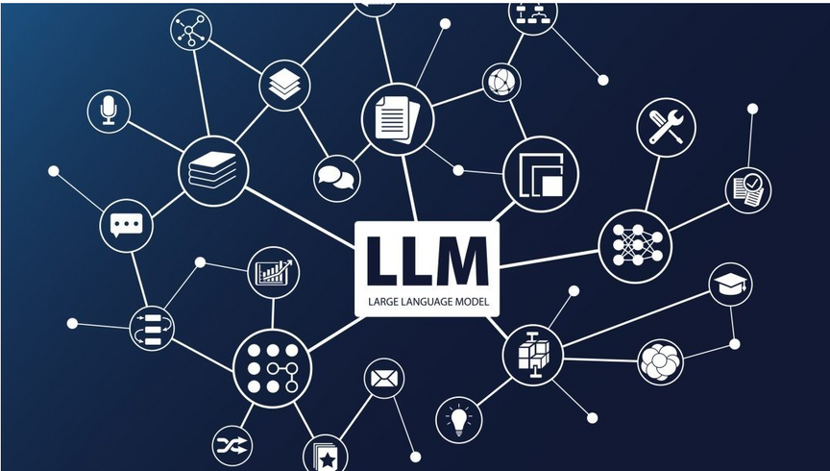
INTRODUCTION: LLM
LARGE LANGUAGE MODELS (LLMS) ARE TRAINED ON MASSIVE AMOUNTS OF TEXT DATA. LLMS PERFORM WELL ON VARIOUS NATURAL LANGUAGES PROCESSING TASKS, SUCH AS LANGUAGE TRANSLATION, TEXT SUMMARIZATION, AND CONVERSATIONAL AGENTS.
THESE MODELS, SUCH AS OPENAI,GEMINI,MISTRAL,LLAMA ARE DESIGNED TO UNDERSTAND, GENERATE, AND INTERPRET HUMAN LANGUAGE IN A WAY THAT MIMICS HUMAN-LIKE UNDERSTANDING. THEY ARE A TYPE OF DEEP LEARNING MODEL SPECIFICALLY FOCUSED ON NATURAL LANGUAGE PROCESSING (NLP) TASKS.

Slide 5
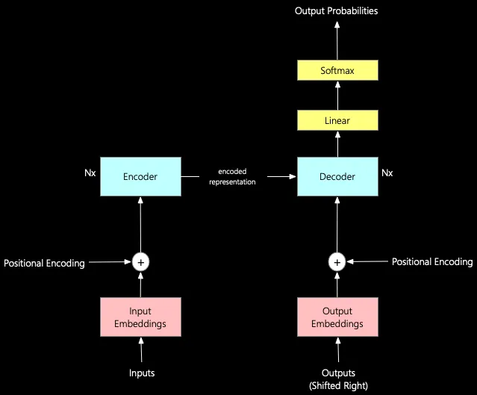
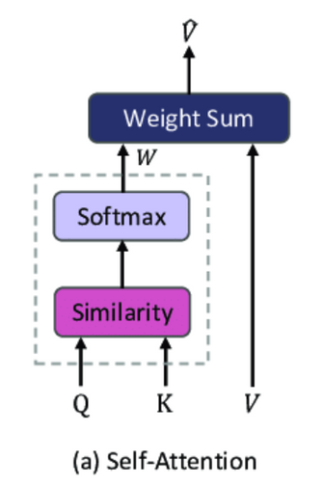
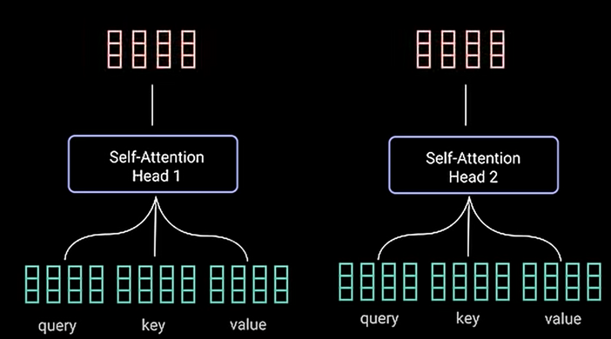
LLM ARCHITECTURE

Slide 6
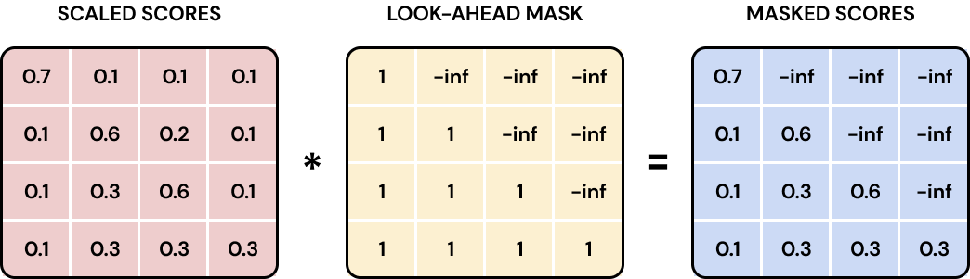
DECODER
Scaled Scores
Masking
Masked Scores

Slide 7
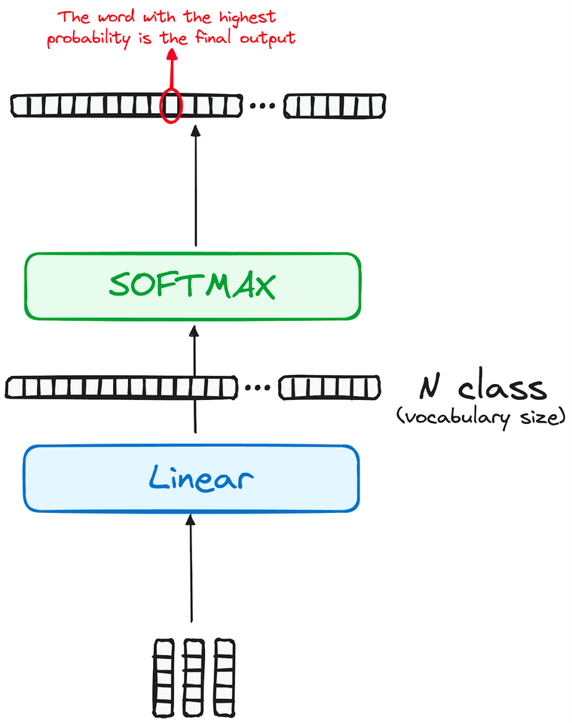
SoftMax
Linear
Decoder
SoftMax

Slide 8


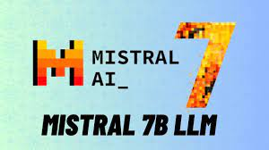
MISTRAL 7B LLM
MISTRAL 7B IS A LARGE LANGUAGE MODEL (LLM) – THINK OF IT AS A SUPER-SMART CHATBOT CAPABLE OF UNDERSTANDING AND GENERATING HUMAN-LIKE TEXT.
Key Strengths:
Impressive Performance: Mistral 7B excels at a wide range of language tasks, including writing different creative text formats, answering questions, and even generating computer code.
Efficiency: It achieves great results without needing massive computer power, making it accessible for more people to use and experiment with.

Slide 9
APPLICATIONS
1. ENHANCED SEARCH ENGINES
2. INTELLIGENT VIRTUAL ASSISTANTS
3. CONTENT SUMMARIZATION TOOLS
4. QUESTION ANSWERING SYSTEMS
5. PERSONALIZED RECOMMENDATIONS
6. AUTOMATED CUSTOMER SUPPORT
7. EDUCATIONAL TUTORING AND SUPPORT
8. CONTENT GENERATION
9. KNOWLEDGE DISCOVERY AND DATA ANALYSIS

Slide 10
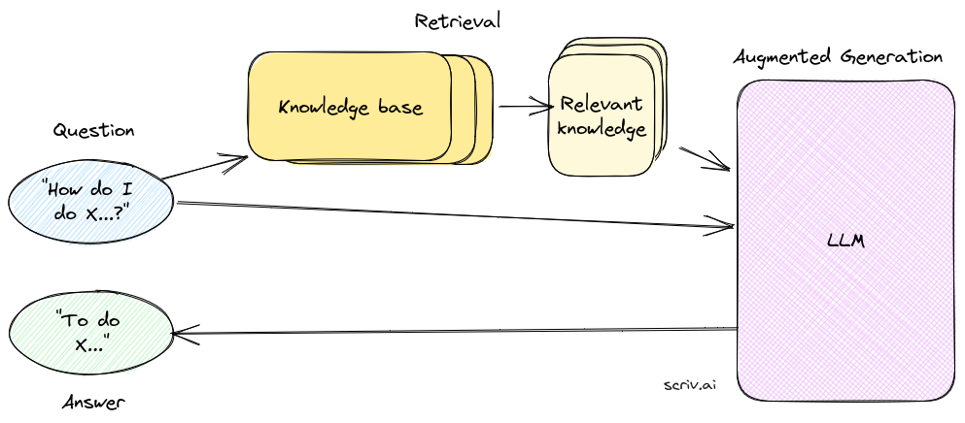
RETRIEVAL AUGMENTED GENERATION
RETRIEVAL-AUGMENTED GENERATION (RAG) ENHANCES LARGE LANGUAGE MODELS (LLMS) BY INTEGRATING EXTERNAL KNOWLEDGE SOURCES INTO THE RESPONSE GENERATION PROCESS. UNLIKE TRADITIONAL LLMS, WHICH RELY SOLELY ON PRE-TRAINED DATA, RAG DYNAMICALLY RETRIEVES RELEVANT INFORMATION FROM DATABASES OR DOCUMENTS WHEN NEEDED. THIS APPROACH USES A RETRIEVAL SYSTEM TO FETCH PERTINENT CONTENT BASED ON THE INPUT QUERY, WHICH IS THEN BLENDED INTO THE GENERATION PROCESS. THE RESULT IS MORE ACCURATE AND CONTEXTUALLY RELEVANT RESPONSES, PARTICULARLY VALUABLE IN FIELDS REQUIRING PRECISE AND CURRENT INFORMATION.

Slide 11
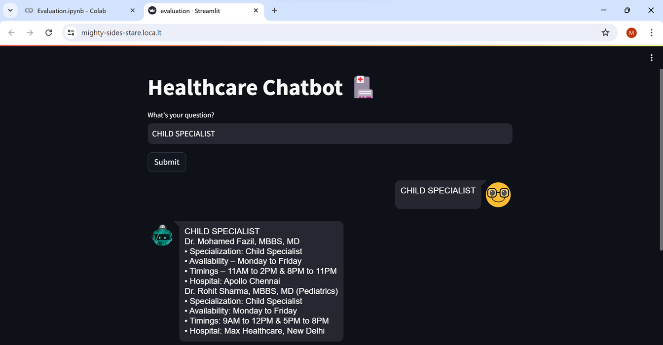
RESULTS
THIS RESULT ILLUSTRATES THE CHATBOT'S PROCESS WHEN A USER INQUIRES ABOUT CHILD SPECIALISTS AND THEIR AVAILABILITY. THIS INFORMATION, INCLUDING DOCTORS' SPECIALIZATIONS, SCHEDULES, AND ASSOCIATED HOSPITALS, IS DIRECTLY PULLED FROM AN UPLOADED DOCUMENT, PROVIDING A SWIFT AND ACCURATE RESPONSE BASED ON PRE-EXISTING DATA.

Slide 12
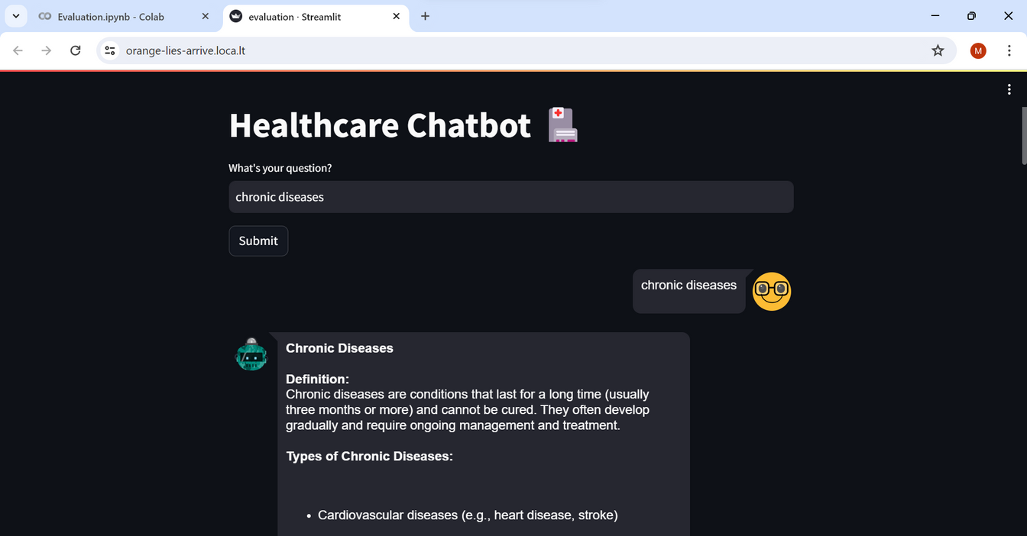
THIS FIGURE DEPICTS THE USER INQUIRING ABOUT CHRONIC CONDITIONS USING THE CHATBOT. INITIALLY, THE CHATBOT SEARCHES FOR IMPORTANT INFORMATION IN A PDF DOCUMENT. IF THE REQUIRED INFORMATION IS NOT DISCOVERED IN THE PDF, THE CHAT?BOT SEARCHES THE LARGE LANGUAGE MODEL (LLM). THIS INCLUDES THOROUGH IN?FORMATION ON THE ILLNESS, INCLUDING TYPES, SYMPTOMS, CAUSES, PREVENTIVE STRATEGIES, AND TREATMENT OPTIONS.

Slide 13
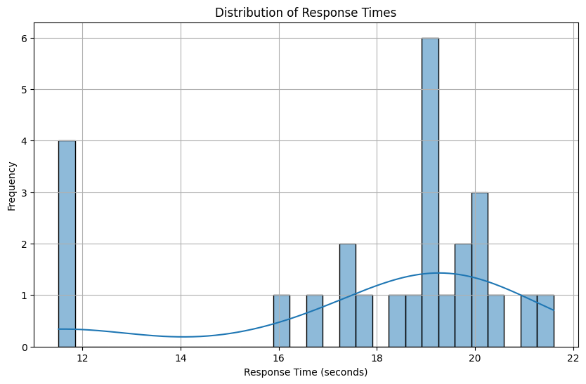
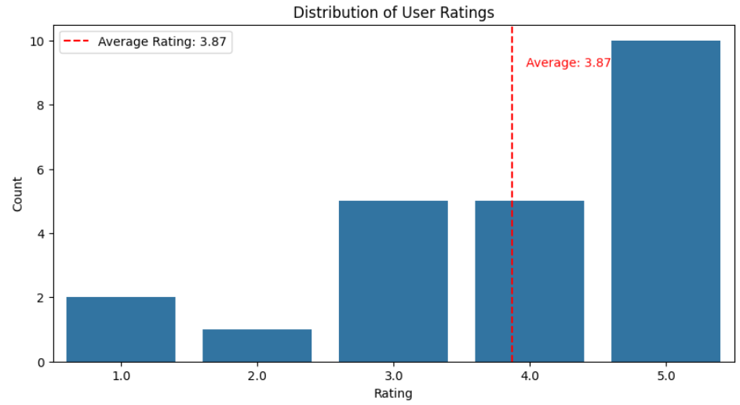
THE AVERAGE RESPONSE TIME FOR THE CHATBOT TO ANSWER A USER'S QUESTION IS APPROXIMATELY 19 SECONDS.
THE AVERAGE USER RATING FOR APPROXIMATELY 25 QUESTIONS IS 3.87 OUT OF 5, WHICH IS CLOSE TO A 4-STAR RATING.

Slide 14
CONCLUSION
THE INTEGRATION OF RAG TECHNIQUES AND THE EFFICIENT MISTRAL 7B LLM HOLDS THE POTENTIAL TO TRANSFORM MEDICAL CHATBOTS. THIS APPROACH ENABLES THE GENERATION OF MORE RELIABLE, INFORMATION-DRIVEN RESPONSES COMPARED TO CHATBOTS LIMITED BY THEIR LANGUAGE MODEL ALONE. SUCH A SYSTEM COULD ENHANCE PATIENT UNDERSTANDING OF MEDICAL CONCEPTS, OFFERING VALUABLE SUPPORT IN HEALTHCARE SETTINGS, WITH AN EMPHASIS ON FACTUAL ACCURACY.

Slide 15
REFERENCES
THAKKAR, HIREN, AND A. MANIMARAN. "COMPREHENSIVE EXAMINATION OF INSTRUCTION-BASED LANGUAGE MODELS: A COMPARATIVE ANALYSIS OF MISTRAL-7B AND LLAMA-2-7B." 2023 International Conference on Emerging Research in Computational Science (ICERCS). IEEE, 2023.
JIANG, ALBERT Q., ET AL. "MISTRAL 7B." ARXIV PREPRINT ARXIV:2310.06825 (2023).WANG, LIANG, ET AL. "IMPROVING TEXT EMBEDDINGS WITH LARGE LANGUAGE MODELS." ARXIV PREPRINT ARXIV:2401.00368 (2023)..
MISTRAL 7B - HTTPS://MISTRAL.AI/NEWS/ANNOUNCING-MISTRAL-7B/
A. Y. ALAN, E. KARAARSLAN, AND O. AYDIN. A RAG-BASED QUESTION AN?SWERING SYSTEM PROPOSAL FOR UNDERSTANDING ISLAM: MUFASSIRQAS LLM. ARXIV PREPRINT ARXIV:2401.15378, 2024.
H. ZOLKEPLI, A. RAZAK, K. ADHA, AND A. NAZHAN. LARGE MALAYSIAN LANGUAGE MODEL BASED ON MISTRAL FOR ENHANCED LOCAL LANGUAGE UNDER?STANDING. ARXIV PREPRINT ARXIV:2401.13565, 2024.

Slide 16


