Slide 1
An Exciting Journey Begins!
Exploring Presentation Topic together.

Slide 2
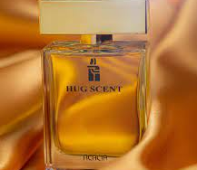
Hug Scent Perfume

Slide 3
Introduction
The World of perfumes is a world that blends beauty and elegance, where each perfume reflects a unique story and special scent.

Slide 4
Project Idea
In this project, we will focus on marketing and targeting strategies for “Hug Scent” Through creating personas , segmenting the market into categories by various demographic , psychographic , Behavioral , Geographic data and determining the SWOT.

Slide 5
Project Objectives
In this project, marketing and targeting "Hug Scent" element will be highlighted. We will discuss how to promote perfume to the target audience. We will look at the factors that make this perfume unique and special in the competing perfume market.

Slide 6

HELLO!
I am Mohamed Gad
A Third–Year Student at Assiut University, Faculty of commerce, Department of Business Information Systems.
You can contact me 01033975256

Slide 7
Today's Agenda
What to expect today?
-Overview of Business
-Segmentation and Targeting.
-Buyer Personas
-SWOT

Slide 8
Let's Get Started!
We encourage your active participation.

Slide 9
Overview of Business
Hug Scent Perfume is a premium fragrance brand that specializes in creating unique, high-quality perfumes and colognes.
Our mission at Hug Scent Perfume is to be the go-to destination for individuals seeking distinctive and luxurious fragrances.

Slide 10
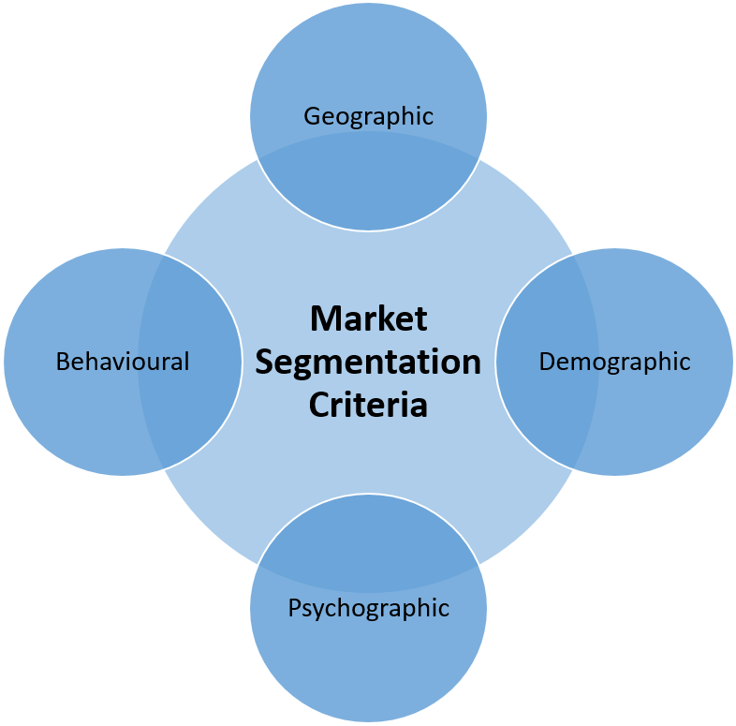
Segmentation and Targeting
Here's a breakdown of how Hug Scent Perfume can segment its market and define its target audience:
-Demographic
-Psychographic
-Behavioral
-Geographic

Slide 11
Demographic
Age: 18-45
Gender: Male
Income: 18-25 * 1500-2000 EGP , 25-45 * 3000-6000 EGP
Education: 18-25 (College) , 25-45 (Employee)

Slide 12
Psychographic
Lifestyle: I Target individuals who value self-expression, luxury, and unique experiences through fragrance.
Values: prefer brands that align with their minimalist values.
Interest: luxury brands, fashion, culture , perfumes.
Behavior: Often purchase perfumes as gifts for their partners or wear fragrances that remind them of significant romantic moments.
Motivations: They prefer brands that prioritize sustainability and responsible sourcing.

Slide 13
Behavioral
this is most relevant to purchase occasion within the perfume industry.
Purchase perfumes as gifts for partners or for special romantic occasions.
Enjoys experimenting with different scents to match his mood or style.
the number of perfume advertisements is constantly increasing because of the approach to birthday. Perfume is a key gift idea and therefore there is an increase in advertising.

Slide 14
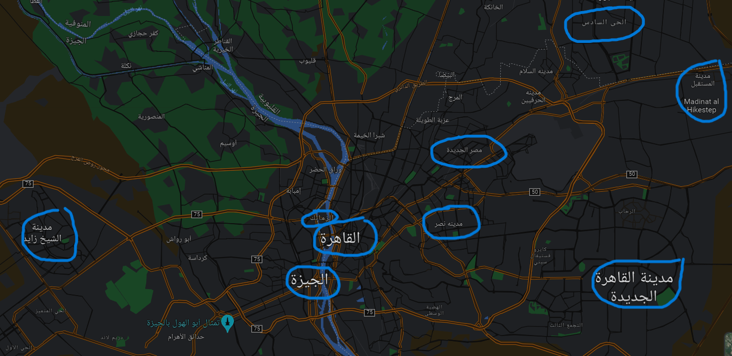
Geographic

Slide 15
Targeting is also used: the perfume market illustrates a differentiated focus market there are several targets in the market, for example different ages and personalities as well as gender, however one perfume will not suit every person so there is a focus within the market. Segmentation aims to highlight different areas in the market for targeting.

Slide 16
“
“let’s describe the buyer personas.”

Slide 17
Buyer Persona:
Students
Employees
sports players

Slide 18
The Buyer Personas
Students
Employees
Sports Players
Name: Mohamed
Age:18-25
Monthly Income: 1500-2000 EGP
Pain Points: Economical and suitable price , the degree of stability in the perfume is high , Be brand.
Information Resources:
Reviews , Friends , FB , IG
Name: Ahmed
Age: 25-45
Monthly Income: 3000 - 6000 EGP
Pain Points: Economical and suitable price , the degree of stability in the perfume is high , Be brand , Delivery Service.
Information Resources:
Reviews , Friends , FB
Name: Mohamed
Age: 20-38
Monthly Income: 15000 - 30000 EGP
Pain Points: the degree of stability in the perfume is high , Be brand , the product is high quality.
Information Resources:
Reviews , Sponsors , FB , IG

Slide 19
The Buyer Personas
Students
Employees
Sports Players
How to solve his/her problem: we have perfumes available at medium prices and suitable for all , the degree of stability is high ,our products are branded.
SM Platforms: FB , IG , X
Online: 6-9 AM , 6-12PM
Interests: perfumes , Fashion , Gift Giving and Special Occasions.
How to solve his/her problem: we have perfumes available at medium prices and high quality , the degree of stability is high ,our products are branded.
SM Platforms: FB , IG , X
Online: 6-7 AM , 9-11PM
Interests: perfumes , Fashion , Gift Giving and Special Occasions.
How to solve his/her problem: we have products are high quality, the degree of stability is high ,our products are branded.
SM Platforms: FB , IG , X
Online: 8-11 AM ,10-11PM
Interests: perfumes , Fashion , Gift Giving and Special Occasions , Brand.

Slide 20
SWOT:
SWOT analysis: is defined as an acronym for
Strengths:
-Unique Fragrance
- brand reputation
-high quality
suitable price.
Weaknesses:
-Limited Product
-limited Product range.
Threats:
-Competition
-Regulatory Changes
-Shifting Consumer Preferences.
Opportunities:
-Market Expansion
-Trend Adaptation
-Online Sales

Slide 21
Thanks!
Any questions?
You can find me at:
Mohamed.gad9395@gmail.com
https://www.linkedin.com/in/mohamedgad0/
Contact me : 01033975256

