Slide 1
A Microcontroller-based Fire Protection System for the Safety of Industries in Bangladesh
Under supervision of Dr/ Laila Abou Hashem
By
1-Mazen Sayed
2-Aboubaker Adel
3-Mazen Magdy
4-Ahmed Gamal Aldin
5-Abdallah Mohamed
6-Khaled Mohamed
7-Mohamed Ahmed Galal

Slide 2
Introduction
4621 registered garment industries in Bangladesh employ about 4 million workers.
fire-safety has become a major concern as We have lost more than 140 lives the past year due to several fire incidents across the country.
Most of Deaths reasons are short circuits, leaking gas, inadequate fire protection system, or lack of effective fire alarm.
There is two type of fire protection:
1-Early warning of fire detection.
2- A system that will not only detect the fire but also take essential attempts to stop it.

Slide 3
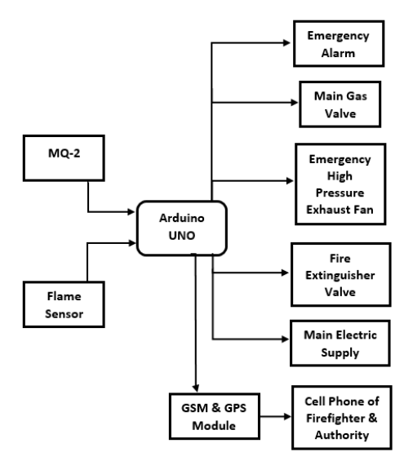
Block diagram of the system.

Slide 4
How it works ?
When the system is powered on it automatically starts to sense the environment for toxic gas or flames.
The sensors will send these data to Arduino UNO. Arduino UNO will examine them according to the installed program
If the flame is detected the system will activate the emergency alarm, disconnect the building's primary power source, shut down the main gas valve to stop gas flow, activate an emergency high-pressure exhaust fan to remove leakage gas, and GSM & GPS module to send notification and position to the firefighter and authority
During gas leakage the gas valve will be shut off, the alarm & exhaust fan will be activated and notification will be sent

Slide 5
System 's components
Flame Sensor
Gas Sensor
Arduino UNO
GSM Modules
Buzzer
Electric Gas Valve
Magnetic Contactor

Slide 6
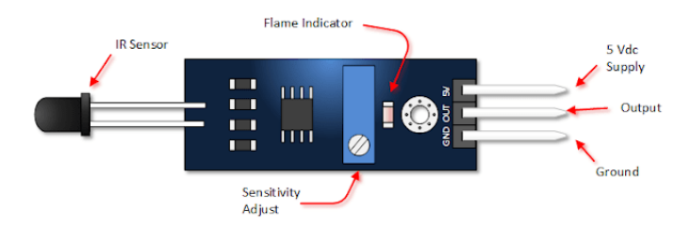
Flame sensor
detecting the presence of flame or fire where it is placed using the infrared flame flash method.
Why we flame senso insted of heat sensors?
As it can respond faster and more accurately than a heat sensor for its mechanism
When the sensor detects flame or fires it sends a signal to the microcontroller and the microcontroller simultaneously active the buzzer & sends a notification to the authority through the GSM module.

Slide 7
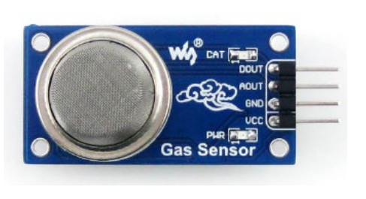
Gas Sensor
we use MQ-2 as a gas or smoke detector sensor.
It has a high sensitivity to detect flammables having a concentration of 300- 10000ppm

Slide 8
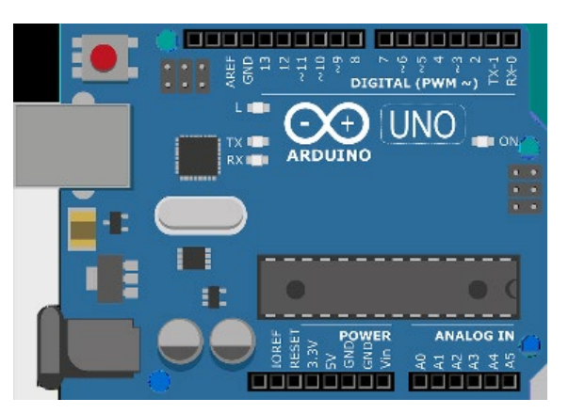
Arduino UNO
It is the central processing unit of the system.
Consist of
It has 6 analog input pins
14 digital input/output pins (6 pins of it used as PWM output.
It can be programmed with the help of Arduino IDE using a type B USB cable .
It is operated at the voltage of 5V to 12V.

Slide 9
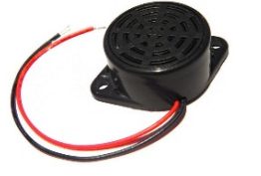
Buzzer
known as a beeper.
It converts electrical energy into sound energy with the help of transistors & capacitors. It is widely used in alarm & timer circuits. In our system, it is used to get alerts when the sensor detects smoke or fire.

Slide 10
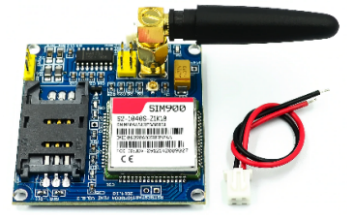
GSM module.
is a specialized hardware device that utilizes GSM technology to enable communication capabilities through cellular networks. When incorporated into an application, it allows for bidirectional wireless communication by sending and receiving both data and voice calls.
A SIM can be inserted in the module to send signals, messages, or to make calls

Slide 11

Electric Gas Valve
is a high-quality solenoid valve that is used to control the flow of gas
we use this electric valve to control the flow of the main gas valve when leakage smoke or fire is detected in the sensor.

Slide 12

Magnetic Contactor
In this system when smoke or fire is detected, the microcontroller sends a signal to this magnetic contactor or relay to turn off the main supply of electricity.

Slide 13
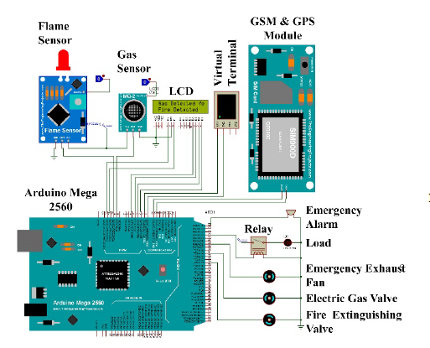
SIMULATION
We have used
Arduino Mega 2560as the central processing unit
Flame sensor and a Gas senor as the input unit
load, emergency alarm, motor control valve, GSM & GPS module, etc. as the output

Slide 14
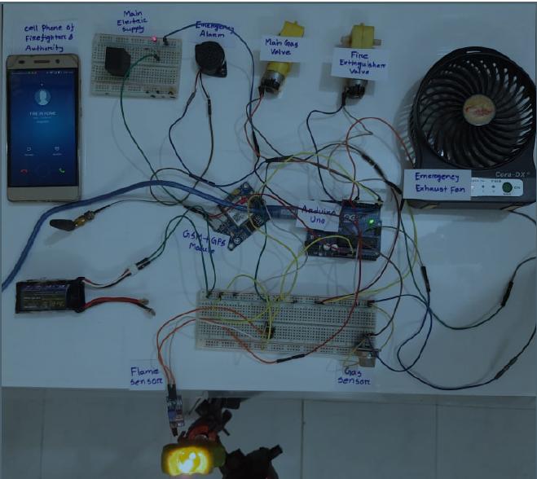
PRACTICAL EXPERIMENT
It's a copy of the simulation but we have used
candle light as a fire source
a relay connected to a load as main power supply
Motor as electric gas valve
Fan as exhaust fan of the industry

Slide 15
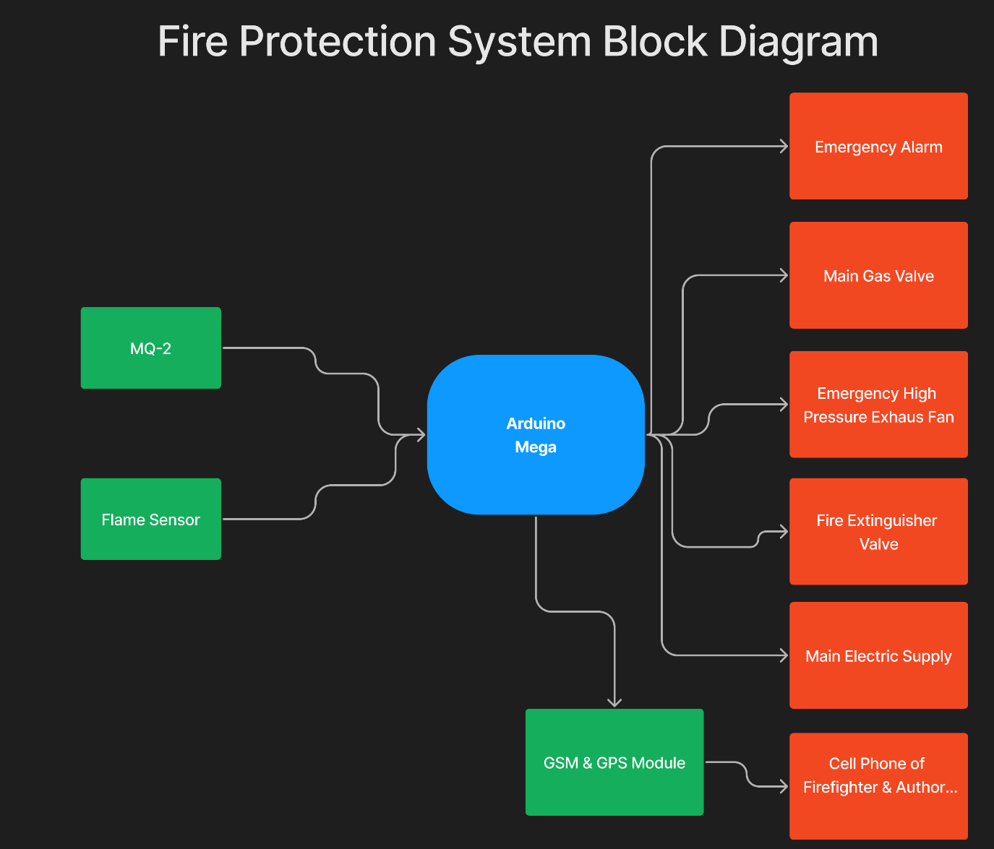
Block Diagram

Slide 16
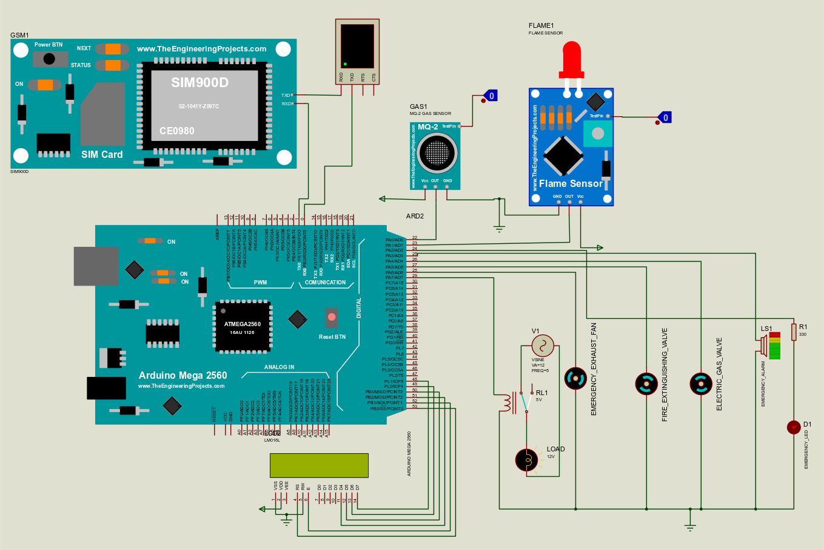
Schematic

Slide 17
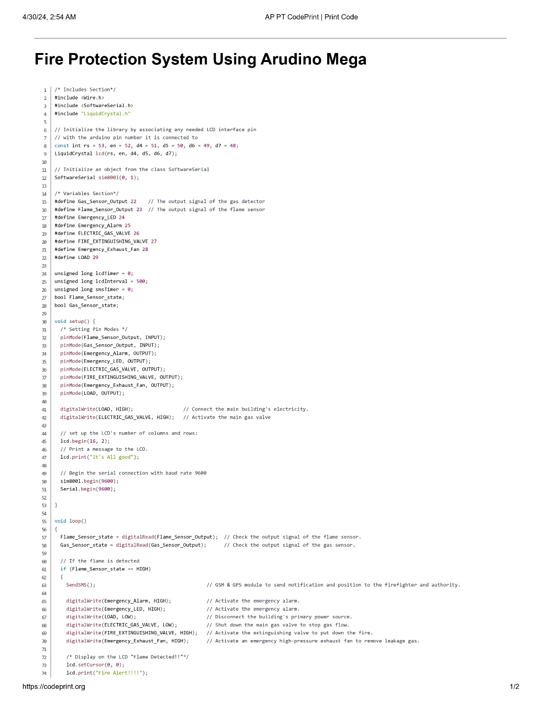
Code

Slide 18
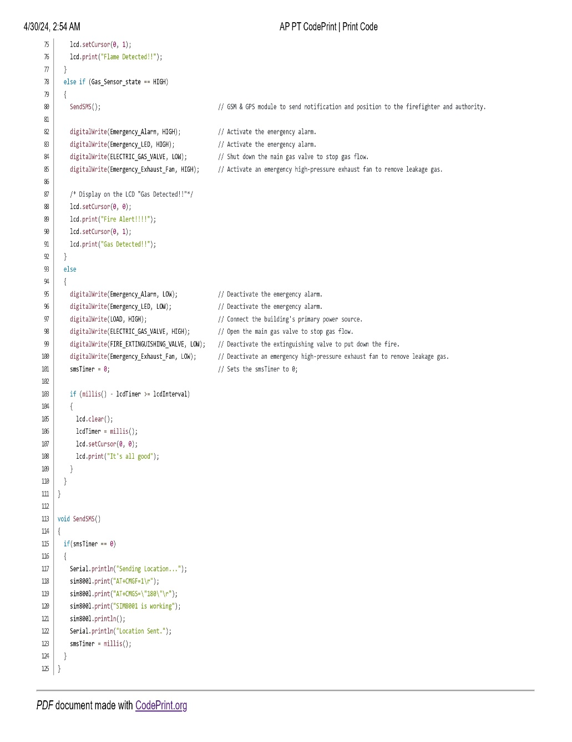
Code

Slide 19
CONCLUSION
In this paper, we have proposed a microcontroller-based automated fire protection system that can detect any fire source and take immediate action to prevent it. At the same time, the system can also send an alert notification to the authority within a very short time to take extra measures

