Slide 1
Comparative Analysis of Search Strategies
for Maze Pathfinding
Artificial Intelligence Course Project

Slide 2
The Challenge: Maze Pathfinding
Objective: Navigate an intelligent agent (robot) through a grid-based maze.
Goal: Find a valid path from a Start Point (S) to a Goal Point (G).
Environment Constraints:
  - N x N Grid.
  - Static obstacles (walls) randomly distributed.
  - Movement allowed in 4 directions (Up, Down, Left, Right).
  - Constant step cost = 1.

Slide 3
Methodology Overview
Goal: To compare the efficiency of different AI search strategies.
Selected Algorithms (5 types):
  - Uninformed Search (Blind): BFS, DFS, UCS, IDS.
  - Informed Search (Heuristic): A* Search.
Evaluation Metrics:
  - Time Complexity: Execution speed.
  - Space Complexity: Memory usage (Nodes expanded).
  - Optimality: Guarantee of the shortest path.

Slide 4
Algorithm 1: Breadth-First Search (BFS)
Concept: Explores the search space level by level (like ripples in water).
Mechanism:
  - Starts at the root node.
  - Visits all neighbors at depth 'd' before moving to depth 'd+1'.
  - Uses a FIFO Queue (First-In, First-Out).
Complexity:
  - Time: O(b^d) (Exponential).
  - Space: O(b^d) (High memory usage).
Pros: Guarantees the Shortest Path (Optimal).

Slide 5
Algorithm 2: Depth-First Search (DFS)
Concept: Explores as deep as possible along each branch before backtracking.
Mechanism:
  - Follows a single path until it hits a dead end.
  - Backtracks to the last junction to try a new path.
  - Uses a LIFO Stack (Last-In, First-Out).
Complexity:
  - Time: O(b^m) (Can get stuck in deep loops).
  - Space: O(bm) (Linear - Very Efficient).
Cons: Not Optimal (often returns long, winding paths).

Slide 6
Algorithm 3: Uniform-Cost Search (UCS)
Concept: Expands the node with the lowest cumulative path cost g(n).
Mechanism:
  - Prioritizes the 'cheapest' path found so far.
  - Uses a Priority Queue ordered by path cost.
Behavior:
  - Since step cost is constant (1), UCS behaves identically to BFS.
  - Designed to handle varying terrain costs (e.g., mud vs. road).
Pros: Guarantees Optimality.

Slide 7
Algorithm 4: Iterative Deepening Search (IDS)
Concept: A hybrid strategy combining the best of BFS and DFS.
Mechanism:
  - Repeatedly runs DFS with an increasing Depth Limit (Limit = 0, 1, 2...).
  - Effectively simulates BFS behavior using DFS memory efficiency.
Complexity:
  - Time: High overhead due to regenerating the tree multiple times.
  - Space: O(bd) (Linear - Low memory).
Pros: Guarantees Shortest Path with low memory usage.

Slide 8
Algorithm 5: A* Search (The Best)
Concept: Informed search that uses 'intelligence' to guide the search.
Mechanism:
  - Uses an evaluation function: f(n) = g(n) + h(n).
  - g(n): Actual cost from Start.
  - h(n): Heuristic estimate to Goal (Manhattan Distance).
  - Prioritizes nodes that minimize f(n) (get closer to the goal).
Pros: The most efficient algorithm; balances Speed and Optimality.

Slide 9
Code Implementation Details
Language: Python.
GUI Library: tkinter (Standard Library).
Architecture: Object-Oriented Programming (OOP).
- Logic Class: SearchAlgorithms (Contains the 5 algorithms).
- Presentation Class: MazeApp (Handles drawing and user interaction).
Data Structures Used:
- deque (Queue for BFS).
- list (Stack for DFS).
- heapq (Priority Queue for UCS and A*).

Slide 10

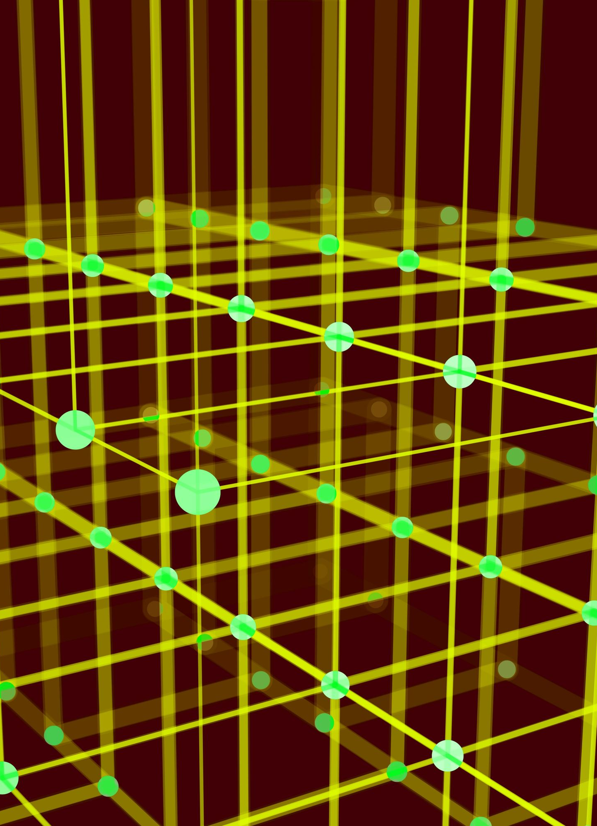
Experimental Setup
Test Environment:
  - Grid Size: 10 x 10.
  - Obstacles: Randomly generated (approx. 20% density).
Consistency:
  - All algorithms were tested on the EXACT same maze configuration to ensure fair comparison.
  - Start Point: (0,0) | Goal Point: (9,9).

Slide 11
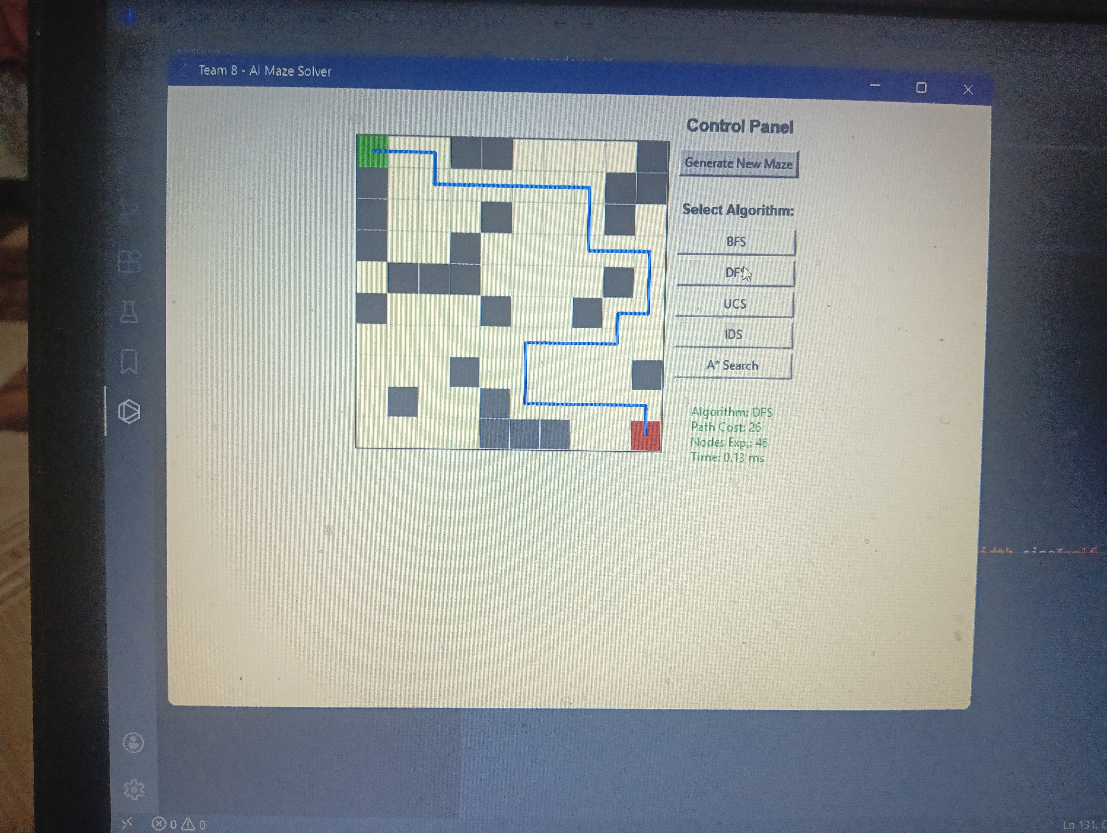
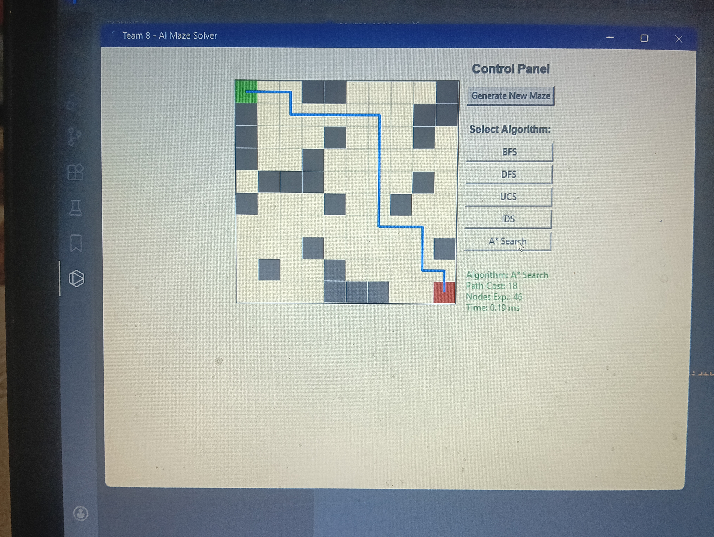
1. A* finding a direct path.
2. DFS finding a long winding path.

Slide 12




Performance Data Comparison
Algorithm | Status | Path Cost | Nodes Expanded | Time (ms)
A* Search | Success | [18] | [46] | [0.35]
BFS | Success | [18] | [70] | [0.15]
UCS | Success | [18] | [73] | [0.24]
DFS | Success | [26] | [46] | [0.27]
IDS | Success | [18] | [47173] | [87.69]

Slide 13
Analysis: Time Complexity
Fastest: A* Search
  - Excels because the heuristic guides it straight to the goal, skipping irrelevant paths.
Moderate: BFS and UCS
  - Reasonably fast but explore all neighbors at the current depth.
Slowest: IDS
  - Significantly slower because it restarts the search from scratch for every new depth limit.

Slide 14

Analysis: Space Complexity & Optimality
Space (Memory):
  - DFS & IDS are the most memory-efficient (Linear Space).
  - BFS consumes the most memory (Exponential Space) to store the frontier.
Optimality (Path Quality):
  - A*, BFS, UCS, IDS: All successfully found the Shortest Path.
  - DFS: Failed to find the shortest path, returning a sub-optimal solution.

Slide 15
Conclusion & Verdict
Winner: A* Search
  - The superior choice for pathfinding in grid environments. Best balance of speed and solution quality.
Reliable Runner-ups: BFS and UCS
  - Dependable for finding optimal paths but require more memory.
Not Recommended:
  - DFS (due to poor path quality).
  - IDS (due to slow execution speed).

Slide 16
Thank You!
Any Questions?
Credits: Team 8

