Slide 1
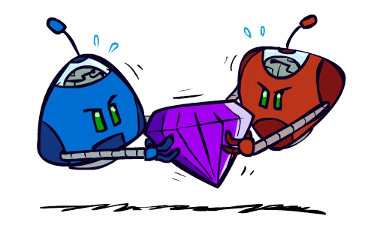
Machine Intelligence - Research Assignment
HTN Guided Adversarial Planning for RTS Games
Instructors: Dan Klein and Pieter Abbeel
University of California, Berkeley
[These slides were created by Dan Klein and Pieter Abbeel for CS188 Intro to AI at UC Berkeley. All CS188 materials are available at http://ai.berkeley.edu.]

Slide 2
Paper
Name: HTN Guided Adversarial Planning for RTS Games
Published IEEE, November 2020
Published by Sun Lin, Zhu Anshi, Li Bo, Fan Xiaoshi

Slide 3

Paper’s Topic
Real-Time Strategy (RTS) Games:
Large State space
Durative Actions
No Turns
Partially observable environment

Slide 4

Paper’s Topic
Some of the proposed methods for RTS games:
Alpha Beta
HTN
AHTN
Added value:
AHTNCO

Slide 5

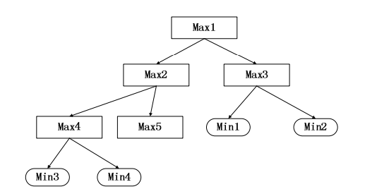
AHTN
Advantages:
Covered Durative Actions
Disadvantages:
simultaneous actions
neither consider the opponent strategies or the time constraint

Slide 6
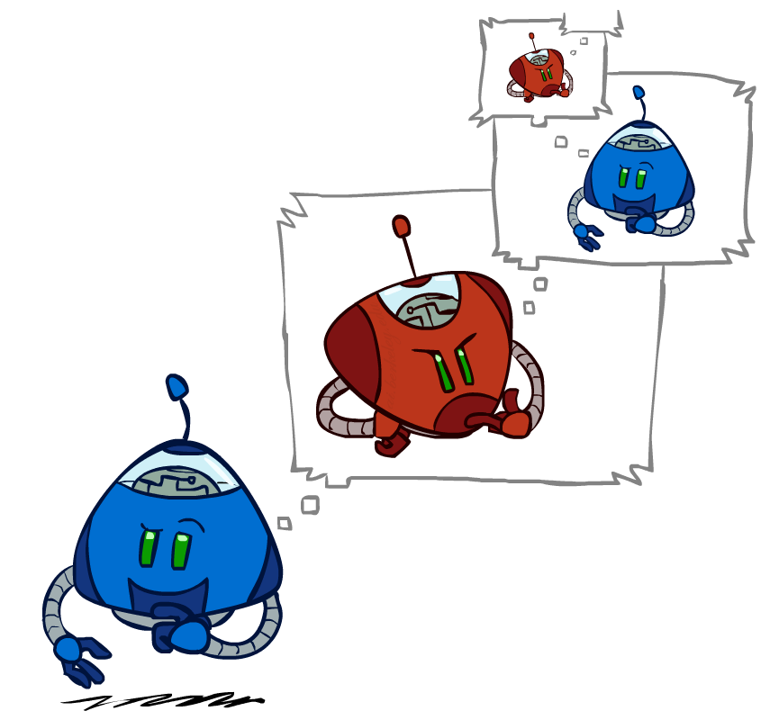

Findings
AHTNCO:
Better considers the concurrent nature of the problem by incorporating the opponent adversarial strategy in the search through generating min nodes
Utilizes a time constraint in the search
The time limitation used for the paper is t_{max} / d where d is the current tree depth.

Slide 7
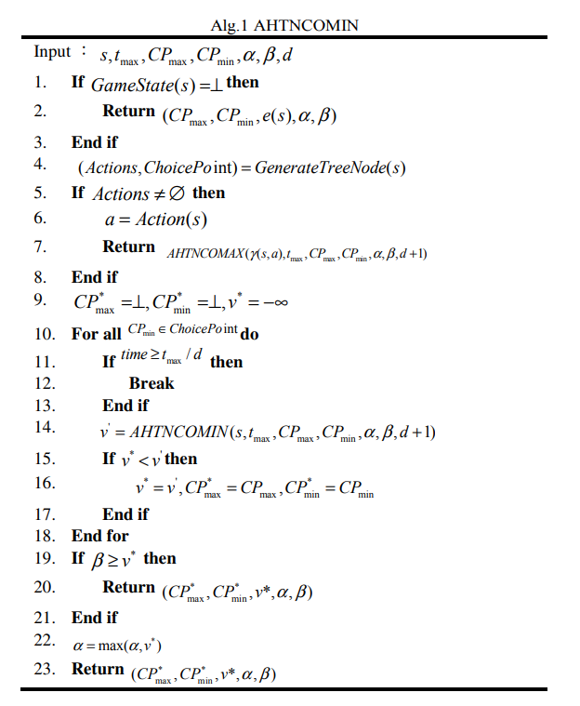
Findings
AHTNCO:

Slide 8
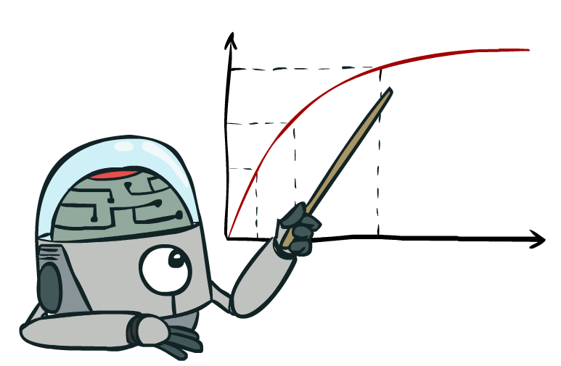
Suggestions
Time limitation :
More flexible time limitation functions can be used which can better capture the effect of different tree branching factors
Exploitation and Exploration?
t_{max} / b^d, will ensure that the agent will spend equal time in all branches but at the
compromise of how far into the future the agent searches

Slide 9


