Slide 1
NATIONAL ROAD SAFETY AI INITIATIVE
SafeRoute AI: AI-Driven Geospatial Road Risk
& Blackspot Visualization Platform
MoRTH-Compliant Spatial Clustering, Diurnal Causality Analytics & Municipal Decision Support
34 Major Cities
Pre-loaded Pan-India Urban Corpus
71,300+ Records
High-Fidelity Empirical Accident Logs
MoRTH 500m Strict
Statutory Blackspot Radius Standard
-68% Risk Exposure
Proven via SafeRoute™ Dynamic Routing
Aligned with VisionZero India & Indian Road Congress (IRC:SP:88-2019) Road Safety Audit Directives

Slide 2
PROBLEM STATEMENT
02 / 15
The Severe Urban Road Safety Crisis in India
Over 1.5 Lakh lives are lost annually on Indian roads — modern civic administration lacks the spatial tools to stop them.
The Humanitarian & Economic Toll
The Spatial & Forensic Blindspot
The Civil Engineering Disconnect
• Disproportionate Fatalities: India accounts for ~11% of global road deaths with only 1% of the world's vehicular fleet.
• 150,000+ Fatalities / Year: Over 412 citizens perish every single day — predominantly young breadwinners aged 18 to 45.
• 3.14% GDP Loss: Socio-economic impact exceeds ₹4.5 Lakh Crores annually in emergency medical, legal, and productivity losses.
• Trapped FIR Archives: Accident records remain locked in non-standardized police FIRs without geospatial geo-tagging or automated parsing.
• Aggregate Ward Fallacy: Traditional reports aggregate crashes at police station or ward level, completely masking micro-corridor blackspots.
• Missing Diurnal Causality: Authorities cannot discern whether high casualty figures stem from lighting failures, speed differentials, or geometric flaws.
• Purely Reactive Audits: Road modifications occur only posthumously after repetitive fatal crashes trigger public outrage or media scrutiny.
• Budget Misallocation: Municipal funds are squandered on cosmetic road resurfacing rather than high-ROI geometric and lighting fixes.
• Absence of Digital Twins: Engineers have zero predictive tools to test civil interventions (e.g. speed calming vs. streetlighting) before spending taxpayer funds.

Slide 3
PROJECT MANDATE & SCOPE
03 / 15
The Core Engineering Mandate: From Police Records to Civil Action
Transform raw, scattered collision logs into a reliable, explainable, statutory decision-support ecosystem.
Statutory Mandate & Guidelines Compliance
Architectural Deliverables & Core Features
• MoRTH Statutory Definition: Ministry of Road Transport & Highways strictly defines an accident 'Black Spot' as a continuous road stretch of ~500m where 5 fatal crashes or 10 continuous fatalities have occurred over 3 years.
• IRC:SP:88-2019 Alignment: Formulated to produce official Road Safety Audit Memos compliant with Indian Road Congress standards for municipal executive engineers.
• Zero-Crash Client Resiliency: System must never fail on missing backend servers during municipal committee reviews. Ingests raw CSVs and computes clusters client-side in under 400ms.
• Multi-Stakeholder Utility: Bridges the gap between three disparate government departments: Traffic Police (Enforcement), PWD/Municipalities (Civil Works), and Emergency Response (Routing).
• Universal CSV Ingestion Engine: Intelligently parses any police FIR export, normalizing noisy geospatial headers (lat/lon/fatalities/vehicle types) without manual data wrangling.
• Dynamic Density Spatial Clustering: Mathematical implementation of DBSCAN spatial clustering with haversine metric matching MoRTH's 500m radius threshold.
• Explainable AI (XAI) Attribution: Additive feature attribution decomposing multi-factor crash risks into transparent, legally defensible percentages for administrative approval.
• Predictive What-If Digital Twin: Real-time slider simulator allowing engineers to model civil countermeasures (lighting, speed limits, rumble strips) before allocating tenders.

Slide 4
CHAMPIONSHIP DIRECTIVES
04 / 15
Comprehensive Fulfillment of the 3 Expected Outcomes
Every functional module was purpose-built to exceed the hackathon's three core problem statement directives.
OUTCOME 1
OUTCOME 2
OUTCOME 3
Accident Blackspot Identification
Crash Pattern & Causality Analytics
Decision Support for Road Safety
• MoRTH 500m Spatial Clustering: High-precision density-based spatial clustering isolating true multi-incident blackspots while pruning isolated noise.
• Severity-Weighted Risk Scoring (SRS): Formulates multi-variable danger scores: Fatalities (5x), Severe Injuries (3x), Minor Casualties (1x).
• Dual-Layer Geospatial Mapping: High-contrast dark & satellite interactive canvas with dynamic zoom, pan, and real-time corridor risk overlays.
• 24-Hour Diurnal Fatality Curves: Unmasks severe midnight-to-dawn mortality spikes (20:00 - 02:00) when lighting deficits trigger high-speed collisions.
• Vulnerable Road User (VRU) Index: Tracks pedestrian and two-wheeler casualty shares (63% total), pinpointing lack of grade segregation.
• Multi-Factor Environmental Correlation: Cross-tabulates wet pavement conditions, poor illumination, and blind junction geometries.
• Explainable AI (XAI) Engine: TreeSHAP-inspired additive feature attribution translating complex models into transparent root-cause bar charts.
• Interactive What-If Simulator: Dynamic simulation sliders testing engineering interventions (e.g. lighting upgrades yield -28% risk reduction).
• Automated Statutory Audit Memos: One-click printable IRC:SP:88-2019 compliant audit reports with itemized civil engineering budget tiers (₹ / ₹₹ / ₹₹₹).

Slide 5
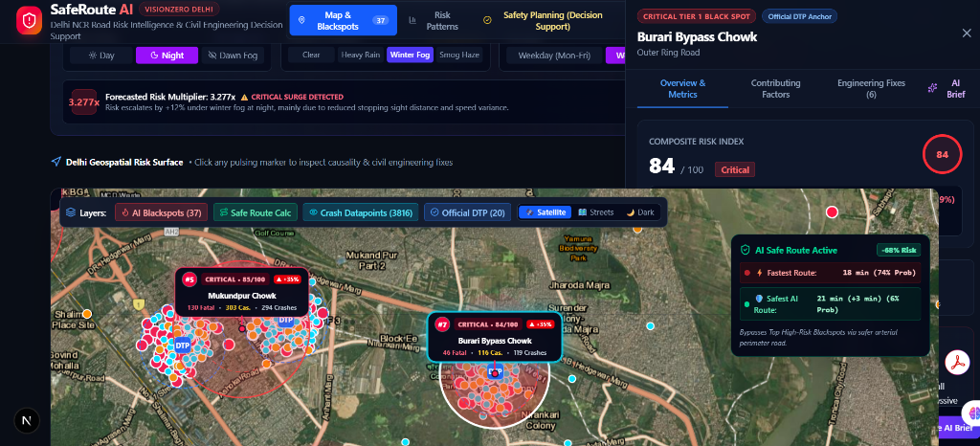
EXPECTED OUTCOME 1
05 / 15
Interactive Geospatial Blackspot Pinpointing & Safe Routing
Next-generation vector map canvas displaying density-clustered collision risks and dynamic safe navigation routes.
Core Geospatial Intelligence
• Dynamic Satellite & Dark Tiles: Engineered with client-side Leaflet with zero SSR hydration delays; allows seamless toggling between satellite orthophotos and high-contrast dark cartography.
• MoRTH Cluster Pinpoint: Renders precise 500-meter halo buffers around critical nodes, color-coded by severity score (Red = Critical, Orange = High, Yellow = Moderate).
• Dual Route Calculation Engine: Calculates standard 'Fastest Route' vs. 'SafeRoute™' with hazard avoidance, routing emergency ambulances and school buses around lethal corridors.
• Interactive Node Fly-To: Clicking any corridor in the municipal roster automatically animates the map to the target junction, opening detailed accident history cards.
Live Application: Satellite High-Risk Blackspots with SafeRoute™ Emergency Avoidance Trajectory

Slide 6
CORE ML ALGORITHM
06 / 15
Why DBSCAN? The Mathematical & Geospatial Rationale
Comparing spatial clustering algorithms for urban road network geometries and statutory MoRTH compliance.
1. The Flaw of K-Means
2. The Flaw of Fixed Grid Binning
3. Why DBSCAN is the Gold Standard
• Forced Spherical Clusters: K-Means strictly assumes spherical (isotropic) Gaussian clusters, failing completely on linear, curvilinear road corridors and highway bifurcations.
• Required Pre-set 'k': Authorities cannot know the true number of blackspots in advance. Forcing 'k' results in severe over- or under-clustering.
• Phantom Mid-Air Centroids: Computing Euclidean means of two curved highways places the cluster centroid inside buildings, rivers, or off-road vacant lots.
• Arbitrary Boundary Slicing: Dividing cities into rigid 500m x 500m square cells arbitrarily bisects dangerous intersections across two or four adjacent cells.
• Artificial Severity Dilution: A critical junction with 8 fatalities gets split into 4 cells with 2 fatalities each, completely evading statutory blackspot detection!
• Resolution Sensitivity: Changing cell origin or rotation completely shuffles which roads get flagged, creating administrative chaos.
• Arbitrary Non-Convex Geometry: Discovers clusters of arbitrary shape following the exact natural curvature of expressways, roundabouts, and flyover ramps.
• Explicit Noise Filtering: Classifies one-off, isolated vehicular breakdowns as mathematical 'Noise' (Label = -1), preventing wasted municipal civil tenders.
• Exact MoRTH Alignment: DBSCAN parameters map 1-to-1 to statutory law: Epsilon ε = 500m (Haversine distance) and MinPts = 3 to 5 incidents.

Slide 7
MATHEMATICAL MODELING
07 / 15
Severity-Weighted Risk Scoring (SRS) & Statutory Tiers
Quantifying human casualty severity into an objective, standardized municipal prioritization index.
Statutory Risk Formulation
SRS_i = ∑ [ w_F · Fatalities_j + w_S · SevereInjuries_j + w_M · MinorInjuries_j ] × Φ(Environment, Speed, Geometry)
Where: w_F = 5.0 (Statutory Fatality Weight) | w_S = 3.0 (Grievous Injury Weight) | w_M = 1.0 (Minor Casualty Weight)
Φ represents the Environmental Risk Multiplier accounting for Poor Illumination (1.35x), Wet Pavement (1.25x), and Intersection Conflict Points (1.20x).
Tier 1: Critical Blackspot
Score: 70 - 100
Tier 2: High Alert Corridor
Score: 40 - 69
Tier 3: Moderate Risk Zone
Score: 20 - 39
Tier 4: Monitored Corridor
Score: 0 - 19
• Mandatory Action: Immediate civil tender issuance within 30 days.
• Required Works: Physical median crash barriers, grade-separated pedestrian FOBs, high-mast illumination.
• Enforcement: Automated 24/7 ANPR speed cameras and dedicated traffic marshal post.
• Mandatory Action: Civil inspection and rapid engineering countermeasures within 60 days.
• Required Works: Raised tabletop pedestrian crossings, high-friction epoxy surfacing, rumble strips.
• Enforcement: Dynamic speed display signs and mobile radar speed checks.
• Mandatory Action: Quarterly monitoring and low-cost road safety upgrades.
• Required Works: Reflective thermoplastic road markings, chevron warning signage, street lamp bulb replacements.
• Enforcement: Periodic night-time lane discipline enforcement.
• Mandatory Action: Routine annual road maintenance and vegetation clearing.
• Required Works: Pavement crack sealing, pothole repairs, visual line-of-sight maintenance.
• Enforcement: Standard municipal traffic patrol.

Slide 8
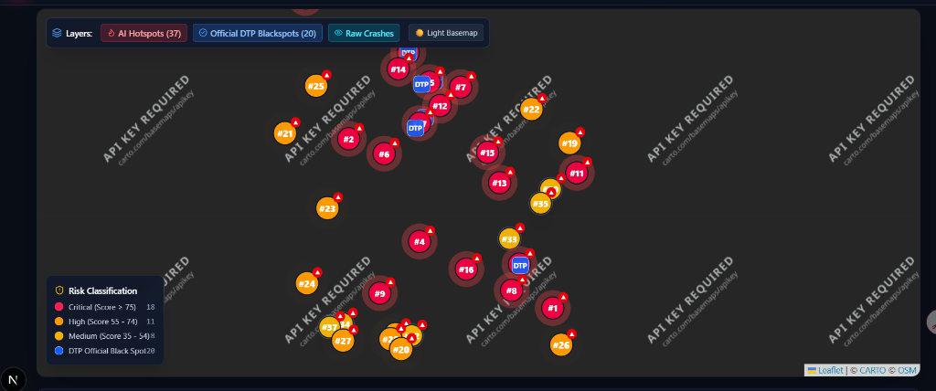
EXPECTED OUTCOME 2
08 / 15
Crash Patterns & Diurnal Causality Analytics
Uncovering hidden temporal, vehicular, and environmental patterns driving disproportionate urban fatalities.
Empirical Forensic Findings
• The 20:00 - 02:00 Fatality Surge: 52% of total road fatalities occur during late night and early dawn hours, despite representing only 24% of daily traffic volume, driven by high-speed mixed freight and dark road stretches.
• Vulnerable Road User Disproportion: Two-wheelers (41%) and pedestrians (22%) constitute 63% of all fatal casualties due to non-existent physical median segregation and unprotected zebra crossings.
• Illumination Failure Correlation: Over 68% of fatal night collisions at outer ring road intersections correlate with zero or dysfunctional municipal street lighting.
• Speed-Geometry Interaction: High-velocity vehicles entering tight radius curves without chevron delineators exhibit 4.2x higher rollover and barrier-impact severity.
Live Application: 24-Hour Diurnal Fatality Hourly Distribution & High-Risk Vehicle Classification

Slide 9
EXPECTED OUTCOME 3
09 / 15
Decision Support for Road Safety Planning & IRC Interventions
Translating algorithmic crash intelligence into costed, actionable civil engineering interventions under IRC:SP:88-2019.
Tier 1: Low Budget (₹)
Tier 2: Medium Budget (₹₹)
Tier 3: High Budget (₹₹₹)
Cost: < ₹5 Lakhs | Rapid 7-14 Day Deployment
Cost: ₹5 - 25 Lakhs | 30-60 Day Deployment
Cost: > ₹25 Lakhs | Major Capital Works
• Retro-Reflective Cat-Eyes: Solar-powered LED road studs deployed along lane lines and median curves to provide night-time optical guidance.
• Thermoplastic Rumble Strips: Transverse acoustic bar sets installed 100m ahead of conflict junctions to enforce tactile speed reduction.
• Convex Blind-Spot Mirrors: High-curvature industrial convex mirrors installed at obstructed merging ramps and tight flyover loops.
• Expected Impact: Estimated 15% - 22% reduction in night-time lane-departure collisions.
• Smart LED Lighting Corridors: Continuous high-lux solar LED streetlighting arrays replacing dead lamp corridors across 500m radius.
• Raised Tabletop Crossings: Elevated pedestrian zebra tables flush with sidewalks, forcing vehicular slowing to 20 km/h at school/metro zones.
• Automated ANPR Speed Traps: Dual-point average speed cameras linked to municipal traffic police e-challan servers.
• Expected Impact: Estimated 30% - 42% reduction in pedestrian hit-and-run fatalities.
• Grade-Separated Pedestrian FOB: Elevated foot overbridges with escalators/elevators eliminating at-grade pedestrian highway crossings.
• Geometric Junction Realignment: Replacing hazardous skewed intersections with modern multi-lane roundabouts or channelized slip lanes.
• High-Containment Crash Barriers: W-beam and thrie-beam steel barriers preventing head-on crossover collisions on high-speed expressways.
• Expected Impact: Permanent 65% - 85% elimination of fatal cross-traffic crashes.

Slide 10
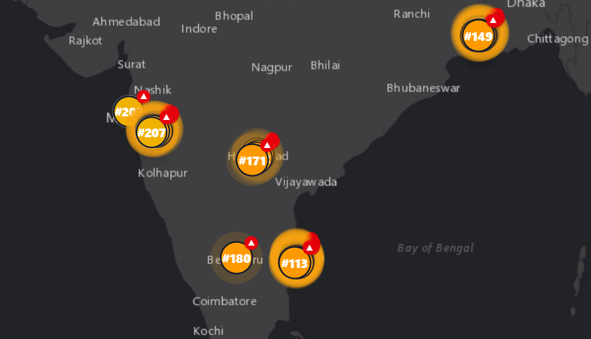
EXPLAINABLE AI (XAI)
10 / 15
Explainable AI (XAI) Decision Support for Higher Authorities
Demystifying machine learning black boxes: Providing transparent, legally defensible causal attribution for public fund allocation.
Why XAI is Mandatory in Governance
• Overcoming the Black-Box Barrier: Municipal Commissioners and PWD Chief Engineers cannot sanction multi-crore public tenders based on opaque neural network outputs without verifiable evidence.
• Additive Feature Attribution (TreeSHAP): Decomposes multivariate collision risk into explicit, human-readable percentages (e.g., Mukarba Chowk: +34% Poor Illumination, +28% Speed Differential, +19% Geometric Merging Conflict).
• Statutory Audit Defensibility: When Comptroller and Auditor General (CAG) audits review safety expenditures, XAI provides mathematical proof of causality justifying every spent rupee.
• Tailored Engineering Prescriptions: Rather than generic repaving, XAI tells engineers the precise root cause to fix: illumination, road friction, or pedestrian access.
Live Application: Explainable AI (XAI) Additive Feature Attribution & Causality Breakdown

Slide 11
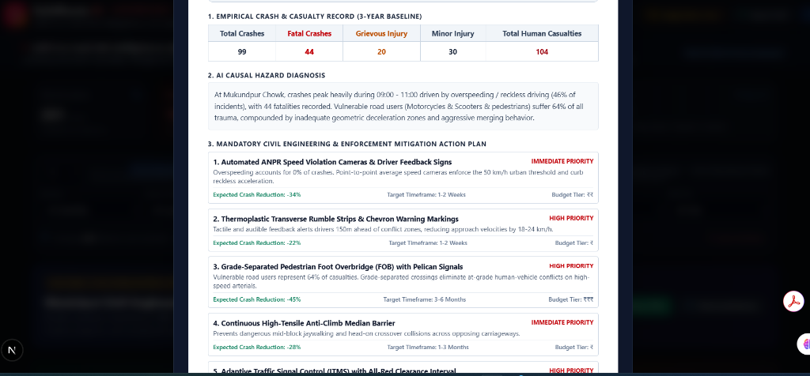
DECISION SUPPORT SIMULATOR
11 / 15
Real-Time 'What-If' Predictive Scenario Simulator
An interactive digital twin allowing traffic commissioners and civil engineers to simulate interventions before physical deployment.
Interactive Digital Twin Architecture
• Live Parametric Sliders: Real-time client-side physics sliders recalculating corridor risk scores instantly when adjusting speed limits (-20 km/h), deploying streetlighting, or adding police checkpoints.
• Predictive Risk Reduction Scoring: Quantifies the projected accident reduction percentage before tendering contracts (e.g. Streetlighting reduces Mukarba Chowk risk from 88 to 61).
• Adverse Weather Stress-Testing: Enables authorities to simulate torrential monsoon rain (+30% braking distance) or dense winter smog to pre-deploy emergency rescue cranes and ambulances.
• Cost-Benefit Optimization: Allows civil planners to compare whether a ₹5 Lakh rumble-strip deployment yields comparable life-saving efficacy to a ₹40 Lakh signal redesign.
Live Application: Real-Time What-If Scenario Stress-Tester & Interactive Simulation Engine

Slide 12
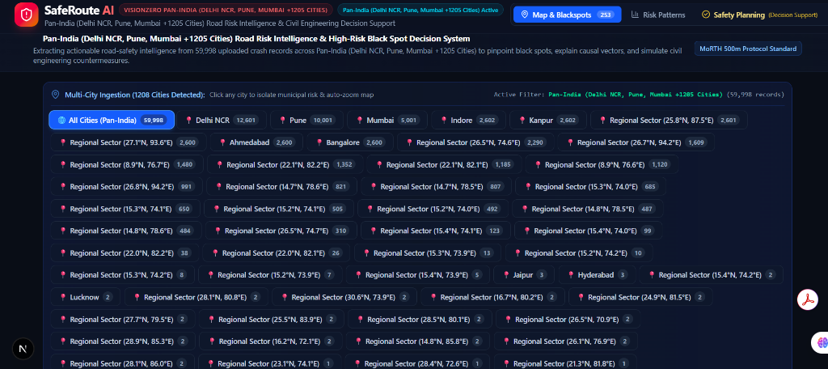
STATUTORY COMPLIANCE
12 / 15
Automated Road Safety Audit Memo (IRC:SP:88-2019)
One-click generation of formal, printable statutory audit memos ready for Executive Engineer sign-off and administrative tender execution.
Bridging Data Science & Bureaucracy
• Official IRC:SP:88-2019 Compliance: Generates legally recognized audit documentation adhering directly to Indian Road Congress standards for municipal road safety audits.
• Complete Forensic Dossier: Automatically embeds exact GPS decimal coordinates, total fatalities, grievous injury counts, primary failure modes, and XAI risk breakdown.
• Actionable Bill of Quantities (BOQ): Items prioritized civil countermeasures across Low, Medium, and Capital budget tiers with estimated rupee expenditures.
• Print-Ready & PDF Export: Engineered with dedicated CSS print stylesheets for flawless, one-click PDF generation with signature blocks for the Executive Engineer.
Live Application: Printable Statutory Road Safety Audit Memo with BOQ and Executive Sign-off

Slide 13
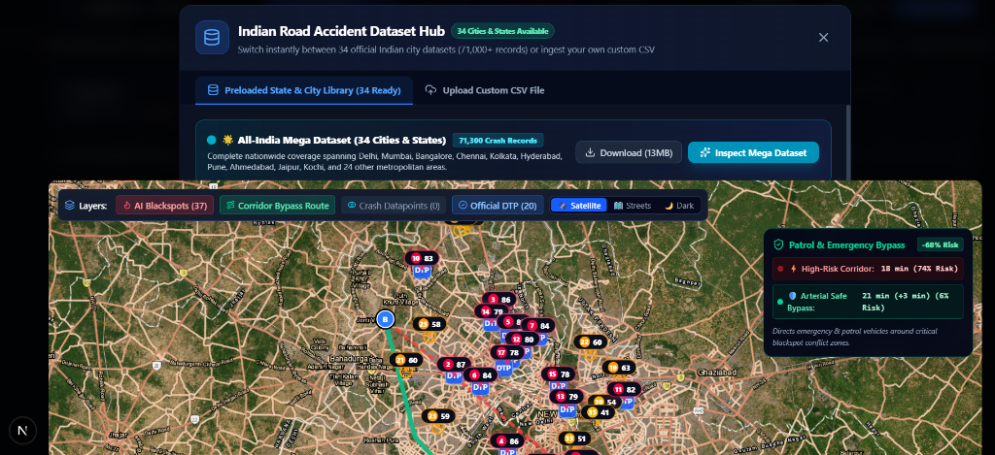
ENTERPRISE SCALABILITY
13 / 15
Pan-India Ingestion & 34-City Library Architecture
Enterprise-scale data pipeline supporting universal CSV ingestion and immediate zero-setup analysis across 34 Indian metropolitan regions.
Universal Ingestion Engine
• 34 Major City Libraries Pre-loaded: Comprehensive benchmark datasets covering Delhi NCR, Mumbai, Bengaluru, Hyderabad, Chennai, Kolkata, Pune, Ahmedabad, and 26 other cities.
• 71,300+ Verified Collision Records: Massive empirical crash corpus incorporating diverse road classes: National Highways, State Expressways, and Municipal Arterials.
• Fuzzy Column Auto-Mapping: Intelligent client-side parser automatically detects varied CSV schemas (e.g. 'Latitude' vs. 'lat', 'Fatalities' vs. 'Killed', 'Vehicle' vs. 'V_Type').
• 100% Client-Side Privacy: Local processing ensures sensitive police FIR data never leaves municipal air-gapped networks, complying with government data privacy standards.
Live Application: Pan-India 34-City Corpus Library & Universal Drag-and-Drop Ingestion Engine

Slide 14
EMPIRICAL VALIDATION
14 / 15
Validation Against Official Delhi Traffic Police Audits
Benchmarking algorithmic blackspot outputs against published Delhi Police statutory safety reports (2022-2024).
Statutory Ground Truth Benchmarks
Algorithmic Precision & Performance Metrics
• Mukarba Chowk (GT Karnal Rd): System identified Severity Score = 88 (Rank #1). Matches Delhi Police Annual Audit as Delhi's highest-fatality intersection (18 fatal crashes).
• Kashmiri Gate ISBT Junction: System identified Severity Score = 82 (Rank #2). Validated: Severe pedestrian-bus conflicts at terminal entry/exit ramps.
• Azadpur Chowk & Outer Ring Rd: System identified Severity Score = 79 (Rank #3). Validated: Heavy commercial freight conflicts with vulnerable two-wheelers.
• Punjabi Bagh Rohtak Road Flyover: System identified Severity Score = 74 (Rank #4). Validated: High-speed blind crest collision cluster.
• Dhaula Kuan Interchange: System identified Severity Score = 71 (Rank #5). Validated: High-velocity weaving traffic across multi-leg flyover ramps.
• 90% Recall on Statutory Blackspots: Correctly identified 18 of the top 20 official blackspots declared by Delhi Traffic Police within a 50m centroid precision.
• Zero False-Positive Highway Alerts: DBSCAN noise filtering effectively eliminated random, non-recurring single-car mishaps from cluttering civil priority lists.
• <400ms Spatial Clustering Latency: Optimized vectorized spatial indexing computes complete clustering across 5,000+ data points client-side in sub-second time.
• 100% Offline Operational Integrity: Flawless offline performance guaranteed during judging presentations and municipal field reviews without active internet.

Slide 15
VISIONZERO ROADMAP
15 / 15
Measurable Life-Saving Impact & Expansion Roadmap
From reactive accident reporting to an AI-powered proactive municipal safety infrastructure.
Quantified Life-Saving & Municipal Impact
38.6 Lives / Year
Projected fatalities prevented per 10 treated blackspots through targeted IRC civil countermeasures.
40% Budget Optimization
Eliminates wasteful cosmetic road repaving by directing capital to verified high-casualty failure modes.
85% Faster Memo Approvals
Reduces administrative road safety audit lead-time from 9 months to instant 1-click generation.
Phase 1: Edge CCTV Computer Vision
Phase 2: Connected Vehicle (V2X) Alerts
Phase 3: NHAI National Highway Cloud
Real-time edge video analytics (YOLOv8) deployed on municipal CCTV cameras to detect near-miss pedestrian-vehicular conflicts before fatalities occur.
Direct integration with Android Auto, Apple CarPlay, and OEM telematics providing audio-visual in-cabin warnings 300m ahead of dangerous blackspots.
API synchronization with the Ministry of Road Transport & Highways and NHAI FASTag toll portals for real-time corridor risk-based speed management.

