Slide 1
Faculty of Computers and Information Luxor University
Artificial Intelligence Project

Slide 2
HBO
Mohamed Mostafa Ahmed Eltaieb
Mohamed Khalid Mohamed
Mohamed Elsayed Yousef

Slide 3
Agenda
Problem Formulation
AI Algorithms
Project Execution

Slide 4
Problem Formulation
Problem Definition
Agent Specification (PEAS )
Problem Formulation (Start State, Goal State ,Search space, Actions, Path Cost)
Task Environment

Slide 5
Problem Definition
Problem: Find the optimal path from the start (home) to the goal (school) in a maze.

Slide 6
Agent Specification
Performance Measure: The efficiency of the algorithm in finding the shortest path from home to school.
Environment: The maze with walls, open spaces, the start point (home), and the goal point (school).
Actuators: The AI algorithms (BFS, DFS, UCS, A*, GBFS) that decide the next move in the maze.
Sensors: Feedback from Keyboard and Mouse.

Slide 7
Problem Formulation
Start State: The initial position of the agent in the maze (Home in the Top Left and the School in the Bottom Right).
Goal State: The Home is connected with The School By a Line.
Search Space: All possible states reachable from the start state.
Actions: The possible moves (up, down, left, right) the agent can take in the maze.
Path cost: 1 for each state (1 per action).

Slide 8
Task Environment
Fully Observable: The agent can perceive the entire maze and its current position.
Deterministic: The outcome of each action is certain.
Static: The maze does not change while the agent is deciding its moves.
Discrete: The possible positions in the maze and available actions are discrete.
Single-Agent: The focus is on the pathfinding agent.

Slide 9
AI Algorithms
List The Algorithms Used To Solve The Problem
Comparison Between Used Algorithms In Solving The Problem (Based on your running represent: Time, Space, Optimality, Completeness)

Slide 10
Algorithms Used To Solve The Problem
Breadth-First Search (BFS)
Depth-First Search (DFS)
Uniform Cost Search (UCS)
A Search (A-star)*
Greedy Best-First Search (GBFS)

Slide 11
Algorithms Comparison
1. Time Complexity:
BFS: O(b^d), where b is the branching factor, and d is the depth of the tree.
DFS: O(b^m), where m is the maximum depth of the search tree.
UCS: O(b^(C/ε)), where C is the cost of the optimal solution, and ε is the minimum step cost.
A Search:* O(b^d), Depends on the heuristic and goal cost (f(n)=h(n)+g(n)).
GBFS: O(b^m), Depends on the heuristic (f(n)=h(n)).
2. Space Complexity:
BFS: O(b^d), where b is the branching factor, and d is the depth of the shallowest goal.
DFS: O(bm), where m is the maximum depth of the search tree.
UCS: O(b^(C/ε)), where C is the cost of the optimal solution, and ε is the minimum step cost.
A Search:* O(b^d), Depends on the heuristic; in the worst case, it can be exponential.
GBFS: O(b^m).

Slide 12
Algorithms Comparison
3. Optimality:
BFS: Finds the optimal solution if all step costs are identical.
DFS: Does not guarantee optimality; it may find a solution that is not the shortest.
UCS: Guarantees optimality as long as step costs are non-negative.
A Search:* Guarantees optimality with an admissible heuristic.
GBFS: Not guaranteed to be optimal.
4. Completeness:
BFS: Complete if the branching factor is finite.
DFS: Not complete; may get stuck in cycles.
UCS: Complete if step costs are bounded away from zero.
A Search:* Complete if the heuristic is admissible.
GBFS: Not guaranteed to be complete.

Slide 13
Project Execution
Represent you project (Running, Code, Video/Screenshots, etc.)

Slide 14
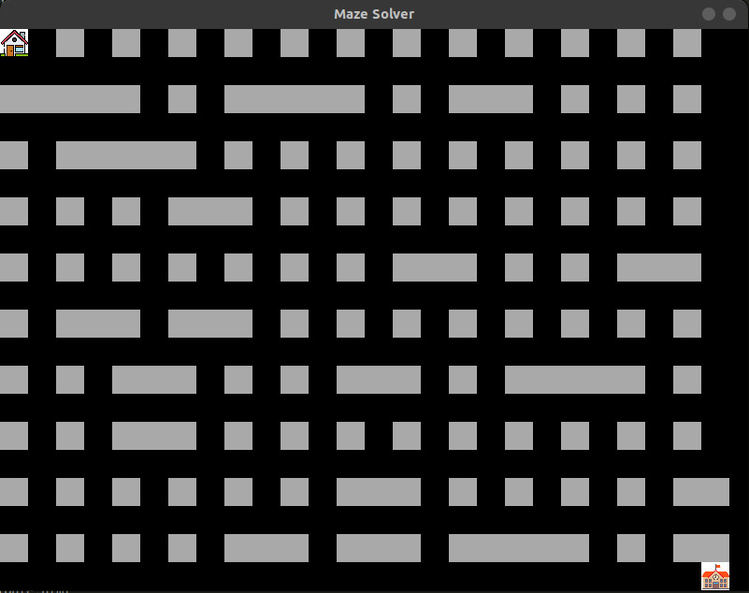
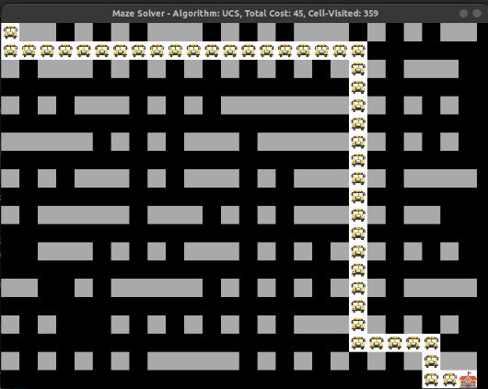
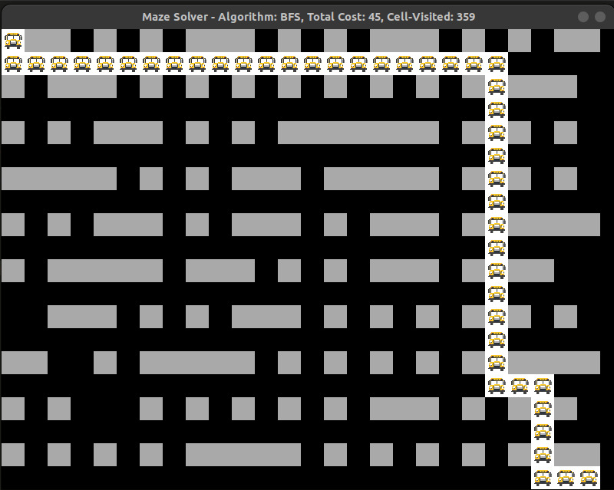
Project Representation

Slide 15
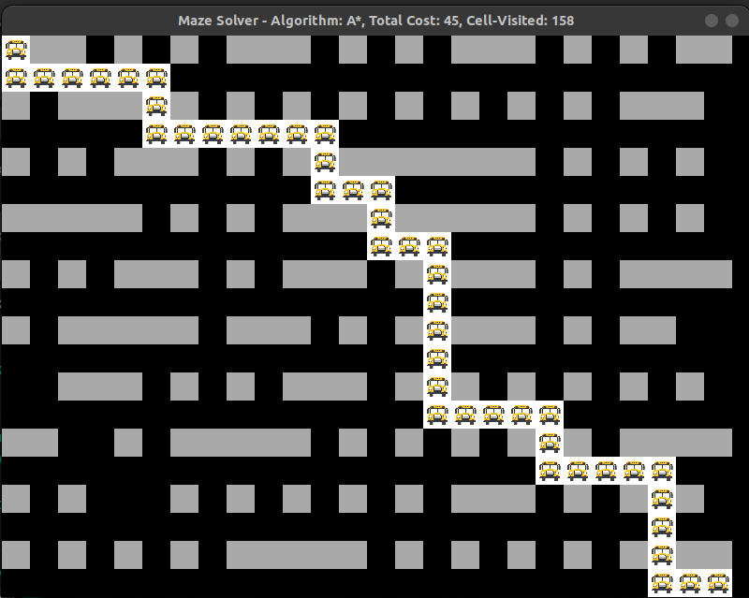
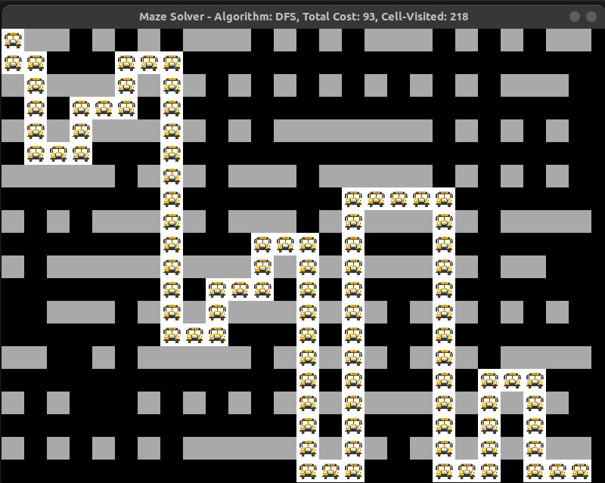
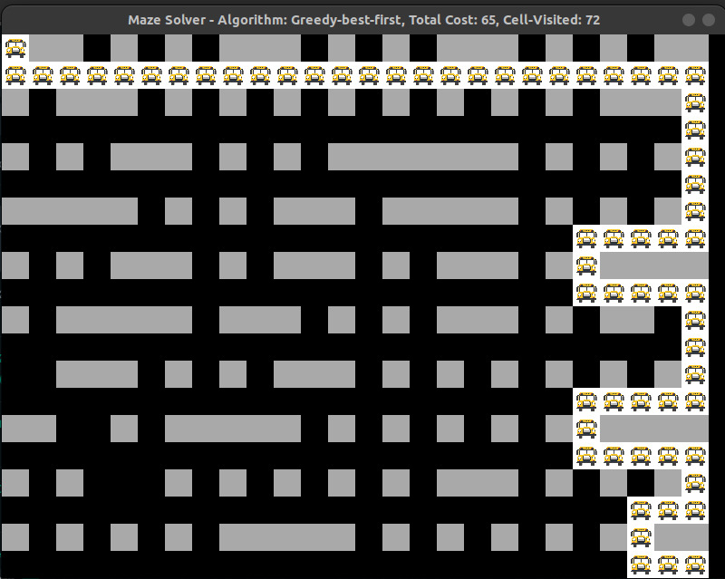
Project Representation

Slide 16
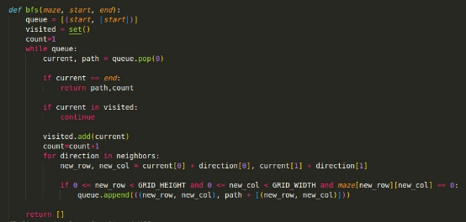
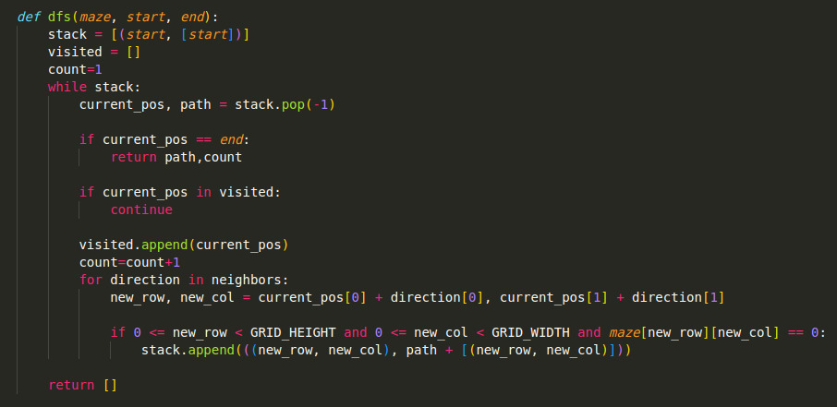
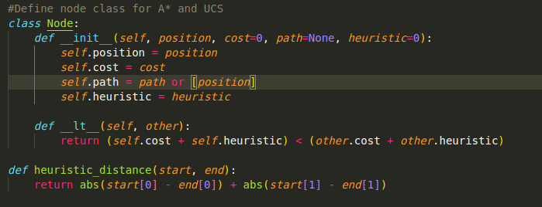
Project Representation

Slide 17
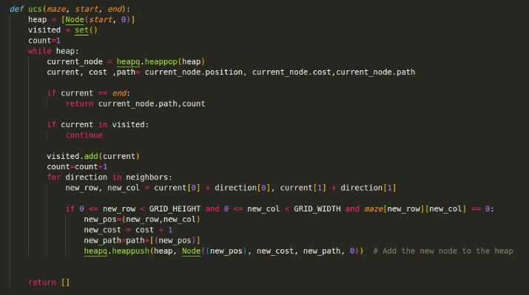
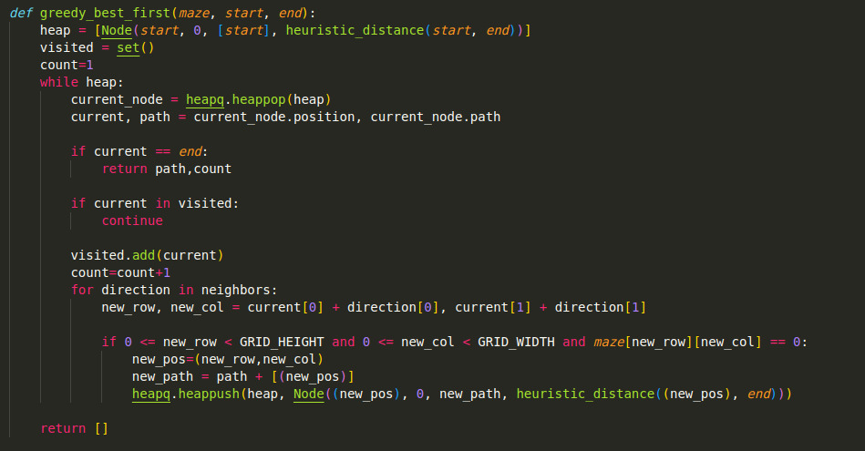
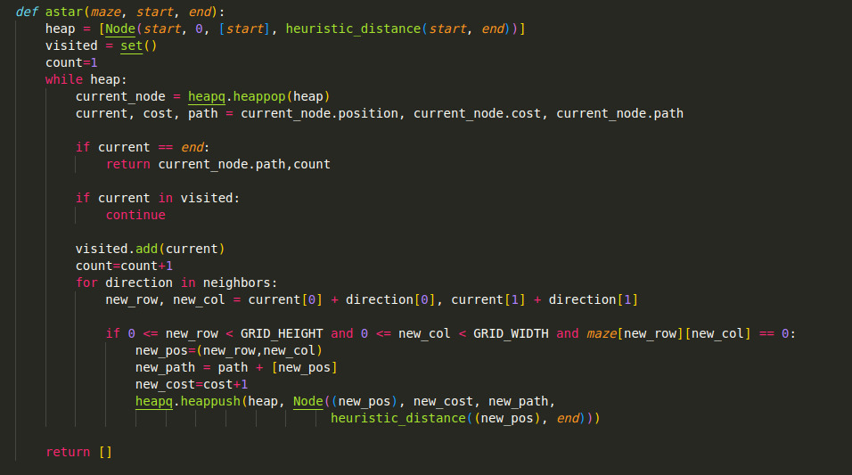
Project Representation

Slide 18

Thank You

