Slide 1


To-Do List Manager in C

Slide 2
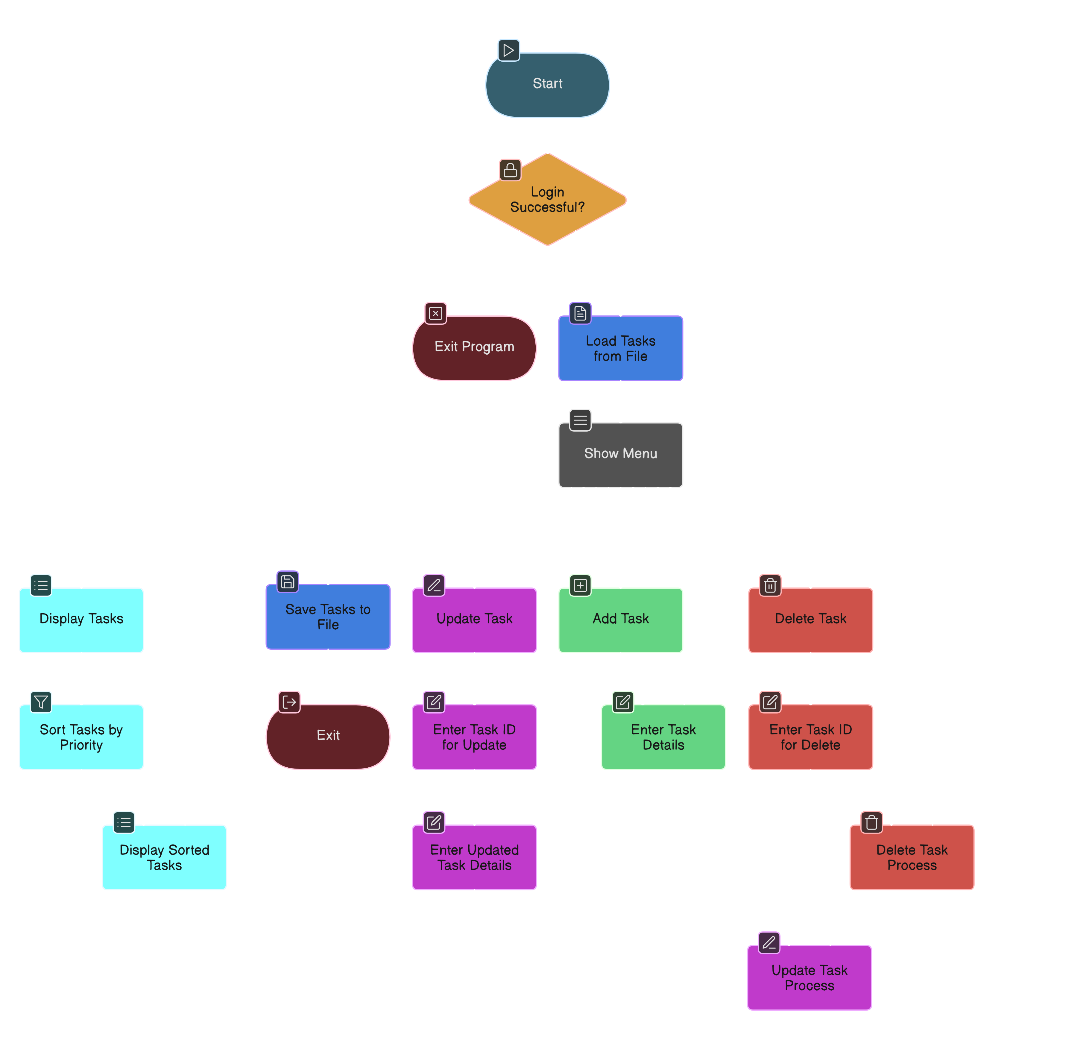

Slide 3

Agenda
Project Overview
Login System
Task Structure
Add Task
Display & Sort Tasks
Delete & Update Task
File Handling
Main Menu
Key Challenges
Conclusion

Slide 4
Project Overview
Purpose: Create a simple command-line task manager with basic functionality like:
User authentication
Adding, displaying, updating, and deleting tasks
Sorting tasks by priority
Saving/loading from a file

Slide 5
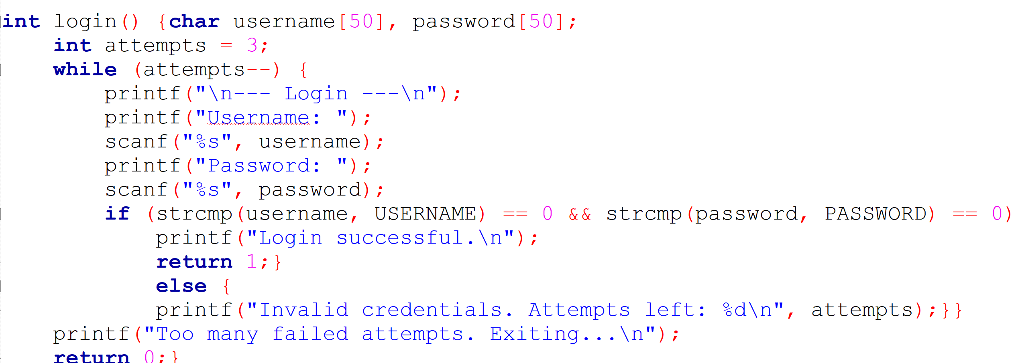
Login System
Features:
Hardcoded credentials (admin / 1234)
3 login attempts
Blocks access after failed attempts

Slide 6
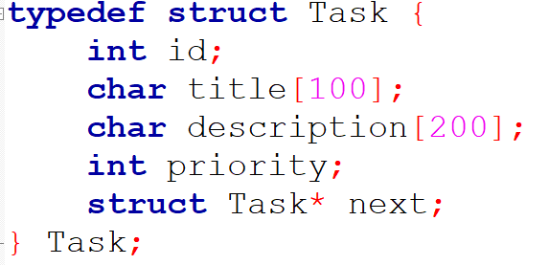
Task Structure
Linked list stores tasks dynamically
Each task has an ID, title, description, and priority

Slide 7
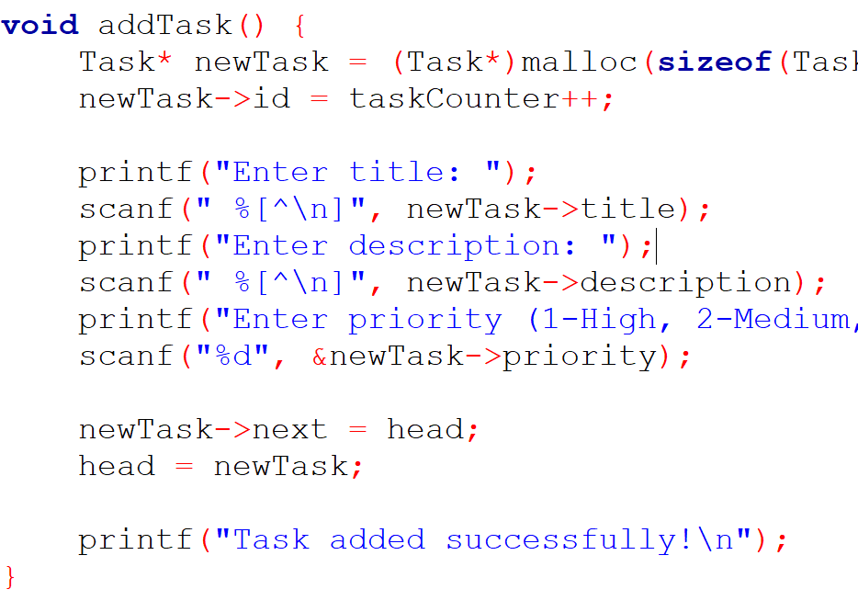
Add Task
How it works:
Prompts user for task details
Adds to the front of the linked list
Automatically assigns unique ID

Slide 8
Display & Sort Tasks
Display Tasks:
Sorted by priority before printing
Sorting: Custom bubble sort on a linked list swapping task contents

Slide 9
Delete & Update Task
Search by ID
Update:
Modify title, description, priority
Delete: Remove from linked list and free memory

Slide 10
File Handling
Persistent Storage:
Tasks saved to tasks.txt on exit
Tasks loaded from file at startup

Slide 11
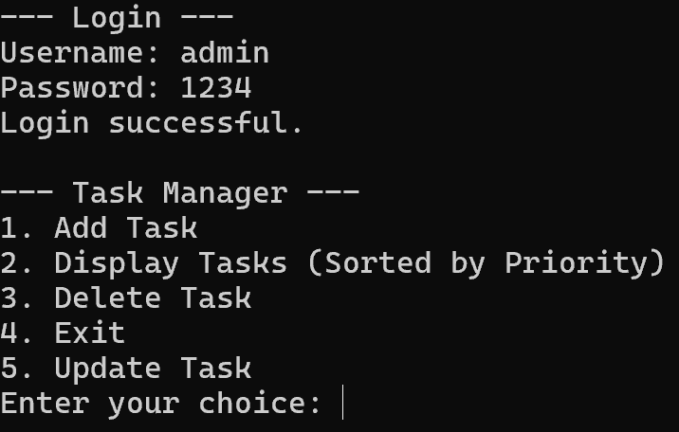
Main Menu
Options:
Add Task
Display Tasks
Delete Task
Update Task
Exit

Slide 12
Key Challenges
Manual sorting of linked list
Managing dynamic memory
Input handling (especially with scanf)
Simple but effective user authentication

Slide 13
Conclusion
Successfully created a fully functional CLI To-Do List in C
Demonstrated usage of:
Linked lists
File I/O
Structs and pointers
Basic user interaction

Slide 14
Thank you

