Slide 1
Business KPIs & Insights
How to read the dashboard and what it enables for decision-making
As-of: Jan 20, 2026 (project context)
Notes:
[Sources]
- Date-table/time-intelligence guidance (Power BI): https://learn.microsoft.com/en-us/power-bi/transform-model/desktop-date-tables
- DATESBETWEEN (DAX): https://learn.microsoft.com/en-us/dax/datesbetween-function-dax
[/Sources]

Slide 2
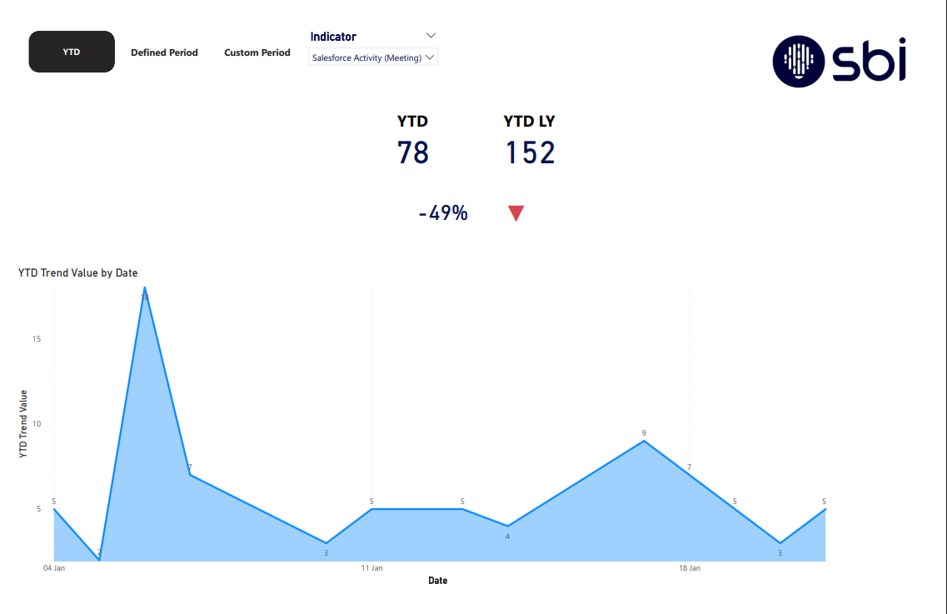
What this dashboard answers
One place to track activity volume by Indicator, compare periods, and spot trend changes
Primary questions
• Are we up or down vs last year for the same period?
• Is the change driven by specific activity Indicators (email, meetings, etc.)?
• Are there spikes/drops that require operational follow-up?
• How do two business-defined periods compare (custom Period1 vs Period2)?
How to use (workflow)
1) Select Indicator (single-select)
2) Choose the analysis mode: YTD, Defined (365/180), or Custom
3) Read the KPI cards (Current, LY, % change)
4) Use the trend chart to interpret timing and volatility
Example: YTD page
Notes:
[Sources]
- Date table/time intelligence patterns in Power BI: https://learn.microsoft.com/en-us/power-bi/transform-model/desktop-date-tables
[/Sources]

Slide 3
KPI definitions
What YTD / LY / rolling windows / custom periods mean
Definitions (as-of Jan 20, 2026)
• YTD: Jan 1, 2026 → AsOfDate (latest loaded date with activity)
• YTD LY: Jan 1, 2025 → same day-of-year cut (12 months earlier)
• Last 365/180: trailing window ending at AsOfDate; LY = same shifted window
• Custom periods: user-selected Period1 vs Period2 ranges
• % variance: (Current − Comparison) / Comparison
• Arrow: ▲ when % ≥ 0, ▼ when % < 0
Notes:
[Sources]
- DATESBETWEEN (DAX): https://learn.microsoft.com/en-us/dax/datesbetween-function-dax
- DAX time intelligence functions: https://learn.microsoft.com/en-us/dax/time-intelligence-functions-dax
[/Sources]

Slide 4
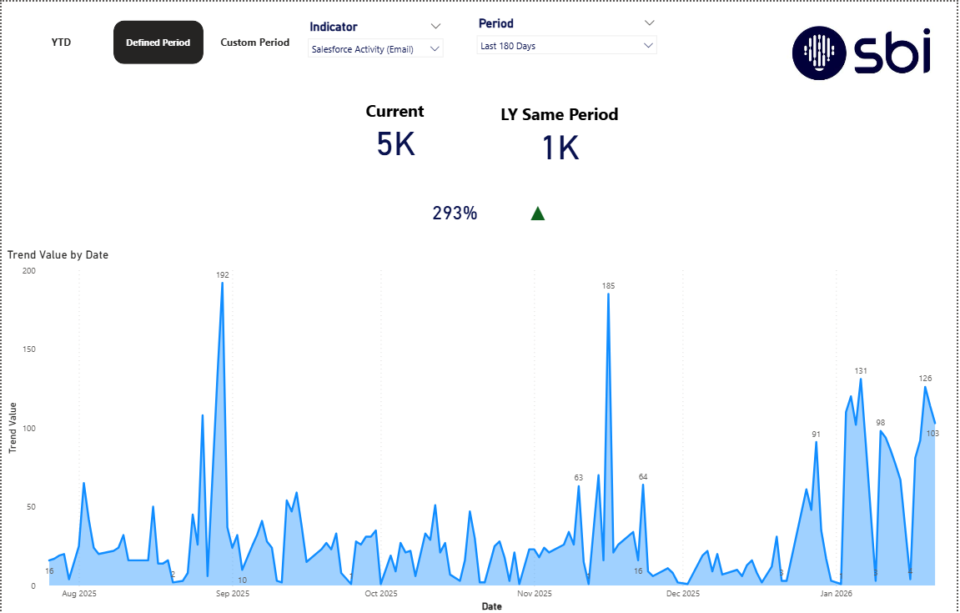
Defined period (Last 365 / 180 days)
Operational monitoring with consistent windows
Defined Period view (example screenshot)
Use this view to answer: “Are we trending up/down over the last N days, and how does it compare to last year’s same period?”
Notes:
[Sources]
- Bookmarks & navigation (optional): https://learn.microsoft.com/en-us/power-bi/create-reports/button-navigators
[/Sources]

Slide 5
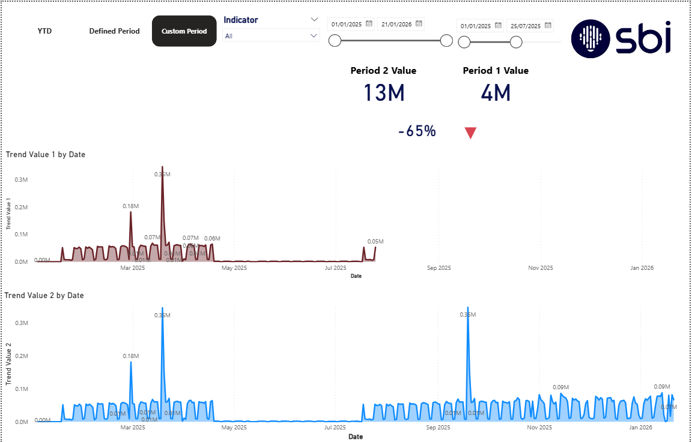
Custom periods (Period 1 vs Period 2)
Compare any two business-defined windows
Typical uses
Custom Period view (example screenshot)
Compare pre/post policy changes, campaigns, org changes, holidays, or project milestones by selecting two date ranges and evaluating both value and trend.
Notes:
[Sources]
- Date table/time intelligence patterns: https://learn.microsoft.com/en-us/power-bi/guidance/model-date-tables
[/Sources]

Slide 6
Business impact & next steps
How this dashboard supports decision-making
Business impact
What stakeholders receive
Single source for activity KPIs across Indicators with consistent comparisons.
Faster trend detection: spikes/drops are visible immediately in the trend charts.
Supports operational planning (resource allocation, workload patterns) using rolling windows.
Supports business review cycles via custom period comparison (Period1 vs Period2).
• A self-serve dashboard with three analysis modes
• Clear definitions of KPIs (YTD, LY, rolling, custom)
• Visual trend context to interpret changes
• A technical README + scripts for reproducibility
Notes:
[Sources]
- Power BI bookmarks (for tabbed UX): https://learn.microsoft.com/en-us/power-bi/create-reports/desktop-bookmarks
- Power BI navigators: https://learn.microsoft.com/en-us/power-bi/create-reports/button-navigators
[/Sources]

