Slide 1
Technical Implementation
SQL Server (Cloud SQL) + Power BI • Activity KPI Dashboard
As-of: Jan 20, 2026 (project context)
Notes:
[Sources]
- Date-table/time-intelligence guidance (Power BI): https://learn.microsoft.com/en-us/power-bi/transform-model/desktop-date-tables
- DATESBETWEEN (DAX): https://learn.microsoft.com/en-us/dax/datesbetween-function-dax
[/Sources]

Slide 2
System overview
High-level data flow and modeling approach
1) Restore DB
2) Prepare dataset
3) Power BI model
Import .bak into SQL Server
(Cloud SQL for SQL Server)
Shift dates to 2025/2026
Rebuild Dim_Time_day (2025–2026)
Star schema
DAX measures A/B/C
3 report pages
Power BI star schema
Dim_Indicator
ind_id, ind_desc…
v_Fact_Activities_Shifted
• ind_id
• activity_date
• act_value
Dim_Time_day
day_date, week_id…
Implementation notes
Date table is marked in Power BI to enable time-intelligence patterns.
AsOfDate anchored to the latest FACT date (prevents empty future dates).
All KPIs are filtered by selected Indicator (Dim_Indicator).
Notes:
[Sources]
- Mark as date table (Power BI): https://learn.microsoft.com/en-us/power-bi/transform-model/desktop-date-tables
- Date table modeling guidance: https://learn.microsoft.com/en-us/power-bi/guidance/model-date-tables
[/Sources]

Slide 3
Database restore (Cloud SQL for SQL Server)
Import .bak into the SQL Server instance
Restore steps
Example CLI
1) Upload the .bak file to Cloud Storage
2) Import/restore into Cloud SQL (SQL Server)
3) Verify database and user credentials
4) Confirm connectivity from Power BI (public IP or proxy)
gcloud sql import bak INSTANCE \
+ gs://BUCKET/backup.bak \
+ --database=DB_NAME
Why this matters
The restored database is the single source used by Power BI. The remaining steps (date shifting, date dimension rebuild, measures) are layered on top without changing the original backup tables.
Notes:
[Sources]
- Cloud SQL for SQL Server import/export with BAK: https://docs.cloud.google.com/sql/docs/sqlserver/import-export/import-export-bak
- gcloud sql import bak reference: https://docs.cloud.google.com/sdk/gcloud/reference/sql/import/bak
[/Sources]

Slide 4
Data preparation (SQL)
Shift dates to 2025/2026 and rebuild the date dimension
Key changes
Snippet (shift view)
Create a view (v_Fact_Activities_Shifted) that moves activity_date forward by +4 years (2021→2025, 2022→2026).
Cast act_value to INT (defaults invalid values to 0).
Rebuild Dim_Time_day for a full daily calendar (2025-01-01 → 2026-12-31) with ISO week_id and LY/LW helper dates.
DATEADD(year, 4, CONVERT(date,
TRY_CONVERT(datetimeoffset(0), activity_date)))
AS activity_date
Snippet (ISO week_id)
CONCAT(
YEAR(DATEADD(day,3, DATETRUNC(iso_week, d))),
RIGHT('00'+CAST(DATEPART(iso_week,d) AS varchar(2)),2)
) AS week_id
Outcome
Power BI can treat the dataset as “current/previous year” and compute YTD/LY and rolling windows using a complete date dimension.
Notes:
[Sources]
- Time-intelligence patterns rely on a proper date table: https://learn.microsoft.com/en-us/power-bi/transform-model/desktop-date-tables
[/Sources]

Slide 5
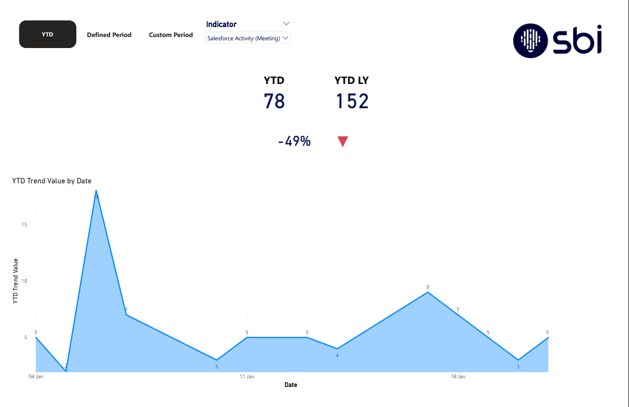
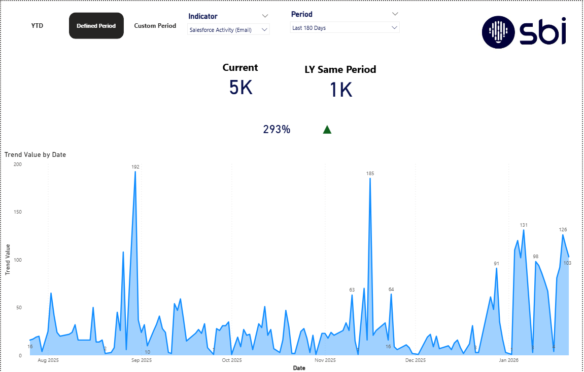
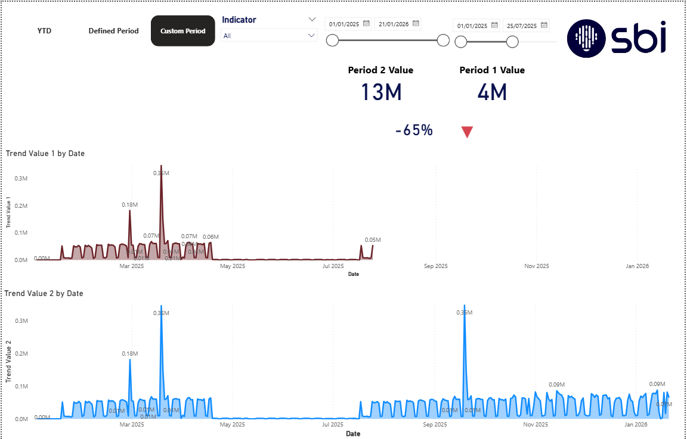
Power BI model
Tables loaded, relationships, and refresh
Report pages (examples)
Imported tables
• dbo.v_Fact_Activities_Shifted
• dbo.Dim_Indicator
• dbo.Dim_Time_day
Optional: Dim_Employees for future slicing (not required for KPIs).
YTD
Relationships + settings
• Fact[ind_id] → Dim_Indicator[ind_id]
• Fact[activity_date] → Dim_Time_day[day_date]
• Mark Dim_Time_day as the Date table
• Use AsOfDate = max fact date to avoid empty future periods
Defined period (365/180)
Custom period comparison
Notes:
[Sources]
- Mark as date table (Power BI): https://learn.microsoft.com/en-us/power-bi/transform-model/desktop-date-tables
- Date table modeling guidance: https://learn.microsoft.com/en-us/power-bi/guidance/model-date-tables
[/Sources]

Slide 6
KPI calculations (DAX)
Measures for A) YTD, B) rolling windows, C) custom periods
Core measures
Example pattern
Activities = SUM(Fact[act_value])
AsOfDate = MAX(Fact[activity_date]) with filters removed
All comparisons are scoped to the selected Indicator (Dim_Indicator).
m_YTD =
VAR d = [AsOfDate]
VAR s = DATE(YEAR(d),1,1)
RETURN CALCULATE([Activities],
DATESBETWEEN(Dim_Time_day[day_date], s, d))
A/B/C logic summary
A) YTD: Jan 1 → AsOfDate; LY = same window 12 months earlier
B) Defined: Last N days (365/180) → AsOfDate; LY = same shifted window
C) Custom: Period1 vs Period2 defined by slicers; trend shows both periods
Variance % = (Current − LY) / LY; arrow ▲/▼ based on sign
m_VarPct =
VAR cur=[Current]
VAR ly=[LY]
RETURN DIVIDE(cur-ly, ly)
Notes:
[Sources]
- DATESBETWEEN (DAX): https://learn.microsoft.com/en-us/dax/datesbetween-function-dax
- DAX time intelligence functions: https://learn.microsoft.com/en-us/dax/time-intelligence-functions-dax
[/Sources]

Slide 7
Report UX
Three pages (YTD / Defined / Custom) or single-page tabs via bookmarks
Navigation options
Option 1 (simple): Three report pages
• YTD page
• Defined Period page
• Custom Period page
Option 2 (tabbed): One page + bookmark navigator
• Group visuals by tab (Selection pane)
• Create bookmarks per tab
• Use Bookmark navigator buttons
Slicer behavior
Keep Indicator slicer global (applies across tabs/pages).
For bookmark tabs, disable “Data” for bookmarks to prevent slicer resets.
Trend charts use a trend measure that returns BLANK outside the selected window.
Example: Defined period page
Notes:
[Sources]
- Bookmarks in Power BI: https://learn.microsoft.com/en-us/power-bi/create-reports/desktop-bookmarks
- Page & bookmark navigators: https://learn.microsoft.com/en-us/power-bi/create-reports/button-navigators
[/Sources]

Slide 8
Refresh & “today” filtering
Optional Power Query filter to restrict dataset to today
Why filter to today?
Recommended approach used in this project
When the date dimension extends beyond available fact data, visuals may show empty future dates. Filtering to today (or using AsOfDate based on fact max) keeps KPIs aligned with the “current” reporting cut.
• AsOfDate is based on the latest fact date, so KPIs do not depend on the end of the date table.
• Optional M filter ensures refresh only includes data up to today (UTC) when required.
Power Query (M) example
TodayUTC = Date.From(DateTimeZone.UtcNow()),
FilteredToToday = Table.SelectRows(
#"Changed Type", each [activity_date] <= TodayUTC)
Notes:
[Sources]
- Date table settings (Power BI): https://learn.microsoft.com/en-us/power-bi/transform-model/desktop-date-tables
[/Sources]

Slide 9
QA, validation & handoff
How results were checked and what is delivered
Validation checks
Deliverables
• SQL spot-check: SUM(act_value) for an indicator over a known date window
• Power BI cards match SQL results for the same window
• Relationships verified (Fact→Date, Fact→Indicator)
• Edge cases: LY = 0 handled with DIVIDE() to avoid errors
• Activity-KPI-Dashboard.pbix
• Technical_Implementation.pptx
• Business_KPIs.pptx
• SQL scripts + README
Handoff package (GitHub)
• SQL scripts (shift view + rebuild date dimension)
• Power BI file (PBIX)
• Two decks: Technical + Business
• README with setup steps and troubleshooting
Notes:
[Sources]
- DAX time-intelligence overview: https://learn.microsoft.com/en-us/dax/time-intelligence-functions-dax
[/Sources]

