Slide 1

Prediction Engine
Introduction
Goals and Requirements
Long term prediction
Short term predictions
Computation Complexity
Real-time Processing
Data Status

Slide 2
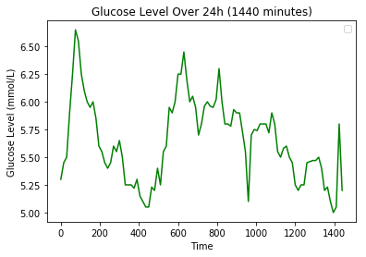
Prediction Engine
Introduction
Goals and Requirements
Long/Short Term Prediction
Computation Complexity
Real-time Processing
Data Status

Slide 3
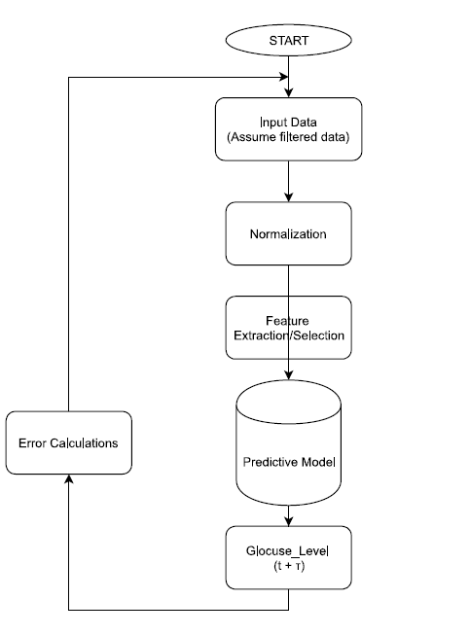
Prediction Engine
Prediction Framework Architecture
Filtered Data
Normalization
Feature Selection
Predictive Model
Output
Error Calculations

Slide 4
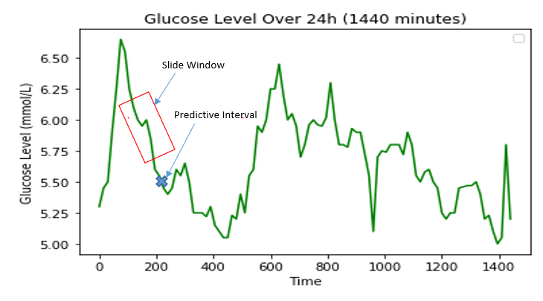

Prediction Engine
Prototype Model
Simple Linear Regression
Slide Window
Window Size
Predictive Interval
$GL\left(t\right)=βt+$ $α$

Slide 5
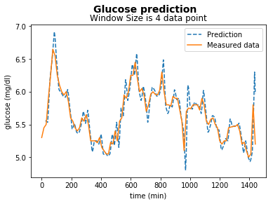
Prediction Engine
Prototype Model
Simple Linear Regression
Slide Window
Window Size
Predictive Interval
$GL\left(t\right)=βt+$ $α$

Slide 6
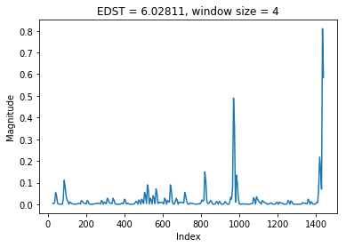
Prediction Engine
Prototype Model
Simple Linear Regression
Slide Window
Window Size
Predictive Interval
How good is it?
Traditional Accuracy
Accuracy = (1-MSE) = 98.9%
Error Measurement Mechanisms
Error Difference Square (EDS)
$GL\left(t\right)=βt+$ $α$

Slide 7
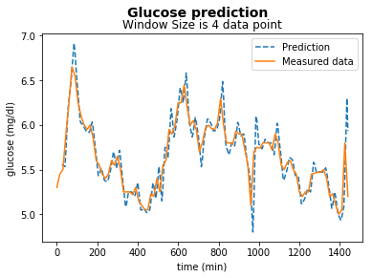

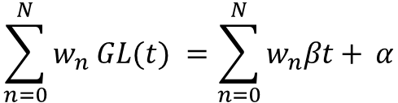
Prediction Engine
Improve The Model
Weighted Linear Regression
$$\sum_{n=0}^{N}{w_{n} GL(t)} =\sum_{n=0}^{N}{w_{n}βt+ }α$$
Compare to Prototype
Window Size
Predictive Interval
EDS

Slide 8
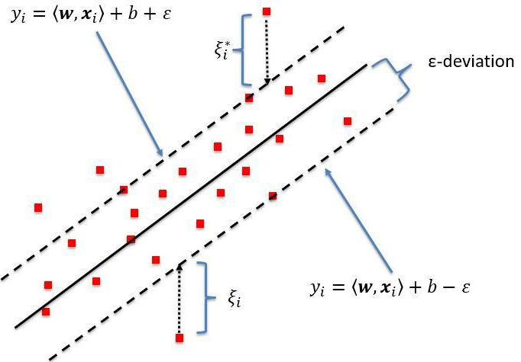
Prediction Engine
Support Vector Regression Model
Linear Mode
https://www.researchgate.net/publication/320916953_Predicting_Top-of-Atmosphere_Thermal_Radiance_Using_MERRA-2_Atmospheric_Data_with_Deep_Learning/figures?lo=1

Slide 9
Prediction Engine
Support Vector Regression Model
Linear Mode
Glucose Level is not linear
Kernel Mode

Slide 10
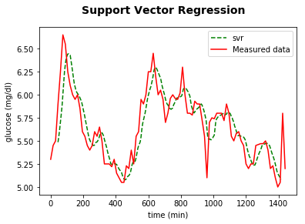
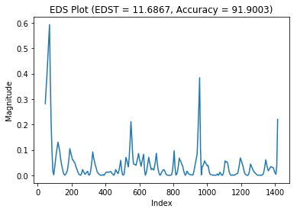
Prediction Engine
Support Vector Regression Model
Linear Mode
Glucose Level is not linear
Kernel Mode
Increase Prediction Parameters
Window Size: 45 minutes
Predictive Interval: 25 minutes

Slide 11
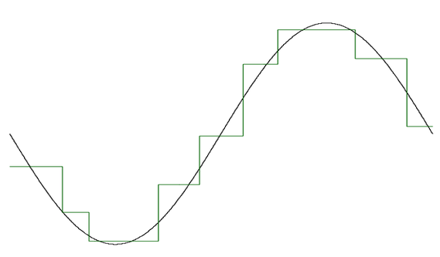
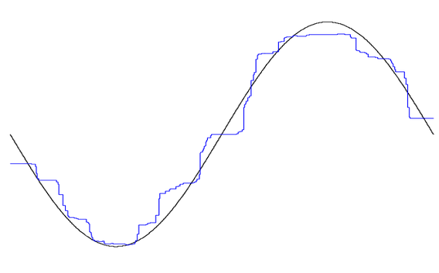
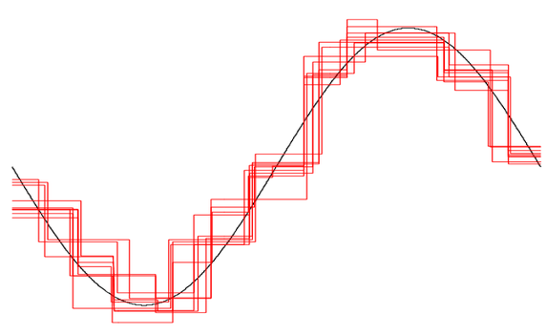
Prediction Engine
Random Forest Regression Model
Multiple of Decision Trees
http://qetartu.blogspot.com/2016/12/applied-econometrics-statistical.html

Slide 12
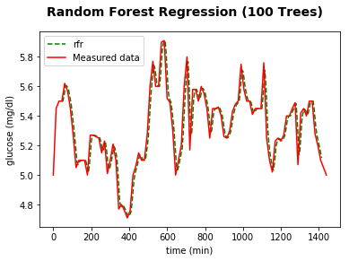
Prediction Engine
Random Forest Regression Model
Multiple of Decision Trees
Window Size: 45 minutes
Predictive Interval: 25 minutes
Too Good!
Overfitting Problem

Slide 13
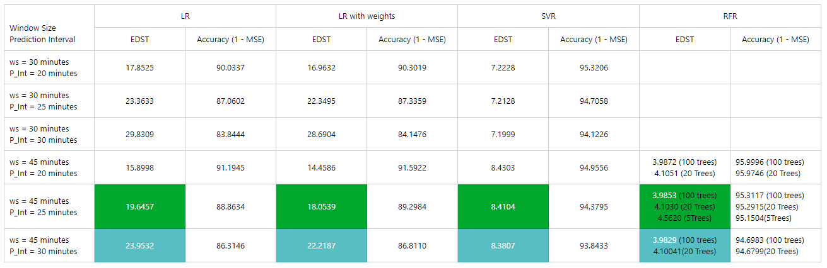
Prediction Engine
Compare Models

Slide 14
Prediction Engine
Overall Look - Conclusion
Random Forest Regression Too Good!
Overfitting Problem
Model Independencies

Slide 15
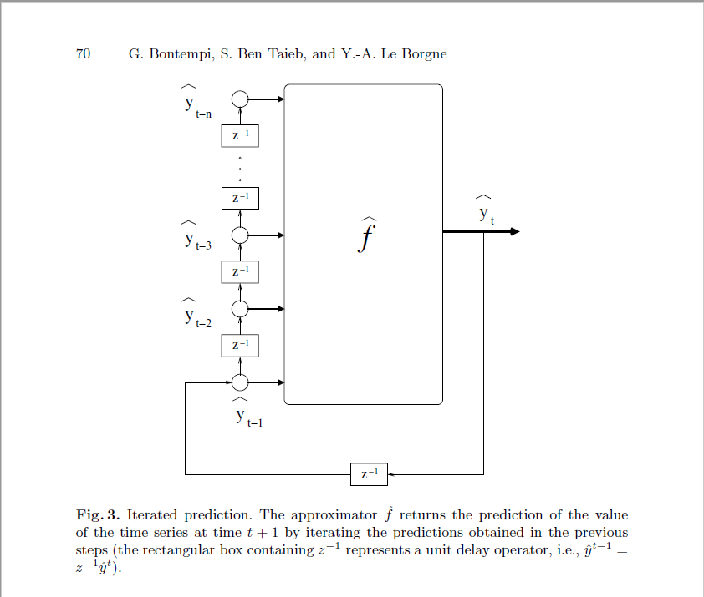

Prediction Engine
Overall Look - Conclusion
Random Forest Regression Too Good!
Overfitting Problem
Model Independencies
Time-Series Analysis
Autoregressive Model
$GL\left(t\right)=β{GL(t)}_{n−1}+$ $α$

Slide 16
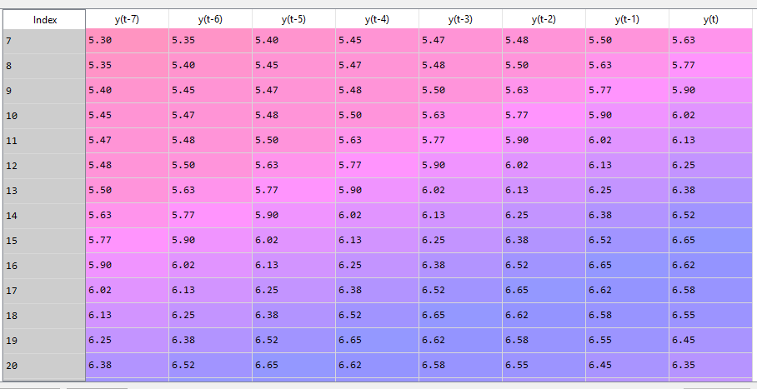
Prediction Engine
Overall Look - Conclusion
Random Forest Regression Too Good!
Overfitting Problem
Model Independencies
Time-Series Analysis
Autoregressive Model

Slide 17
Prediction Engine
Overall Look - Conclusion
Random Forest Regression Too Good!
Overfitting Problem
Model Independencies
Time-Series Analysis
Autoregressive Model
Long Term Predictions
Neural Network: RNN, FFNN, LSTM

Slide 18
DRAFT SLIDES DESIGN

Slide 19
Prediction Engine
Prototype Model
Simple Linear Regression
Slide Window
Window Size
Predictive Interval
$$GL\left(t\right)=bt+c$$
Slide Window
Predictive Interval

