Slide 1


Asynchronous Programming in Python
Presented by :Ahmed Hossam Rafik
Supervised by : Eng Mohamed El Adawy

Slide 2
The Core Concept: Sync vs. Async
Imagine programming is a journey from Point A to Point D. In traditional, synchronous programming, we travel in a straight line. If there is a delay at Point B, the entire journey stops. We just sit there waiting.
Asynchronous programming changes the game. Instead of waiting, we send out scouts. We can start exploring paths B, C, and D even if the task at A isn’t completely finished yet.
By doing this, our program handles multiple tasks at the exact same time without sitting around doing nothing during idle waiting periods

Slide 3
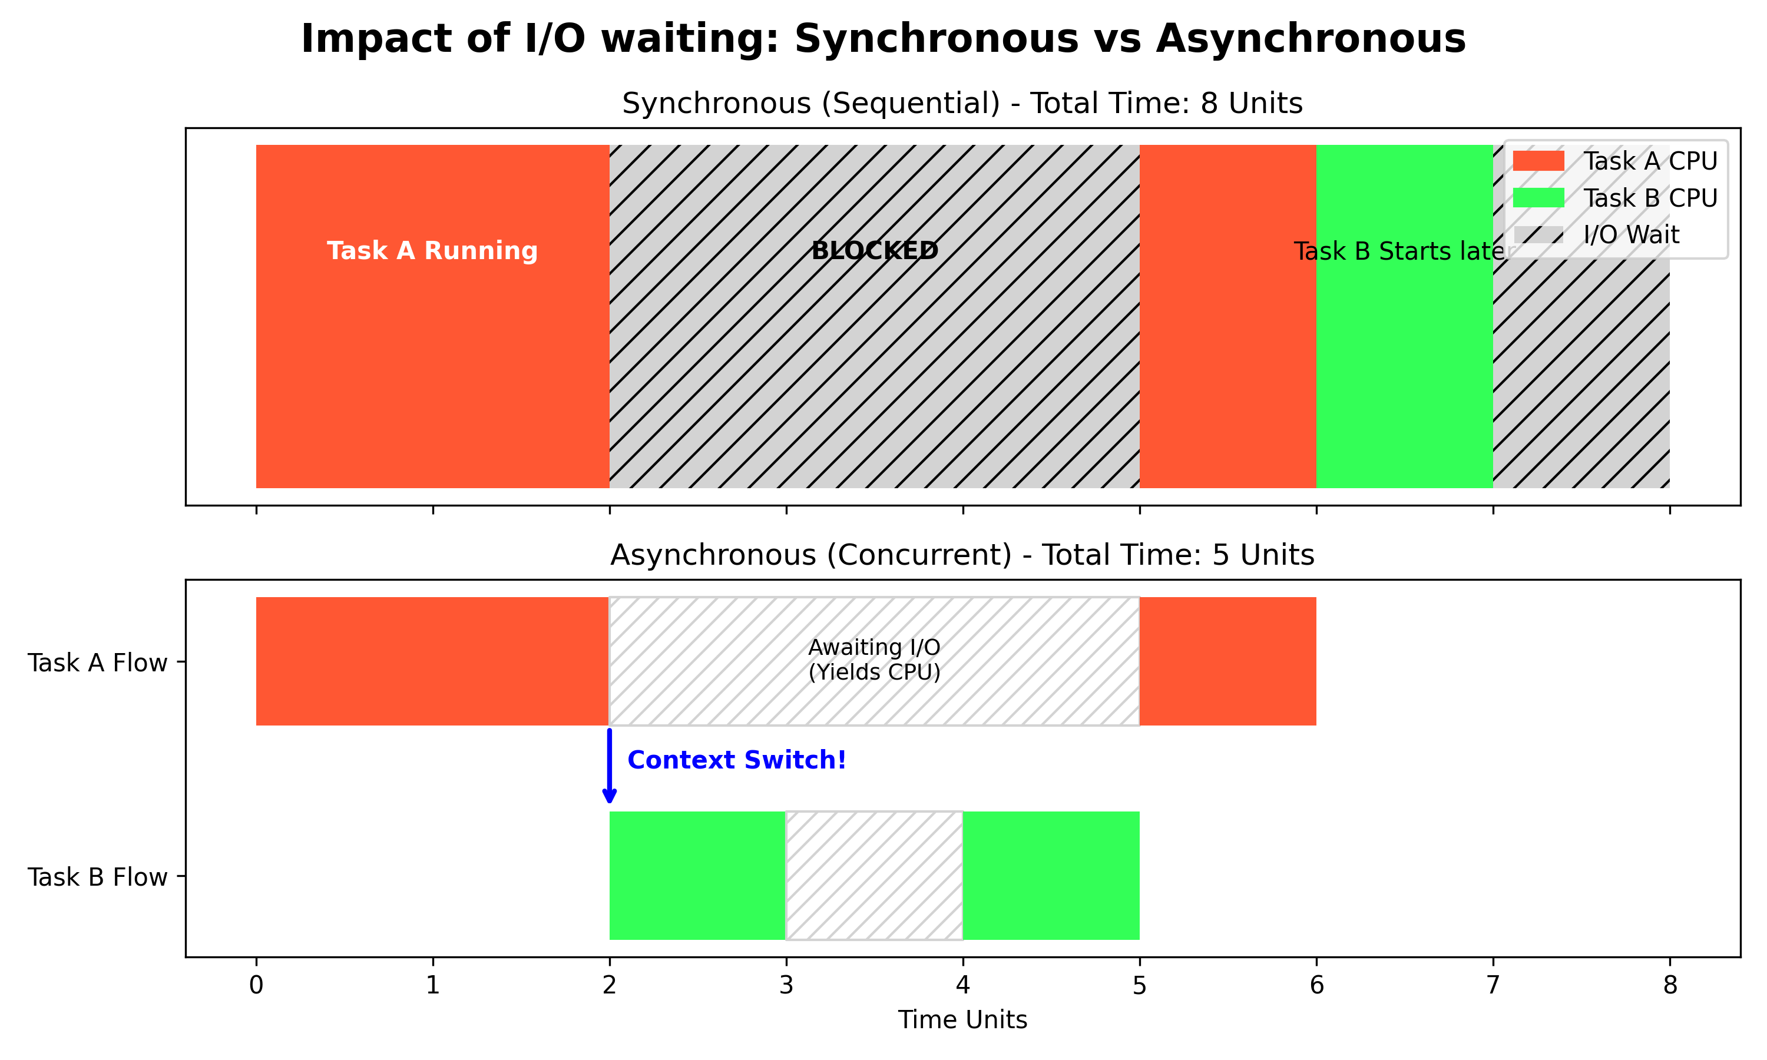
The Core Concept: Sync vs. Async
The Benefit: Code handles multiple operations simultaneously, eliminating unnecessary waiting times.

Slide 4
Concurrency Models
Choosing the Right Concurrency Model:
Async IO: Best for tasks with heavy waiting (Network requests, reading files). Very low CPU usage.
Threads: Best for tasks that wait but also need to share memory/data. Runs in parallel within the same application.
Processes: Best for CPU-heavy tasks (Intensive computations). Runs truly parallel across multiple CPU cores.

Slide 5
Event Loop
The Heart of Async is the Event Loop as it acts as the central hub: Manages and distributes all tasks.
How it Works:
Tasks circle the hub waiting for their turn.
Cooperative Yielding: Tasks step aside when waiting.
Resumption: Once the awaited operation finishes, the task resumes

Slide 6
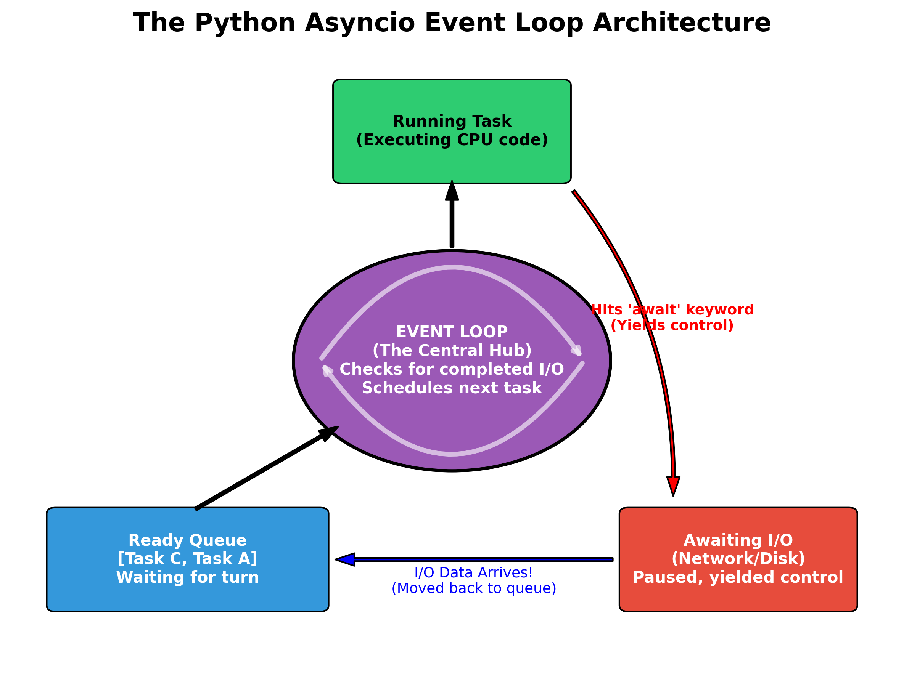
Event loop
If you are using Async IO, the brain of the operation is the Event Loop.

Slide 7
Coroutines & The `await` Keyword
What is a Coroutine? A function defined with 'async def’.
Creation vs. Execution: Calling an async function only creates a coroutine object; it doesn't run it.
The Trigger: The 'await' keyword is required to execute the coroutine and get its result.
The Entry Point: 'asyncio.run()' starts the event loop and executes the main coroutine.

Slide 8
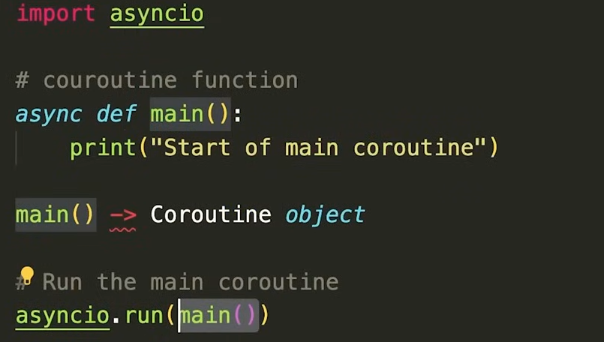
Coroutines & The `await` Keyword
So we need to pass coroutine object to async code run. It's going to wait for that to finish and it's going to start the event loop for us where it handles all of our asynchronous programing.

Slide 9
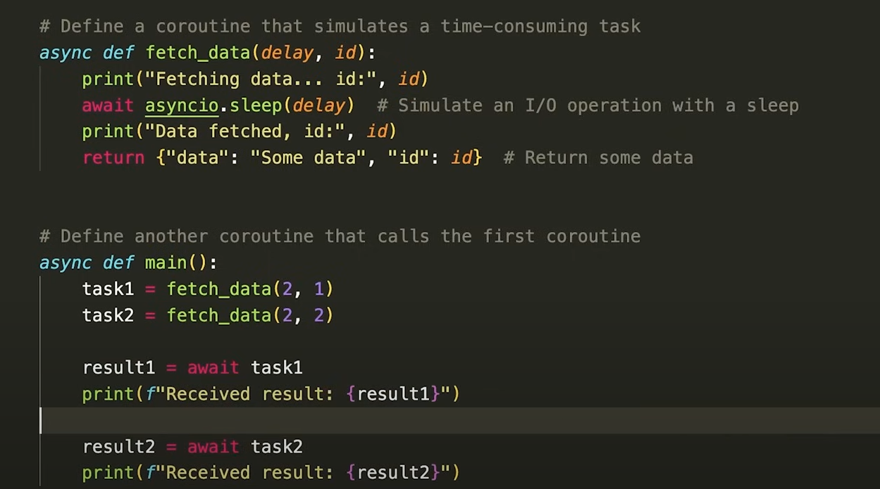
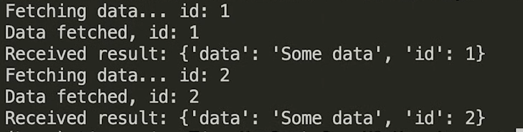

Managing Concurrency: Tasks
It seems like they are not running concurrently and this is because code routine doesn't start running until it's awaited. So in this case we actually wait for the first code routine to finish and then start with the second and the solution here is create tasks
This will not be executed until the coroutine is awaited
Here we will not proceed the rest of the code until the task is finished

Slide 10
Managing Concurrency: Tasks
asyncio.create_task(): Schedules a coroutine to run in the background immediately.
asyncio.gather(): Runs multiple coroutines concurrently and collects their results into a list.
TaskGroups: The modern way to group tasks (using 'async with TaskGroup') with built-in error handling.

Slide 11
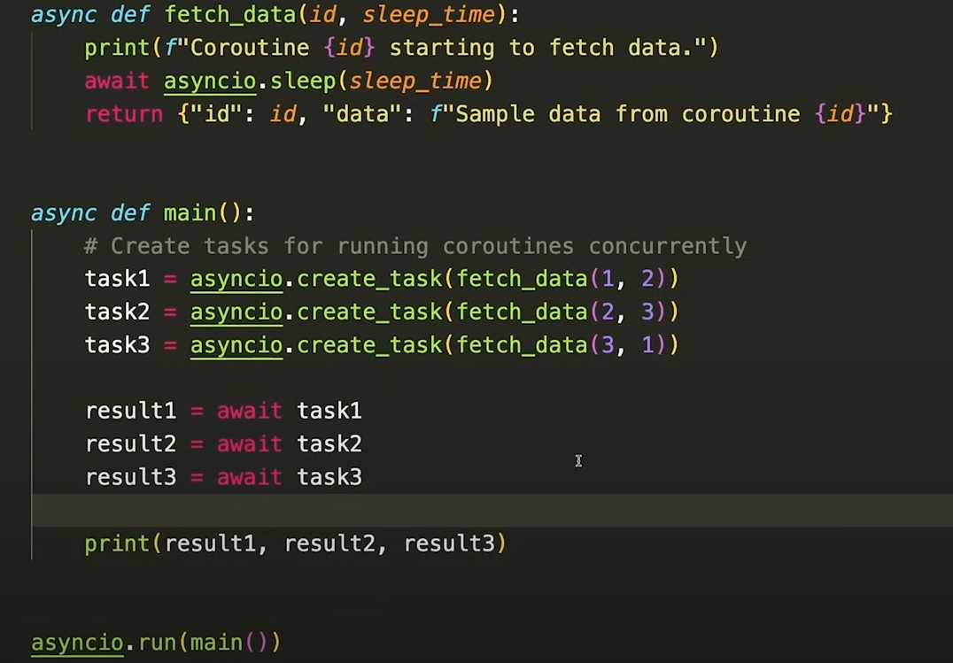
Managing Concurrency: Tasks
They ran concurrently

Slide 12
Keeping it Safe: Synchronization Primitives
The Limit: The
Lock: Protects a shared resource. Ensures only one coroutine accesses it at a time.
Semaphore: Limits access to a specific number of coroutines (e.g., max 5 network requests).
Event: A simple Boolean flag that allows code to block until another part sets the flag to True.

Slide 13
Summary & Key Takeaways
Efficiency Over Waiting: Async IO maximizes performance by managing many waiting tasks concurrently on a single thread.
The Event Loop is the Engine: It cooperatively pauses and resumes tasks, ensuring the CPU is never idle during I/O delays.
Coroutines & Tasks: Use 'async' and 'await' to define operations, and Tasks to run them simultaneously.
Play it Safe: Always use Synchronization Primitives to protect shared data.

Slide 14
Thank You!

