Slide 1


Next-Generation Verification: Python Async, Co-Simulation, and Cocotb
How asynchronous programming made modern Python-based verification possible
Presented by: Mohamed Hussein
Supervised by: Eng. Mohamed El-Awady

Slide 2
Agenda
The Verification Challenge Today • Limitations of Traditional UVM-Based Flows
Asynchronous Programming Fundamentals • Event Loop & Cooperative Concurrency
How Cocotb Works • Hardware-Aware Scheduler • Co-Simulation Architecture
Verification with Python • UVM Mapping • DSP & Scientific Modeling Integration
Balanced Comparison & Strategic View • Strengths vs SystemVerilog • When to Use Cocotb

Slide 3
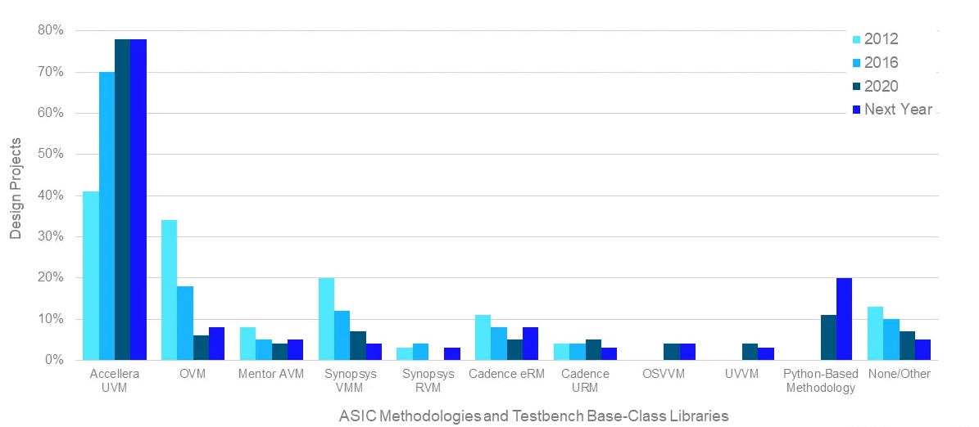
The Problem With Traditional Verification
The Reality Today
Heavy UVM boilerplate
Long compile times
Steep learning curve
Hard integration with scientific tools
Difficult reuse outside simulation
Key Question:
Can we get hardware-accurate simulation with software-level flexibility?
Transition: To answer that → we must understand asynchronous programming.

Slide 4
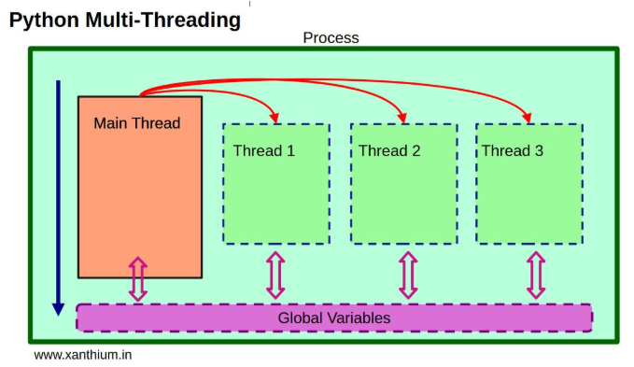
What is Asynchronous Programming?
The Traditional Way: Multithreading
OS manages multiple threads
Context switching is expensive
Requires:
Locks
Mutexes
Semaphores
Risk of:
Deadlocks
Race conditions
Threads are preemptive → the OS decides when to pause them.

Slide 5
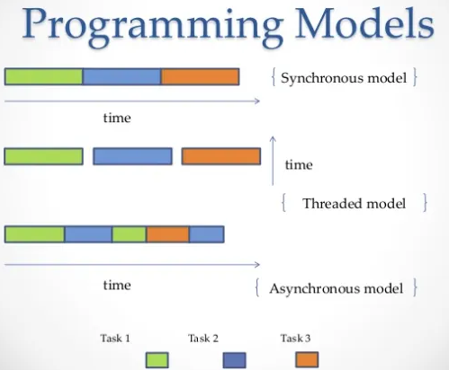
The Async Way: Cooperative Multitasking
Python Async Model
Single thread
Single Event Loop
Tasks voluntarily yield control
When a coroutine hits await:
It pauses itself
Returns control to event loop
Another task runs instantly
No OS thread switching. No locks. No heavy context switching.

Slide 6
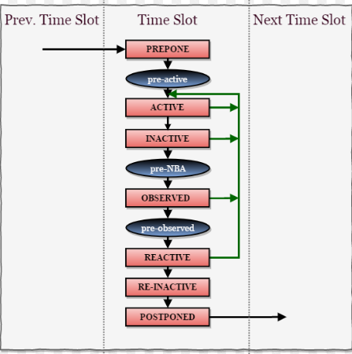
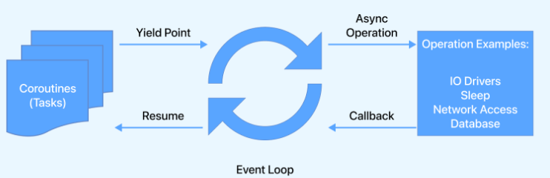
How Time Moves (Concurrency Model)
SystemVerilog
Uses:
Event-driven simulation kernel
Active region
Inactive region
NBA region
fork...join
The simulator:
Pauses threads
Advances simulation time
Resumes threads
Python Async
Event loop
Task scheduling
Cooperative yielding.

Slide 7
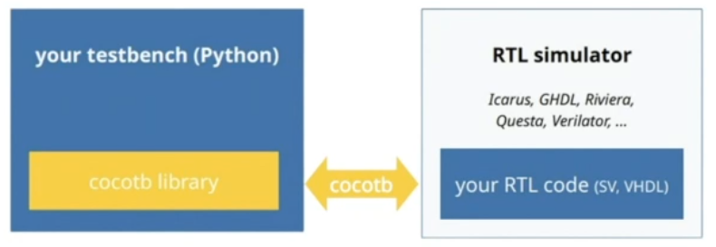
The Breakthrough: Async + Hardware Simulation
Async gives us:
Controlled pausing
Controlled resuming
Deterministic scheduling
This is EXACTLY what a hardware
simulator needs.
So cocotb replaces:
asyncio event loop
With:
Hardware-aware scheduler

Slide 8


How Cocotb Works Internally
Standard Python:
Cocotb:
What happens:
Coroutine yields
Cocotb notifies simulator (Questa, VCS, Xcelium)
Simulator advances simulation time
Event occurs
Coroutine resumes
Simulation time is now controlled from Python.
That is the magic.

Slide 9

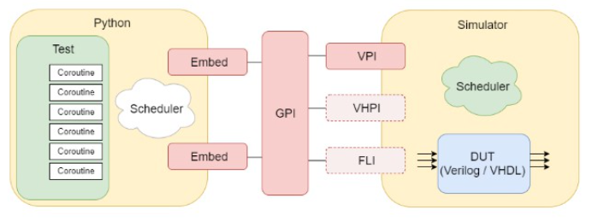
Co-Simulation Architecture
The SystemVerilog Way:
Testbench is hardware.
DUT is instantiated
The Cocotb Way:
No tb_top
No instantiation
Pure Python testbench
The Bridge
Cocotb uses:
VPI (Verilog)
VHPI (VHDL)
FLI (Mentor)

Slide 10
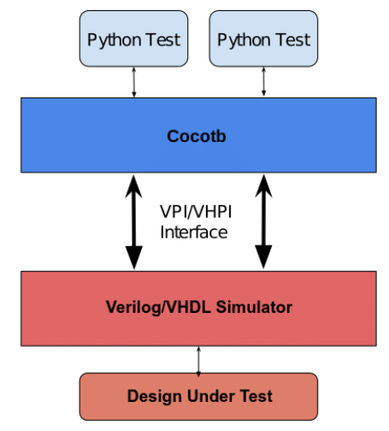
Why This Architecture Is Powerful
Separation of Concerns
RTL = Hardware
Testbench = Software
Cleaner architecture.
Language Independence
RTL can be:
Verilog
SystemVerilog
VHDL
Testbench is always Python.
No Recompile of Testbench
SystemVerilog:
Modify TB → recompile everything
Cocotb:
Modify Python → rerun instantly
Huge productivity gain.

Slide 11
Mapping UVM to Cocotb (Conceptual)
Python Async Component | UVM Equivalent | Role
Producer | uvm_driver / sequencer | Drives stimulus
Consumer | DUT | Consumes stimulus
Checker | uvm_scoreboard | Compares outputs
Environment | uvm_env | Connects components
The structure is identical.
Only the language changes.

Slide 12
Time and Events Mapping
SystemVerilog | Cocotb
#10ns | await Timer(10, "ns")
@(posedge clk) | await RisingEdge(dut.clk)
<= | .value =
Simulation Region | SystemVerilog Concept | Cocotb Equivalent | Use Case
Active Region | Procedural blocks execute | Default coroutine execution | Driving signals
NBA Region | <= scheduled updates | Handled by simulator | Non-blocking semantics preserved
Postponed / Stable | Sampling after updates | await ReadOnly() | Safe scoreboard sampling
Pre-drive phase | Before signal updates | await ReadWrite() | Coordinated driving
Delta cycle advance | #0 | await NextTimeStep() | Avoid race conditions

Slide 13
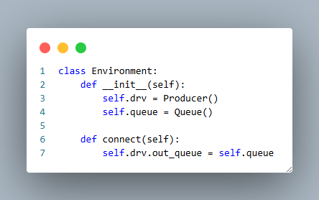
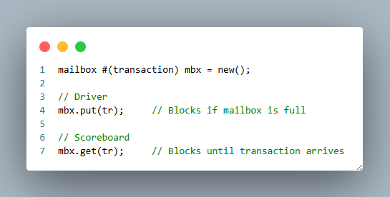
Inter-Process Communication
Cocotb
Async Queue
Event
Python data structures
SystemVerilog
mailbox
semaphores
events
Safer, Cleaner, No blocking deadlocks.

Slide 14
Can Cocotb Do Everything SystemVerilog Can?
✔ Randomization
Use Python:
random
hypothesis
numpy
✔ Constrained Random
Write constraint functions.
Use SAT libraries if needed.
✔ Scoreboarding
Pure Python logic.
✔ Coverage
Functional coverage via Python tracking
Can export coverage data
Integrate with simulator coverage
✔ Parallel drivers/monitors
Unlimited coroutines.
Yes — architecturally, nothing is missing.

Slide 15
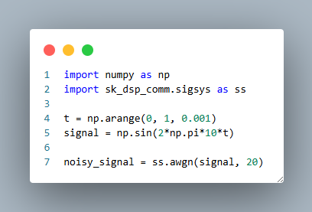
The Python Ecosystem Advantage
SystemVerilog:
Closed verification language
Python:
NumPy
SciPy
Pandas
PyTorch
TensorFlow
Matplotlib
AWGN built-in function
Verifying:
DDS
OFDM
256-QAM
5G modem
Neural network accelerator
You can generate golden models directly in Python.

Slide 16

The Big Picture
Asynchronous programming:
Made cooperative scheduling possible
Co-simulation:
Connected Python to RTL
Cocotb:
Combines both
Gives hardware-accurate simulation
With software-level flexibility
It’s not replacing hardware simulation.
It’s modernizing the testbench.

Slide 17
Where SystemVerilog Is Stronger Today
Cocotb is powerful — but SystemVerilog is still more mature in some verification-specific areas.
Main Differences:
Built-in constraint solver (SV)
Native functional coverage DSL (SV)
Deep simulator/tool integration (SV)
Large enterprise ecosystem (SV)
These are tooling maturity advantages — not fundamental language limitations

Slide 18
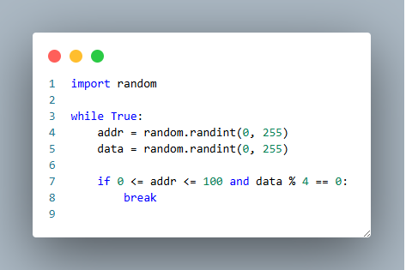
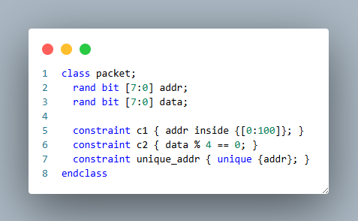
Constrained Random: Declarative vs Manual
Cocotb
SystemVerilog
✔ Automatic solving ✔ Cross-variable constraints ✔ Backtracking constraint solver
❌ Not declarative ❌ No native unique keywork
This is a library gap, not a language limitation.

Slide 19
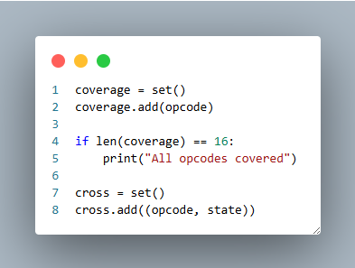
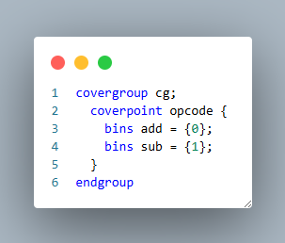
Functional Coverage: Built-in vs Custom
Cocotb
SystemVerilog
✔ Flexible ✔ Unlimited customization ❌ No automatic bin engine ❌ No native coverage database
tooling maturity issue.
✔ Built-in bins ✔ Cross coverage ✔ Automatic reports ✔ Integrated with simulator
Very mature ecosystem.

Slide 20
Enterprise & Tooling Considerations
In large ASIC environments:
UVM is standardized
Coverage databases are integrated
Regression systems are built around SV
Teams are trained in UVM
Switching to cocotb requires:
Infrastructure changes
Cultural shift
New regression strategy

Slide 21
Balanced Strategic View
Area | SystemVerilog | Cocotb
Constraint solving | Built-in & powerful | Manual / library-based
Functional coverage | Native DSL | Custom tracking
Enterprise tooling | Very mature | Growing
Numerical modeling | Limited | Extremely strong
Ecosystem size | HDL-focused | Massive Python ecosystem
Flexibility | Moderate | Very high
Final Honest Takeaway
SystemVerilog: | Cocotb:
Specialized Mature Enterprise-proven | Flexible Software-native Rapidly evolving Ideal for algorithm-heavy verification
The gaps (constraints, coverage) are shrinking — because Python evolves faster than hardware languages.

