Slide 1

TX PATH VERIFICATION PLAN
Prepared by:
Ahmed Hossam
Mohamed Hussein
Moustafa Dawood
Under supervision of:
Eng. Mohamed El-Adawy

Slide 2

TX PATH VERIFICATION PLAN
Black-Box Testing · ISAC TX Wrapper
Document ID
Scope
Date
V-Plan-TX
Black-Box TX Path
April 18, 2026
14
7
5
Test Cases
Feature Areas
Coverage Groups
Document ID: VPlan-TX | Status: DRAFT | Fs = 491.52 MHz | FFT/IFFT N = 4096 | WL=16 FL=5

Slide 3
BLACK-BOX INTERFACE & ENVIRONMENT ARCHITECTURE
Signals & Verification Topology
Signal
Dir
Width
Description
ENV TOPOLOGY
clk
Input
1-bit
System clock — Fs = 491.52 MHz
Top Agent
(Active)
rst_n
Input
1-bit
Active-low synchronous reset
frame_start
Input
1-bit
Asserted for 1 cycle to begin a new TX frame
DDS Agent
(Passive)
ofdm_sym[N]
Input
Complex
256-QAM symbols for OFDM subcarriers (I/Q, WL=16)
tx_out[15:0]
Output
16-bit
TX time-domain output — WL=16, FL=5 fixed-point
FFT Agent
(Passive)
valid_out
Output
1-bit
High when tx_out contains a valid output sample
IFFT Agent
(Passive)
▸ DUT: TX Wrapper (black-box)
▸ Methodology: UVM single active agent
▸ N = 4096 (Radix-2 FFT/IFFT)
▸ 256-QAM · 1500 active subcarriers
▸ Chirp BW: 200 MHz LFM · M_dds 10-bit

Slide 4

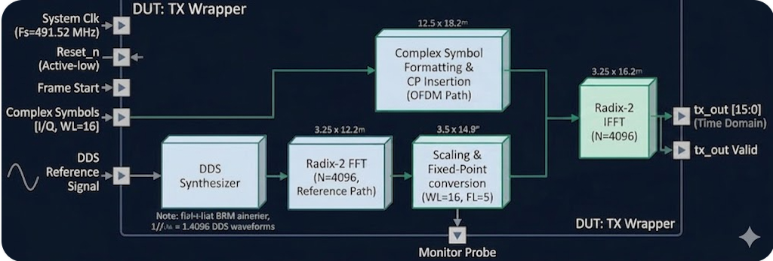
BLACK-BOX INTERFACE & ENVIRONMENT ARCHITECTURE
TX PATH

Slide 5
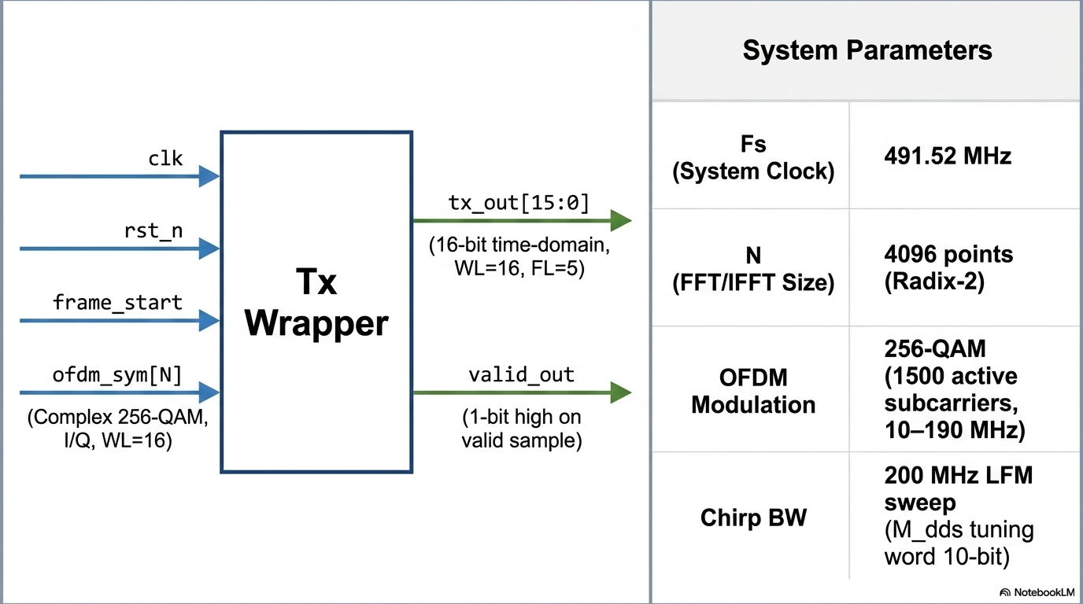
BLACK-BOX INTERFACE & ENVIRONMENT ARCHITECTURE
Signals & Verification Topology

Slide 6
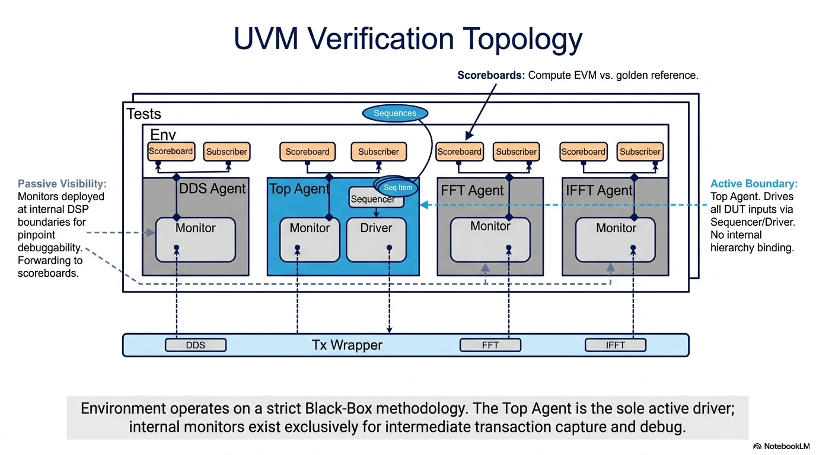

Slide 7
FEATURES TO BE VERIFIED
Observable Behaviour at tx_out / valid_out — No Internal Signals Referenced
F-01
Dual-Band TX Output Quality
F-02
Output Word Format & Overflow
Model checking for both OFDM and chirp bands vs. python golden. Both bands present simultaneously in the same output frame.
All samples within signed 16-bit range [−32768, +32767]. No wrap-around under any valid stimulus. Saturation replaces wrap.
F-03
Reset Behaviour
F-04
Output Sample Count & Timing
rst_n forces tx_out = 0 and valid_out = 0. First complete frame post-reset achieves zero error. No residual state corruption.
Exactly N=4096 valid_out cycles per frame. Pipeline latency is fixed and constant across all frames (deterministic).
F-05
Determinism
F-06
Frame Boundary Integrity
Bit-exact identical tx_out for identical (M_dds, ofdm_sym, frame_start) inputs across every simulation run and seed.
Last sample of frame N not corrupted by frame N+1 stimulus. Long idle gaps do not corrupt subsequent frames.
F-07
Chirp-Only and OFDM-Only
Single-band: Null frame: all 4096 samples = 0x0000.

Slide 8
TEST PLAN OVERVIEW
14 Black-Box Test Cases — Golden Reference: SYSTEM_builtin.m
ID
Test Name
Feature(s)
Group
TC-001
Null Frame — All Zeros
F-07
A — Null & Boundary
TC-002
Chirp-Only — Zero OFDM
F-01,F-07
A — Null & Boundary
TC-003
OFDM-Only — Zero Chirp
F-01,F-07
A — Null & Boundary
TC-004
Constant M_dds — Single Chirp Tone
F-01,F-02
B — Single-Band Operation
TC-005
Full M_dds Sweep — 0 to 1023
F-01
B — Single-Band Operation
TC-006
Output Word Format — Normal
F-02
C — Word Format & Overflow
TC-007
Overflow / Saturation Behaviour
F-02
C — Word Format & Overflow
TC-008
valid_out Gating Verification
F-04
C — Word Format & Overflow
TC-009
Reset Before Frame Start
F-03
F — Reset & Control
TC-010
Reset Mid-Frame
F-03
F — Reset & Control
TC-011
Multiple Consecutive Resets
F-03
F — Reset & Control
TC-012
Back-to-Back 20 Frames — No Gaps
F-06
H — Regression & Stress
TC-013
Long Gap Between Frames
F-06
H — Regression & Stress
TC-014
100 Random Frames — Full Regression
F-01,F-02,F-06
H — Regression & Stress

Slide 9
PASS: All 4096 tx_out samples are exactly 0 (Error = 0).
TEST CASES: GROUP A — NULL & BOUNDARY / GROUP B — SINGLE-BAND
TC-001 through TC-005
TC-001
Null Frame — All Zeros
Feat: F-07
TC-002
Chirp-Only — Zero OFDM
Feat: F-01, F-07
STIMULUS
STIMULUS
Set M_dds = 0 for all samples, ofdm_sym = 0 for all subcarriers. Assert frame_start, capture one full frame.
Apply full M_dds sweep (0→1023 over 4096 samples). Set all ofdm_sym = 0.
EXPECTED / PASS
EXPECTED / PASS
PASS: All samples = 0 AND valid_out count = 4096 → PASS; any non-zero sample → FAIL
PASS: All 4096 dut_tx_out samples perfectly match python_ref_tx_out (Error = 0).
TC-003
OFDM-Only — Zero Chirp
Feat: F-01, F-07
TC-004
Constant M_dds — Single Chirp Tone
Feat: F-01, F-02
STIMULUS
STIMULUS
Set M_dds = 0 (no chirp). Apply 1500 random 256-QAM symbols.
Hold M_dds = 512 (constant, ~100 MHz) for all 4096 samples. Apply zero OFDM. Take FFT of tx_out.
EXPECTED / PASS
PASS: Bit-exact match between dut_tx_out and python_ref_tx_out (Error = 0).
PASS: Bit-exact match between dut_tx_out and python_ref_tx_out (Error = 0).
EXPECTED / PASS
TC-005
Full M_dds Sweep — 0 to full range
Feat: F-01
STIMULUS
Apply M_dds linearly from 0 to full range across 4096 samples (full chirp sweep). Zero OFDM.
EXPECTED / PASS
PASS: Bit-exact match between dut_tx_out and python_ref_tx_out (Error = 0).

Slide 10
TEST CASES: GROUP C — WORD FORMAT & OVERFLOW
TC-006 through TC-008 | F-02, F-04
TC-006
Output Word Format — Normal Operation
Feat: F-02
STIMULUS:
Dual-band nominal stimulus. Inspect all 4096 tx_out samples for correct signed 16-bit fixed-point format (WL=16, FL=5).
EXPECTED:
All samples within [−32768, +32767]. No sample equals −32768 unless saturation is explicitly expected.
PASS: All samples in valid signed range → PASS
ℹ Format check: signed 16-bit two's complement, FL=5 fractional bits
TC-007
Overflow / Saturation Behaviour
Feat: F-02
STIMULUS:
Drive worst-case maximum-amplitude stimulus: max M_dds + all OFDM corner symbols simultaneously.
EXPECTED:
If any sample hits ±32767, the next sample must NOT jump to the opposite extreme (no wrap-around).
PASS: No wrap-around on any sample → PASS
ℹ Saturate-don't-wrap: verify sign does not invert at peak amplitude
TC-008
valid_out Gating Verification
Feat: F-04
STIMULUS:
Send one frame. Observe valid_out timing relative to frame_start. Verify valid_out is LOW between frames and during pipeline latency.
EXPECTED:
valid_out = 1 for exactly 4096 consecutive cycles per frame. valid_out = 0 between frames.
PASS: valid_out count = 4096 AND valid_out = 0 between frames → PASS
ℹ Pipeline latency L must remain constant (ASS-05 deterministic latency)

Slide 11
TEST CASES: GROUP F — RESET & CONTROL
TC-009 through TC-011 | F-03
TC-009
Reset Before Frame Start
Feat: F-03
STIMULUS:
Assert rst_n = 0 for 10 cycles, then release. Immediately send a full frame. Capture tx_out .
EXPECTED:
tx_out = 0 during reset assertion.
PASS : tx_out is 0 during reset, and the subsequent frame exactly matches Python (Error = 0).
TC-010
Reset Mid-Frame
Feat: F-03
STIMULUS:
Start a frame. Assert rst_n = 0 after exactly 2048 samples (mid-frame). Release reset. Send a new complete frame.
EXPECTED:
tx_out goes to 0 immediately on reset assertion.
PASS: Immediate 0 on reset, and the new frame exactly matches the Python reference (Error = 0).
TC-011
Multiple Consecutive Resets
Feat: F-03
STIMULUS:
Assert and release rst_n 5 times consecutively with no frames in between. Then send a frame.
EXPECTED:
No accumulated state from repeated resets corrupts the output.
PASS:: No latent pipeline corruption; output exactly matches the Python reference (Error = 0).
SVA Reference — ASS-01: rst_n == 0 |-> tx_out == 0 && valid_out == 0 (all cycles) | ASS-04: tx_out stable at 0 throughout rst_n assertion

Slide 12
TEST CASES: GROUP H — REGRESSION & STRESS
TC-012 through TC-014 | F-01, F-02, F-06
TC-012
Back-to-Back 20 Frames — No Gaps
HIGH
STIMULUS:
Transmit 20 consecutive frames with zero idle cycles between them. Each frame uses a different random OFDM seed.
EXPECTED:
For every one of the 20 frames No inter-frame contamination observable at tx_out.
PASS: 0 errors across all 20 frames compared to the fixed-point Python model.
TC-013
Long Gap Between Frames
MED
STIMULUS:
Send frame 1. Insert 10,000 idle cycles (no frame_start). Send frame 2 with different stimulus.
EXPECTED:
Frame 2 no stale pipeline state from frame 1 corrupts frame 2.
PASS: Frame 2 outputs exactly match the Python reference (Error = 0).
TC-014
100 Random Frames — Full Regression
CRITICAL
STIMULUS:
Run 100 frames with fully constrained-random M_dds sequences and 256-QAM symbol sets (unique seed per frame).
EXPECTED:
For all 100 frames, both chirp and OFDM bands independently.
PASS: 0 total mismatch errors across all 409,600 generated samples against the Python model.

Slide 13
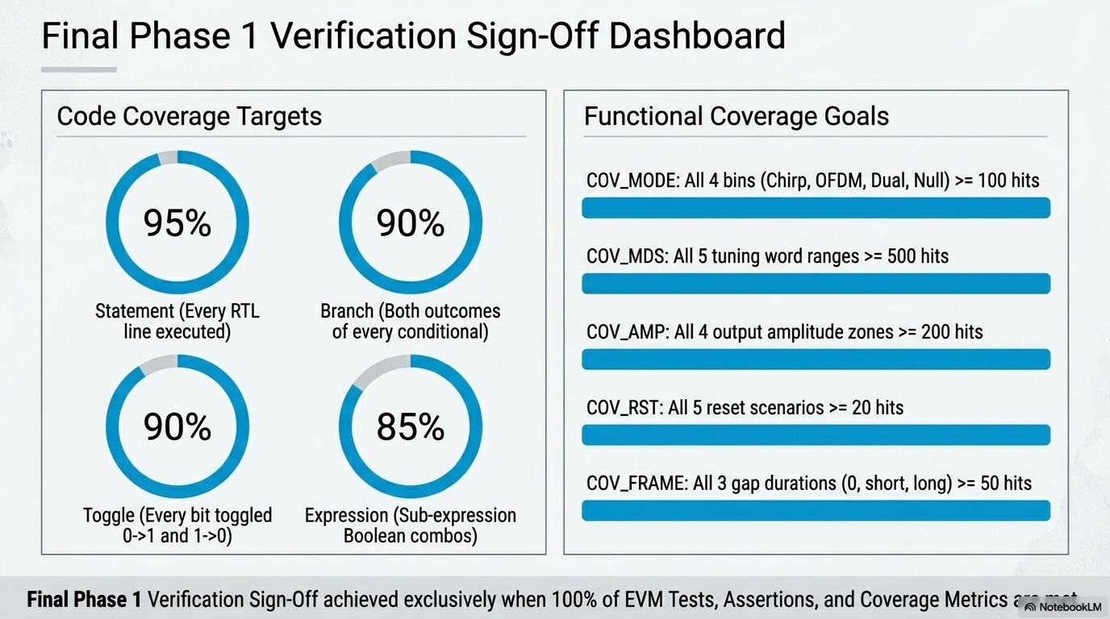
COVERAGE PLAN
Code Coverage Targets & Functional Coverage Groups

Slide 14
SVA ASSERTIONS & VERIFICATION ROADMAP
Output-Port SVA Assertions + Phase Roadmap
FUTURE VERIFICATION ROADMAP
Phase 1 (Current)
Phase 2 (Next)
Phase 3 (Final)
TX Path Verification
RX Path Verification
Top-Level Integration
Black-box TX wrapper · 14 test cases · Single active agent vs Python golden
Replicate hierarchical strategy for RX: inject into RX IFFT, verify Equalizer, Multiplier, RX FFT. Validate radar + comms detection.
Merge TX+RX environments. Loop TX output → RX input (simulating analog/channel). Full end-to-end regression tests.
⚠ Pending RTL Clarifications: (1) Control plane: APB CSR vs. direct hardware ports (2) Data plane: AXI4-Stream vs. custom valid/data for streaming OFDM input

