Slide 1

RX PATH VERIFICATION PLAN
Prepared by:
Ahmed Hossam
Mohamed Hussein
Moustafa dawoodstaf Dawood
Under supervision of:
Eng.Mohamed El-Adawy
Eng. Mohamed El-Adaw

Slide 2
R X P A T H V E R I F I C A T I O N P L A N
Black-Box Testing · ISAC RX Wrapper
Document ID
Scope
Date
V-Plan-RX
Black-Box RX Path
May 2026
14
7
5
Test Cases
Feature Areas
Coverage Groups
DUT: RX Wrapper (black-box) · Methodology: PYUVM single active agent (Rx Top Agent)
RX FFT: N = 4096 (Radix-2) · IFFT: N = 2048 (Radix-2, Radar Range Profile)
256-QAM · 1500 active OFDM subcarriers · Chirp BW: 200 MHz LFM
Document ID: VPlan-RX | Status: DRAFT | Fs = 491.52 MHz | FFT N = 4096 | IFFT N = 2048 | WL=16

Slide 3
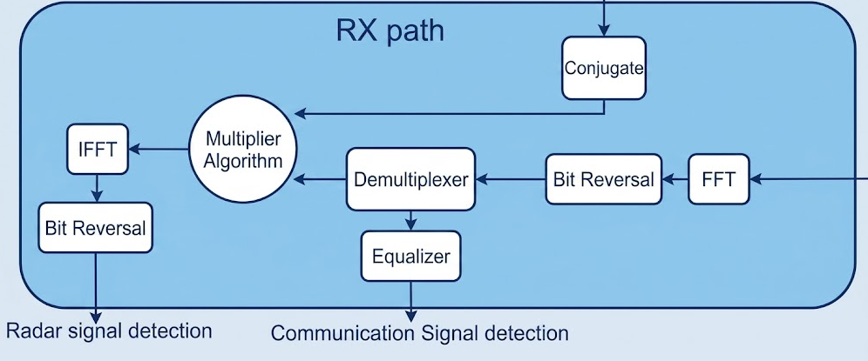

R X P A T H A R C H I T E C T U R E
RX Signal Processing Pipeline
Document ID: VPlan-RX | Status: DRAFT | Fs = 491.52 MHz | FFT N = 4096 | IFFT N = 2048 | WL=16

Slide 4
BLACK-BOX INTERFACE & ENVIRONMENT ARCHITECTURE
Signals & Verification Topology
clk
System Parameters
rst
Fs
(System Clock)
491.52 MHz
N
(FFT/IFFT Size)
4096 points
(Radix-2)
Ref_wr_en
ofdm_out_re
Ref_wr_re
ofdm_out_im
RX FFT
Precision
WL=16, FL=14
Rx
Wrapper
Ref_wr_im
ofdm_valid
Radar IFFT
Precision
WL=16, FL=5
radar_out_re
Rx_in_im
OFDM Band
10-190 MHz
(bins 84-1583)
radar_out_im
Rx_in_re
radar_valid
Chirp Band
0-200 MHz
(bins 2430-4096)
Rx_valid_in
Multiplier
Complex * conj(ref)
(No Equalizer)
Document ID: VPlan-RX | Status: DRAFT | Fs = 491.52 MHz | FFT N = 4096 | IFFT N = 2048 | WL=16

Slide 5
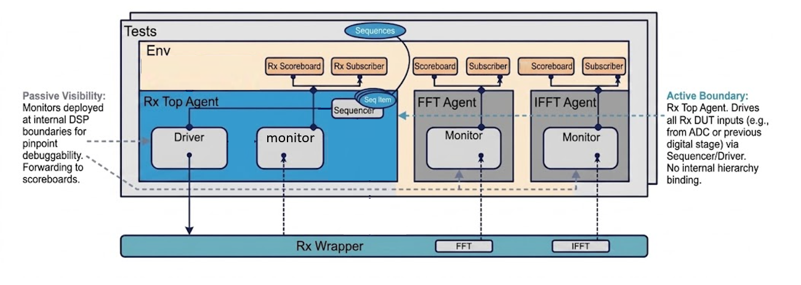
R X P A T H A R C H I T E C T U R E
PYUVM Verification Topology
Document ID: VPlan-RX | Status: DRAFT | Fs = 491.52 MHz | FFT N = 4096 | IFFT N = 2048 | WL=16

Slide 6
BLACK-BOX INTERFACE & ENVIRONMENT ARCHITECTURE
Signals & Verification Topology
Signal | Dir | Width | Description
clk | Input | 1-bit | System clock — Fs = 491.52 MHz
rst_n | Input | 1-bit | Active-low synchronous reset
rx_valid_in | Input | 1-bit | High when rx_in_re/im contains a valid sample
rx_in_re / rx_in_im | Input | 16-bit each | Time-domain complex RX input (WL=16, from TX/channel)
ref_wr_en | Input | 1-bit | Reference RAM write enable (from TX chirp reference)
ref_wr_re / ref_wr_im | Input | 16-bit each | Reference RAM write data (WL=16)
ofdm_valid_out | Output | 1-bit | High when ofdm_out contains a valid OFDM sample
ofdm_out_re / ofdm_out_im | Output | 16-bit each | OFDM frequency-domain output (bins 0–2047)
radar_valid_out | Output | 1-bit | High when radar_out contains a valid range-profile sample
radar_out_re / radar_out_im | Output | 16-bit each | Radar range-profile output (2048 samples per frame)
ENV TOPOLOGY
Rx Top Agent
(Active)
FFT Agent
(Passive)
IFFT Agent
(Passive)
Scoreboards
& Subscribers
Document ID: VPlan-RX | Status: DRAFT | Fs = 491.52 MHz | FFT N = 4096 | IFFT N = 2048 | WL=16

Slide 7
F E A T U R E S T O B E V E R I F I E D
Observable Behaviour at ofdm_out / radar_out — No Internal Signals Referenced
F-RX-01 Dual-Path RX Output Quality
F-RX-04 Output Sample Count & Timing
Both OFDM and Radar outputs verified against Python golden . Simultaneous dual-path operation correctness confirmed per frame.
Exactly 2048 ofdm_valid cycles per frame. Exactly 2048 radar_valid cycles per frame. Pipeline latency is constant and deterministic across all frames.
F-RX-02 Conjugate Multiplier Correctness
F-RX-05 Frame Boundary & Determinism
Radar bins multiplied by conjugate of reference RAM content. Correct complex conjugate multiply (re×re + im×im → re, re×im - im×re → im) verified at radar output.
Last sample of frame N not corrupted by frame N+1. Bit-exact identical outputs for identical inputs across every simulation run. Long idle gaps do not corrupt subsequent frames.
F-RX-03 Reset Behaviour
rst_n forces both ofdm_out and radar_out to zero and their valid signals low. First complete frame post-reset is error-free. No residual state corruption.
Document ID: VPlan-RX | Status: DRAFT | Fs = 491.52 MHz | FFT N = 4096 | IFFT N = 2048 | WL=16

Slide 8
T E S T P L A N O V E R V I E W
18 Black-Box Test Cases — Golden Reference: SYSTEM_builtin.m
ID | Test Name | Feature(s) | Group
TC-RX-001 | Null Input — All Zeros | F-RX-05 | A — Null & Boundary
TC-RX-002 | Zero Reference, Chirp Signal In | F-RX-02 | A — Null & Boundary
TC-RX-003 | OFDM-Only Input (Radar Bins = 0) | F-RX-01 | A — Null & Boundary
TC-RX-004 | Pure OFDM Signal Recovery | F-RX-01 | B — OFDM Path
TC-RX-005 | Mixed OFDM+Radar — OFDM Extraction | F-RX-01 | B — OFDM Path
TC-RX-006 | OFDM Sample Count & Valid Timing | F-RX-04 | B — OFDM Path
TC-RX-007 | Radar Range Profile — Loaded Reference | F-RX-01, F-RX-02 | C — Radar Profile
TC-RX-008 | Radar Sample Count per Frame | F-RX-04 | C — Radar Profile
TC-RX-009 | Reset Before Input | F-RX-03 | E — Reset & Control
TC-RX-010 | Reset Mid-Frame | F-RX-03 | E — Reset & Control
TC-RX-011 | Multiple Consecutive Resets | F-RX-03 | E — Reset & Control
TC-RX-012 | Back-to-Back 20 Frames | F-RX-05 | G — Regression & Stress
TC-RX-013 | Long Gap Between Frames | F-RX-05 | G — Regression & Stress
TC-RX-014 | 100 Random Frames — Full Regression | F-RX-01, F-RX-02, F-RX-05 | G — Regression & Stress
Document ID: VPlan-RX | Status: DRAFT | Fs = 491.52 MHz | FFT N = 4096 | IFFT N = 2048 | WL=16

Slide 9
TEST CASES:GROUP A—NULL & BOUNDARY / GROUP B—OFDM PATH
TC-RX-001 through TC-RX-006
TC-RX-001 Null Input — All Zeros
Feat: F-RX-05
TC-RX-002 Zero Reference, Chirp Signal In
Feat: F-RX-02
STIMULUS
STIMULUS
Set rx_in_re = 0, rx_in_im = 0 for all samples. Assert rx_valid_in, capture one full frame. No reference written.
Apply chirp-only signal (radar bins only). Reference RAM = zeros (never written). Capture radar_out.
EXPECTED / PASS
EXPECTED / PASS
PASS: All 2048 ofdm_out samples = 0 AND all 2048 radar_out samples = 0. Both valid counts correct.
PASS: radar_out = 0 (multiply by zero reference → zero). ofdm_out also matches MATLAB (zeros in OFDM bins).
TC-RX-003 OFDM-Only Input (Radar Bins = 0)
Feat: F-RX-01
TC-RX-004 Pure OFDM Signal Recovery
Feat: F-RX-01
STIMULUS
STIMULUS
Apply OFDM signal occupying bins 0–2047 only. Bins 2048–4095 = 0.
Apply full 1500-subcarrier 256-QAM OFDM signal. Zero chirp reference.
EXPECTED / PASS
EXPECTED / PASS
PASS: ofdm_out matches MATLAB golden. radar_out = 0 (zero radar bins). No cross-path contamination.
PASS: Bit-exact match between ofdm_out and MATLAB python_ref (Error = 0). All 2048 OFDM samples verified.
TC-RX-005 Mixed OFDM+Radar — OFDM Extraction
Feat: F-RX-01
TC-RX-006 OFDM Sample Count & Valid Timing
Feat: F-RX-04
STIMULUS
STIMULUS
Apply combined OFDM + chirp signal. Load valid chirp reference into RAM before frame.
Send one frame. Observe ofdm_valid timing relative to rx_valid_in. Verify ofdm_valid is LOW between frames.
EXPECTED / PASS
EXPECTED / PASS
PASS: ofdm_out independently matches MATLAB OFDM reference. radar_out independently matches MATLAB radar reference.
PASS: ofdm_valid = 1 for exactly 2048 consecutive cycles. ofdm_valid = 0 between frames. Latency constant.
Document ID: VPlan-RX | Status: DRAFT | Fs = 491.52 MHz | FFT N = 4096 | IFFT N = 2048 | WL=16

Slide 10
T E S T C A S E S : G R O U P C — R A D A R P R O F I L E / G R O U P D — R E F E R E N C E R A M
TC-RX-007 through TC-RX-010 | F-RX-01, F-RX-02, F-RX-04, F-RX-06
TC-RX-007 Radar Range Profile — Loaded Reference
Feat: F-RX-01, F-RX-02
STIMULUS
Pre-load 2048-entry reference RAM with TX chirp reference (from MATLAB model). Apply matching received chirp signal. Capture radar_out.
EXPECTED / PASS
PASS: Bit-exact match between radar_out and MATLAB range-profile golden reference (Error = 0). 2048 samples verified.
TC-RX-008 Radar Sample Count per Frame
Feat: F-RX-04
STIMULUS
Send one frame with valid chirp. Count radar_valid pulses. Verify radar_valid = 0 between frames and during pipeline latency.
EXPECTED / PASS
PASS: radar_valid = 1 for exactly 2048 consecutive cycles. radar_valid = 0 between frames. Pipeline latency L constant.
Document ID: VPlan-RX | Status: DRAFT | Fs = 491.52 MHz | FFT N = 4096 | IFFT N = 2048 | WL=16

Slide 11
T E S T C A S E S : G R O U P E — R E S E T & C O N T R O L
TC-RX-011 through TC-RX-013 | F-RX-05
TC-RX-009
Reset Before Input
Feat: F-RX-03
STIMULUS:
Assert rst_n = 0 for 10 cycles, then release. Immediately send a full frame. Capture both ofdm_out and radar_out.
PASS:
PASS: Both ofdm_out and radar_out = 0 during reset assertion. Subsequent full frame exactly matches MATLAB (Error = 0 on both paths).
TC-RX-010
Reset Mid-Frame
Feat: F-RX-03
STIMULUS:
Start a frame. Assert rst_n = 0 after exactly 2048 samples (mid-pipeline). Release reset. Send a new complete frame.
PASS:
PASS: Both outputs go to 0 immediately on reset assertion. New complete frame (post-reset) exactly matches MATLAB reference (Error = 0).
TC-RX-011
Multiple Consecutive Resets
Feat: F-RX-03
STIMULUS:
Assert and release rst_n 5 times consecutively with no frames in between. Then send one complete frame.
PASS:
PASS: No accumulated pipeline state corruption from repeated resets. Output frame exactly matches MATLAB reference (Error = 0). Both ofdm_valid and radar_valid behave correctly.
SVA Reference — ASS-01: rst_n == 0 |-> ofdm_out == 0 && radar_out == 0 && ofdm_valid == 0 && radar_valid == 0 (all cycles)
Document ID: VPlan-RX | Status: DRAFT | Fs = 491.52 MHz | FFT N = 4096 | IFFT N = 2048 | WL=16

Slide 12
T E S T C A S E S : G R O U P F — D E M U X B O U N D A R Y / G R O U P G — R E G R E S S I O N & S T R E S S
TC-RX-014 through TC-RX-018 | F-RX-03, F-RX-07
TC-RX-012 Back-to-Back 20 Frames — No Gaps
HIGH
TC-RX-013 Long Gap Between Frames
MED
STIMULUS:
Transmit 20 consecutive frames with zero idle cycles. Each frame uses a unique random 256-QAM seed and chirp sequence.
STIMULUS:
Send frame 1. Insert 10,000 idle cycles (rx_valid_in = 0). Send frame 2 with different stimulus.
PASS:
PASS: 0 errors across all 20 × 2048 = 40,960 ofdm samples AND all 20 × 2048 = 40,960 radar samples vs MATLAB.
PASS:
PASS: Frame 2 outputs exactly match MATLAB reference (Error = 0). No stale pipeline state from frame 1 on either path.
TC-RX-014 100 Random Frames — Full Regression
CRITICAL
STIMULUS:
Run 100 frames with fully constrained-random rx_in sequences and ref_wr data (unique seed per frame). Mix OFDM-only, radar-only, and dual-band frames.
PASS: 0 total mismatch errors across all 100 × 4096 = 409,600 samples on both ofdm_out and radar_out vs MATLAB model.
PASS:
Document ID: VPlan-RX | Status: DRAFT | Fs = 491.52 MHz | FFT N = 4096 | IFFT N = 2048 | WL=16

Slide 13
C O V E R A G E P L A N
Code Coverage Targets & Functional Coverage Groups
Code Coverage Targets
Functional Coverage Goals
COV_PATH:
100%
95%
All 4 bins (OFDM-only, Radar-only, Dual, Null) ≥ 100 hits
COV_REF:
Statement
Branch
Both ref states (loaded vs zero) ≥ 200 hits each
Every RTL line executed
Both conditional outcomes
COV_BIN:
Boundary bins (0, 2047, 2048, 4095) each ≥ 50 hits
100%
95%
COV_RST:
All 5 reset scenarios ≥ 20 hits each
Toggle
Expression
COV_FRAME:
All 3 gap durations (0, short, long) ≥ 50 hits
Every bit 0→1 and 1→0
Boolean sub-expression combos
Final Phase 2 Verification Sign-Off Dashboard — All coverage goals must be met before Phase 3 integration
Document ID: VPlan-RX | Status: DRAFT | Fs = 491.52 MHz | FFT N = 4096 | IFFT N = 2048 | WL=16

Slide 14
VERIFICATION ROAD MAP
Phase Roadmap
Phase 1 (DONE)
Phase 2 (CURRENT)
TX Path Verification
RX Path Verification
Black-box TX wrapper · 14 test cases · Single active agent vs Python golden
Black-box RX wrapper · 18 test cases · PUVM topology · Dual-output verification vs Python
Document ID: VPlan-RX | Status: DRAFT | Fs = 491.52 MHz | FFT N = 4096 | IFFT N = 2048 | WL=16

